Slide 1
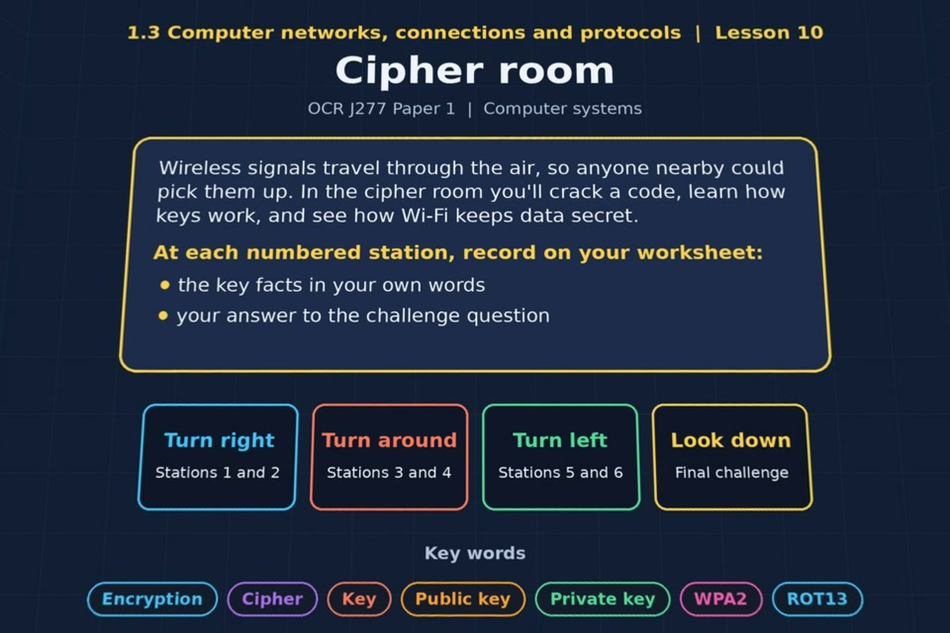

TOPIC 1.3 / LESSON 10
CIPHER ROOM
Wi-Fi encryption
KEY QUESTION
What is the purpose of encryption?
1 / 19
Notes:
The image shows the actual opening scene of the experience. Begin with the worksheet starter, or the brief opening question for lessons without one.
Sources: Revise 360 experiences/nw-l10.json and worksheets/NW_L10_CipherRoom_Worksheet.docx. Answers are indicative classroom examples, not an official OCR mark scheme.

Slide 2
TOPIC 1.3 / LESSON 10 / WORKSHEET
By the end of this lesson
1.
know the basics of how cryptography can work with a simple key
2.
know how wireless devices authenticate each other before communicating data
3.
understand the difference between private and public keys
4.
understand why private keys are never shared
2 / 19
Notes:
These learning outcomes follow the lesson worksheet.
Sources: Revise 360 experiences/nw-l10.json and worksheets/NW_L10_CipherRoom_Worksheet.docx. Answers are indicative classroom examples, not an official OCR mark scheme.

Slide 3
TOPIC 1.3 / LESSON 10 / WORKSHEET STARTER
Starter: before the experience
Shift every letter of MEET AT NOON forward by 5 places. Swap with a partner and decode theirs. What would make this code harder to crack?
3 / 19
Notes:
Students answer the worksheet starter before showing the sample answers.
Sources: Revise 360 experiences/nw-l10.json and worksheets/NW_L10_CipherRoom_Worksheet.docx. Answers are indicative classroom examples, not an official OCR mark scheme.

Slide 4
TOPIC 1.3 / LESSON 10 / CHECK
Starter: sample answers
1.
MEET AT NOON shifted forward five places becomes RJJY FY STTS.
2.
A simple fixed shift is easy to try or analyse. A less predictable key and stronger algorithm make a code harder to break.
4 / 19
Notes:
Accept equivalent correct explanations. Reveal after the question so it can be marked as students go.
Sources: Revise 360 experiences/nw-l10.json and worksheets/NW_L10_CipherRoom_Worksheet.docx. Answers are indicative classroom examples, not an official OCR mark scheme.

Slide 5
TOPIC 1.3 / LESSON 10 / WORKSHEET KEY TERMS
Key terminology quiz
1.
Encryption
2.
Public key
3.
Private key
5 / 19
Notes:
Students define the exact terms listed on their worksheet.
Sources: Revise 360 experiences/nw-l10.json and worksheets/NW_L10_CipherRoom_Worksheet.docx. Answers are indicative classroom examples, not an official OCR mark scheme.

Slide 6
TOPIC 1.3 / LESSON 10 / CHECK
Key terminology: answers
Encryption
Encryption: converting readable plaintext into ciphertext so someone without the right key cannot read it.
Public key
Public key: a key that can be shared openly and used to encrypt data for its owner.
Private key
Private key: the matching secret key kept by its owner and used to decrypt that data.
6 / 19
Notes:
Reveal after the key terminology quiz. Accept accurate definitions in students’ own words.
Sources: Revise 360 experiences/nw-l10.json and worksheets/NW_L10_CipherRoom_Worksheet.docx. Answers are indicative classroom examples, not an official OCR mark scheme.

Slide 7
TOPIC 1.3 / LESSON 10 / EXPERIENCE
Worksheet + experience
01 OPEN EXPERIENCE ↗
Open Cipher room in Topic 1.3. Keep the worksheet beside you.
02 SIX STATIONS
Read each panel. Write the key fact IN YOUR OWN WORDS and answer the worksheet challenge before tapping its badge.
03 FINAL CHALLENGE
Complete the ★ task before tapping the star. Copy your score (out of 24), then complete the worksheet task or review.
04 PLENARY
Finish the experience in this lesson. Near the end, close it for the plenary knowledge checks.
7 / 19
Notes:
Leave this combined worksheet and experience instruction slide on the board. The OPEN EXPERIENCE label is a clickable link. Students should complete the experience and reach the plenary near the end of the lesson. First on-screen answers count.
Sources: Revise 360 experiences/nw-l10.json and worksheets/NW_L10_CipherRoom_Worksheet.docx. Answers are indicative classroom examples, not an official OCR mark scheme.

Slide 8
TOPIC 1.3 / LESSON 10 / EXTENSION
Apply your learning
Answer the key question: what is the purpose of encryption?
Use the task and table on your worksheet.
8 / 19
Notes:
This follows the post-experience task, key question or revision results on the worksheet.
Sources: Revise 360 experiences/nw-l10.json and worksheets/NW_L10_CipherRoom_Worksheet.docx. Answers are indicative classroom examples, not an official OCR mark scheme.

Slide 9
TOPIC 1.3 / LESSON 10 / EXTENSION
Check and improve
Why does sharing a public key help, while sharing a private key is dangerous?
9 / 19
Notes:
Use this question to extend or improve an explanation before the plenary.
Sources: Revise 360 experiences/nw-l10.json and worksheets/NW_L10_CipherRoom_Worksheet.docx. Answers are indicative classroom examples, not an official OCR mark scheme.

Slide 10
TOPIC 1.3 / LESSON 10 / CHECK
Application: sample answers
1.
Encryption turns readable plaintext into ciphertext using a key.
2.
Only someone with the appropriate key can recover the original data.
3.
It protects wireless traffic that nearby people could otherwise intercept.
4.
Other people use the public key to encrypt for the owner. The matching private key decrypts, so exposing it would let an attacker read protected messages.
10 / 19
Notes:
These are indicative answers. Credit other accurate examples or justified choices.
Sources: Revise 360 experiences/nw-l10.json and worksheets/NW_L10_CipherRoom_Worksheet.docx. Answers are indicative classroom examples, not an official OCR mark scheme.

Slide 11
TOPIC 1.3 / LESSON 10 / ANSWERS
After the experience: stations 1–3
Check your key facts and challenge responses.
1 Why encrypt?
Encryption protects the confidentiality of data. Wireless radio traffic can be received by nearby devices, so protection matters.
2 ROT13 and the Romans
URYYB JBEYQ in ROT13 is HELLO WORLD. ROT13 is weak because anyone can reverse the fixed shift.
3 Keys
The key controls encryption and decryption. Sending a secret key with the message lets an eavesdropper read both.
11 / 19
Notes:
Show after completion. These concise points address the worksheet station challenges and help students improve their own wording.
Sources: Revise 360 experiences/nw-l10.json and worksheets/NW_L10_CipherRoom_Worksheet.docx. Answers are indicative classroom examples, not an official OCR mark scheme.

Slide 12
TOPIC 1.3 / LESSON 10 / ANSWERS
After the experience: stations 4–6
Check your key facts and challenge responses.
4 Public and private keys
The public key may be shared; the private key must stay with its owner. Leaking it lets another person decrypt data meant for the owner.
5 The WPA2 handshake
WPA2 authenticates a device and access point, then establishes protected communication without sending the Wi-Fi master password in the clear.
6 Staying safe on Wi-Fi
Open café Wi-Fi may expose traffic to interception or fake access points. Use trusted encrypted connections and avoid sensitive tasks on an untrusted network.
12 / 19
Notes:
Show after completion. These concise points address the worksheet station challenges and help students improve their own wording.
Sources: Revise 360 experiences/nw-l10.json and worksheets/NW_L10_CipherRoom_Worksheet.docx. Answers are indicative classroom examples, not an official OCR mark scheme.

Slide 13
TOPIC 1.3 / LESSON 10 / CHECK
Final challenge · answers 1–4
1.
Plaintext → The original, readable message
2.
Ciphertext → The scrambled message
3.
Key → The secret used to encrypt and decrypt
4.
Public key → Shared with anyone and used to encrypt
13 / 19
Notes:
These are the exact matches, sort categories or ordered steps from the interactive experience task. Use them to check the corresponding worksheet work.
Sources: Revise 360 experiences/nw-l10.json and worksheets/NW_L10_CipherRoom_Worksheet.docx. Answers are indicative classroom examples, not an official OCR mark scheme.

Slide 14
TOPIC 1.3 / LESSON 10 / CHECK
Final challenge · answers 5–6
5.
Private key → Kept secret and used to decrypt
6.
Encryption → Scrambling data so it can't be read without the key
14 / 19
Notes:
These are the exact matches, sort categories or ordered steps from the interactive experience task. Use them to check the corresponding worksheet work.
Sources: Revise 360 experiences/nw-l10.json and worksheets/NW_L10_CipherRoom_Worksheet.docx. Answers are indicative classroom examples, not an official OCR mark scheme.

Slide 15
TOPIC 1.3 / LESSON 10 / PLENARY
Plenary: questions 1–2
Close the experience. Answer from memory on the worksheet.
a) Explain why wireless traffic needs encrypting more urgently than traffic on a cable. [3]
b) Describe how a public key and a private key are used together. [4]
15 / 19
Notes:
These are the exact exit, exam-practice or test-ready questions from the worksheet. Allow independent writing before the answers.
Sources: Revise 360 experiences/nw-l10.json and worksheets/NW_L10_CipherRoom_Worksheet.docx. Answers are indicative classroom examples, not an official OCR mark scheme.

Slide 16
TOPIC 1.3 / LESSON 10 / PLENARY
Plenary: question 3
Close the experience. Answer from memory on the worksheet.
c) Explain why the Wi-Fi key itself is never sent between the device and the access point. [3]
16 / 19
Notes:
These are the exact exit, exam-practice or test-ready questions from the worksheet. Allow independent writing before the answers.
Sources: Revise 360 experiences/nw-l10.json and worksheets/NW_L10_CipherRoom_Worksheet.docx. Answers are indicative classroom examples, not an official OCR mark scheme.

Slide 17
TOPIC 1.3 / LESSON 10 / CHECK
Plenary: answers 1–2
Indicative points. Credit accurate answers in students’ own words.
a) Wireless signals travel through the air and nearby people can capture them. Encryption makes intercepted data unreadable without the key, protecting confidential information.
b) The owner shares the public key. A sender encrypts data with it; only the matching private key, kept secret by the owner, decrypts that data.
17 / 19
Notes:
Classroom answer points, not an official OCR mark scheme. Ask students to improve one answer.
Sources: Revise 360 experiences/nw-l10.json and worksheets/NW_L10_CipherRoom_Worksheet.docx. Answers are indicative classroom examples, not an official OCR mark scheme.

Slide 18
TOPIC 1.3 / LESSON 10 / CHECK
Plenary: answer 3
Indicative points. Credit accurate answers in students’ own words.
c) If the Wi-Fi secret were sent over the air, an eavesdropper could capture it. The WPA2 handshake proves the devices know it and creates session protection without transmitting the master password in the clear.
18 / 19
Notes:
Classroom answer points, not an official OCR mark scheme. Ask students to improve one answer.
Sources: Revise 360 experiences/nw-l10.json and worksheets/NW_L10_CipherRoom_Worksheet.docx. Answers are indicative classroom examples, not an official OCR mark scheme.

Slide 19
TOPIC 1.3 / LESSON 10 / SELF-CHECK
How confident am I?
Select Not yet, Getting there or Confident for each objective on the worksheet.
1.
How a simple substitution cipher works
2.
How devices authenticate with WPA2
3.
Public and private keys
19 / 19
Notes:
These are the exact confidence objectives from the worksheet. Students identify one area to revisit.
Sources: Revise 360 experiences/nw-l10.json and worksheets/NW_L10_CipherRoom_Worksheet.docx. Answers are indicative classroom examples, not an official OCR mark scheme.

