Slide 1
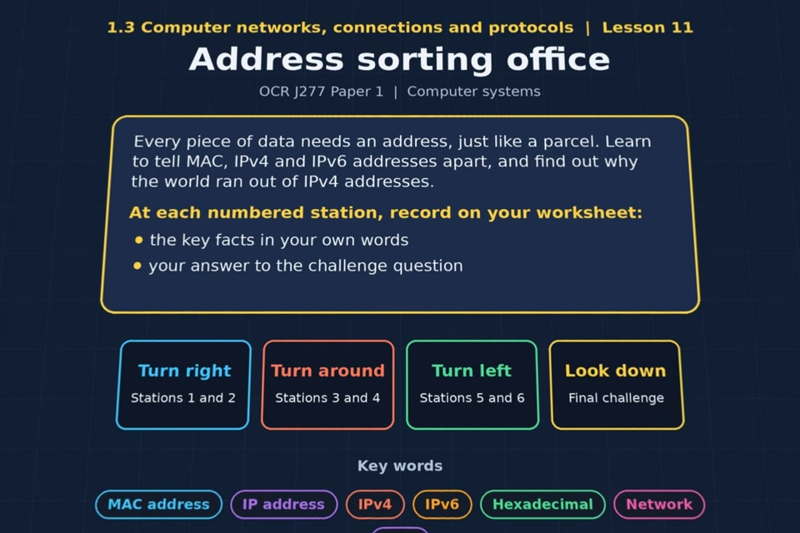

TOPIC 1.3 / LESSON 11
ADDRESS SORTING OFFICE
MAC, IPv4 and IPv6
KEY QUESTION
What are the differences between the three types of network address?
1 / 20
Notes:
The image shows the actual opening scene of the experience. Begin with the worksheet starter, or the brief opening question for lessons without one.
Sources: Revise 360 experiences/nw-l11.json and worksheets/NW_L11_AddressSortingOffice_Worksheet.docx. Answers are indicative classroom examples, not an official OCR mark scheme.

Slide 2
TOPIC 1.3 / LESSON 11 / WORKSHEET
By the end of this lesson
1.
understand the uses of MAC and IP addressing
2.
understand the difference between IPv4 and IPv6
3.
understand the need for IPv6
2 / 20
Notes:
These learning outcomes follow the lesson worksheet.
Sources: Revise 360 experiences/nw-l11.json and worksheets/NW_L11_AddressSortingOffice_Worksheet.docx. Answers are indicative classroom examples, not an official OCR mark scheme.

Slide 3
TOPIC 1.3 / LESSON 11 / WORKSHEET STARTER
Starter: before the experience
A parcel needs a house number and a postcode to arrive. Suggest why a computer might need more than one kind of address too.
3 / 20
Notes:
Students answer the worksheet starter before showing the sample answers.
Sources: Revise 360 experiences/nw-l11.json and worksheets/NW_L11_AddressSortingOffice_Worksheet.docx. Answers are indicative classroom examples, not an official OCR mark scheme.

Slide 4
TOPIC 1.3 / LESSON 11 / CHECK
Starter: sample answers
1.
One address identifies the device or interface on a local network; another identifies where it is on a wider network.
2.
Routers and switches need different addressing information to deliver data correctly.
4 / 20
Notes:
Accept equivalent correct explanations. Reveal after the question so it can be marked as students go.
Sources: Revise 360 experiences/nw-l11.json and worksheets/NW_L11_AddressSortingOffice_Worksheet.docx. Answers are indicative classroom examples, not an official OCR mark scheme.

Slide 5
TOPIC 1.3 / LESSON 11 / WORKSHEET KEY TERMS
Key terminology quiz
1.
MAC address
2.
IP address
5 / 20
Notes:
Students define the exact terms listed on their worksheet.
Sources: Revise 360 experiences/nw-l11.json and worksheets/NW_L11_AddressSortingOffice_Worksheet.docx. Answers are indicative classroom examples, not an official OCR mark scheme.

Slide 6
TOPIC 1.3 / LESSON 11 / CHECK
Key terminology: answers
MAC address
MAC address: a hardware identifier associated with a network interface card, used for delivery on a local network.
IP address
IP address: a logical address used to identify a device on a network and route packets between networks.
6 / 20
Notes:
Reveal after the key terminology quiz. Accept accurate definitions in students’ own words.
Sources: Revise 360 experiences/nw-l11.json and worksheets/NW_L11_AddressSortingOffice_Worksheet.docx. Answers are indicative classroom examples, not an official OCR mark scheme.

Slide 7
TOPIC 1.3 / LESSON 11 / EXPERIENCE
Worksheet + experience
01 OPEN EXPERIENCE ↗
Open Address sorting office in Topic 1.3. Keep the worksheet beside you.
02 SIX STATIONS
Read each panel. Write the key fact IN YOUR OWN WORDS and answer the worksheet challenge before tapping its badge.
03 FINAL CHALLENGE
Complete the ★ task before tapping the star. Copy your score (out of 21), then complete the worksheet task or review.
04 PLENARY
Finish the experience in this lesson. Near the end, close it for the plenary knowledge checks.
7 / 20
Notes:
Leave this combined worksheet and experience instruction slide on the board. The OPEN EXPERIENCE label is a clickable link. Students should complete the experience and reach the plenary near the end of the lesson. First on-screen answers count.
Sources: Revise 360 experiences/nw-l11.json and worksheets/NW_L11_AddressSortingOffice_Worksheet.docx. Answers are indicative classroom examples, not an official OCR mark scheme.

Slide 8
TOPIC 1.3 / LESSON 11 / EXTENSION
Apply your learning
Answer the key question: compare MAC, IPv4 and IPv6 addresses.
Use the task and table on your worksheet.
8 / 20
Notes:
This follows the post-experience task, key question or revision results on the worksheet.
Sources: Revise 360 experiences/nw-l11.json and worksheets/NW_L11_AddressSortingOffice_Worksheet.docx. Answers are indicative classroom examples, not an official OCR mark scheme.

Slide 9
TOPIC 1.3 / LESSON 11 / EXTENSION
Check and improve
A laptop joins a different Wi-Fi network. Which address is likely to change, and why?
9 / 20
Notes:
Use this question to extend or improve an explanation before the plenary.
Sources: Revise 360 experiences/nw-l11.json and worksheets/NW_L11_AddressSortingOffice_Worksheet.docx. Answers are indicative classroom examples, not an official OCR mark scheme.

Slide 10
TOPIC 1.3 / LESSON 11 / CHECK
Application: sample answers
1.
MAC identifies a network interface for local delivery and is normally assigned to the NIC.
2.
IPv4 is a 32-bit logical address written as four decimal numbers, such as 192.168.1.20.
3.
IPv6 is a 128-bit logical address written in hexadecimal, providing far more unique addresses.
4.
Its IP address is assigned for the new network and can change. The network interface retains its MAC address.
10 / 20
Notes:
These are indicative answers. Credit other accurate examples or justified choices.
Sources: Revise 360 experiences/nw-l11.json and worksheets/NW_L11_AddressSortingOffice_Worksheet.docx. Answers are indicative classroom examples, not an official OCR mark scheme.

Slide 11
TOPIC 1.3 / LESSON 11 / ANSWERS
After the experience: stations 1–3
Check your key facts and challenge responses.
1 MAC addresses
A unique MAC address lets a switch distinguish network interfaces and deliver a frame to the intended one.
2 IP addresses
A device may receive a new IP address on a different network. Its NIC keeps its MAC identifier.
3 IPv4
IPv4 has four 8-bit numbers. One 8-bit number ranges from 0 to 255, so 256 is invalid.
11 / 20
Notes:
Show after completion. These concise points address the worksheet station challenges and help students improve their own wording.
Sources: Revise 360 experiences/nw-l11.json and worksheets/NW_L11_AddressSortingOffice_Worksheet.docx. Answers are indicative classroom examples, not an official OCR mark scheme.

Slide 12
TOPIC 1.3 / LESSON 11 / ANSWERS
After the experience: stations 4–6
Check your key facts and challenge responses.
4 IPv6
IPv6 provides many more addresses than IPv4, whose roughly 4.3 billion addresses are insufficient for all devices.
5 LAN or WAN addressing?
A switch uses MAC addresses for frames on the LAN; a router uses IP addresses to move packets between networks.
6 Network and device parts
With the /24 network assumed in the lesson, both 192.168.1.20 and 192.168.1.35 are on 192.168.1.0; the final number identifies each host.
12 / 20
Notes:
Show after completion. These concise points address the worksheet station challenges and help students improve their own wording.
Sources: Revise 360 experiences/nw-l11.json and worksheets/NW_L11_AddressSortingOffice_Worksheet.docx. Answers are indicative classroom examples, not an official OCR mark scheme.

Slide 13
TOPIC 1.3 / LESSON 11 / CHECK
Final challenge · answers 1–4
1.
180.17.255.1 → IPv4
2.
2001:0DB8:AC10:FE01:0000:0000:0000:0000 → IPv6
3.
00-15-E9-2B-99-3C → MAC
4.
32 bits long → IPv4
13 / 20
Notes:
These are the exact matches, sort categories or ordered steps from the interactive experience task. Use them to check the corresponding worksheet work.
Sources: Revise 360 experiences/nw-l11.json and worksheets/NW_L11_AddressSortingOffice_Worksheet.docx. Answers are indicative classroom examples, not an official OCR mark scheme.

Slide 14
TOPIC 1.3 / LESSON 11 / CHECK
Final challenge · answers 5–8
5.
128 bits long → IPv6
6.
48 bits, set when the NIC is made → MAC
7.
Four numbers from 0 to 255 → IPv4
8.
Eight groups of hexadecimal separated by colons → IPv6
14 / 20
Notes:
These are the exact matches, sort categories or ordered steps from the interactive experience task. Use them to check the corresponding worksheet work.
Sources: Revise 360 experiences/nw-l11.json and worksheets/NW_L11_AddressSortingOffice_Worksheet.docx. Answers are indicative classroom examples, not an official OCR mark scheme.

Slide 15
TOPIC 1.3 / LESSON 11 / CHECK
Final challenge · answer 9
9.
Used by switches within a LAN → MAC
15 / 20
Notes:
These are the exact matches, sort categories or ordered steps from the interactive experience task. Use them to check the corresponding worksheet work.
Sources: Revise 360 experiences/nw-l11.json and worksheets/NW_L11_AddressSortingOffice_Worksheet.docx. Answers are indicative classroom examples, not an official OCR mark scheme.

Slide 16
TOPIC 1.3 / LESSON 11 / PLENARY
Plenary: questions 1–2
Close the experience. Answer from memory on the worksheet.
a) State what a MAC address identifies. [1]
b) Explain why IPv6 addresses were needed. [2]
16 / 20
Notes:
These are the exact exit, exam-practice or test-ready questions from the worksheet. Allow independent writing before the answers.
Sources: Revise 360 experiences/nw-l11.json and worksheets/NW_L11_AddressSortingOffice_Worksheet.docx. Answers are indicative classroom examples, not an official OCR mark scheme.

Slide 17
TOPIC 1.3 / LESSON 11 / PLENARY
Plenary: questions 3–4
Close the experience. Answer from memory on the worksheet.
c) Describe two differences between an IPv4 address and an IPv6 address. [4]
d) Explain why a device keeps its MAC address but can be given a different IP address. [3]
17 / 20
Notes:
These are the exact exit, exam-practice or test-ready questions from the worksheet. Allow independent writing before the answers.
Sources: Revise 360 experiences/nw-l11.json and worksheets/NW_L11_AddressSortingOffice_Worksheet.docx. Answers are indicative classroom examples, not an official OCR mark scheme.

Slide 18
TOPIC 1.3 / LESSON 11 / CHECK
Plenary: answers 1–2
Indicative points. Credit accurate answers in students’ own words.
a) A MAC address identifies a network interface card or interface on the local network.
b) The limited number of 32-bit IPv4 addresses could not provide enough unique addresses as internet use grew. IPv6 uses 128 bits and offers vastly more.
18 / 20
Notes:
Classroom answer points, not an official OCR mark scheme. Ask students to improve one answer.
Sources: Revise 360 experiences/nw-l11.json and worksheets/NW_L11_AddressSortingOffice_Worksheet.docx. Answers are indicative classroom examples, not an official OCR mark scheme.

Slide 19
TOPIC 1.3 / LESSON 11 / CHECK
Plenary: answers 3–4
Indicative points. Credit accurate answers in students’ own words.
c) IPv4 is 32 bits and written as four decimal values. IPv6 is 128 bits and written in hexadecimal groups, so it offers many more addresses.
d) The MAC address belongs to the network interface and remains associated with it. An IP address identifies the device on its current network, so a different network can assign another IP address.
19 / 20
Notes:
Classroom answer points, not an official OCR mark scheme. Ask students to improve one answer.
Sources: Revise 360 experiences/nw-l11.json and worksheets/NW_L11_AddressSortingOffice_Worksheet.docx. Answers are indicative classroom examples, not an official OCR mark scheme.

Slide 20
TOPIC 1.3 / LESSON 11 / SELF-CHECK
How confident am I?
Select Not yet, Getting there or Confident for each objective on the worksheet.
1.
Uses of MAC and IP addresses
2.
The difference between IPv4 and IPv6
3.
Why IPv6 is needed
20 / 20
Notes:
These are the exact confidence objectives from the worksheet. Students identify one area to revisit.
Sources: Revise 360 experiences/nw-l11.json and worksheets/NW_L11_AddressSortingOffice_Worksheet.docx. Answers are indicative classroom examples, not an official OCR mark scheme.

