Slide 1
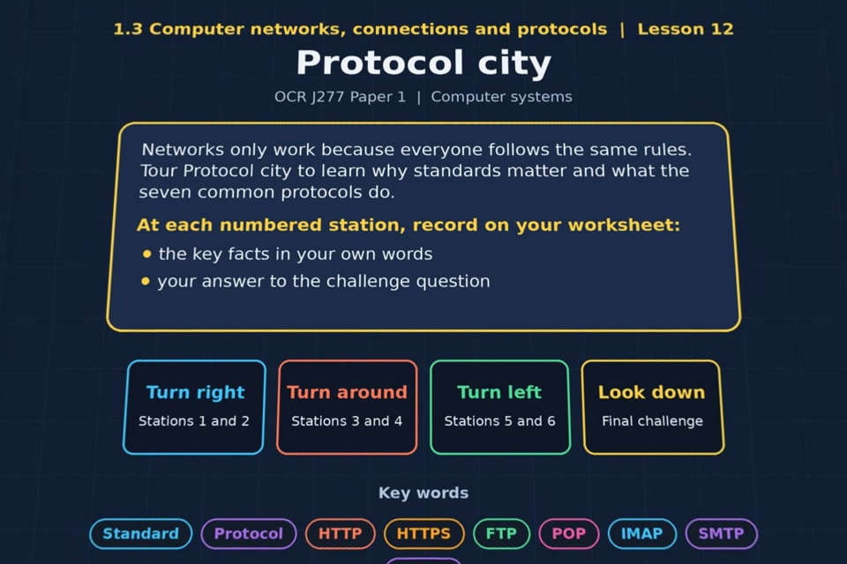

TOPIC 1.3 / LESSON 12
PROTOCOL CITY
Standards and protocols
KEY QUESTION
What are standards and protocols?
1 / 19
Notes:
The image shows the actual opening scene of the experience. Begin with the worksheet starter, or the brief opening question for lessons without one.
Sources: Revise 360 experiences/nw-l12.json and worksheets/NW_L12_ProtocolCity_Worksheet.docx. Answers are indicative classroom examples, not an official OCR mark scheme.

Slide 2
TOPIC 1.3 / LESSON 12 / WORKSHEET
By the end of this lesson
1.
understand the need for standards in computing
2.
understand the seven common protocols and what they are used for
2 / 19
Notes:
These learning outcomes follow the lesson worksheet.
Sources: Revise 360 experiences/nw-l12.json and worksheets/NW_L12_ProtocolCity_Worksheet.docx. Answers are indicative classroom examples, not an official OCR mark scheme.

Slide 3
TOPIC 1.3 / LESSON 12 / WORKSHEET STARTER
Starter: before the experience
List every acronym you already associate with the internet. Which ones do you think are rules for sending data, and which are something else?
3 / 19
Notes:
Students answer the worksheet starter before showing the sample answers.
Sources: Revise 360 experiences/nw-l12.json and worksheets/NW_L12_ProtocolCity_Worksheet.docx. Answers are indicative classroom examples, not an official OCR mark scheme.

Slide 4
TOPIC 1.3 / LESSON 12 / CHECK
Starter: sample answers
1.
Possible protocols: HTTP, HTTPS, FTP, SMTP, POP, IMAP, TCP and IP. They set rules for moving web pages, files, email and packets.
2.
Wi-Fi is a wireless networking standard; DNS is a name lookup service. Discuss each acronym rather than treating them all alike.
4 / 19
Notes:
Accept equivalent correct explanations. Reveal after the question so it can be marked as students go.
Sources: Revise 360 experiences/nw-l12.json and worksheets/NW_L12_ProtocolCity_Worksheet.docx. Answers are indicative classroom examples, not an official OCR mark scheme.

Slide 5
TOPIC 1.3 / LESSON 12 / WORKSHEET KEY TERMS
Key terminology quiz
1.
Standard
2.
Protocol
5 / 19
Notes:
Students define the exact terms listed on their worksheet.
Sources: Revise 360 experiences/nw-l12.json and worksheets/NW_L12_ProtocolCity_Worksheet.docx. Answers are indicative classroom examples, not an official OCR mark scheme.

Slide 6
TOPIC 1.3 / LESSON 12 / CHECK
Key terminology: answers
Standard
Standard: an agreed specification that helps different hardware or software work together.
Protocol
Protocol: a set of rules for how devices format, send and receive data.
6 / 19
Notes:
Reveal after the key terminology quiz. Accept accurate definitions in students’ own words.
Sources: Revise 360 experiences/nw-l12.json and worksheets/NW_L12_ProtocolCity_Worksheet.docx. Answers are indicative classroom examples, not an official OCR mark scheme.

Slide 7
TOPIC 1.3 / LESSON 12 / EXPERIENCE
Worksheet + experience
01 OPEN EXPERIENCE ↗
Open Protocol city in Topic 1.3. Keep the worksheet beside you.
02 SIX STATIONS
Read each panel. Write the key fact IN YOUR OWN WORDS and answer the worksheet challenge before tapping its badge.
03 FINAL CHALLENGE
Complete the ★ task before tapping the star. Copy your score (out of 22), then complete the worksheet task or review.
04 PLENARY
Finish the experience in this lesson. Near the end, close it for the plenary knowledge checks.
7 / 19
Notes:
Leave this combined worksheet and experience instruction slide on the board. The OPEN EXPERIENCE label is a clickable link. Students should complete the experience and reach the plenary near the end of the lesson. First on-screen answers count.
Sources: Revise 360 experiences/nw-l12.json and worksheets/NW_L12_ProtocolCity_Worksheet.docx. Answers are indicative classroom examples, not an official OCR mark scheme.

Slide 8
TOPIC 1.3 / LESSON 12 / EXTENSION
Apply your learning
Answer the key question: what are standards and protocols, and why do networks need them?
Use the task and table on your worksheet.
8 / 19
Notes:
This follows the post-experience task, key question or revision results on the worksheet.
Sources: Revise 360 experiences/nw-l12.json and worksheets/NW_L12_ProtocolCity_Worksheet.docx. Answers are indicative classroom examples, not an official OCR mark scheme.

Slide 9
TOPIC 1.3 / LESSON 12 / EXTENSION
Check and improve
A website loads, but some data packets go missing. Which protocol helps recover them, and what does IP do?
9 / 19
Notes:
Use this question to extend or improve an explanation before the plenary.
Sources: Revise 360 experiences/nw-l12.json and worksheets/NW_L12_ProtocolCity_Worksheet.docx. Answers are indicative classroom examples, not an official OCR mark scheme.

Slide 10
TOPIC 1.3 / LESSON 12 / CHECK
Application: sample answers
1.
Standards give makers common specifications so devices can connect.
2.
Protocols give devices common rules for exchanging data.
3.
HTTP/HTTPS serve web pages, SMTP sends email, TCP checks delivery and IP routes packets.
4.
TCP detects missing packets and arranges retransmission. IP handles addressing and routing packets toward the destination.
10 / 19
Notes:
These are indicative answers. Credit other accurate examples or justified choices.
Sources: Revise 360 experiences/nw-l12.json and worksheets/NW_L12_ProtocolCity_Worksheet.docx. Answers are indicative classroom examples, not an official OCR mark scheme.

Slide 11
TOPIC 1.3 / LESSON 12 / ANSWERS
After the experience: stations 1–3
Check your key facts and challenge responses.
1 Standards
Without a common connector standard, devices need different chargers or adapters and cannot easily interoperate.
2 Protocols
A standard is an agreed specification; a protocol is the agreed communication rule set devices use to exchange data.
3 Web protocols
HTTPS adds encryption and authentication to HTTP, helping protect payment and login details in transit.
11 / 19
Notes:
Show after completion. These concise points address the worksheet station challenges and help students improve their own wording.
Sources: Revise 360 experiences/nw-l12.json and worksheets/NW_L12_ProtocolCity_Worksheet.docx. Answers are indicative classroom examples, not an official OCR mark scheme.

Slide 12
TOPIC 1.3 / LESSON 12 / ANSWERS
After the experience: stations 4–6
Check your key facts and challenge responses.
4 Email protocols
IMAP keeps messages on the server and synchronises mailboxes across devices; POP commonly downloads mail to one device.
5 FTP
FTP can transfer the web designer's files to a web server.
6 TCP/IP
TCP checks delivery and handles missing packets; IP addresses and routes packets. Missing unchecked packets could leave a page incomplete.
12 / 19
Notes:
Show after completion. These concise points address the worksheet station challenges and help students improve their own wording.
Sources: Revise 360 experiences/nw-l12.json and worksheets/NW_L12_ProtocolCity_Worksheet.docx. Answers are indicative classroom examples, not an official OCR mark scheme.

Slide 13
TOPIC 1.3 / LESSON 12 / CHECK
Final challenge · answers 1–4
1.
HTTP → Requests and delivers web pages (HTML files)
2.
HTTPS → Web pages with encryption and authentication
3.
FTP → Sends files between computers
4.
SMTP → Sends email to a mail server
13 / 19
Notes:
These are the exact matches, sort categories or ordered steps from the interactive experience task. Use them to check the corresponding worksheet work.
Sources: Revise 360 experiences/nw-l12.json and worksheets/NW_L12_ProtocolCity_Worksheet.docx. Answers are indicative classroom examples, not an official OCR mark scheme.

Slide 14
TOPIC 1.3 / LESSON 12 / CHECK
Final challenge · answers 5–8
5.
POP → Retrieves email from a mail server
6.
IMAP → Retrieves email and manages mailboxes on the server
7.
TCP → Error-free transmission of packets
8.
IP → Routes packets across a WAN
14 / 19
Notes:
These are the exact matches, sort categories or ordered steps from the interactive experience task. Use them to check the corresponding worksheet work.
Sources: Revise 360 experiences/nw-l12.json and worksheets/NW_L12_ProtocolCity_Worksheet.docx. Answers are indicative classroom examples, not an official OCR mark scheme.

Slide 15
TOPIC 1.3 / LESSON 12 / PLENARY
Plenary: questions 1–2
Close the experience. Answer from memory on the worksheet.
a) Explain why agreed standards matter when devices from different makers connect. [3]
b) Name the protocol used to send email to a mail server. [1]
15 / 19
Notes:
These are the exact exit, exam-practice or test-ready questions from the worksheet. Allow independent writing before the answers.
Sources: Revise 360 experiences/nw-l12.json and worksheets/NW_L12_ProtocolCity_Worksheet.docx. Answers are indicative classroom examples, not an official OCR mark scheme.

Slide 16
TOPIC 1.3 / LESSON 12 / PLENARY
Plenary: questions 3–4
Close the experience. Answer from memory on the worksheet.
c) Describe what HTTPS adds to HTTP and why it matters. [3]
d) Explain how TCP and IP work together when a web page is requested. [4]
16 / 19
Notes:
These are the exact exit, exam-practice or test-ready questions from the worksheet. Allow independent writing before the answers.
Sources: Revise 360 experiences/nw-l12.json and worksheets/NW_L12_ProtocolCity_Worksheet.docx. Answers are indicative classroom examples, not an official OCR mark scheme.

Slide 17
TOPIC 1.3 / LESSON 12 / CHECK
Plenary: answers 1–2
Indicative points. Credit accurate answers in students’ own words.
a) Shared standards let devices from different makers use compatible connectors, data formats and communication methods. They can connect and exchange data reliably.
b) SMTP sends email to a mail server.
17 / 19
Notes:
Classroom answer points, not an official OCR mark scheme. Ask students to improve one answer.
Sources: Revise 360 experiences/nw-l12.json and worksheets/NW_L12_ProtocolCity_Worksheet.docx. Answers are indicative classroom examples, not an official OCR mark scheme.

Slide 18
TOPIC 1.3 / LESSON 12 / CHECK
Plenary: answers 3–4
Indicative points. Credit accurate answers in students’ own words.
c) HTTPS adds encryption and authentication to HTTP. These help prevent interception and reassure users they are communicating with the intended site.
d) IP addresses and routes packets to the web server and back. TCP checks that packets arrive, reorders them and handles missing packets so the page can be reconstructed.
18 / 19
Notes:
Classroom answer points, not an official OCR mark scheme. Ask students to improve one answer.
Sources: Revise 360 experiences/nw-l12.json and worksheets/NW_L12_ProtocolCity_Worksheet.docx. Answers are indicative classroom examples, not an official OCR mark scheme.

Slide 19
TOPIC 1.3 / LESSON 12 / SELF-CHECK
How confident am I?
Select Not yet, Getting there or Confident for each objective on the worksheet.
1.
Why standards are needed
2.
The common protocols and what they do
3.
The difference between standards and protocols
19 / 19
Notes:
These are the exact confidence objectives from the worksheet. Students identify one area to revisit.
Sources: Revise 360 experiences/nw-l12.json and worksheets/NW_L12_ProtocolCity_Worksheet.docx. Answers are indicative classroom examples, not an official OCR mark scheme.

