Slide 1
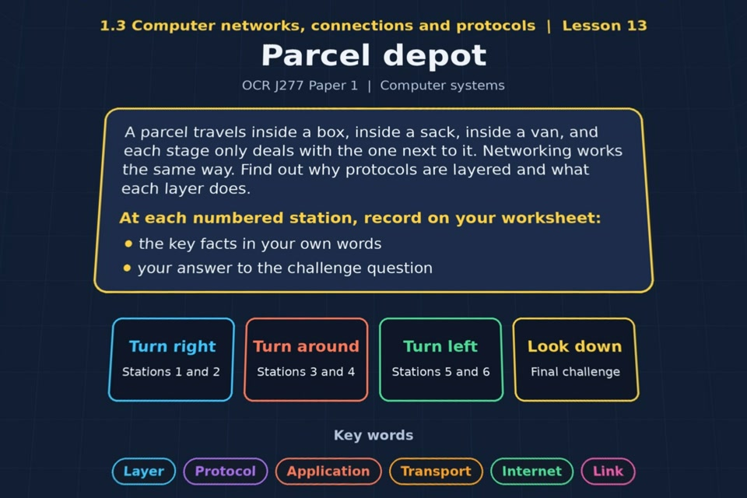

TOPIC 1.3 / LESSON 13
PARCEL DEPOT
Network layers
KEY QUESTION
What are the benefits of layering protocols?
1 / 19
Notes:
The image shows the actual opening scene of the experience. Begin with the worksheet starter, or the brief opening question for lessons without one.
Sources: Revise 360 experiences/nw-l13.json and worksheets/NW_L13_ParcelDepot_Worksheet.docx. Answers are indicative classroom examples, not an official OCR mark scheme.

Slide 2
TOPIC 1.3 / LESSON 13 / WORKSHEET
By the end of this lesson
1.
know why protocols are layered
2.
understand the advantages of layering
2 / 19
Notes:
These learning outcomes follow the lesson worksheet.
Sources: Revise 360 experiences/nw-l13.json and worksheets/NW_L13_ParcelDepot_Worksheet.docx. Answers are indicative classroom examples, not an official OCR mark scheme.

Slide 3
TOPIC 1.3 / LESSON 13 / WORKSHEET STARTER
Starter: before the experience
A parcel goes in a box, the box goes in a sack, the sack goes in a van. What happens if the van is replaced by a train? Why does that not affect the parcel?
3 / 19
Notes:
Students answer the worksheet starter before showing the sample answers.
Sources: Revise 360 experiences/nw-l13.json and worksheets/NW_L13_ParcelDepot_Worksheet.docx. Answers are indicative classroom examples, not an official OCR mark scheme.

Slide 4
TOPIC 1.3 / LESSON 13 / CHECK
Starter: sample answers
1.
The outer transport changes from van to train, but the boxed parcel remains the same.
2.
Each stage has its own job and a clear handover, so one stage can change without redesigning the others.
4 / 19
Notes:
Accept equivalent correct explanations. Reveal after the question so it can be marked as students go.
Sources: Revise 360 experiences/nw-l13.json and worksheets/NW_L13_ParcelDepot_Worksheet.docx. Answers are indicative classroom examples, not an official OCR mark scheme.

Slide 5
TOPIC 1.3 / LESSON 13 / WORKSHEET KEY TERMS
Key terminology quiz
1.
Layer
2.
Protocol
5 / 19
Notes:
Students define the exact terms listed on their worksheet.
Sources: Revise 360 experiences/nw-l13.json and worksheets/NW_L13_ParcelDepot_Worksheet.docx. Answers are indicative classroom examples, not an official OCR mark scheme.

Slide 6
TOPIC 1.3 / LESSON 13 / CHECK
Key terminology: answers
Layer
Layer: one part of a network model with a defined job that offers a service to the layer above.
Protocol
Protocol: a set of agreed rules for communication at a layer.
6 / 19
Notes:
Reveal after the key terminology quiz. Accept accurate definitions in students’ own words.
Sources: Revise 360 experiences/nw-l13.json and worksheets/NW_L13_ParcelDepot_Worksheet.docx. Answers are indicative classroom examples, not an official OCR mark scheme.

Slide 7
TOPIC 1.3 / LESSON 13 / EXPERIENCE
Worksheet + experience
01 OPEN EXPERIENCE ↗
Open Parcel depot in Topic 1.3. Keep the worksheet beside you.
02 SIX STATIONS
Read each panel. Write the key fact IN YOUR OWN WORDS and answer the worksheet challenge before tapping its badge.
03 FINAL CHALLENGE
Complete the ★ task before tapping the star. Copy your score (out of 25), then complete the worksheet task or review.
04 PLENARY
Finish the experience in this lesson. Near the end, close it for the plenary knowledge checks.
7 / 19
Notes:
Leave this combined worksheet and experience instruction slide on the board. The OPEN EXPERIENCE label is a clickable link. Students should complete the experience and reach the plenary near the end of the lesson. First on-screen answers count.
Sources: Revise 360 experiences/nw-l13.json and worksheets/NW_L13_ParcelDepot_Worksheet.docx. Answers are indicative classroom examples, not an official OCR mark scheme.

Slide 8
TOPIC 1.3 / LESSON 13 / EXTENSION
Apply your learning
Answer the key question: what benefits come from layering network protocols?
Use the task and table on your worksheet.
8 / 19
Notes:
This follows the post-experience task, key question or revision results on the worksheet.
Sources: Revise 360 experiences/nw-l13.json and worksheets/NW_L13_ParcelDepot_Worksheet.docx. Answers are indicative classroom examples, not an official OCR mark scheme.

Slide 9
TOPIC 1.3 / LESSON 13 / EXTENSION
Check and improve
A laptop changes from Wi-Fi to an Ethernet cable. Which layer changes and which web protocol can stay the same?
9 / 19
Notes:
Use this question to extend or improve an explanation before the plenary.
Sources: Revise 360 experiences/nw-l13.json and worksheets/NW_L13_ParcelDepot_Worksheet.docx. Answers are indicative classroom examples, not an official OCR mark scheme.

Slide 10
TOPIC 1.3 / LESSON 13 / CHECK
Application: sample answers
1.
Each layer handles one responsibility, so developers can work on smaller problems.
2.
A fault can be traced to a particular layer.
3.
Changing Ethernet to Wi-Fi changes the link layer while higher-layer software can keep working.
4.
The link layer changes to Ethernet. The application can still use HTTP or HTTPS, with TCP and IP above the link.
10 / 19
Notes:
These are indicative answers. Credit other accurate examples or justified choices.
Sources: Revise 360 experiences/nw-l13.json and worksheets/NW_L13_ParcelDepot_Worksheet.docx. Answers are indicative classroom examples, not an official OCR mark scheme.

Slide 11
TOPIC 1.3 / LESSON 13 / ANSWERS
After the experience: stations 1–3
Check your key facts and challenge responses.
1 Why layers?
Layers split networking into smaller jobs with defined interfaces, making systems easier to design and troubleshoot.
2 The parcel model
Parcel, box, sack and transport each do a job. Changing the van to a train changes transport without changing the parcel.
3 Advantages of layering
Benefits include simpler design, easier fault-finding and the ability to change one layer without rewriting the others.
11 / 19
Notes:
Show after completion. These concise points address the worksheet station challenges and help students improve their own wording.
Sources: Revise 360 experiences/nw-l13.json and worksheets/NW_L13_ParcelDepot_Worksheet.docx. Answers are indicative classroom examples, not an official OCR mark scheme.

Slide 12
TOPIC 1.3 / LESSON 13 / ANSWERS
After the experience: stations 4–6
Check your key facts and challenge responses.
4 The four layers
A browser uses the application layer. The link layer sends signals over a physical cable or radio link.
5 Sending an email
For an unencrypted HTML email over Wi-Fi: application SMTP, transport TCP, internet IP, link Wi-Fi.
6 Layers in action
A web page over Ethernet uses HTTP or HTTPS at application, TCP at transport, IP at internet and Ethernet at link.
12 / 19
Notes:
Show after completion. These concise points address the worksheet station challenges and help students improve their own wording.
Sources: Revise 360 experiences/nw-l13.json and worksheets/NW_L13_ParcelDepot_Worksheet.docx. Answers are indicative classroom examples, not an official OCR mark scheme.

Slide 13
TOPIC 1.3 / LESSON 13 / CHECK
Final challenge · answers 1–4
1.
HTTP → Application
2.
FTP → Application
3.
SMTP → Application
4.
IMAP → Application
13 / 19
Notes:
These are the exact matches, sort categories or ordered steps from the interactive experience task. Use them to check the corresponding worksheet work.
Sources: Revise 360 experiences/nw-l13.json and worksheets/NW_L13_ParcelDepot_Worksheet.docx. Answers are indicative classroom examples, not an official OCR mark scheme.

Slide 14
TOPIC 1.3 / LESSON 13 / CHECK
Final challenge · answers 5–8
5.
TCP → Transport
6.
IP → Internet
7.
Ethernet → Link
8.
Wi-Fi → Link
14 / 19
Notes:
These are the exact matches, sort categories or ordered steps from the interactive experience task. Use them to check the corresponding worksheet work.
Sources: Revise 360 experiences/nw-l13.json and worksheets/NW_L13_ParcelDepot_Worksheet.docx. Answers are indicative classroom examples, not an official OCR mark scheme.

Slide 15
TOPIC 1.3 / LESSON 13 / PLENARY
Plenary: questions
Close the experience. Answer from memory on the worksheet.
a) Give three benefits of dividing networking into layers. [3]
b) Explain how layering makes it possible to change from Wi-Fi to a cable without changing any software. [3]
15 / 19
Notes:
These are the exact exit, exam-practice or test-ready questions from the worksheet. Allow independent writing before the answers.
Sources: Revise 360 experiences/nw-l13.json and worksheets/NW_L13_ParcelDepot_Worksheet.docx. Answers are indicative classroom examples, not an official OCR mark scheme.

Slide 16
TOPIC 1.3 / LESSON 13 / CHECK
Plenary: answers
Indicative points. Credit accurate answers in students’ own words.
a) Layering divides a complex task into manageable jobs, makes faults easier to locate, and lets one layer change without redesigning the others.
b) Wi-Fi and Ethernet work at the link layer. Both offer a way to move data for the layers above, so the browser and its application protocol can remain the same.
16 / 19
Notes:
Classroom answer points, not an official OCR mark scheme. Ask students to improve one answer.
Sources: Revise 360 experiences/nw-l13.json and worksheets/NW_L13_ParcelDepot_Worksheet.docx. Answers are indicative classroom examples, not an official OCR mark scheme.

Slide 17
TOPIC 1.3 / LESSON 13 / WORKSHEET
Revision checklist: 1–6
RAG these areas on your worksheet and select the next task.
1.
Types of network: LAN, WAN, standalone
2.
Factors affecting network performance
3.
Client-server and peer-to-peer
4.
Hardware to connect a LAN
5.
The internet, DNS, hosting and the cloud
6.
Star and mesh topologies
17 / 19
Notes:
This checklist follows the worksheet. Students mark red, amber or green and choose a concrete next action.
Sources: Revise 360 experiences/nw-l13.json and worksheets/NW_L13_ParcelDepot_Worksheet.docx. Answers are indicative classroom examples, not an official OCR mark scheme.

Slide 18
TOPIC 1.3 / LESSON 13 / WORKSHEET
Revision checklist: 7–11
RAG these areas on your worksheet and select the next task.
7.
Modes of connection
8.
Wi-Fi encryption
9.
IP and MAC addressing
10.
Standards and protocols
11.
Layers
18 / 19
Notes:
This checklist follows the worksheet. Students mark red, amber or green and choose a concrete next action.
Sources: Revise 360 experiences/nw-l13.json and worksheets/NW_L13_ParcelDepot_Worksheet.docx. Answers are indicative classroom examples, not an official OCR mark scheme.

Slide 19
TOPIC 1.3 / LESSON 13 / SELF-CHECK
How confident am I?
Select Not yet, Getting there or Confident for each objective on the worksheet.
1.
Why protocols are layered
2.
The advantages of layering
3.
Which protocols belong in which layer
19 / 19
Notes:
These are the exact confidence objectives from the worksheet. Students identify one area to revisit.
Sources: Revise 360 experiences/nw-l13.json and worksheets/NW_L13_ParcelDepot_Worksheet.docx. Answers are indicative classroom examples, not an official OCR mark scheme.

