Slide 1
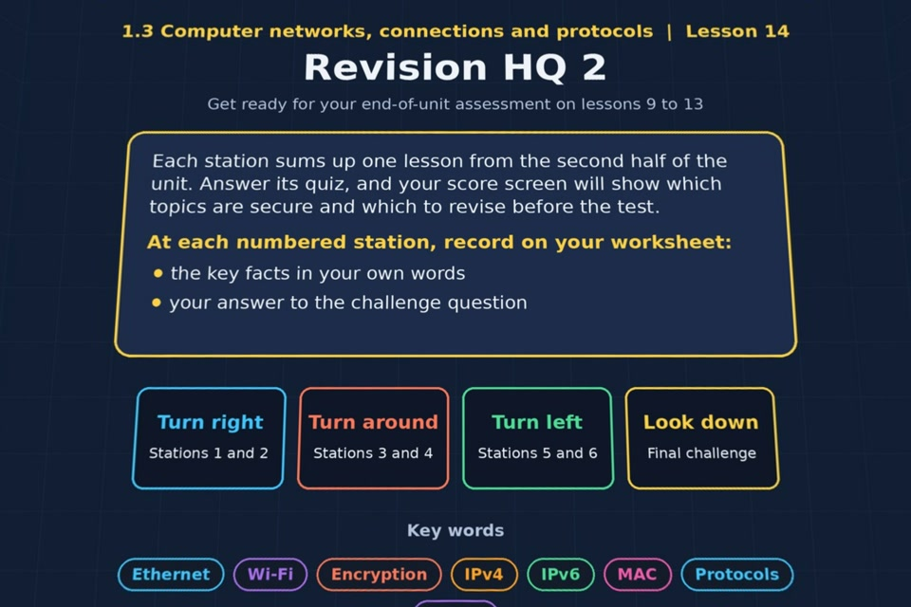

TOPIC 1.3 / LESSON 14
REVISION HQ 2
Catch-up and revision: lessons 9–13
REVISION FOCUS
Which areas need more practice?
1 / 16
Notes:
The image shows the actual opening scene of the experience. Begin with the worksheet starter, or the brief opening question for lessons without one.
Sources: Revise 360 experiences/nw-l14.json and worksheets/NW_L14_RevisionHQ2_Worksheet.docx. Answers are indicative classroom examples, not an official OCR mark scheme.

Slide 2
TOPIC 1.3 / LESSON 14 / WORKSHEET
By the end of this lesson
1.
know which lessons I am secure on and which to revise
2.
be ready for the end-of-unit assessment
2 / 16
Notes:
These learning outcomes follow the lesson worksheet.
Sources: Revise 360 experiences/nw-l14.json and worksheets/NW_L14_RevisionHQ2_Worksheet.docx. Answers are indicative classroom examples, not an official OCR mark scheme.

Slide 3
TOPIC 1.3 / LESSON 14 / WORKSHEET STARTER
Starter: before the experience
Without notes, list as many key terms from lessons 9 to 13 as you can in two minutes.
3 / 16
Notes:
Students answer the worksheet starter before showing the sample answers.
Sources: Revise 360 experiences/nw-l14.json and worksheets/NW_L14_RevisionHQ2_Worksheet.docx. Answers are indicative classroom examples, not an official OCR mark scheme.

Slide 4
TOPIC 1.3 / LESSON 14 / CHECK
Starter: sample answers
1.
Possible terms: Ethernet, Wi-Fi, Bluetooth, encryption, public key, private key, MAC, IPv4, IPv6, protocol and layer.
2.
Add a short meaning beside any term you can explain. Use gaps to choose a revision priority.
4 / 16
Notes:
Accept equivalent correct explanations. Reveal after the question so it can be marked as students go.
Sources: Revise 360 experiences/nw-l14.json and worksheets/NW_L14_RevisionHQ2_Worksheet.docx. Answers are indicative classroom examples, not an official OCR mark scheme.

Slide 5
TOPIC 1.3 / LESSON 14 / EXPERIENCE
Worksheet + experience
01 OPEN EXPERIENCE ↗
Open Revision HQ 2 in Topic 1.3. Keep the worksheet beside you.
02 SIX STATIONS
Read each panel. Write THREE key facts IN YOUR OWN WORDS and answer its worksheet challenge before tapping the badge.
03 FINAL CHALLENGE
Complete the ★ task before tapping the star. Copy your score (out of 24), then complete the worksheet task or review.
04 PLENARY
Finish the experience in this lesson. Near the end, close it for the plenary knowledge checks.
5 / 16
Notes:
Leave this combined worksheet and experience instruction slide on the board. The OPEN EXPERIENCE label is a clickable link. Students should complete the experience and reach the plenary near the end of the lesson. First on-screen answers count.
Sources: Revise 360 experiences/nw-l14.json and worksheets/NW_L14_RevisionHQ2_Worksheet.docx. Answers are indicative classroom examples, not an official OCR mark scheme.

Slide 6
TOPIC 1.3 / LESSON 14 / EXTENSION
Apply your learning
Copy your results into the table, then RAG Lessons 9 to 13 and select the lowest-scoring area to revise.
Use the task and table on your worksheet.
6 / 16
Notes:
This follows the post-experience task, key question or revision results on the worksheet.
Sources: Revise 360 experiences/nw-l14.json and worksheets/NW_L14_RevisionHQ2_Worksheet.docx. Answers are indicative classroom examples, not an official OCR mark scheme.

Slide 7
TOPIC 1.3 / LESSON 14 / EXTENSION
Check and improve
Which one topic needs work before the assessment, and what exact task will you complete?
7 / 16
Notes:
Use this question to extend or improve an explanation before the plenary.
Sources: Revise 360 experiences/nw-l14.json and worksheets/NW_L14_RevisionHQ2_Worksheet.docx. Answers are indicative classroom examples, not an official OCR mark scheme.

Slide 8
TOPIC 1.3 / LESSON 14 / CHECK
Application: sample answers
1.
Use the score and feedback to choose a specific weak lesson.
2.
Complete that lesson's worksheet questions and retry missed experience questions in review mode.
3.
Practise one exam answer from memory and improve it against the answer points.
4.
For example: revise IPv4 versus IPv6, redo Lesson 11's address sorting task, then answer the two-address comparison question.
8 / 16
Notes:
These are indicative answers. Credit other accurate examples or justified choices.
Sources: Revise 360 experiences/nw-l14.json and worksheets/NW_L14_RevisionHQ2_Worksheet.docx. Answers are indicative classroom examples, not an official OCR mark scheme.

Slide 9
TOPIC 1.3 / LESSON 14 / ANSWERS
After the experience: stations 1–3
Check your key facts and challenge responses.
1 Lesson 9: Modes of connection
Wired Ethernet can give stable speed; Wi-Fi gives mobility; Bluetooth suits short-range, low-power devices. Choose by context.
2 Lesson 10: Wi-Fi encryption
Encryption protects data against unauthorised reading. The right key is needed to decrypt ciphertext.
3 Lesson 11: IP and MAC addressing
MAC identifies an interface locally. IPv4 and IPv6 are logical IP addresses for routing; IPv6 is 128 bits.
9 / 16
Notes:
Show after completion. These concise points address the worksheet station challenges and help students improve their own wording.
Sources: Revise 360 experiences/nw-l14.json and worksheets/NW_L14_RevisionHQ2_Worksheet.docx. Answers are indicative classroom examples, not an official OCR mark scheme.

Slide 10
TOPIC 1.3 / LESSON 14 / ANSWERS
After the experience: stations 4–6
Check your key facts and challenge responses.
4 Lesson 12: Standards and protocols
Standards support compatibility. Protocols set communication rules, such as HTTP, SMTP, TCP and IP.
5 Lesson 13: Layers
Layers separate networking jobs so developers can change or troubleshoot one without changing every other layer.
6 Exam technique
Explain needs a reason or cause. Describe gives relevant features; state gives a brief answer.
10 / 16
Notes:
Show after completion. These concise points address the worksheet station challenges and help students improve their own wording.
Sources: Revise 360 experiences/nw-l14.json and worksheets/NW_L14_RevisionHQ2_Worksheet.docx. Answers are indicative classroom examples, not an official OCR mark scheme.

Slide 11
TOPIC 1.3 / LESSON 14 / CHECK
Final challenge · answers 1–4
1.
Ethernet → A wired standard for connecting devices on a LAN
2.
Bluetooth → Short-range, low-power wireless connection between two devices
3.
Encryption → Scrambling data so it can't be read without the key
4.
IPv6 → A 128-bit address, written in hexadecimal
11 / 16
Notes:
These are the exact matches, sort categories or ordered steps from the interactive experience task. Use them to check the corresponding worksheet work.
Sources: Revise 360 experiences/nw-l14.json and worksheets/NW_L14_RevisionHQ2_Worksheet.docx. Answers are indicative classroom examples, not an official OCR mark scheme.

Slide 12
TOPIC 1.3 / LESSON 14 / CHECK
Final challenge · answers 5–6
5.
Protocol → A set of rules for how devices communicate
6.
Layer → A part of networking with one defined responsibility
12 / 16
Notes:
These are the exact matches, sort categories or ordered steps from the interactive experience task. Use them to check the corresponding worksheet work.
Sources: Revise 360 experiences/nw-l14.json and worksheets/NW_L14_RevisionHQ2_Worksheet.docx. Answers are indicative classroom examples, not an official OCR mark scheme.

Slide 13
TOPIC 1.3 / LESSON 14 / PLENARY
Plenary: questions
Close the experience. Answer from memory on the worksheet.
a) Explain one advantage of using IPv6 instead of IPv4. [2]
b) Describe how public and private keys are used. [3]
13 / 16
Notes:
These are the exact exit, exam-practice or test-ready questions from the worksheet. Allow independent writing before the answers.
Sources: Revise 360 experiences/nw-l14.json and worksheets/NW_L14_RevisionHQ2_Worksheet.docx. Answers are indicative classroom examples, not an official OCR mark scheme.

Slide 14
TOPIC 1.3 / LESSON 14 / CHECK
Plenary: answers
Indicative points. Credit accurate answers in students’ own words.
a) IPv6 uses 128-bit addresses, providing far more unique addresses than 32-bit IPv4, whose address space is limited.
b) The public key is shared so others can encrypt data for its owner. The owner keeps the matching private key secret and uses it to decrypt.
14 / 16
Notes:
Classroom answer points, not an official OCR mark scheme. Ask students to improve one answer.
Sources: Revise 360 experiences/nw-l14.json and worksheets/NW_L14_RevisionHQ2_Worksheet.docx. Answers are indicative classroom examples, not an official OCR mark scheme.

Slide 15
TOPIC 1.3 / LESSON 14 / WORKSHEET
Revision checklist
RAG these areas on your worksheet and select the next task.
1.
Modes of connection
2.
Wi-Fi encryption
3.
IP and MAC addressing
4.
Standards and protocols
5.
Layers
15 / 16
Notes:
This checklist follows the worksheet. Students mark red, amber or green and choose a concrete next action.
Sources: Revise 360 experiences/nw-l14.json and worksheets/NW_L14_RevisionHQ2_Worksheet.docx. Answers are indicative classroom examples, not an official OCR mark scheme.

Slide 16
TOPIC 1.3 / LESSON 14 / SELF-CHECK
How confident am I?
Select Not yet, Getting there or Confident for each objective on the worksheet.
1.
Lessons 9 and 10
2.
Lessons 11 and 12
3.
Lesson 13
16 / 16
Notes:
These are the exact confidence objectives from the worksheet. Students identify one area to revisit.
Sources: Revise 360 experiences/nw-l14.json and worksheets/NW_L14_RevisionHQ2_Worksheet.docx. Answers are indicative classroom examples, not an official OCR mark scheme.

