Slide 1
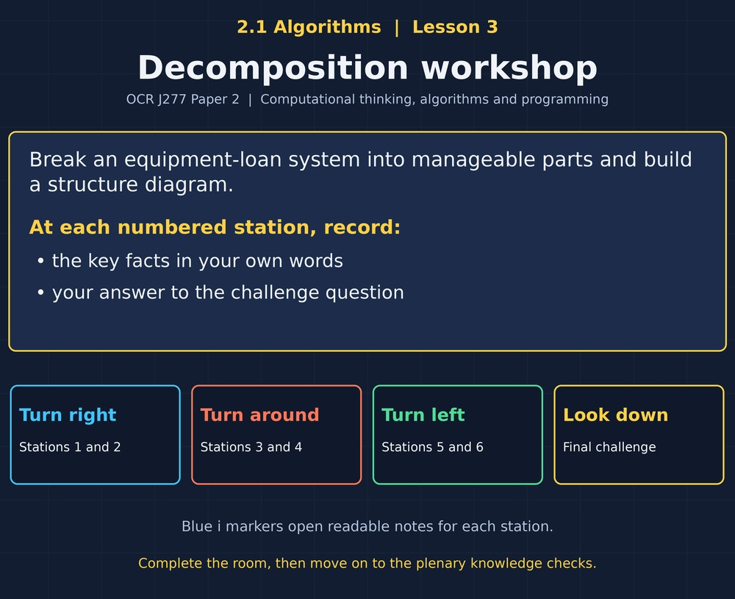

TOPIC 2.1 / LESSON 03
DECOMPOSITION WORKSHOP
Decomposition and structure diagrams
DO NOW: RESEARCH AND DISCUSS
How could a team share the work of building one program?
1 / 18
Notes:
Topic 2.1 lesson 3: Decomposition and structure diagrams.
Source sequence: supplied 2.1 - Algorithms(3).pdf, lessons 1–16. Original Revise360 explanations and practice questions.
Curriculum: OCR J277 specification v3.1, sections 2.1.1–2.1.3, https://www.ocr.org.uk/Images/558027-specification-gcse-computer-science-j277.pdf

Slide 2
TOPIC 2.1 / LESSON 03 / WORKSHEET
By the end of this lesson
1.
Decompose a problem into sub-problems.
2.
Interpret and create structure diagrams.
3.
Explain benefits of decomposition.
2 / 18
Notes:
Topic 2.1 lesson 3: Decomposition and structure diagrams.
Source sequence: supplied 2.1 - Algorithms(3).pdf, lessons 1–16. Original Revise360 explanations and practice questions.
Curriculum: OCR J277 specification v3.1, sections 2.1.1–2.1.3, https://www.ocr.org.uk/Images/558027-specification-gcse-computer-science-j277.pdf

Slide 3
TOPIC 2.1 / LESSON 03 / WORKSHEET STARTER
Starter: before the experience
A school club needs to register members, lend equipment and record returns. Name three smaller problems.
3 / 18
Notes:
Topic 2.1 lesson 3: Decomposition and structure diagrams.
Source sequence: supplied 2.1 - Algorithms(3).pdf, lessons 1–16. Original Revise360 explanations and practice questions.
Curriculum: OCR J277 specification v3.1, sections 2.1.1–2.1.3, https://www.ocr.org.uk/Images/558027-specification-gcse-computer-science-j277.pdf

Slide 4
TOPIC 2.1 / LESSON 03 / CHECK
Starter: sample answers
1.
Manage members, issue loans and process returns are three suitable sub-problems.
4 / 18
Notes:
Topic 2.1 lesson 3: Decomposition and structure diagrams.
Source sequence: supplied 2.1 - Algorithms(3).pdf, lessons 1–16. Original Revise360 explanations and practice questions.
Curriculum: OCR J277 specification v3.1, sections 2.1.1–2.1.3, https://www.ocr.org.uk/Images/558027-specification-gcse-computer-science-j277.pdf

Slide 5
TOPIC 2.1 / LESSON 03 / WORKSHEET KEY TERMS
Key terminology quiz
1.
Decomposition
2.
Structure diagram
5 / 18
Notes:
Topic 2.1 lesson 3: Decomposition and structure diagrams.
Source sequence: supplied 2.1 - Algorithms(3).pdf, lessons 1–16. Original Revise360 explanations and practice questions.
Curriculum: OCR J277 specification v3.1, sections 2.1.1–2.1.3, https://www.ocr.org.uk/Images/558027-specification-gcse-computer-science-j277.pdf

Slide 6
TOPIC 2.1 / LESSON 03 / CHECK
Key terminology: answers
Decomposition
Breaking a problem into smaller, manageable sub-problems.
Structure diagram
A hierarchy showing a system and its component sub-problems.
6 / 18
Notes:
Topic 2.1 lesson 3: Decomposition and structure diagrams.
Source sequence: supplied 2.1 - Algorithms(3).pdf, lessons 1–16. Original Revise360 explanations and practice questions.
Curriculum: OCR J277 specification v3.1, sections 2.1.1–2.1.3, https://www.ocr.org.uk/Images/558027-specification-gcse-computer-science-j277.pdf

Slide 7
TOPIC 2.1 / LESSON 03 / EXPERIENCE
Worksheet + experience
01 OPEN THE EXPERIENCE NOW
Open Decomposition workshop in Topic 2.1. Keep the worksheet beside you.
02 SIX STATIONS
At each station, write key facts IN YOUR OWN WORDS. Answer its worksheet challenge before tapping the badge.
03 FINAL CHALLENGE
Attempt the worksheet final challenge before tapping the star. Record your score, then use review mode to correct mistakes.
04 PLENARY
Finish the experience in this lesson. Near the end, close it for the plenary knowledge checks.
7 / 18
Notes:
Topic 2.1 lesson 3: Decomposition and structure diagrams.
Source sequence: supplied 2.1 - Algorithms(3).pdf, lessons 1–16. Original Revise360 explanations and practice questions.
Curriculum: OCR J277 specification v3.1, sections 2.1.1–2.1.3, https://www.ocr.org.uk/Images/558027-specification-gcse-computer-science-j277.pdf
Allow approximately 25–30 minutes for the experience and worksheet. Pupils record facts in their own words.

Slide 8
TOPIC 2.1 / LESSON 03 / CONSOLIDATION
After the experience
Return to the Do Now question. Use two things you learned in the room to improve your original answer.
Link your explanation to the problem and use a worked example where it helps.
8 / 18
Notes:
Topic 2.1 lesson 3: Decomposition and structure diagrams.
Source sequence: supplied 2.1 - Algorithms(3).pdf, lessons 1–16. Original Revise360 explanations and practice questions.
Curriculum: OCR J277 specification v3.1, sections 2.1.1–2.1.3, https://www.ocr.org.uk/Images/558027-specification-gcse-computer-science-j277.pdf

Slide 9
TOPIC 2.1 / LESSON 03 / CONSOLIDATION
Check and improve
Use review mode to correct any mistakes. Write one correction and explain why the right answer fits. Then complete the plenary from memory.
9 / 18
Notes:
Topic 2.1 lesson 3: Decomposition and structure diagrams.
Source sequence: supplied 2.1 - Algorithms(3).pdf, lessons 1–16. Original Revise360 explanations and practice questions.
Curriculum: OCR J277 specification v3.1, sections 2.1.1–2.1.3, https://www.ocr.org.uk/Images/558027-specification-gcse-computer-science-j277.pdf

Slide 10
TOPIC 2.1 / LESSON 03 / CHECK
A stronger explanation
Compare your reasoning, then improve one sentence on your worksheet.
Check coverage
Processing returns is missing and must be included.
Review and explain
Your correction should name the correct idea and explain why it fits the question. Use the experience feedback to check it.
10 / 18
Notes:
Topic 2.1 lesson 3: Decomposition and structure diagrams.
Source sequence: supplied 2.1 - Algorithms(3).pdf, lessons 1–16. Original Revise360 explanations and practice questions.
Curriculum: OCR J277 specification v3.1, sections 2.1.1–2.1.3, https://www.ocr.org.uk/Images/558027-specification-gcse-computer-science-j277.pdf

Slide 11
TOPIC 2.1 / LESSON 03 / ANSWERS
After the experience: stations 1–3
Check your key facts and challenge responses.
1 Split the problem
Manage members, issue books and process returned books are suitable parts.
2 Read the hierarchy
Check availability and record borrower.
3 Refine a sub-problem
Find the active loan, mark it returned and make the item available again.
11 / 18
Notes:
Topic 2.1 lesson 3: Decomposition and structure diagrams.
Source sequence: supplied 2.1 - Algorithms(3).pdf, lessons 1–16. Original Revise360 explanations and practice questions.
Curriculum: OCR J277 specification v3.1, sections 2.1.1–2.1.3, https://www.ocr.org.uk/Images/558027-specification-gcse-computer-science-j277.pdf

Slide 12
TOPIC 2.1 / LESSON 03 / ANSWERS
After the experience: stations 4–6
Check your key facts and challenge responses.
4 Structure versus flow
It shows what the system contains, rather than the order of execution and decision paths.
5 Work as a team
Their parts exchange member details. A consistent ID allows the parts to work together.
6 Check coverage
Processing returns is missing and must be included.
12 / 18
Notes:
Topic 2.1 lesson 3: Decomposition and structure diagrams.
Source sequence: supplied 2.1 - Algorithms(3).pdf, lessons 1–16. Original Revise360 explanations and practice questions.
Curriculum: OCR J277 specification v3.1, sections 2.1.1–2.1.3, https://www.ocr.org.uk/Images/558027-specification-gcse-computer-science-j277.pdf

Slide 13
TOPIC 2.1 / LESSON 03 / CHECK
Final challenge: answers
Check your choices and the reasons you gave.
1. Match each sub-problem to a suitable smaller task.
Answer: Members: Add a member record; Loans: Check item availability; Returns: Mark an item available
Each child must belong to its parent.
2. Why test each part before combining them?
Answer: It helps locate faults within smaller sections
13 / 18
Notes:
Topic 2.1 lesson 3: Decomposition and structure diagrams.
Source sequence: supplied 2.1 - Algorithms(3).pdf, lessons 1–16. Original Revise360 explanations and practice questions.
Curriculum: OCR J277 specification v3.1, sections 2.1.1–2.1.3, https://www.ocr.org.uk/Images/558027-specification-gcse-computer-science-j277.pdf

Slide 14
TOPIC 2.1 / LESSON 03 / PLENARY
Plenary: questions (a–b)
Take the headset off or close the page. Answer from memory on the worksheet.
a)
Define decomposition. [2]
b)
Draw a structure diagram for a club system with members, loans and returns. Decompose loans into two tasks. [4]
14 / 18
Notes:
Topic 2.1 lesson 3: Decomposition and structure diagrams.
Source sequence: supplied 2.1 - Algorithms(3).pdf, lessons 1–16. Original Revise360 explanations and practice questions.
Curriculum: OCR J277 specification v3.1, sections 2.1.1–2.1.3, https://www.ocr.org.uk/Images/558027-specification-gcse-computer-science-j277.pdf
Close the experience before attempting the questions.

Slide 15
TOPIC 2.1 / LESSON 03 / PLENARY
Plenary: question (c)
Keep the experience closed. Explain your reasoning in full sentences.
c)
Explain one advantage of decomposition for a team. [2]
Use the marks in brackets to judge how much detail to include.
15 / 18
Notes:
Topic 2.1 lesson 3: Decomposition and structure diagrams.
Source sequence: supplied 2.1 - Algorithms(3).pdf, lessons 1–16. Original Revise360 explanations and practice questions.
Curriculum: OCR J277 specification v3.1, sections 2.1.1–2.1.3, https://www.ocr.org.uk/Images/558027-specification-gcse-computer-science-j277.pdf

Slide 16
TOPIC 2.1 / LESSON 03 / CHECK
Plenary: answers (a–b)
Indicative points. Credit accurate answers in students’ own words.
a Break a complex problem (1) into smaller manageable sub-problems (1).
b Whole system above three appropriate parts (1), correct parent-child connections (1), check availability beneath loans (1), record loan beneath loans (1).
16 / 18
Notes:
Topic 2.1 lesson 3: Decomposition and structure diagrams.
Source sequence: supplied 2.1 - Algorithms(3).pdf, lessons 1–16. Original Revise360 explanations and practice questions.
Curriculum: OCR J277 specification v3.1, sections 2.1.1–2.1.3, https://www.ocr.org.uk/Images/558027-specification-gcse-computer-science-j277.pdf

Slide 17
TOPIC 2.1 / LESSON 03 / CHECK
Plenary: answer (c)
Indicative points for the final question.
Separate tasks can be assigned to different people (1), allowing work on manageable parts in parallel (1).
17 / 18
Notes:
Topic 2.1 lesson 3: Decomposition and structure diagrams.
Source sequence: supplied 2.1 - Algorithms(3).pdf, lessons 1–16. Original Revise360 explanations and practice questions.
Curriculum: OCR J277 specification v3.1, sections 2.1.1–2.1.3, https://www.ocr.org.uk/Images/558027-specification-gcse-computer-science-j277.pdf

Slide 18
TOPIC 2.1 / LESSON 03 / SELF-CHECK
How confident am I?
On the worksheet, select Not yet, Getting there or Confident for each objective.
1.
Decompose a problem into sub-problems.
2.
Interpret and create structure diagrams.
3.
Explain benefits of decomposition.
18 / 18
Notes:
Topic 2.1 lesson 3: Decomposition and structure diagrams.
Source sequence: supplied 2.1 - Algorithms(3).pdf, lessons 1–16. Original Revise360 explanations and practice questions.
Curriculum: OCR J277 specification v3.1, sections 2.1.1–2.1.3, https://www.ocr.org.uk/Images/558027-specification-gcse-computer-science-j277.pdf

