Slide 1
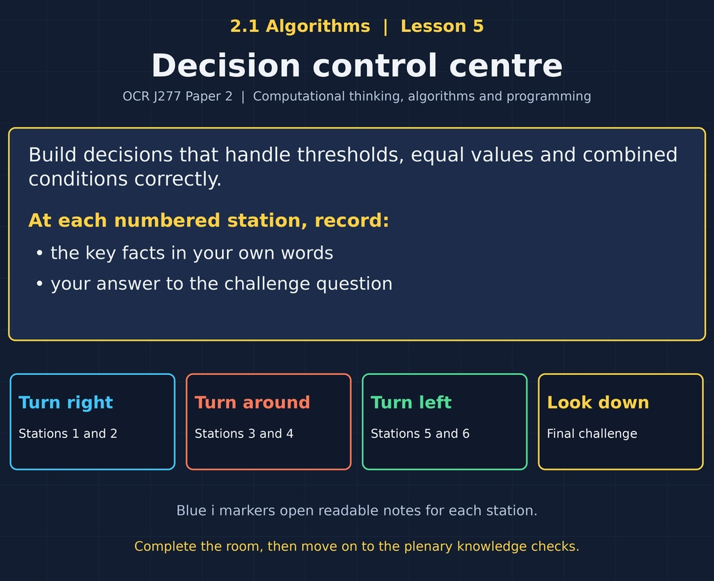

TOPIC 2.1 / LESSON 05
DECISION CONTROL CENTRE
Algorithmic thinking: selection
DO NOW: RESEARCH AND DISCUSS
Is age greater than 16 the same as age at least 16?
1 / 18
Notes:
Topic 2.1 lesson 5: Algorithmic thinking: selection.
Source sequence: supplied 2.1 - Algorithms(3).pdf, lessons 1–16. Original Revise360 explanations and practice questions.
Curriculum: OCR J277 specification v3.1, sections 2.1.1–2.1.3, https://www.ocr.org.uk/Images/558027-specification-gcse-computer-science-j277.pdf

Slide 2
TOPIC 2.1 / LESSON 05 / WORKSHEET
By the end of this lesson
1.
Apply selection to decisions.
2.
Handle boundary and equality cases.
3.
Combine conditions accurately.
2 / 18
Notes:
Topic 2.1 lesson 5: Algorithmic thinking: selection.
Source sequence: supplied 2.1 - Algorithms(3).pdf, lessons 1–16. Original Revise360 explanations and practice questions.
Curriculum: OCR J277 specification v3.1, sections 2.1.1–2.1.3, https://www.ocr.org.uk/Images/558027-specification-gcse-computer-science-j277.pdf

Slide 3
TOPIC 2.1 / LESSON 05 / WORKSHEET STARTER
Starter: before the experience
A club accepts pupils aged 12 or older. Should age 12 be accepted?
3 / 18
Notes:
Topic 2.1 lesson 5: Algorithmic thinking: selection.
Source sequence: supplied 2.1 - Algorithms(3).pdf, lessons 1–16. Original Revise360 explanations and practice questions.
Curriculum: OCR J277 specification v3.1, sections 2.1.1–2.1.3, https://www.ocr.org.uk/Images/558027-specification-gcse-computer-science-j277.pdf

Slide 4
TOPIC 2.1 / LESSON 05 / CHECK
Starter: sample answers
1.
Yes. Age 12 is included, so the condition must be age >= 12.
4 / 18
Notes:
Topic 2.1 lesson 5: Algorithmic thinking: selection.
Source sequence: supplied 2.1 - Algorithms(3).pdf, lessons 1–16. Original Revise360 explanations and practice questions.
Curriculum: OCR J277 specification v3.1, sections 2.1.1–2.1.3, https://www.ocr.org.uk/Images/558027-specification-gcse-computer-science-j277.pdf

Slide 5
TOPIC 2.1 / LESSON 05 / WORKSHEET KEY TERMS
Key terminology quiz
1.
Selection
2.
Condition
5 / 18
Notes:
Topic 2.1 lesson 5: Algorithmic thinking: selection.
Source sequence: supplied 2.1 - Algorithms(3).pdf, lessons 1–16. Original Revise360 explanations and practice questions.
Curriculum: OCR J277 specification v3.1, sections 2.1.1–2.1.3, https://www.ocr.org.uk/Images/558027-specification-gcse-computer-science-j277.pdf

Slide 6
TOPIC 2.1 / LESSON 05 / CHECK
Key terminology: answers
Selection
Choosing which instructions to execute using a condition.
Condition
An expression evaluated as true or false.
6 / 18
Notes:
Topic 2.1 lesson 5: Algorithmic thinking: selection.
Source sequence: supplied 2.1 - Algorithms(3).pdf, lessons 1–16. Original Revise360 explanations and practice questions.
Curriculum: OCR J277 specification v3.1, sections 2.1.1–2.1.3, https://www.ocr.org.uk/Images/558027-specification-gcse-computer-science-j277.pdf

Slide 7
TOPIC 2.1 / LESSON 05 / EXPERIENCE
Worksheet + experience
01 OPEN THE EXPERIENCE NOW
Open Decision control centre in Topic 2.1. Keep the worksheet beside you.
02 SIX STATIONS
At each station, write key facts IN YOUR OWN WORDS. Answer its worksheet challenge before tapping the badge.
03 FINAL CHALLENGE
Attempt the worksheet final challenge before tapping the star. Record your score, then use review mode to correct mistakes.
04 PLENARY
Finish the experience in this lesson. Near the end, close it for the plenary knowledge checks.
7 / 18
Notes:
Topic 2.1 lesson 5: Algorithmic thinking: selection.
Source sequence: supplied 2.1 - Algorithms(3).pdf, lessons 1–16. Original Revise360 explanations and practice questions.
Curriculum: OCR J277 specification v3.1, sections 2.1.1–2.1.3, https://www.ocr.org.uk/Images/558027-specification-gcse-computer-science-j277.pdf
Allow approximately 25–30 minutes for the experience and worksheet. Pupils record facts in their own words.

Slide 8
TOPIC 2.1 / LESSON 05 / CONSOLIDATION
After the experience
Return to the Do Now question. Use two things you learned in the room to improve your original answer.
Link your explanation to the problem and use a worked example where it helps.
8 / 18
Notes:
Topic 2.1 lesson 5: Algorithmic thinking: selection.
Source sequence: supplied 2.1 - Algorithms(3).pdf, lessons 1–16. Original Revise360 explanations and practice questions.
Curriculum: OCR J277 specification v3.1, sections 2.1.1–2.1.3, https://www.ocr.org.uk/Images/558027-specification-gcse-computer-science-j277.pdf

Slide 9
TOPIC 2.1 / LESSON 05 / CONSOLIDATION
Check and improve
Use review mode to correct any mistakes. Write one correction and explain why the right answer fits. Then complete the plenary from memory.
9 / 18
Notes:
Topic 2.1 lesson 5: Algorithmic thinking: selection.
Source sequence: supplied 2.1 - Algorithms(3).pdf, lessons 1–16. Original Revise360 explanations and practice questions.
Curriculum: OCR J277 specification v3.1, sections 2.1.1–2.1.3, https://www.ocr.org.uk/Images/558027-specification-gcse-computer-science-j277.pdf

Slide 10
TOPIC 2.1 / LESSON 05 / CHECK
A stronger explanation
Compare your reasoning, then improve one sentence on your worksheet.
Nested decisions
No. The outer IF body is skipped.
Review and explain
Your correction should name the correct idea and explain why it fits the question. Use the experience feedback to check it.
10 / 18
Notes:
Topic 2.1 lesson 5: Algorithmic thinking: selection.
Source sequence: supplied 2.1 - Algorithms(3).pdf, lessons 1–16. Original Revise360 explanations and practice questions.
Curriculum: OCR J277 specification v3.1, sections 2.1.1–2.1.3, https://www.ocr.org.uk/Images/558027-specification-gcse-computer-science-j277.pdf

Slide 11
TOPIC 2.1 / LESSON 05 / ANSWERS
After the experience: stations 1–3
Check your key facts and challenge responses.
1 Two possible paths
The ELSE branch prints Unavailable.
2 Include the boundary
It rejects a pupil aged exactly 12, although the rule includes them.
3 Three-way decisions
Equal values may get the wrong result or no intended output.
11 / 18
Notes:
Topic 2.1 lesson 5: Algorithmic thinking: selection.
Source sequence: supplied 2.1 - Algorithms(3).pdf, lessons 1–16. Original Revise360 explanations and practice questions.
Curriculum: OCR J277 specification v3.1, sections 2.1.1–2.1.3, https://www.ocr.org.uk/Images/558027-specification-gcse-computer-science-j277.pdf

Slide 12
TOPIC 2.1 / LESSON 05 / ANSWERS
After the experience: stations 4–6
Check your key facts and challenge responses.
4 Both conditions
No. Both membership and availability are required, and availability is false.
5 Either condition
Yes. OR includes the case where both conditions are true.
6 Nested decisions
No. The outer IF body is skipped.
12 / 18
Notes:
Topic 2.1 lesson 5: Algorithmic thinking: selection.
Source sequence: supplied 2.1 - Algorithms(3).pdf, lessons 1–16. Original Revise360 explanations and practice questions.
Curriculum: OCR J277 specification v3.1, sections 2.1.1–2.1.3, https://www.ocr.org.uk/Images/558027-specification-gcse-computer-science-j277.pdf

Slide 13
TOPIC 2.1 / LESSON 05 / CHECK
Final challenge: answers
Check your choices and the reasons you gave.
1. Match the phrase to its condition.
Answer: At least 10: x >= 10; Below 10: x < 10; Exactly 10: x == 10
Equality must be handled as the wording requires.
2. A loan needs a member AND an available item. Member is true and available is false. Result?
Answer: Reject the loan
13 / 18
Notes:
Topic 2.1 lesson 5: Algorithmic thinking: selection.
Source sequence: supplied 2.1 - Algorithms(3).pdf, lessons 1–16. Original Revise360 explanations and practice questions.
Curriculum: OCR J277 specification v3.1, sections 2.1.1–2.1.3, https://www.ocr.org.uk/Images/558027-specification-gcse-computer-science-j277.pdf

Slide 14
TOPIC 2.1 / LESSON 05 / PLENARY
Plenary: questions (a–b)
Take the headset off or close the page. Answer from memory on the worksheet.
a)
Write a condition for a temperature from 18 to 24 inclusive. [2]
b)
Explain the difference between AND and OR. [2]
14 / 18
Notes:
Topic 2.1 lesson 5: Algorithmic thinking: selection.
Source sequence: supplied 2.1 - Algorithms(3).pdf, lessons 1–16. Original Revise360 explanations and practice questions.
Curriculum: OCR J277 specification v3.1, sections 2.1.1–2.1.3, https://www.ocr.org.uk/Images/558027-specification-gcse-computer-science-j277.pdf
Close the experience before attempting the questions.

Slide 15
TOPIC 2.1 / LESSON 05 / PLENARY
Plenary: question (c)
Keep the experience closed. Explain your reasoning in full sentences.
c)
An algorithm uses age > 16 for a rule of at least 16. Identify and correct the error. [2]
Use the marks in brackets to judge how much detail to include.
15 / 18
Notes:
Topic 2.1 lesson 5: Algorithmic thinking: selection.
Source sequence: supplied 2.1 - Algorithms(3).pdf, lessons 1–16. Original Revise360 explanations and practice questions.
Curriculum: OCR J277 specification v3.1, sections 2.1.1–2.1.3, https://www.ocr.org.uk/Images/558027-specification-gcse-computer-science-j277.pdf

Slide 16
TOPIC 2.1 / LESSON 05 / CHECK
Plenary: answers (a–b)
Indicative points. Credit accurate answers in students’ own words.
a temperature >= 18 (1) AND temperature <= 24 (1).
b AND needs both conditions true (1). OR needs at least one true (1).
16 / 18
Notes:
Topic 2.1 lesson 5: Algorithmic thinking: selection.
Source sequence: supplied 2.1 - Algorithms(3).pdf, lessons 1–16. Original Revise360 explanations and practice questions.
Curriculum: OCR J277 specification v3.1, sections 2.1.1–2.1.3, https://www.ocr.org.uk/Images/558027-specification-gcse-computer-science-j277.pdf

Slide 17
TOPIC 2.1 / LESSON 05 / CHECK
Plenary: answer (c)
Indicative points for the final question.
The boundary age 16 is rejected (1). Use age >= 16 (1).
17 / 18
Notes:
Topic 2.1 lesson 5: Algorithmic thinking: selection.
Source sequence: supplied 2.1 - Algorithms(3).pdf, lessons 1–16. Original Revise360 explanations and practice questions.
Curriculum: OCR J277 specification v3.1, sections 2.1.1–2.1.3, https://www.ocr.org.uk/Images/558027-specification-gcse-computer-science-j277.pdf

Slide 18
TOPIC 2.1 / LESSON 05 / SELF-CHECK
How confident am I?
On the worksheet, select Not yet, Getting there or Confident for each objective.
1.
Apply selection to decisions.
2.
Handle boundary and equality cases.
3.
Combine conditions accurately.
18 / 18
Notes:
Topic 2.1 lesson 5: Algorithmic thinking: selection.
Source sequence: supplied 2.1 - Algorithms(3).pdf, lessons 1–16. Original Revise360 explanations and practice questions.
Curriculum: OCR J277 specification v3.1, sections 2.1.1–2.1.3, https://www.ocr.org.uk/Images/558027-specification-gcse-computer-science-j277.pdf

