Slide 1
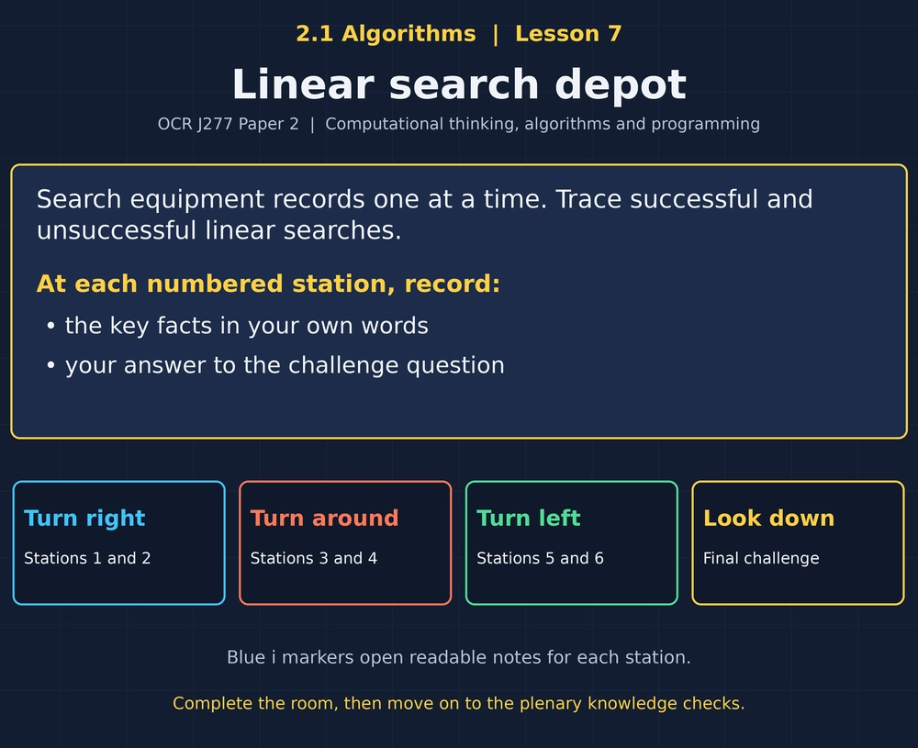

TOPIC 2.1 / LESSON 07
LINEAR SEARCH DEPOT
Linear search
DO NOW: RESEARCH AND DISCUSS
How would you find an item in a box with no useful ordering?
1 / 18
Notes:
Topic 2.1 lesson 7: Linear search.
Source sequence: supplied 2.1 - Algorithms(3).pdf, lessons 1–16. Original Revise360 explanations and practice questions.
Curriculum: OCR J277 specification v3.1, sections 2.1.1–2.1.3, https://www.ocr.org.uk/Images/558027-specification-gcse-computer-science-j277.pdf

Slide 2
TOPIC 2.1 / LESSON 07 / WORKSHEET
By the end of this lesson
1.
Describe and trace linear search.
2.
Interpret a search code segment.
3.
Compare successful and unsuccessful searches.
2 / 18
Notes:
Topic 2.1 lesson 7: Linear search.
Source sequence: supplied 2.1 - Algorithms(3).pdf, lessons 1–16. Original Revise360 explanations and practice questions.
Curriculum: OCR J277 specification v3.1, sections 2.1.1–2.1.3, https://www.ocr.org.uk/Images/558027-specification-gcse-computer-science-j277.pdf

Slide 3
TOPIC 2.1 / LESSON 07 / WORKSHEET STARTER
Starter: before the experience
Search [18, 4, 27, 9] from left to right for 27. Which values are checked?
3 / 18
Notes:
Topic 2.1 lesson 7: Linear search.
Source sequence: supplied 2.1 - Algorithms(3).pdf, lessons 1–16. Original Revise360 explanations and practice questions.
Curriculum: OCR J277 specification v3.1, sections 2.1.1–2.1.3, https://www.ocr.org.uk/Images/558027-specification-gcse-computer-science-j277.pdf

Slide 4
TOPIC 2.1 / LESSON 07 / CHECK
Starter: sample answers
1.
18, then 4, then 27. Stop when 27 is found.
4 / 18
Notes:
Topic 2.1 lesson 7: Linear search.
Source sequence: supplied 2.1 - Algorithms(3).pdf, lessons 1–16. Original Revise360 explanations and practice questions.
Curriculum: OCR J277 specification v3.1, sections 2.1.1–2.1.3, https://www.ocr.org.uk/Images/558027-specification-gcse-computer-science-j277.pdf

Slide 5
TOPIC 2.1 / LESSON 07 / WORKSHEET KEY TERMS
Key terminology quiz
1.
Linear search
2.
Index
5 / 18
Notes:
Topic 2.1 lesson 7: Linear search.
Source sequence: supplied 2.1 - Algorithms(3).pdf, lessons 1–16. Original Revise360 explanations and practice questions.
Curriculum: OCR J277 specification v3.1, sections 2.1.1–2.1.3, https://www.ocr.org.uk/Images/558027-specification-gcse-computer-science-j277.pdf

Slide 6
TOPIC 2.1 / LESSON 07 / CHECK
Key terminology: answers
Linear search
Checking items one at a time until a target is found or the list ends.
Index
A position used to access an item in a list.
6 / 18
Notes:
Topic 2.1 lesson 7: Linear search.
Source sequence: supplied 2.1 - Algorithms(3).pdf, lessons 1–16. Original Revise360 explanations and practice questions.
Curriculum: OCR J277 specification v3.1, sections 2.1.1–2.1.3, https://www.ocr.org.uk/Images/558027-specification-gcse-computer-science-j277.pdf

Slide 7
TOPIC 2.1 / LESSON 07 / EXPERIENCE
Worksheet + experience
01 OPEN THE EXPERIENCE NOW
Open Linear search depot in Topic 2.1. Keep the worksheet beside you.
02 SIX STATIONS
At each station, write key facts IN YOUR OWN WORDS. Answer its worksheet challenge before tapping the badge.
03 FINAL CHALLENGE
Attempt the worksheet final challenge before tapping the star. Record your score, then use review mode to correct mistakes.
04 PLENARY
Finish the experience in this lesson. Near the end, close it for the plenary knowledge checks.
7 / 18
Notes:
Topic 2.1 lesson 7: Linear search.
Source sequence: supplied 2.1 - Algorithms(3).pdf, lessons 1–16. Original Revise360 explanations and practice questions.
Curriculum: OCR J277 specification v3.1, sections 2.1.1–2.1.3, https://www.ocr.org.uk/Images/558027-specification-gcse-computer-science-j277.pdf
Allow approximately 25–30 minutes for the experience and worksheet. Pupils record facts in their own words.

Slide 8
TOPIC 2.1 / LESSON 07 / CONSOLIDATION
After the experience
Return to the Do Now question. Use two things you learned in the room to improve your original answer.
Link your explanation to the problem and use a worked example where it helps.
8 / 18
Notes:
Topic 2.1 lesson 7: Linear search.
Source sequence: supplied 2.1 - Algorithms(3).pdf, lessons 1–16. Original Revise360 explanations and practice questions.
Curriculum: OCR J277 specification v3.1, sections 2.1.1–2.1.3, https://www.ocr.org.uk/Images/558027-specification-gcse-computer-science-j277.pdf

Slide 9
TOPIC 2.1 / LESSON 07 / CONSOLIDATION
Check and improve
Use review mode to correct any mistakes. Write one correction and explain why the right answer fits. Then complete the plenary from memory.
9 / 18
Notes:
Topic 2.1 lesson 7: Linear search.
Source sequence: supplied 2.1 - Algorithms(3).pdf, lessons 1–16. Original Revise360 explanations and practice questions.
Curriculum: OCR J277 specification v3.1, sections 2.1.1–2.1.3, https://www.ocr.org.uk/Images/558027-specification-gcse-computer-science-j277.pdf

Slide 10
TOPIC 2.1 / LESSON 07 / CHECK
A stronger explanation
Compare your reasoning, then improve one sentence on your worksheet.
Best and worst cases
More items must be checked before a last-item match or not-found result.
Review and explain
Your correction should name the correct idea and explain why it fits the question. Use the experience feedback to check it.
10 / 18
Notes:
Topic 2.1 lesson 7: Linear search.
Source sequence: supplied 2.1 - Algorithms(3).pdf, lessons 1–16. Original Revise360 explanations and practice questions.
Curriculum: OCR J277 specification v3.1, sections 2.1.1–2.1.3, https://www.ocr.org.uk/Images/558027-specification-gcse-computer-science-j277.pdf

Slide 11
TOPIC 2.1 / LESSON 07 / ANSWERS
After the experience: stations 1–3
Check your key facts and challenge responses.
1 Check one at a time
Three comparisons. With zero-based indexing, its index is 2.
2 Unsorted lists
It checks items directly and does not discard a half based on value order.
3 Unsuccessful searches
Four, one for each item.
11 / 18
Notes:
Topic 2.1 lesson 7: Linear search.
Source sequence: supplied 2.1 - Algorithms(3).pdf, lessons 1–16. Original Revise360 explanations and practice questions.
Curriculum: OCR J277 specification v3.1, sections 2.1.1–2.1.3, https://www.ocr.org.uk/Images/558027-specification-gcse-computer-science-j277.pdf

Slide 12
TOPIC 2.1 / LESSON 07 / ANSWERS
After the experience: stations 4–6
Check your key facts and challenge responses.
4 Read the code
It compares the current list item with the search target.
5 Index versus value
Value 9, index 2, and three target comparisons.
6 Best and worst cases
More items must be checked before a last-item match or not-found result.
12 / 18
Notes:
Topic 2.1 lesson 7: Linear search.
Source sequence: supplied 2.1 - Algorithms(3).pdf, lessons 1–16. Original Revise360 explanations and practice questions.
Curriculum: OCR J277 specification v3.1, sections 2.1.1–2.1.3, https://www.ocr.org.uk/Images/558027-specification-gcse-computer-science-j277.pdf

Slide 13
TOPIC 2.1 / LESSON 07 / CHECK
Final challenge: answers
Check your choices and the reasons you gave.
1. Search [13, 5, 21, 8, 3] for 8. What is its zero-based index?
Answer: 3
2. In the same search, how many target comparisons occur?
Answer: 4
13 / 18
Notes:
Topic 2.1 lesson 7: Linear search.
Source sequence: supplied 2.1 - Algorithms(3).pdf, lessons 1–16. Original Revise360 explanations and practice questions.
Curriculum: OCR J277 specification v3.1, sections 2.1.1–2.1.3, https://www.ocr.org.uk/Images/558027-specification-gcse-computer-science-j277.pdf

Slide 14
TOPIC 2.1 / LESSON 07 / PLENARY
Plenary: questions (a–b)
Take the headset off or close the page. Answer from memory on the worksheet.
a)
Describe a linear search for an absent target. [3]
b)
Trace a search for 6 in [9, 2, 4, 6, 1]. Give checked values and its zero-based index. [2]
14 / 18
Notes:
Topic 2.1 lesson 7: Linear search.
Source sequence: supplied 2.1 - Algorithms(3).pdf, lessons 1–16. Original Revise360 explanations and practice questions.
Curriculum: OCR J277 specification v3.1, sections 2.1.1–2.1.3, https://www.ocr.org.uk/Images/558027-specification-gcse-computer-science-j277.pdf
Close the experience before attempting the questions.

Slide 15
TOPIC 2.1 / LESSON 07 / PLENARY
Plenary: question (c)
Keep the experience closed. Explain your reasoning in full sentences.
c)
Explain one reason to use linear search for a short unsorted list. [2]
Use the marks in brackets to judge how much detail to include.
15 / 18
Notes:
Topic 2.1 lesson 7: Linear search.
Source sequence: supplied 2.1 - Algorithms(3).pdf, lessons 1–16. Original Revise360 explanations and practice questions.
Curriculum: OCR J277 specification v3.1, sections 2.1.1–2.1.3, https://www.ocr.org.uk/Images/558027-specification-gcse-computer-science-j277.pdf

Slide 16
TOPIC 2.1 / LESSON 07 / CHECK
Plenary: answers (a–b)
Indicative points. Credit accurate answers in students’ own words.
a Start at the first item (1), compare each item with the target (1), report not found after the final item (1).
b Checks 9, 2, 4, 6 (1). Index 3 (1).
16 / 18
Notes:
Topic 2.1 lesson 7: Linear search.
Source sequence: supplied 2.1 - Algorithms(3).pdf, lessons 1–16. Original Revise360 explanations and practice questions.
Curriculum: OCR J277 specification v3.1, sections 2.1.1–2.1.3, https://www.ocr.org.uk/Images/558027-specification-gcse-computer-science-j277.pdf

Slide 17
TOPIC 2.1 / LESSON 07 / CHECK
Plenary: answer (c)
Indicative points for the final question.
No sorting is required (1), so a short one-off search can directly check the items (1).
17 / 18
Notes:
Topic 2.1 lesson 7: Linear search.
Source sequence: supplied 2.1 - Algorithms(3).pdf, lessons 1–16. Original Revise360 explanations and practice questions.
Curriculum: OCR J277 specification v3.1, sections 2.1.1–2.1.3, https://www.ocr.org.uk/Images/558027-specification-gcse-computer-science-j277.pdf

Slide 18
TOPIC 2.1 / LESSON 07 / SELF-CHECK
How confident am I?
On the worksheet, select Not yet, Getting there or Confident for each objective.
1.
Describe and trace linear search.
2.
Interpret a search code segment.
3.
Compare successful and unsuccessful searches.
18 / 18
Notes:
Topic 2.1 lesson 7: Linear search.
Source sequence: supplied 2.1 - Algorithms(3).pdf, lessons 1–16. Original Revise360 explanations and practice questions.
Curriculum: OCR J277 specification v3.1, sections 2.1.1–2.1.3, https://www.ocr.org.uk/Images/558027-specification-gcse-computer-science-j277.pdf

