Slide 1
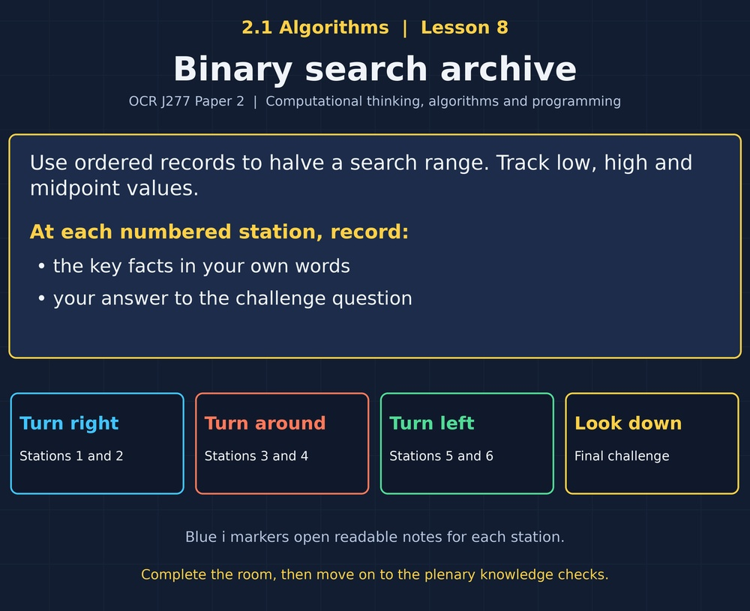

TOPIC 2.1 / LESSON 08
BINARY SEARCH ARCHIVE
Binary search
DO NOW: RESEARCH AND DISCUSS
Why does a dictionary put words in order?
1 / 18
Notes:
Topic 2.1 lesson 8: Binary search.
Source sequence: supplied 2.1 - Algorithms(3).pdf, lessons 1–16. Original Revise360 explanations and practice questions.
Curriculum: OCR J277 specification v3.1, sections 2.1.1–2.1.3, https://www.ocr.org.uk/Images/558027-specification-gcse-computer-science-j277.pdf

Slide 2
TOPIC 2.1 / LESSON 08 / WORKSHEET
By the end of this lesson
1.
Describe and trace binary search.
2.
Explain why sorted data is required.
3.
Compare binary and linear search choices.
2 / 18
Notes:
Topic 2.1 lesson 8: Binary search.
Source sequence: supplied 2.1 - Algorithms(3).pdf, lessons 1–16. Original Revise360 explanations and practice questions.
Curriculum: OCR J277 specification v3.1, sections 2.1.1–2.1.3, https://www.ocr.org.uk/Images/558027-specification-gcse-computer-science-j277.pdf

Slide 3
TOPIC 2.1 / LESSON 08 / WORKSHEET STARTER
Starter: before the experience
In [2, 5, 8, 11, 14], the middle value is 8. Where can target 14 still be?
3 / 18
Notes:
Topic 2.1 lesson 8: Binary search.
Source sequence: supplied 2.1 - Algorithms(3).pdf, lessons 1–16. Original Revise360 explanations and practice questions.
Curriculum: OCR J277 specification v3.1, sections 2.1.1–2.1.3, https://www.ocr.org.uk/Images/558027-specification-gcse-computer-science-j277.pdf

Slide 4
TOPIC 2.1 / LESSON 08 / CHECK
Starter: sample answers
1.
Only to the right of 8 because the list is in ascending order.
4 / 18
Notes:
Topic 2.1 lesson 8: Binary search.
Source sequence: supplied 2.1 - Algorithms(3).pdf, lessons 1–16. Original Revise360 explanations and practice questions.
Curriculum: OCR J277 specification v3.1, sections 2.1.1–2.1.3, https://www.ocr.org.uk/Images/558027-specification-gcse-computer-science-j277.pdf

Slide 5
TOPIC 2.1 / LESSON 08 / WORKSHEET KEY TERMS
Key terminology quiz
1.
Binary search
2.
Midpoint
5 / 18
Notes:
Topic 2.1 lesson 8: Binary search.
Source sequence: supplied 2.1 - Algorithms(3).pdf, lessons 1–16. Original Revise360 explanations and practice questions.
Curriculum: OCR J277 specification v3.1, sections 2.1.1–2.1.3, https://www.ocr.org.uk/Images/558027-specification-gcse-computer-science-j277.pdf

Slide 6
TOPIC 2.1 / LESSON 08 / CHECK
Key terminology: answers
Binary search
Searching sorted data by comparing with the middle item and discarding the impossible half.
Midpoint
The middle index of the current search range.
6 / 18
Notes:
Topic 2.1 lesson 8: Binary search.
Source sequence: supplied 2.1 - Algorithms(3).pdf, lessons 1–16. Original Revise360 explanations and practice questions.
Curriculum: OCR J277 specification v3.1, sections 2.1.1–2.1.3, https://www.ocr.org.uk/Images/558027-specification-gcse-computer-science-j277.pdf

Slide 7
TOPIC 2.1 / LESSON 08 / EXPERIENCE
Worksheet + experience
01 OPEN THE EXPERIENCE NOW
Open Binary search archive in Topic 2.1. Keep the worksheet beside you.
02 SIX STATIONS
At each station, write key facts IN YOUR OWN WORDS. Answer its worksheet challenge before tapping the badge.
03 FINAL CHALLENGE
Attempt the worksheet final challenge before tapping the star. Record your score, then use review mode to correct mistakes.
04 PLENARY
Finish the experience in this lesson. Near the end, close it for the plenary knowledge checks.
7 / 18
Notes:
Topic 2.1 lesson 8: Binary search.
Source sequence: supplied 2.1 - Algorithms(3).pdf, lessons 1–16. Original Revise360 explanations and practice questions.
Curriculum: OCR J277 specification v3.1, sections 2.1.1–2.1.3, https://www.ocr.org.uk/Images/558027-specification-gcse-computer-science-j277.pdf
Allow approximately 25–30 minutes for the experience and worksheet. Pupils record facts in their own words.

Slide 8
TOPIC 2.1 / LESSON 08 / CONSOLIDATION
After the experience
Return to the Do Now question. Use two things you learned in the room to improve your original answer.
Link your explanation to the problem and use a worked example where it helps.
8 / 18
Notes:
Topic 2.1 lesson 8: Binary search.
Source sequence: supplied 2.1 - Algorithms(3).pdf, lessons 1–16. Original Revise360 explanations and practice questions.
Curriculum: OCR J277 specification v3.1, sections 2.1.1–2.1.3, https://www.ocr.org.uk/Images/558027-specification-gcse-computer-science-j277.pdf

Slide 9
TOPIC 2.1 / LESSON 08 / CONSOLIDATION
Check and improve
Use review mode to correct any mistakes. Write one correction and explain why the right answer fits. Then complete the plenary from memory.
9 / 18
Notes:
Topic 2.1 lesson 8: Binary search.
Source sequence: supplied 2.1 - Algorithms(3).pdf, lessons 1–16. Original Revise360 explanations and practice questions.
Curriculum: OCR J277 specification v3.1, sections 2.1.1–2.1.3, https://www.ocr.org.uk/Images/558027-specification-gcse-computer-science-j277.pdf

Slide 10
TOPIC 2.1 / LESSON 08 / CHECK
A stronger explanation
Compare your reasoning, then improve one sentence on your worksheet.
Choose the search
Sorting takes work. For a short unsorted list, one linear scan may be simpler and cheaper overall.
Review and explain
Your correction should name the correct idea and explain why it fits the question. Use the experience feedback to check it.
10 / 18
Notes:
Topic 2.1 lesson 8: Binary search.
Source sequence: supplied 2.1 - Algorithms(3).pdf, lessons 1–16. Original Revise360 explanations and practice questions.
Curriculum: OCR J277 specification v3.1, sections 2.1.1–2.1.3, https://www.ocr.org.uk/Images/558027-specification-gcse-computer-science-j277.pdf

Slide 11
TOPIC 2.1 / LESSON 08 / ANSWERS
After the experience: stations 1–3
Check your key facts and challenge responses.
1 Sorted data first
It guarantees smaller values lie before the middle and larger values after it.
2 Find the midpoint
(3 + 8) DIV 2 = 5.
3 Discard the wrong half
The midpoint has already failed to match and should not remain in the search range.
11 / 18
Notes:
Topic 2.1 lesson 8: Binary search.
Source sequence: supplied 2.1 - Algorithms(3).pdf, lessons 1–16. Original Revise360 explanations and practice questions.
Curriculum: OCR J277 specification v3.1, sections 2.1.1–2.1.3, https://www.ocr.org.uk/Images/558027-specification-gcse-computer-science-j277.pdf

Slide 12
TOPIC 2.1 / LESSON 08 / ANSWERS
After the experience: stations 4–6
Check your key facts and challenge responses.
4 Trace a successful search
12, then 6. The target is found after two comparisons.
5 Trace not found
No indices remain in the possible search range.
6 Choose the search
Sorting takes work. For a short unsorted list, one linear scan may be simpler and cheaper overall.
12 / 18
Notes:
Topic 2.1 lesson 8: Binary search.
Source sequence: supplied 2.1 - Algorithms(3).pdf, lessons 1–16. Original Revise360 explanations and practice questions.
Curriculum: OCR J277 specification v3.1, sections 2.1.1–2.1.3, https://www.ocr.org.uk/Images/558027-specification-gcse-computer-science-j277.pdf

Slide 13
TOPIC 2.1 / LESSON 08 / CHECK
Final challenge: answers
Check your choices and the reasons you gave.
1. Order the checks for target 14 in [2, 4, 6, 8, 10, 12, 14].
Answer: Check 8 at index 3 → Keep indices 4 to 6 → Check 12 at index 5 → Check 14 at index 6
Round down at each midpoint.
2. What is the worst-case advantage as a sorted list grows?
Answer: Binary search repeatedly halves the remaining range
13 / 18
Notes:
Topic 2.1 lesson 8: Binary search.
Source sequence: supplied 2.1 - Algorithms(3).pdf, lessons 1–16. Original Revise360 explanations and practice questions.
Curriculum: OCR J277 specification v3.1, sections 2.1.1–2.1.3, https://www.ocr.org.uk/Images/558027-specification-gcse-computer-science-j277.pdf

Slide 14
TOPIC 2.1 / LESSON 08 / PLENARY
Plenary: questions (a–b)
Take the headset off or close the page. Answer from memory on the worksheet.
a)
Explain why binary search requires sorted data. [2]
b)
Trace binary search for 4 in [2, 4, 6, 8, 10, 12, 14]. Round midpoint down. [3]
14 / 18
Notes:
Topic 2.1 lesson 8: Binary search.
Source sequence: supplied 2.1 - Algorithms(3).pdf, lessons 1–16. Original Revise360 explanations and practice questions.
Curriculum: OCR J277 specification v3.1, sections 2.1.1–2.1.3, https://www.ocr.org.uk/Images/558027-specification-gcse-computer-science-j277.pdf
Close the experience before attempting the questions.

Slide 15
TOPIC 2.1 / LESSON 08 / PLENARY
Plenary: question (c)
Keep the experience closed. Explain your reasoning in full sentences.
c)
Explain when linear search could be a better choice. [2]
Use the marks in brackets to judge how much detail to include.
15 / 18
Notes:
Topic 2.1 lesson 8: Binary search.
Source sequence: supplied 2.1 - Algorithms(3).pdf, lessons 1–16. Original Revise360 explanations and practice questions.
Curriculum: OCR J277 specification v3.1, sections 2.1.1–2.1.3, https://www.ocr.org.uk/Images/558027-specification-gcse-computer-science-j277.pdf

Slide 16
TOPIC 2.1 / LESSON 08 / CHECK
Plenary: answers (a–b)
Indicative points. Credit accurate answers in students’ own words.
a Ordering locates smaller and larger values on known sides (1), allowing one half to be safely discarded (1).
b Check 8 at index 3 (1), keep indices 0 to 2 (1), check 4 at index 1 and stop (1).
16 / 18
Notes:
Topic 2.1 lesson 8: Binary search.
Source sequence: supplied 2.1 - Algorithms(3).pdf, lessons 1–16. Original Revise360 explanations and practice questions.
Curriculum: OCR J277 specification v3.1, sections 2.1.1–2.1.3, https://www.ocr.org.uk/Images/558027-specification-gcse-computer-science-j277.pdf

Slide 17
TOPIC 2.1 / LESSON 08 / CHECK
Plenary: answer (c)
Indicative points for the final question.
A short unsorted list with one lookup (1), because sorting first adds work not needed for a linear scan (1).
17 / 18
Notes:
Topic 2.1 lesson 8: Binary search.
Source sequence: supplied 2.1 - Algorithms(3).pdf, lessons 1–16. Original Revise360 explanations and practice questions.
Curriculum: OCR J277 specification v3.1, sections 2.1.1–2.1.3, https://www.ocr.org.uk/Images/558027-specification-gcse-computer-science-j277.pdf

Slide 18
TOPIC 2.1 / LESSON 08 / SELF-CHECK
How confident am I?
On the worksheet, select Not yet, Getting there or Confident for each objective.
1.
Describe and trace binary search.
2.
Explain why sorted data is required.
3.
Compare binary and linear search choices.
18 / 18
Notes:
Topic 2.1 lesson 8: Binary search.
Source sequence: supplied 2.1 - Algorithms(3).pdf, lessons 1–16. Original Revise360 explanations and practice questions.
Curriculum: OCR J277 specification v3.1, sections 2.1.1–2.1.3, https://www.ocr.org.uk/Images/558027-specification-gcse-computer-science-j277.pdf

