Slide 1
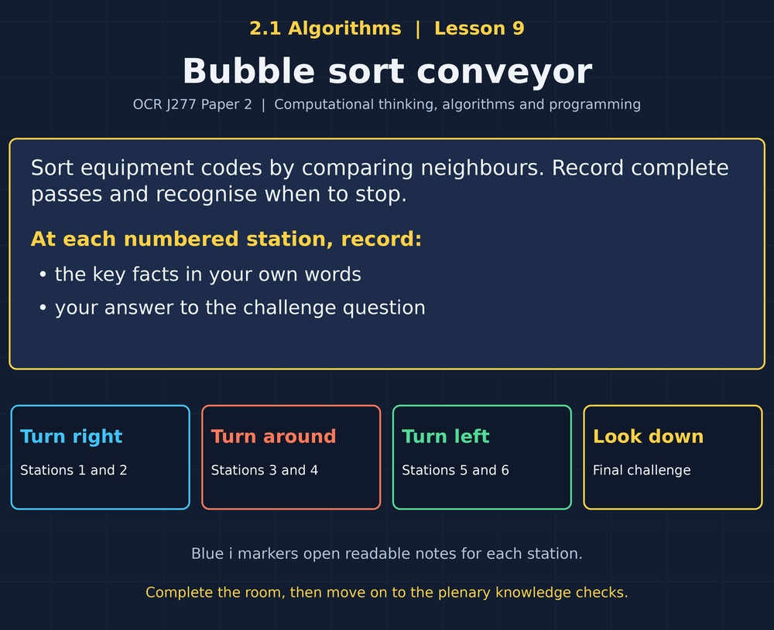

TOPIC 2.1 / LESSON 09
BUBBLE SORT CONVEYOR
Bubble sort
DO NOW: RESEARCH AND DISCUSS
Can moving one item at a time eventually put a whole list in order?
1 / 18
Notes:
Topic 2.1 lesson 9: Bubble sort.
Source sequence: supplied 2.1 - Algorithms(3).pdf, lessons 1–16. Original Revise360 explanations and practice questions.
Curriculum: OCR J277 specification v3.1, sections 2.1.1–2.1.3, https://www.ocr.org.uk/Images/558027-specification-gcse-computer-science-j277.pdf

Slide 2
TOPIC 2.1 / LESSON 09 / WORKSHEET
By the end of this lesson
1.
Describe adjacent comparisons and swaps.
2.
Trace complete bubble-sort passes.
3.
Explain an early stopping condition.
2 / 18
Notes:
Topic 2.1 lesson 9: Bubble sort.
Source sequence: supplied 2.1 - Algorithms(3).pdf, lessons 1–16. Original Revise360 explanations and practice questions.
Curriculum: OCR J277 specification v3.1, sections 2.1.1–2.1.3, https://www.ocr.org.uk/Images/558027-specification-gcse-computer-science-j277.pdf

Slide 3
TOPIC 2.1 / LESSON 09 / WORKSHEET STARTER
Starter: before the experience
For ascending order, should neighbouring values 7 and 3 be swapped? Why?
3 / 18
Notes:
Topic 2.1 lesson 9: Bubble sort.
Source sequence: supplied 2.1 - Algorithms(3).pdf, lessons 1–16. Original Revise360 explanations and practice questions.
Curriculum: OCR J277 specification v3.1, sections 2.1.1–2.1.3, https://www.ocr.org.uk/Images/558027-specification-gcse-computer-science-j277.pdf

Slide 4
TOPIC 2.1 / LESSON 09 / CHECK
Starter: sample answers
1.
Yes. 7 is greater than 3, so swapping puts the smaller value first.
4 / 18
Notes:
Topic 2.1 lesson 9: Bubble sort.
Source sequence: supplied 2.1 - Algorithms(3).pdf, lessons 1–16. Original Revise360 explanations and practice questions.
Curriculum: OCR J277 specification v3.1, sections 2.1.1–2.1.3, https://www.ocr.org.uk/Images/558027-specification-gcse-computer-science-j277.pdf

Slide 5
TOPIC 2.1 / LESSON 09 / WORKSHEET KEY TERMS
Key terminology quiz
1.
Pass
2.
Swap
5 / 18
Notes:
Topic 2.1 lesson 9: Bubble sort.
Source sequence: supplied 2.1 - Algorithms(3).pdf, lessons 1–16. Original Revise360 explanations and practice questions.
Curriculum: OCR J277 specification v3.1, sections 2.1.1–2.1.3, https://www.ocr.org.uk/Images/558027-specification-gcse-computer-science-j277.pdf

Slide 6
TOPIC 2.1 / LESSON 09 / CHECK
Key terminology: answers
Pass
One traversal of the part of the list currently being processed.
Swap
Exchanging the positions of two values.
6 / 18
Notes:
Topic 2.1 lesson 9: Bubble sort.
Source sequence: supplied 2.1 - Algorithms(3).pdf, lessons 1–16. Original Revise360 explanations and practice questions.
Curriculum: OCR J277 specification v3.1, sections 2.1.1–2.1.3, https://www.ocr.org.uk/Images/558027-specification-gcse-computer-science-j277.pdf

Slide 7
TOPIC 2.1 / LESSON 09 / EXPERIENCE
Worksheet + experience
01 OPEN THE EXPERIENCE NOW
Open Bubble sort conveyor in Topic 2.1. Keep the worksheet beside you.
02 SIX STATIONS
At each station, write key facts IN YOUR OWN WORDS. Answer its worksheet challenge before tapping the badge.
03 FINAL CHALLENGE
Attempt the worksheet final challenge before tapping the star. Record your score, then use review mode to correct mistakes.
04 PLENARY
Finish the experience in this lesson. Near the end, close it for the plenary knowledge checks.
7 / 18
Notes:
Topic 2.1 lesson 9: Bubble sort.
Source sequence: supplied 2.1 - Algorithms(3).pdf, lessons 1–16. Original Revise360 explanations and practice questions.
Curriculum: OCR J277 specification v3.1, sections 2.1.1–2.1.3, https://www.ocr.org.uk/Images/558027-specification-gcse-computer-science-j277.pdf
Allow approximately 25–30 minutes for the experience and worksheet. Pupils record facts in their own words.

Slide 8
TOPIC 2.1 / LESSON 09 / CONSOLIDATION
After the experience
Return to the Do Now question. Use two things you learned in the room to improve your original answer.
Link your explanation to the problem and use a worked example where it helps.
8 / 18
Notes:
Topic 2.1 lesson 9: Bubble sort.
Source sequence: supplied 2.1 - Algorithms(3).pdf, lessons 1–16. Original Revise360 explanations and practice questions.
Curriculum: OCR J277 specification v3.1, sections 2.1.1–2.1.3, https://www.ocr.org.uk/Images/558027-specification-gcse-computer-science-j277.pdf

Slide 9
TOPIC 2.1 / LESSON 09 / CONSOLIDATION
Check and improve
Use review mode to correct any mistakes. Write one correction and explain why the right answer fits. Then complete the plenary from memory.
9 / 18
Notes:
Topic 2.1 lesson 9: Bubble sort.
Source sequence: supplied 2.1 - Algorithms(3).pdf, lessons 1–16. Original Revise360 explanations and practice questions.
Curriculum: OCR J277 specification v3.1, sections 2.1.1–2.1.3, https://www.ocr.org.uk/Images/558027-specification-gcse-computer-science-j277.pdf

Slide 10
TOPIC 2.1 / LESSON 09 / CHECK
A stronger explanation
Compare your reasoning, then improve one sentence on your worksheet.
Stop when unchanged
Other adjacent pairs may still be out of order. The whole active pass must be checked.
Review and explain
Your correction should name the correct idea and explain why it fits the question. Use the experience feedback to check it.
10 / 18
Notes:
Topic 2.1 lesson 9: Bubble sort.
Source sequence: supplied 2.1 - Algorithms(3).pdf, lessons 1–16. Original Revise360 explanations and practice questions.
Curriculum: OCR J277 specification v3.1, sections 2.1.1–2.1.3, https://www.ocr.org.uk/Images/558027-specification-gcse-computer-science-j277.pdf

Slide 11
TOPIC 2.1 / LESSON 09 / ANSWERS
After the experience: stations 1–3
Check your key facts and challenge responses.
1 Compare neighbours
No. They are already in a valid ascending order.
2 Complete the first pass
No. 4 and 2 are still out of order, though 5 is in its final position.
3 Continue the passes
1, 2, 4, 5.
11 / 18
Notes:
Topic 2.1 lesson 9: Bubble sort.
Source sequence: supplied 2.1 - Algorithms(3).pdf, lessons 1–16. Original Revise360 explanations and practice questions.
Curriculum: OCR J277 specification v3.1, sections 2.1.1–2.1.3, https://www.ocr.org.uk/Images/558027-specification-gcse-computer-science-j277.pdf

Slide 12
TOPIC 2.1 / LESSON 09 / ANSWERS
After the experience: stations 4–6
Check your key facts and challenge responses.
4 Swaps and comparisons
Three adjacent comparisons and one swap.
5 Read the swap
It preserves the original a[i] so it is not lost when a[i] is overwritten.
6 Stop when unchanged
Other adjacent pairs may still be out of order. The whole active pass must be checked.
12 / 18
Notes:
Topic 2.1 lesson 9: Bubble sort.
Source sequence: supplied 2.1 - Algorithms(3).pdf, lessons 1–16. Original Revise360 explanations and practice questions.
Curriculum: OCR J277 specification v3.1, sections 2.1.1–2.1.3, https://www.ocr.org.uk/Images/558027-specification-gcse-computer-science-j277.pdf

Slide 13
TOPIC 2.1 / LESSON 09 / CHECK
Final challenge: answers
Check your choices and the reasons you gave.
1. First full left-to-right bubble pass on [4, 3, 2, 1] gives...
Answer: 3, 2, 1, 4
2. Why can the rightmost value then be excluded?
Answer: It is the largest and is in its final position
13 / 18
Notes:
Topic 2.1 lesson 9: Bubble sort.
Source sequence: supplied 2.1 - Algorithms(3).pdf, lessons 1–16. Original Revise360 explanations and practice questions.
Curriculum: OCR J277 specification v3.1, sections 2.1.1–2.1.3, https://www.ocr.org.uk/Images/558027-specification-gcse-computer-science-j277.pdf

Slide 14
TOPIC 2.1 / LESSON 09 / PLENARY
Plenary: questions (a–b)
Take the headset off or close the page. Answer from memory on the worksheet.
a)
Show the first left-to-right pass on [6, 2, 5, 1], recording each swap. [3]
b)
Explain how a swap flag can reduce unnecessary passes. [2]
14 / 18
Notes:
Topic 2.1 lesson 9: Bubble sort.
Source sequence: supplied 2.1 - Algorithms(3).pdf, lessons 1–16. Original Revise360 explanations and practice questions.
Curriculum: OCR J277 specification v3.1, sections 2.1.1–2.1.3, https://www.ocr.org.uk/Images/558027-specification-gcse-computer-science-j277.pdf
Close the experience before attempting the questions.

Slide 15
TOPIC 2.1 / LESSON 09 / PLENARY
Plenary: question (c)
Keep the experience closed. Explain your reasoning in full sentences.
c)
Explain why one pass does not necessarily sort a list. [2]
Use the marks in brackets to judge how much detail to include.
15 / 18
Notes:
Topic 2.1 lesson 9: Bubble sort.
Source sequence: supplied 2.1 - Algorithms(3).pdf, lessons 1–16. Original Revise360 explanations and practice questions.
Curriculum: OCR J277 specification v3.1, sections 2.1.1–2.1.3, https://www.ocr.org.uk/Images/558027-specification-gcse-computer-science-j277.pdf

Slide 16
TOPIC 2.1 / LESSON 09 / CHECK
Plenary: answers (a–b)
Indicative points. Credit accurate answers in students’ own words.
a 2,6,5,1 (1); 2,5,6,1 (1); 2,5,1,6 (1).
b Reset the flag before a pass and set it on a swap (1). Stop after a whole pass leaves it false (1).
16 / 18
Notes:
Topic 2.1 lesson 9: Bubble sort.
Source sequence: supplied 2.1 - Algorithms(3).pdf, lessons 1–16. Original Revise360 explanations and practice questions.
Curriculum: OCR J277 specification v3.1, sections 2.1.1–2.1.3, https://www.ocr.org.uk/Images/558027-specification-gcse-computer-science-j277.pdf

Slide 17
TOPIC 2.1 / LESSON 09 / CHECK
Plenary: answer (c)
Indicative points for the final question.
It places the largest remaining value at the end (1), but other values can still be out of order (1).
17 / 18
Notes:
Topic 2.1 lesson 9: Bubble sort.
Source sequence: supplied 2.1 - Algorithms(3).pdf, lessons 1–16. Original Revise360 explanations and practice questions.
Curriculum: OCR J277 specification v3.1, sections 2.1.1–2.1.3, https://www.ocr.org.uk/Images/558027-specification-gcse-computer-science-j277.pdf

Slide 18
TOPIC 2.1 / LESSON 09 / SELF-CHECK
How confident am I?
On the worksheet, select Not yet, Getting there or Confident for each objective.
1.
Describe adjacent comparisons and swaps.
2.
Trace complete bubble-sort passes.
3.
Explain an early stopping condition.
18 / 18
Notes:
Topic 2.1 lesson 9: Bubble sort.
Source sequence: supplied 2.1 - Algorithms(3).pdf, lessons 1–16. Original Revise360 explanations and practice questions.
Curriculum: OCR J277 specification v3.1, sections 2.1.1–2.1.3, https://www.ocr.org.uk/Images/558027-specification-gcse-computer-science-j277.pdf

