Slide 1
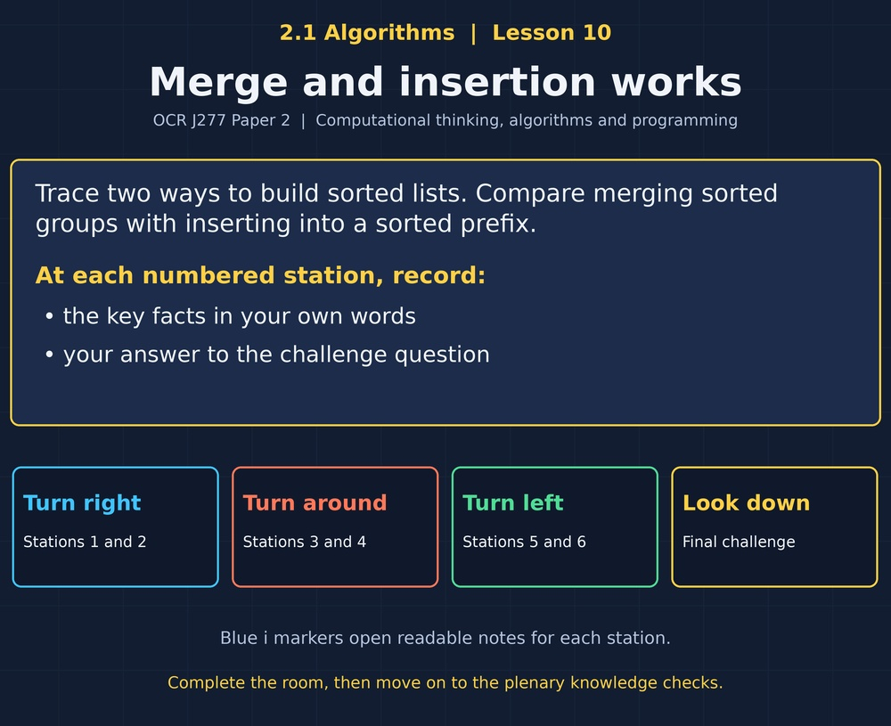

TOPIC 2.1 / LESSON 10
MERGE AND INSERTION WORKS
Merge sort and insertion sort
DO NOW: RESEARCH AND DISCUSS
How do you put a new playing card into a sorted hand?
1 / 18
Notes:
Topic 2.1 lesson 10: Merge sort and insertion sort.
Source sequence: supplied 2.1 - Algorithms(3).pdf, lessons 1–16. Original Revise360 explanations and practice questions.
Curriculum: OCR J277 specification v3.1, sections 2.1.1–2.1.3, https://www.ocr.org.uk/Images/558027-specification-gcse-computer-science-j277.pdf

Slide 2
TOPIC 2.1 / LESSON 10 / WORKSHEET
By the end of this lesson
1.
Trace merge sort splits and merges.
2.
Trace insertion sort.
3.
Compare the main sorting methods.
2 / 18
Notes:
Topic 2.1 lesson 10: Merge sort and insertion sort.
Source sequence: supplied 2.1 - Algorithms(3).pdf, lessons 1–16. Original Revise360 explanations and practice questions.
Curriculum: OCR J277 specification v3.1, sections 2.1.1–2.1.3, https://www.ocr.org.uk/Images/558027-specification-gcse-computer-science-j277.pdf

Slide 3
TOPIC 2.1 / LESSON 10 / WORKSHEET STARTER
Starter: before the experience
Merge sorted lists [2, 7] and [3, 5]. What is the sorted result?
3 / 18
Notes:
Topic 2.1 lesson 10: Merge sort and insertion sort.
Source sequence: supplied 2.1 - Algorithms(3).pdf, lessons 1–16. Original Revise360 explanations and practice questions.
Curriculum: OCR J277 specification v3.1, sections 2.1.1–2.1.3, https://www.ocr.org.uk/Images/558027-specification-gcse-computer-science-j277.pdf

Slide 4
TOPIC 2.1 / LESSON 10 / CHECK
Starter: sample answers
1.
2, 3, 5, 7. Repeatedly take the smaller front value, then append the remainder.
4 / 18
Notes:
Topic 2.1 lesson 10: Merge sort and insertion sort.
Source sequence: supplied 2.1 - Algorithms(3).pdf, lessons 1–16. Original Revise360 explanations and practice questions.
Curriculum: OCR J277 specification v3.1, sections 2.1.1–2.1.3, https://www.ocr.org.uk/Images/558027-specification-gcse-computer-science-j277.pdf

Slide 5
TOPIC 2.1 / LESSON 10 / WORKSHEET KEY TERMS
Key terminology quiz
1.
Merge
2.
Sorted prefix
5 / 18
Notes:
Topic 2.1 lesson 10: Merge sort and insertion sort.
Source sequence: supplied 2.1 - Algorithms(3).pdf, lessons 1–16. Original Revise360 explanations and practice questions.
Curriculum: OCR J277 specification v3.1, sections 2.1.1–2.1.3, https://www.ocr.org.uk/Images/558027-specification-gcse-computer-science-j277.pdf

Slide 6
TOPIC 2.1 / LESSON 10 / CHECK
Key terminology: answers
Merge
Combine sorted lists into one sorted list.
Sorted prefix
The ordered section at the beginning of a list.
6 / 18
Notes:
Topic 2.1 lesson 10: Merge sort and insertion sort.
Source sequence: supplied 2.1 - Algorithms(3).pdf, lessons 1–16. Original Revise360 explanations and practice questions.
Curriculum: OCR J277 specification v3.1, sections 2.1.1–2.1.3, https://www.ocr.org.uk/Images/558027-specification-gcse-computer-science-j277.pdf

Slide 7
TOPIC 2.1 / LESSON 10 / EXPERIENCE
Worksheet + experience
01 OPEN THE EXPERIENCE NOW
Open Merge and insertion works in Topic 2.1. Keep the worksheet beside you.
02 SIX STATIONS
At each station, write key facts IN YOUR OWN WORDS. Answer its worksheet challenge before tapping the badge.
03 FINAL CHALLENGE
Attempt the worksheet final challenge before tapping the star. Record your score, then use review mode to correct mistakes.
04 PLENARY
Finish the experience in this lesson. Near the end, close it for the plenary knowledge checks.
7 / 18
Notes:
Topic 2.1 lesson 10: Merge sort and insertion sort.
Source sequence: supplied 2.1 - Algorithms(3).pdf, lessons 1–16. Original Revise360 explanations and practice questions.
Curriculum: OCR J277 specification v3.1, sections 2.1.1–2.1.3, https://www.ocr.org.uk/Images/558027-specification-gcse-computer-science-j277.pdf
Allow approximately 25–30 minutes for the experience and worksheet. Pupils record facts in their own words.

Slide 8
TOPIC 2.1 / LESSON 10 / CONSOLIDATION
After the experience
Return to the Do Now question. Use two things you learned in the room to improve your original answer.
Link your explanation to the problem and use a worked example where it helps.
8 / 18
Notes:
Topic 2.1 lesson 10: Merge sort and insertion sort.
Source sequence: supplied 2.1 - Algorithms(3).pdf, lessons 1–16. Original Revise360 explanations and practice questions.
Curriculum: OCR J277 specification v3.1, sections 2.1.1–2.1.3, https://www.ocr.org.uk/Images/558027-specification-gcse-computer-science-j277.pdf

Slide 9
TOPIC 2.1 / LESSON 10 / CONSOLIDATION
Check and improve
Use review mode to correct any mistakes. Write one correction and explain why the right answer fits. Then complete the plenary from memory.
9 / 18
Notes:
Topic 2.1 lesson 10: Merge sort and insertion sort.
Source sequence: supplied 2.1 - Algorithms(3).pdf, lessons 1–16. Original Revise360 explanations and practice questions.
Curriculum: OCR J277 specification v3.1, sections 2.1.1–2.1.3, https://www.ocr.org.uk/Images/558027-specification-gcse-computer-science-j277.pdf

Slide 10
TOPIC 2.1 / LESSON 10 / CHECK
A stronger explanation
Compare your reasoning, then improve one sentence on your worksheet.
Compare the methods
Insertion sort, because many keys are already close to their correct positions.
Review and explain
Your correction should name the correct idea and explain why it fits the question. Use the experience feedback to check it.
10 / 18
Notes:
Topic 2.1 lesson 10: Merge sort and insertion sort.
Source sequence: supplied 2.1 - Algorithms(3).pdf, lessons 1–16. Original Revise360 explanations and practice questions.
Curriculum: OCR J277 specification v3.1, sections 2.1.1–2.1.3, https://www.ocr.org.uk/Images/558027-specification-gcse-computer-science-j277.pdf

Slide 11
TOPIC 2.1 / LESSON 10 / ANSWERS
After the experience: stations 1–3
Check your key facts and challenge responses.
1 Divide the list
A single item cannot be out of order relative to another item in its list.
2 Merge sorted groups
3, because it is smaller than the other front value, 7.
3 Read a merge segment
The other front value has not been output yet and must remain available for comparison.
11 / 18
Notes:
Topic 2.1 lesson 10: Merge sort and insertion sort.
Source sequence: supplied 2.1 - Algorithms(3).pdf, lessons 1–16. Original Revise360 explanations and practice questions.
Curriculum: OCR J277 specification v3.1, sections 2.1.1–2.1.3, https://www.ocr.org.uk/Images/558027-specification-gcse-computer-science-j277.pdf

Slide 12
TOPIC 2.1 / LESSON 10 / ANSWERS
After the experience: stations 4–6
Check your key facts and challenge responses.
4 Insert into a prefix
2, 5, 6. The final value 1 has not yet been inserted.
5 Shift and insert
Shifting could overwrite its original position. Saving it preserves the value for insertion.
6 Compare the methods
Insertion sort, because many keys are already close to their correct positions.
12 / 18
Notes:
Topic 2.1 lesson 10: Merge sort and insertion sort.
Source sequence: supplied 2.1 - Algorithms(3).pdf, lessons 1–16. Original Revise360 explanations and practice questions.
Curriculum: OCR J277 specification v3.1, sections 2.1.1–2.1.3, https://www.ocr.org.uk/Images/558027-specification-gcse-computer-science-j277.pdf

Slide 13
TOPIC 2.1 / LESSON 10 / CHECK
Final challenge: answers
Check your choices and the reasons you gave.
1. Insertion sort on [4, 1, 3, 2]: after inserting the first two keys, the list is...
Answer: 1, 3, 4, 2
2. Which statement describes the usual school-level merge-sort implementation?
Answer: It uses additional temporary storage during merging
13 / 18
Notes:
Topic 2.1 lesson 10: Merge sort and insertion sort.
Source sequence: supplied 2.1 - Algorithms(3).pdf, lessons 1–16. Original Revise360 explanations and practice questions.
Curriculum: OCR J277 specification v3.1, sections 2.1.1–2.1.3, https://www.ocr.org.uk/Images/558027-specification-gcse-computer-science-j277.pdf

Slide 14
TOPIC 2.1 / LESSON 10 / PLENARY
Plenary: questions (a–b)
Take the headset off or close the page. Answer from memory on the worksheet.
a)
Show the split and merge stages for [8, 3, 6, 1]. [4]
b)
Show the list after each insertion for [5, 2, 4, 1]. [3]
14 / 18
Notes:
Topic 2.1 lesson 10: Merge sort and insertion sort.
Source sequence: supplied 2.1 - Algorithms(3).pdf, lessons 1–16. Original Revise360 explanations and practice questions.
Curriculum: OCR J277 specification v3.1, sections 2.1.1–2.1.3, https://www.ocr.org.uk/Images/558027-specification-gcse-computer-science-j277.pdf
Close the experience before attempting the questions.

Slide 15
TOPIC 2.1 / LESSON 10 / PLENARY
Plenary: question (c)
Keep the experience closed. Explain your reasoning in full sentences.
c)
Give one difference between merge and insertion sort. [2]
Use the marks in brackets to judge how much detail to include.
15 / 18
Notes:
Topic 2.1 lesson 10: Merge sort and insertion sort.
Source sequence: supplied 2.1 - Algorithms(3).pdf, lessons 1–16. Original Revise360 explanations and practice questions.
Curriculum: OCR J277 specification v3.1, sections 2.1.1–2.1.3, https://www.ocr.org.uk/Images/558027-specification-gcse-computer-science-j277.pdf

Slide 16
TOPIC 2.1 / LESSON 10 / CHECK
Plenary: answers (a–b)
Indicative points. Credit accurate answers in students’ own words.
a Split into [8,3] and [6,1] (1), split into singles (1), merge to [3,8] and [1,6] (1), merge to [1,3,6,8] (1).
b [2,5,4,1] (1), [2,4,5,1] (1), [1,2,4,5] (1).
16 / 18
Notes:
Topic 2.1 lesson 10: Merge sort and insertion sort.
Source sequence: supplied 2.1 - Algorithms(3).pdf, lessons 1–16. Original Revise360 explanations and practice questions.
Curriculum: OCR J277 specification v3.1, sections 2.1.1–2.1.3, https://www.ocr.org.uk/Images/558027-specification-gcse-computer-science-j277.pdf

Slide 17
TOPIC 2.1 / LESSON 10 / CHECK
Plenary: answer (c)
Indicative points for the final question.
Merge splits and combines sorted groups (1). Insertion places successive keys into a growing sorted prefix (1).
17 / 18
Notes:
Topic 2.1 lesson 10: Merge sort and insertion sort.
Source sequence: supplied 2.1 - Algorithms(3).pdf, lessons 1–16. Original Revise360 explanations and practice questions.
Curriculum: OCR J277 specification v3.1, sections 2.1.1–2.1.3, https://www.ocr.org.uk/Images/558027-specification-gcse-computer-science-j277.pdf

Slide 18
TOPIC 2.1 / LESSON 10 / SELF-CHECK
How confident am I?
On the worksheet, select Not yet, Getting there or Confident for each objective.
1.
Trace merge sort splits and merges.
2.
Trace insertion sort.
3.
Compare the main sorting methods.
18 / 18
Notes:
Topic 2.1 lesson 10: Merge sort and insertion sort.
Source sequence: supplied 2.1 - Algorithms(3).pdf, lessons 1–16. Original Revise360 explanations and practice questions.
Curriculum: OCR J277 specification v3.1, sections 2.1.1–2.1.3, https://www.ocr.org.uk/Images/558027-specification-gcse-computer-science-j277.pdf

