Slide 1
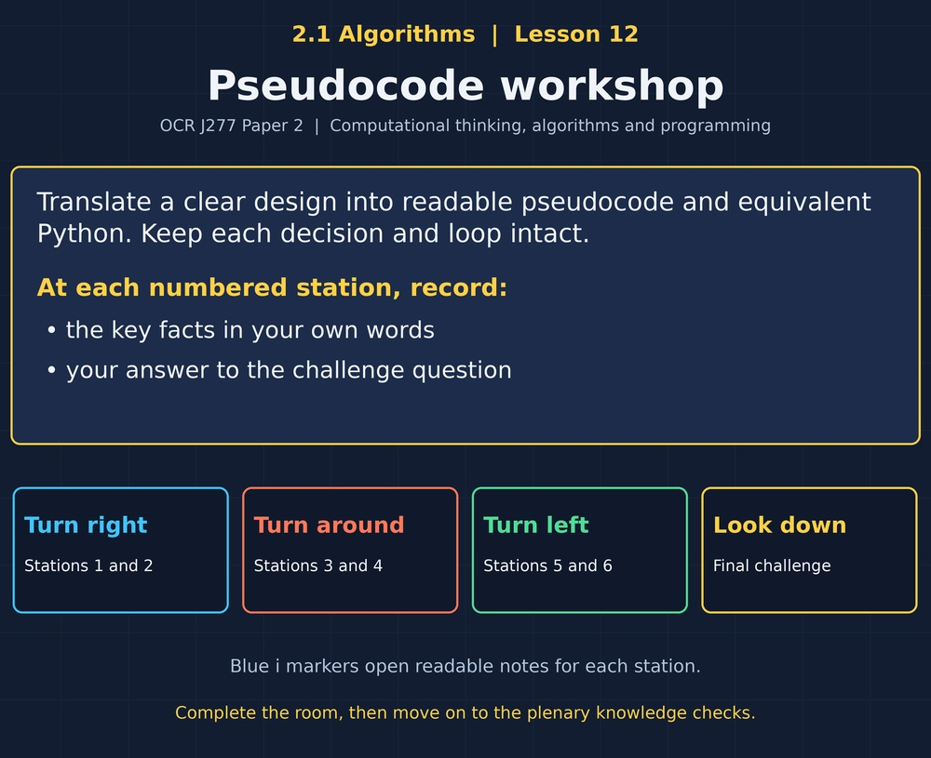

TOPIC 2.1 / LESSON 12
PSEUDOCODE WORKSHOP
Producing algorithms: pseudocode
DO NOW: RESEARCH AND DISCUSS
How can you explain an algorithm without choosing a particular programming language?
1 / 18
Notes:
Topic 2.1 lesson 12: Producing algorithms: pseudocode.
Source sequence: supplied 2.1 - Algorithms(3).pdf, lessons 1–16. Original Revise360 explanations and practice questions.
Curriculum: OCR J277 specification v3.1, sections 2.1.1–2.1.3, https://www.ocr.org.uk/Images/558027-specification-gcse-computer-science-j277.pdf

Slide 2
TOPIC 2.1 / LESSON 12 / WORKSHEET
By the end of this lesson
1.
Write clear pseudocode.
2.
Translate between algorithm representations.
3.
Distinguish assignment and comparison.
2 / 18
Notes:
Topic 2.1 lesson 12: Producing algorithms: pseudocode.
Source sequence: supplied 2.1 - Algorithms(3).pdf, lessons 1–16. Original Revise360 explanations and practice questions.
Curriculum: OCR J277 specification v3.1, sections 2.1.1–2.1.3, https://www.ocr.org.uk/Images/558027-specification-gcse-computer-science-j277.pdf

Slide 3
TOPIC 2.1 / LESSON 12 / WORKSHEET STARTER
Starter: before the experience
What happens after score = 5 followed by score = score + 2?
3 / 18
Notes:
Topic 2.1 lesson 12: Producing algorithms: pseudocode.
Source sequence: supplied 2.1 - Algorithms(3).pdf, lessons 1–16. Original Revise360 explanations and practice questions.
Curriculum: OCR J277 specification v3.1, sections 2.1.1–2.1.3, https://www.ocr.org.uk/Images/558027-specification-gcse-computer-science-j277.pdf

Slide 4
TOPIC 2.1 / LESSON 12 / CHECK
Starter: sample answers
1.
The value of score becomes 7. The second assignment replaces its previous value.
4 / 18
Notes:
Topic 2.1 lesson 12: Producing algorithms: pseudocode.
Source sequence: supplied 2.1 - Algorithms(3).pdf, lessons 1–16. Original Revise360 explanations and practice questions.
Curriculum: OCR J277 specification v3.1, sections 2.1.1–2.1.3, https://www.ocr.org.uk/Images/558027-specification-gcse-computer-science-j277.pdf

Slide 5
TOPIC 2.1 / LESSON 12 / WORKSHEET KEY TERMS
Key terminology quiz
1.
Pseudocode
2.
Assignment
5 / 18
Notes:
Topic 2.1 lesson 12: Producing algorithms: pseudocode.
Source sequence: supplied 2.1 - Algorithms(3).pdf, lessons 1–16. Original Revise360 explanations and practice questions.
Curriculum: OCR J277 specification v3.1, sections 2.1.1–2.1.3, https://www.ocr.org.uk/Images/558027-specification-gcse-computer-science-j277.pdf

Slide 6
TOPIC 2.1 / LESSON 12 / CHECK
Key terminology: answers
Pseudocode
A readable description of algorithm steps using programming-like notation.
Assignment
Storing a value in a variable.
6 / 18
Notes:
Topic 2.1 lesson 12: Producing algorithms: pseudocode.
Source sequence: supplied 2.1 - Algorithms(3).pdf, lessons 1–16. Original Revise360 explanations and practice questions.
Curriculum: OCR J277 specification v3.1, sections 2.1.1–2.1.3, https://www.ocr.org.uk/Images/558027-specification-gcse-computer-science-j277.pdf

Slide 7
TOPIC 2.1 / LESSON 12 / EXPERIENCE
Worksheet + experience
01 OPEN THE EXPERIENCE NOW
Open Pseudocode workshop in Topic 2.1. Keep the worksheet beside you.
02 SIX STATIONS
At each station, write key facts IN YOUR OWN WORDS. Answer its worksheet challenge before tapping the badge.
03 FINAL CHALLENGE
Attempt the worksheet final challenge before tapping the star. Record your score, then use review mode to correct mistakes.
04 PLENARY
Finish the experience in this lesson. Near the end, close it for the plenary knowledge checks.
7 / 18
Notes:
Topic 2.1 lesson 12: Producing algorithms: pseudocode.
Source sequence: supplied 2.1 - Algorithms(3).pdf, lessons 1–16. Original Revise360 explanations and practice questions.
Curriculum: OCR J277 specification v3.1, sections 2.1.1–2.1.3, https://www.ocr.org.uk/Images/558027-specification-gcse-computer-science-j277.pdf
Allow approximately 25–30 minutes for the experience and worksheet. Pupils record facts in their own words.

Slide 8
TOPIC 2.1 / LESSON 12 / CONSOLIDATION
After the experience
Return to the Do Now question. Use two things you learned in the room to improve your original answer.
Link your explanation to the problem and use a worked example where it helps.
8 / 18
Notes:
Topic 2.1 lesson 12: Producing algorithms: pseudocode.
Source sequence: supplied 2.1 - Algorithms(3).pdf, lessons 1–16. Original Revise360 explanations and practice questions.
Curriculum: OCR J277 specification v3.1, sections 2.1.1–2.1.3, https://www.ocr.org.uk/Images/558027-specification-gcse-computer-science-j277.pdf

Slide 9
TOPIC 2.1 / LESSON 12 / CONSOLIDATION
Check and improve
Write the three-number total in Python, run it with 3, 4 and 5, and compare the output with your pseudocode. Expected total: 12.
9 / 18
Notes:
Topic 2.1 lesson 12: Producing algorithms: pseudocode.
Source sequence: supplied 2.1 - Algorithms(3).pdf, lessons 1–16. Original Revise360 explanations and practice questions.
Curriculum: OCR J277 specification v3.1, sections 2.1.1–2.1.3, https://www.ocr.org.uk/Images/558027-specification-gcse-computer-science-j277.pdf

Slide 10
TOPIC 2.1 / LESSON 12 / CHECK
A stronger explanation
Compare your reasoning, then improve one sentence on your worksheet.
Check equivalence
OCR for loops include the end value while Python range excludes the stop value.
Review and explain
Your correction should name the correct idea and explain why it fits the question. Use the experience feedback to check it.
10 / 18
Notes:
Topic 2.1 lesson 12: Producing algorithms: pseudocode.
Source sequence: supplied 2.1 - Algorithms(3).pdf, lessons 1–16. Original Revise360 explanations and practice questions.
Curriculum: OCR J277 specification v3.1, sections 2.1.1–2.1.3, https://www.ocr.org.uk/Images/558027-specification-gcse-computer-science-j277.pdf

Slide 11
TOPIC 2.1 / LESSON 12 / ANSWERS
After the experience: stations 1–3
Check your key facts and challenge responses.
1 Readable instructions
Another person must be able to follow it and obtain the intended result.
2 Assignment or equality
= assigns a value. == compares two values and produces true or false.
3 Write selection
Allowed, because 12 >= 12 is true.
11 / 18
Notes:
Topic 2.1 lesson 12: Producing algorithms: pseudocode.
Source sequence: supplied 2.1 - Algorithms(3).pdf, lessons 1–16. Original Revise360 explanations and practice questions.
Curriculum: OCR J277 specification v3.1, sections 2.1.1–2.1.3, https://www.ocr.org.uk/Images/558027-specification-gcse-computer-science-j277.pdf

Slide 12
TOPIC 2.1 / LESSON 12 / ANSWERS
After the experience: stations 4–6
Check your key facts and challenge responses.
4 Write repetition
The required result is the final total after all three inputs have been added.
5 Translate to Python
Python range(1, 4) includes 1, 2 and 3 but excludes 4.
6 Check equivalence
OCR for loops include the end value while Python range excludes the stop value.
12 / 18
Notes:
Topic 2.1 lesson 12: Producing algorithms: pseudocode.
Source sequence: supplied 2.1 - Algorithms(3).pdf, lessons 1–16. Original Revise360 explanations and practice questions.
Curriculum: OCR J277 specification v3.1, sections 2.1.1–2.1.3, https://www.ocr.org.uk/Images/558027-specification-gcse-computer-science-j277.pdf

Slide 13
TOPIC 2.1 / LESSON 12 / CHECK
Final challenge: answers
Check your choices and the reasons you gave.
1. OCR for i = 2 to 4 prints i. Which Python range matches?
Answer: range(2, 5)
2. Which describes pseudocode?
Answer: A precise readable description that need not execute as a program
13 / 18
Notes:
Topic 2.1 lesson 12: Producing algorithms: pseudocode.
Source sequence: supplied 2.1 - Algorithms(3).pdf, lessons 1–16. Original Revise360 explanations and practice questions.
Curriculum: OCR J277 specification v3.1, sections 2.1.1–2.1.3, https://www.ocr.org.uk/Images/558027-specification-gcse-computer-science-j277.pdf

Slide 14
TOPIC 2.1 / LESSON 12 / PLENARY
Plenary: questions (a–b)
Take the headset off or close the page. Answer from memory on the worksheet.
a)
Write pseudocode to input quantity and unit price and output the total. [3]
b)
Write selection that outputs Free if cost == 0 and Pay otherwise. [3]
14 / 18
Notes:
Topic 2.1 lesson 12: Producing algorithms: pseudocode.
Source sequence: supplied 2.1 - Algorithms(3).pdf, lessons 1–16. Original Revise360 explanations and practice questions.
Curriculum: OCR J277 specification v3.1, sections 2.1.1–2.1.3, https://www.ocr.org.uk/Images/558027-specification-gcse-computer-science-j277.pdf
Close the experience before attempting the questions.

Slide 15
TOPIC 2.1 / LESSON 12 / PLENARY
Plenary: question (c)
Keep the experience closed. Explain your reasoning in full sentences.
c)
Explain the loop-bound difference between OCR for and Python range. [2]
Use the marks in brackets to judge how much detail to include.
15 / 18
Notes:
Topic 2.1 lesson 12: Producing algorithms: pseudocode.
Source sequence: supplied 2.1 - Algorithms(3).pdf, lessons 1–16. Original Revise360 explanations and practice questions.
Curriculum: OCR J277 specification v3.1, sections 2.1.1–2.1.3, https://www.ocr.org.uk/Images/558027-specification-gcse-computer-science-j277.pdf

Slide 16
TOPIC 2.1 / LESSON 12 / CHECK
Plenary: answers (a–b)
Indicative points. Credit accurate answers in students’ own words.
a Read both inputs (1), multiply them (1), output the product (1).
b Correct equality test (1), Free on true path (1), Pay on false path (1).
16 / 18
Notes:
Topic 2.1 lesson 12: Producing algorithms: pseudocode.
Source sequence: supplied 2.1 - Algorithms(3).pdf, lessons 1–16. Original Revise360 explanations and practice questions.
Curriculum: OCR J277 specification v3.1, sections 2.1.1–2.1.3, https://www.ocr.org.uk/Images/558027-specification-gcse-computer-science-j277.pdf

Slide 17
TOPIC 2.1 / LESSON 12 / CHECK
Plenary: answer (c)
Indicative points for the final question.
OCR for includes its end value (1). Python range excludes its stop value (1).
17 / 18
Notes:
Topic 2.1 lesson 12: Producing algorithms: pseudocode.
Source sequence: supplied 2.1 - Algorithms(3).pdf, lessons 1–16. Original Revise360 explanations and practice questions.
Curriculum: OCR J277 specification v3.1, sections 2.1.1–2.1.3, https://www.ocr.org.uk/Images/558027-specification-gcse-computer-science-j277.pdf

Slide 18
TOPIC 2.1 / LESSON 12 / SELF-CHECK
How confident am I?
On the worksheet, select Not yet, Getting there or Confident for each objective.
1.
Write clear pseudocode.
2.
Translate between algorithm representations.
3.
Distinguish assignment and comparison.
18 / 18
Notes:
Topic 2.1 lesson 12: Producing algorithms: pseudocode.
Source sequence: supplied 2.1 - Algorithms(3).pdf, lessons 1–16. Original Revise360 explanations and practice questions.
Curriculum: OCR J277 specification v3.1, sections 2.1.1–2.1.3, https://www.ocr.org.uk/Images/558027-specification-gcse-computer-science-j277.pdf

