Slide 1
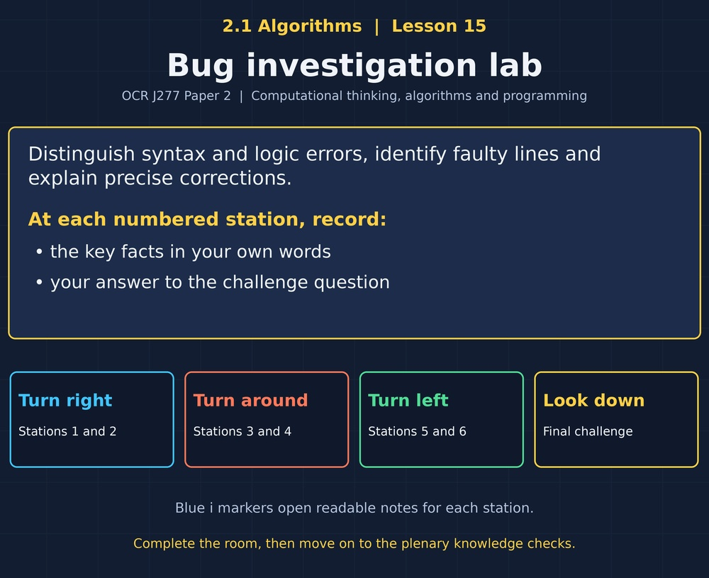

TOPIC 2.1 / LESSON 15
BUG INVESTIGATION LAB
Identifying common errors and fixes
DO NOW: RESEARCH AND DISCUSS
Why does a program running without an error message not prove it is correct?
1 / 18
Notes:
Topic 2.1 lesson 15: Identifying common errors and fixes.
Source sequence: supplied 2.1 - Algorithms(3).pdf, lessons 1–16. Original Revise360 explanations and practice questions.
Curriculum: OCR J277 specification v3.1, sections 2.1.1–2.1.3, https://www.ocr.org.uk/Images/558027-specification-gcse-computer-science-j277.pdf

Slide 2
TOPIC 2.1 / LESSON 15 / WORKSHEET
By the end of this lesson
1.
Distinguish syntax and logic errors.
2.
Locate and correct faulty code.
3.
Use test evidence to verify a fix.
2 / 18
Notes:
Topic 2.1 lesson 15: Identifying common errors and fixes.
Source sequence: supplied 2.1 - Algorithms(3).pdf, lessons 1–16. Original Revise360 explanations and practice questions.
Curriculum: OCR J277 specification v3.1, sections 2.1.1–2.1.3, https://www.ocr.org.uk/Images/558027-specification-gcse-computer-science-j277.pdf

Slide 3
TOPIC 2.1 / LESSON 15 / WORKSHEET STARTER
Starter: before the experience
Python print("Ready" is missing a closing bracket. Is the problem a syntax rule or a wrong calculation?
3 / 18
Notes:
Topic 2.1 lesson 15: Identifying common errors and fixes.
Source sequence: supplied 2.1 - Algorithms(3).pdf, lessons 1–16. Original Revise360 explanations and practice questions.
Curriculum: OCR J277 specification v3.1, sections 2.1.1–2.1.3, https://www.ocr.org.uk/Images/558027-specification-gcse-computer-science-j277.pdf

Slide 4
TOPIC 2.1 / LESSON 15 / CHECK
Starter: sample answers
1.
It breaks Python syntax because the opening parenthesis is not closed.
4 / 18
Notes:
Topic 2.1 lesson 15: Identifying common errors and fixes.
Source sequence: supplied 2.1 - Algorithms(3).pdf, lessons 1–16. Original Revise360 explanations and practice questions.
Curriculum: OCR J277 specification v3.1, sections 2.1.1–2.1.3, https://www.ocr.org.uk/Images/558027-specification-gcse-computer-science-j277.pdf

Slide 5
TOPIC 2.1 / LESSON 15 / WORKSHEET KEY TERMS
Key terminology quiz
1.
Syntax error
2.
Logic error
5 / 18
Notes:
Topic 2.1 lesson 15: Identifying common errors and fixes.
Source sequence: supplied 2.1 - Algorithms(3).pdf, lessons 1–16. Original Revise360 explanations and practice questions.
Curriculum: OCR J277 specification v3.1, sections 2.1.1–2.1.3, https://www.ocr.org.uk/Images/558027-specification-gcse-computer-science-j277.pdf

Slide 6
TOPIC 2.1 / LESSON 15 / CHECK
Key terminology: answers
Syntax error
Code that breaks the grammatical rules of the language.
Logic error
Validly structured code whose behaviour does not meet the intended requirement.
6 / 18
Notes:
Topic 2.1 lesson 15: Identifying common errors and fixes.
Source sequence: supplied 2.1 - Algorithms(3).pdf, lessons 1–16. Original Revise360 explanations and practice questions.
Curriculum: OCR J277 specification v3.1, sections 2.1.1–2.1.3, https://www.ocr.org.uk/Images/558027-specification-gcse-computer-science-j277.pdf

Slide 7
TOPIC 2.1 / LESSON 15 / EXPERIENCE
Worksheet + experience
01 OPEN THE EXPERIENCE NOW
Open Bug investigation lab in Topic 2.1. Keep the worksheet beside you.
02 SIX STATIONS
At each station, write key facts IN YOUR OWN WORDS. Answer its worksheet challenge before tapping the badge.
03 FINAL CHALLENGE
Attempt the worksheet final challenge before tapping the star. Record your score, then use review mode to correct mistakes.
04 PLENARY
Finish the experience in this lesson. Near the end, close it for the plenary knowledge checks.
7 / 18
Notes:
Topic 2.1 lesson 15: Identifying common errors and fixes.
Source sequence: supplied 2.1 - Algorithms(3).pdf, lessons 1–16. Original Revise360 explanations and practice questions.
Curriculum: OCR J277 specification v3.1, sections 2.1.1–2.1.3, https://www.ocr.org.uk/Images/558027-specification-gcse-computer-science-j277.pdf
Allow approximately 25–30 minutes for the experience and worksheet. Pupils record facts in their own words.

Slide 8
TOPIC 2.1 / LESSON 15 / CONSOLIDATION
After the experience
Return to the Do Now question. Use two things you learned in the room to improve your original answer.
Link your explanation to the problem and use a worked example where it helps.
8 / 18
Notes:
Topic 2.1 lesson 15: Identifying common errors and fixes.
Source sequence: supplied 2.1 - Algorithms(3).pdf, lessons 1–16. Original Revise360 explanations and practice questions.
Curriculum: OCR J277 specification v3.1, sections 2.1.1–2.1.3, https://www.ocr.org.uk/Images/558027-specification-gcse-computer-science-j277.pdf

Slide 9
TOPIC 2.1 / LESSON 15 / CONSOLIDATION
Check and improve
In Python, test the faulty and corrected average with 6 and 10, then 4 and 4. Expected corrected outputs are 8 and 4.
9 / 18
Notes:
Topic 2.1 lesson 15: Identifying common errors and fixes.
Source sequence: supplied 2.1 - Algorithms(3).pdf, lessons 1–16. Original Revise360 explanations and practice questions.
Curriculum: OCR J277 specification v3.1, sections 2.1.1–2.1.3, https://www.ocr.org.uk/Images/558027-specification-gcse-computer-science-j277.pdf

Slide 10
TOPIC 2.1 / LESSON 15 / CHECK
A stronger explanation
Compare your reasoning, then improve one sentence on your worksheet.
Verify with evidence
It verifies that the correction has not started accepting values below the threshold.
Review and explain
Your correction should name the correct idea and explain why it fits the question. Use the experience feedback to check it.
10 / 18
Notes:
Topic 2.1 lesson 15: Identifying common errors and fixes.
Source sequence: supplied 2.1 - Algorithms(3).pdf, lessons 1–16. Original Revise360 explanations and practice questions.
Curriculum: OCR J277 specification v3.1, sections 2.1.1–2.1.3, https://www.ocr.org.uk/Images/558027-specification-gcse-computer-science-j277.pdf

Slide 11
TOPIC 2.1 / LESSON 15 / ANSWERS
After the experience: stations 1–3
Check your key facts and challenge responses.
1 Syntax rules
Add the closing parenthesis after the closing quote.
2 Logic can be wrong
11, because division happens before addition. The correct average is 8.
3 Off-by-one errors
A four-item zero-indexed list ends at index 3.
11 / 18
Notes:
Topic 2.1 lesson 15: Identifying common errors and fixes.
Source sequence: supplied 2.1 - Algorithms(3).pdf, lessons 1–16. Original Revise360 explanations and practice questions.
Curriculum: OCR J277 specification v3.1, sections 2.1.1–2.1.3, https://www.ocr.org.uk/Images/558027-specification-gcse-computer-science-j277.pdf

Slide 12
TOPIC 2.1 / LESSON 15 / ANSWERS
After the experience: stations 4–6
Check your key facts and challenge responses.
4 Faulty initialisation
Before the loop, so earlier additions remain in the total.
5 Trace the faulty line
Use if age >= 12 then. Equality must be included.
6 Verify with evidence
It verifies that the correction has not started accepting values below the threshold.
12 / 18
Notes:
Topic 2.1 lesson 15: Identifying common errors and fixes.
Source sequence: supplied 2.1 - Algorithms(3).pdf, lessons 1–16. Original Revise360 explanations and practice questions.
Curriculum: OCR J277 specification v3.1, sections 2.1.1–2.1.3, https://www.ocr.org.uk/Images/558027-specification-gcse-computer-science-j277.pdf

Slide 13
TOPIC 2.1 / LESSON 15 / CHECK
Final challenge: answers
Check your choices and the reasons you gave.
1. Classify the errors.
Answer: Python if x > 0 with no colon: Syntax; Average calculated as a + b / 2: Logic; Missing closing quote: Syntax; Discount applied below the wrong threshold: Logic
Syntax breaks language rules. Logic breaks the intended solution.
2. The corrected average works for 6 and 10. What should you conclude?
Answer: That test passes, but other suitable tests are still useful
13 / 18
Notes:
Topic 2.1 lesson 15: Identifying common errors and fixes.
Source sequence: supplied 2.1 - Algorithms(3).pdf, lessons 1–16. Original Revise360 explanations and practice questions.
Curriculum: OCR J277 specification v3.1, sections 2.1.1–2.1.3, https://www.ocr.org.uk/Images/558027-specification-gcse-computer-science-j277.pdf

Slide 14
TOPIC 2.1 / LESSON 15 / PLENARY
Plenary: questions (a–b)
Take the headset off or close the page. Answer from memory on the worksheet.
a)
State the difference between syntax and logic errors. [2]
b)
Correct average = a + b / 2 and explain why the change is needed. [3]
14 / 18
Notes:
Topic 2.1 lesson 15: Identifying common errors and fixes.
Source sequence: supplied 2.1 - Algorithms(3).pdf, lessons 1–16. Original Revise360 explanations and practice questions.
Curriculum: OCR J277 specification v3.1, sections 2.1.1–2.1.3, https://www.ocr.org.uk/Images/558027-specification-gcse-computer-science-j277.pdf
Close the experience before attempting the questions.

Slide 15
TOPIC 2.1 / LESSON 15 / PLENARY
Plenary: question (c)
Keep the experience closed. Explain your reasoning in full sentences.
c)
A four-item Python list is accessed with range(5). Explain and correct the issue. [2]
Use the marks in brackets to judge how much detail to include.
15 / 18
Notes:
Topic 2.1 lesson 15: Identifying common errors and fixes.
Source sequence: supplied 2.1 - Algorithms(3).pdf, lessons 1–16. Original Revise360 explanations and practice questions.
Curriculum: OCR J277 specification v3.1, sections 2.1.1–2.1.3, https://www.ocr.org.uk/Images/558027-specification-gcse-computer-science-j277.pdf

Slide 16
TOPIC 2.1 / LESSON 15 / CHECK
Plenary: answers (a–b)
Indicative points. Credit accurate answers in students’ own words.
a Syntax breaks language grammar (1). Logic gives unintended behaviour even when the code is syntactically valid (1).
b Use (a + b) / 2 (1). Division otherwise happens first (1). Parentheses add the values before halving (1).
16 / 18
Notes:
Topic 2.1 lesson 15: Identifying common errors and fixes.
Source sequence: supplied 2.1 - Algorithms(3).pdf, lessons 1–16. Original Revise360 explanations and practice questions.
Curriculum: OCR J277 specification v3.1, sections 2.1.1–2.1.3, https://www.ocr.org.uk/Images/558027-specification-gcse-computer-science-j277.pdf

Slide 17
TOPIC 2.1 / LESSON 15 / CHECK
Plenary: answer (c)
Indicative points for the final question.
It includes invalid index 4 (1). Use range(4) to visit indices 0 to 3 (1).
17 / 18
Notes:
Topic 2.1 lesson 15: Identifying common errors and fixes.
Source sequence: supplied 2.1 - Algorithms(3).pdf, lessons 1–16. Original Revise360 explanations and practice questions.
Curriculum: OCR J277 specification v3.1, sections 2.1.1–2.1.3, https://www.ocr.org.uk/Images/558027-specification-gcse-computer-science-j277.pdf

Slide 18
TOPIC 2.1 / LESSON 15 / SELF-CHECK
How confident am I?
On the worksheet, select Not yet, Getting there or Confident for each objective.
1.
Distinguish syntax and logic errors.
2.
Locate and correct faulty code.
3.
Use test evidence to verify a fix.
18 / 18
Notes:
Topic 2.1 lesson 15: Identifying common errors and fixes.
Source sequence: supplied 2.1 - Algorithms(3).pdf, lessons 1–16. Original Revise360 explanations and practice questions.
Curriculum: OCR J277 specification v3.1, sections 2.1.1–2.1.3, https://www.ocr.org.uk/Images/558027-specification-gcse-computer-science-j277.pdf

