Slide 1
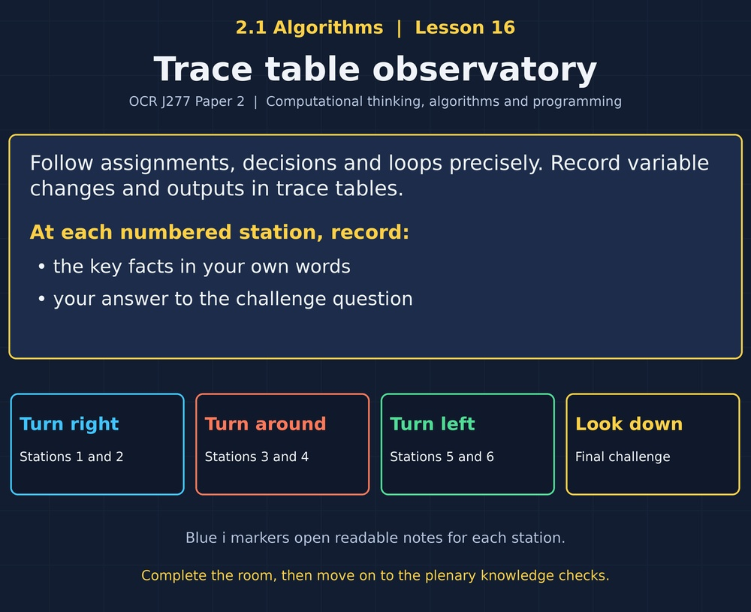

TOPIC 2.1 / LESSON 17 / ASSESSMENT
ALGORITHMS ASSESSMENT
Topic 2.1 review and reflection
PREPARE TO WORK INDEPENDENTLY
Close the experience and notes. Have the assessment worksheet ready.
1 / 18
Notes:
Original Revise360 Topic 2.1 assessment. Keep slide 3 displayed during the 45-minute closed-book assessment. Show feedback slides only after scripts are collected or the assessment has finished. Use the separate mark scheme for marking detail. OCR J277 specification 2.1.1–2.1.3.

Slide 2
TOPIC 2.1 / LESSON 17 / ASSESSMENT
What this assessment checks
1.
Explain computational thinking and structure diagrams.
2.
Trace searching and sorting algorithms.
3.
Create, correct and trace algorithms.
2 / 18
Notes:
Original Revise360 Topic 2.1 assessment. Keep slide 3 displayed during the 45-minute closed-book assessment. Show feedback slides only after scripts are collected or the assessment has finished. Use the separate mark scheme for marking detail. OCR J277 specification 2.1.1–2.1.3.

Slide 3
TOPIC 2.1 / LESSON 17 / ASSESSMENT
Assessment: 40 marks
You have 45 minutes. Answer every question on the worksheet. Show the steps for searches and sorts. Read the marks and check your answers.
Keep this slide displayed until the assessment is finished.
3 / 18
Notes:
Original Revise360 Topic 2.1 assessment. Keep slide 3 displayed during the 45-minute closed-book assessment. Show feedback slides only after scripts are collected or the assessment has finished. Use the separate mark scheme for marking detail. OCR J277 specification 2.1.1–2.1.3.

Slide 4
TOPIC 2.1 / LESSON 17 / ASSESSMENT
Feedback after the assessment
1.
Check your answers against the following slides. Award marks for the required points. Record your total out of 40 and choose one target for improvement.
4 / 18
Notes:
Original Revise360 Topic 2.1 assessment. Keep slide 3 displayed during the 45-minute closed-book assessment. Show feedback slides only after scripts are collected or the assessment has finished. Use the separate mark scheme for marking detail. OCR J277 specification 2.1.1–2.1.3.

Slide 5
TOPIC 2.1 / LESSON 17 / ASSESSMENT
Question 1: computational thinking
a)
What does abstraction mean?
b–c)
Which loan details matter, and how does decomposition help?
5 / 18
Notes:
Original Revise360 Topic 2.1 assessment. Keep slide 3 displayed during the 45-minute closed-book assessment. Show feedback slides only after scripts are collected or the assessment has finished. Use the separate mark scheme for marking detail. OCR J277 specification 2.1.1–2.1.3.

Slide 6
TOPIC 2.1 / LESSON 17 / ASSESSMENT
Question 1: answers [6]
Abstraction and relevant details [4]
Keep relevant details and remove unnecessary detail for a purpose. Retain borrower ID or due date. Ignore a favourite film.
Decomposition [2]
Split the system into smaller sub-problems. This makes each part easier to understand, develop or test.
6 / 18
Notes:
Original Revise360 Topic 2.1 assessment. Keep slide 3 displayed during the 45-minute closed-book assessment. Show feedback slides only after scripts are collected or the assessment has finished. Use the separate mark scheme for marking detail. OCR J277 specification 2.1.1–2.1.3.

Slide 7
TOPIC 2.1 / LESSON 17 / ASSESSMENT
Question 2: structure diagram [4]
01 WHOLE SYSTEM
Place Equipment-loan system at the top.
02 MAIN PARTS
Connect Members, Loans and Returns beneath it.
03 REFINE LOANS
Under Loans, add Check availability and Record loan.
04 CHECK THE CONNECTIONS
Children are parts of their parent. A structure diagram does not show execution order.
7 / 18
Notes:
Original Revise360 Topic 2.1 assessment. Keep slide 3 displayed during the 45-minute closed-book assessment. Show feedback slides only after scripts are collected or the assessment has finished. Use the separate mark scheme for marking detail. OCR J277 specification 2.1.1–2.1.3.

Slide 8
TOPIC 2.1 / LESSON 17 / ASSESSMENT
Question 3: searching
List: [2, 4, 6, 8, 10, 12, 14]
Target: 12
Compare the values checked by linear and binary search.
Use zero-based indices and round binary-search midpoints down.
8 / 18
Notes:
Original Revise360 Topic 2.1 assessment. Keep slide 3 displayed during the 45-minute closed-book assessment. Show feedback slides only after scripts are collected or the assessment has finished. Use the separate mark scheme for marking detail. OCR J277 specification 2.1.1–2.1.3.

Slide 9
TOPIC 2.1 / LESSON 17 / ASSESSMENT
Question 3: answers [6]
Linear search checks 2, 4, 6, 8, 10, 12. Six target comparisons. [2]
Binary search first checks 8 at index 3. Keep indices 4–6. Then check 12 at index 5 and stop. [3]
Binary search requires sorted data. [1]
9 / 18
Notes:
Original Revise360 Topic 2.1 assessment. Keep slide 3 displayed during the 45-minute closed-book assessment. Show feedback slides only after scripts are collected or the assessment has finished. Use the separate mark scheme for marking detail. OCR J277 specification 2.1.1–2.1.3.

Slide 10
TOPIC 2.1 / LESSON 17 / ASSESSMENT
Question 4a: bubble sort [4]
First full left-to-right pass on [6, 2, 5, 1].
Record each swap [3]
[2, 6, 5, 1]
[2, 5, 6, 1]
[2, 5, 1, 6]
Final position [1]
6 is in its final position at the right-hand end. The other values are not yet fully sorted.
10 / 18
Notes:
Original Revise360 Topic 2.1 assessment. Keep slide 3 displayed during the 45-minute closed-book assessment. Show feedback slides only after scripts are collected or the assessment has finished. Use the separate mark scheme for marking detail. OCR J277 specification 2.1.1–2.1.3.

Slide 11
TOPIC 2.1 / LESSON 17 / ASSESSMENT
Questions 4b–c: merge and insertion
Do not mix up the methods.
Merge [2, 8] and [3, 7] [2]
Compare 2 with 3 and take 2. Then compare 8 with 3 and take 3.
Complete the merge [1]
The final list is [2, 3, 7, 8].
Insertion sort [5, 2, 4, 1] [3]
After each key: [2,5,4,1], then [2,4,5,1], then [1,2,4,5].
11 / 18
Notes:
Original Revise360 Topic 2.1 assessment. Keep slide 3 displayed during the 45-minute closed-book assessment. Show feedback slides only after scripts are collected or the assessment has finished. Use the separate mark scheme for marking detail. OCR J277 specification 2.1.1–2.1.3.

Slide 12
TOPIC 2.1 / LESSON 17 / ASSESSMENT
Question 5: flowchart [5]
Check symbols, conditions, labels and connected paths.
Input and decision [2]
Input age in a parallelogram. Test age >= 12 in a diamond.
Branches and outputs [2]
Label True and False. Output Allowed on True and Too young on False, using input/output symbols.
Complete paths [1]
Use start and end terminals, connected by sensible flow lines.
12 / 18
Notes:
Original Revise360 Topic 2.1 assessment. Keep slide 3 displayed during the 45-minute closed-book assessment. Show feedback slides only after scripts are collected or the assessment has finished. Use the separate mark scheme for marking detail. OCR J277 specification 2.1.1–2.1.3.

Slide 13
TOPIC 2.1 / LESSON 17 / ASSESSMENT
Question 6: debugging [3]
The intended result is the average of a and b.
This is a logic error. [1]
Correct expression: average = (a + b) / 2. [1]
Parentheses ensure the values are added before division by 2. [1]
13 / 18
Notes:
Original Revise360 Topic 2.1 assessment. Keep slide 3 displayed during the 45-minute closed-book assessment. Show feedback slides only after scripts are collected or the assessment has finished. Use the separate mark scheme for marking detail. OCR J277 specification 2.1.1–2.1.3.

Slide 14
TOPIC 2.1 / LESSON 17 / ASSESSMENT
Question 7: trace table
The loop adds i for i = 1 to 4, starting from total = 0.
a)
Record the initial total and the total after every iteration.
b)
Record the value output after the loop.
14 / 18
Notes:
Original Revise360 Topic 2.1 assessment. Keep slide 3 displayed during the 45-minute closed-book assessment. Show feedback slides only after scripts are collected or the assessment has finished. Use the separate mark scheme for marking detail. OCR J277 specification 2.1.1–2.1.3.

Slide 15
TOPIC 2.1 / LESSON 17 / ASSESSMENT
Question 7: answer [6]
Keep variable changes separate from output events.
Initial total: 0
After i = 1: total = 1
After i = 2: total = 3
After i = 3: total = 6
After i = 4: total = 10
Output after the loop: 10
One mark for each correct entry.
15 / 18
Notes:
Original Revise360 Topic 2.1 assessment. Keep slide 3 displayed during the 45-minute closed-book assessment. Show feedback slides only after scripts are collected or the assessment has finished. Use the separate mark scheme for marking detail. OCR J277 specification 2.1.1–2.1.3.

Slide 16
TOPIC 2.1 / LESSON 17 / ASSESSMENT
Find your next step
Use your question scores to choose a useful revision lesson.
Questions 1–2: revisit lessons 1–3.
Questions 3–4: revisit lessons 7–10.
Question 5: revisit lesson 11.
Question 6: revisit lesson 15.
Question 7: revisit lesson 16.
16 / 18
Notes:
Original Revise360 Topic 2.1 assessment. Keep slide 3 displayed during the 45-minute closed-book assessment. Show feedback slides only after scripts are collected or the assessment has finished. Use the separate mark scheme for marking detail. OCR J277 specification 2.1.1–2.1.3.

Slide 17
TOPIC 2.1 / LESSON 17 / ASSESSMENT
Make a correction
Complete the reflection section of the worksheet.
1.
Choose one missed question and write a corrected answer.
2.
Explain what caused the error and how you will avoid it next time.
17 / 18
Notes:
Original Revise360 Topic 2.1 assessment. Keep slide 3 displayed during the 45-minute closed-book assessment. Show feedback slides only after scripts are collected or the assessment has finished. Use the separate mark scheme for marking detail. OCR J277 specification 2.1.1–2.1.3.

Slide 18
TOPIC 2.1 / LESSON 17 / ASSESSMENT
Check your understanding
Use the relevant experience in review mode after the assessment.
1.
Explain the corrected idea in your own words.
2.
Try a new example without looking at the answer.
3.
Record whether you need more practice or feel confident.
18 / 18
Notes:
Original Revise360 Topic 2.1 assessment. Keep slide 3 displayed during the 45-minute closed-book assessment. Show feedback slides only after scripts are collected or the assessment has finished. Use the separate mark scheme for marking detail. OCR J277 specification 2.1.1–2.1.3.

