Slide 1
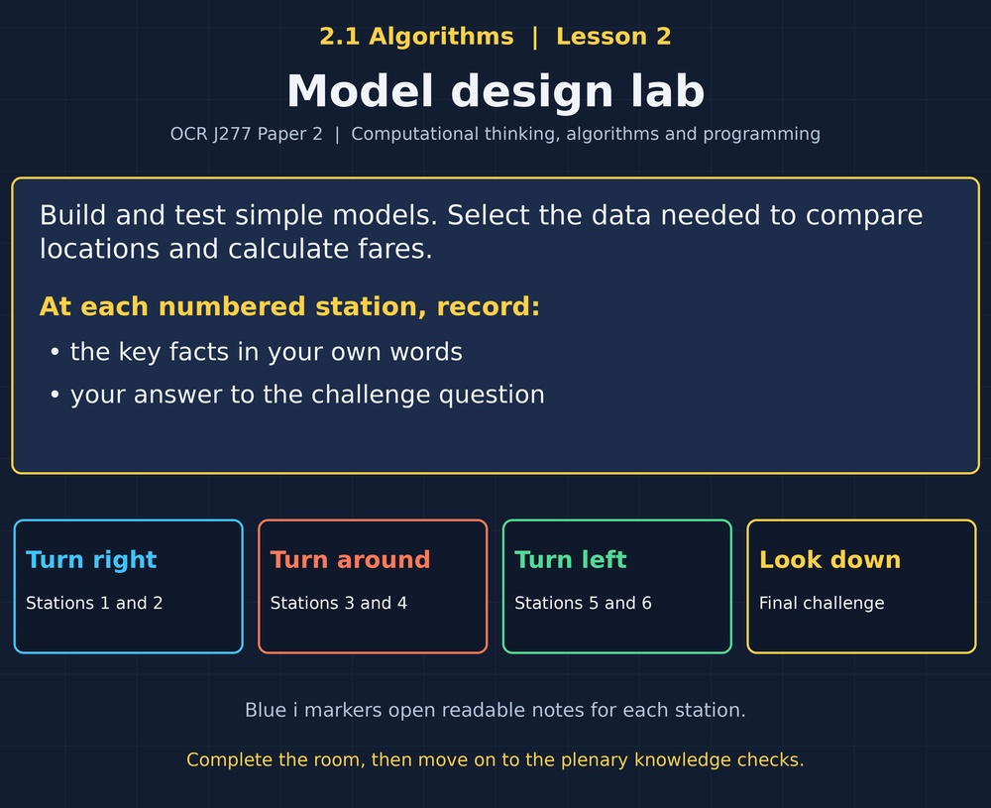

TOPIC 2.1 / LESSON 02
MODEL DESIGN LAB
Applying abstraction
DO NOW: RESEARCH AND DISCUSS
Can a simplified model give a correct answer?
1 / 18
Notes:
Topic 2.1 lesson 2: Applying abstraction.
Source sequence: supplied 2.1 - Algorithms(3).pdf, lessons 1–16. Original Revise360 explanations and practice questions.
Curriculum: OCR J277 specification v3.1, sections 2.1.1–2.1.3, https://www.ocr.org.uk/Images/558027-specification-gcse-computer-science-j277.pdf

Slide 2
TOPIC 2.1 / LESSON 02 / WORKSHEET
By the end of this lesson
1.
Apply abstraction to a new problem.
2.
Identify inputs, processing and outputs.
3.
Refine a model when requirements change.
2 / 18
Notes:
Topic 2.1 lesson 2: Applying abstraction.
Source sequence: supplied 2.1 - Algorithms(3).pdf, lessons 1–16. Original Revise360 explanations and practice questions.
Curriculum: OCR J277 specification v3.1, sections 2.1.1–2.1.3, https://www.ocr.org.uk/Images/558027-specification-gcse-computer-science-j277.pdf

Slide 3
TOPIC 2.1 / LESSON 02 / WORKSHEET STARTER
Starter: before the experience
A program compares two places north or south. Does it need latitude, shop names or building colours?
3 / 18
Notes:
Topic 2.1 lesson 2: Applying abstraction.
Source sequence: supplied 2.1 - Algorithms(3).pdf, lessons 1–16. Original Revise360 explanations and practice questions.
Curriculum: OCR J277 specification v3.1, sections 2.1.1–2.1.3, https://www.ocr.org.uk/Images/558027-specification-gcse-computer-science-j277.pdf

Slide 4
TOPIC 2.1 / LESSON 02 / CHECK
Starter: sample answers
1.
Latitude is relevant to north/south position. Shop names and building colours are not.
4 / 18
Notes:
Topic 2.1 lesson 2: Applying abstraction.
Source sequence: supplied 2.1 - Algorithms(3).pdf, lessons 1–16. Original Revise360 explanations and practice questions.
Curriculum: OCR J277 specification v3.1, sections 2.1.1–2.1.3, https://www.ocr.org.uk/Images/558027-specification-gcse-computer-science-j277.pdf

Slide 5
TOPIC 2.1 / LESSON 02 / WORKSHEET KEY TERMS
Key terminology quiz
1.
Input
2.
Output
5 / 18
Notes:
Topic 2.1 lesson 2: Applying abstraction.
Source sequence: supplied 2.1 - Algorithms(3).pdf, lessons 1–16. Original Revise360 explanations and practice questions.
Curriculum: OCR J277 specification v3.1, sections 2.1.1–2.1.3, https://www.ocr.org.uk/Images/558027-specification-gcse-computer-science-j277.pdf

Slide 6
TOPIC 2.1 / LESSON 02 / CHECK
Key terminology: answers
Input
Data supplied to an algorithm.
Output
Information produced by an algorithm.
6 / 18
Notes:
Topic 2.1 lesson 2: Applying abstraction.
Source sequence: supplied 2.1 - Algorithms(3).pdf, lessons 1–16. Original Revise360 explanations and practice questions.
Curriculum: OCR J277 specification v3.1, sections 2.1.1–2.1.3, https://www.ocr.org.uk/Images/558027-specification-gcse-computer-science-j277.pdf

Slide 7
TOPIC 2.1 / LESSON 02 / EXPERIENCE
Worksheet + experience
01 OPEN THE EXPERIENCE NOW
Open Model design lab in Topic 2.1. Keep the worksheet beside you.
02 SIX STATIONS
At each station, write key facts IN YOUR OWN WORDS. Answer its worksheet challenge before tapping the badge.
03 FINAL CHALLENGE
Attempt the worksheet final challenge before tapping the star. Record your score, then use review mode to correct mistakes.
04 PLENARY
Finish the experience in this lesson. Near the end, close it for the plenary knowledge checks.
7 / 18
Notes:
Topic 2.1 lesson 2: Applying abstraction.
Source sequence: supplied 2.1 - Algorithms(3).pdf, lessons 1–16. Original Revise360 explanations and practice questions.
Curriculum: OCR J277 specification v3.1, sections 2.1.1–2.1.3, https://www.ocr.org.uk/Images/558027-specification-gcse-computer-science-j277.pdf
Allow approximately 25–30 minutes for the experience and worksheet. Pupils record facts in their own words.

Slide 8
TOPIC 2.1 / LESSON 02 / CONSOLIDATION
After the experience
Return to the Do Now question. Use two things you learned in the room to improve your original answer.
Link your explanation to the problem and use a worked example where it helps.
8 / 18
Notes:
Topic 2.1 lesson 2: Applying abstraction.
Source sequence: supplied 2.1 - Algorithms(3).pdf, lessons 1–16. Original Revise360 explanations and practice questions.
Curriculum: OCR J277 specification v3.1, sections 2.1.1–2.1.3, https://www.ocr.org.uk/Images/558027-specification-gcse-computer-science-j277.pdf

Slide 9
TOPIC 2.1 / LESSON 02 / CONSOLIDATION
Check and improve
Use review mode to correct any mistakes. Write one correction and explain why the right answer fits. Then complete the plenary from memory.
9 / 18
Notes:
Topic 2.1 lesson 2: Applying abstraction.
Source sequence: supplied 2.1 - Algorithms(3).pdf, lessons 1–16. Original Revise360 explanations and practice questions.
Curriculum: OCR J277 specification v3.1, sections 2.1.1–2.1.3, https://www.ocr.org.uk/Images/558027-specification-gcse-computer-science-j277.pdf

Slide 10
TOPIC 2.1 / LESSON 02 / CHECK
A stronger explanation
Compare your reasoning, then improve one sentence on your worksheet.
Test the simplified model
They check equality and signed-number comparisons that positive unequal examples may miss.
Review and explain
Your correction should name the correct idea and explain why it fits the question. Use the experience feedback to check it.
10 / 18
Notes:
Topic 2.1 lesson 2: Applying abstraction.
Source sequence: supplied 2.1 - Algorithms(3).pdf, lessons 1–16. Original Revise360 explanations and practice questions.
Curriculum: OCR J277 specification v3.1, sections 2.1.1–2.1.3, https://www.ocr.org.uk/Images/558027-specification-gcse-computer-science-j277.pdf

Slide 11
TOPIC 2.1 / LESSON 02 / ANSWERS
After the experience: stations 1–3
Check your key facts and challenge responses.
1 Define the question
The required answer determines which data the model needs.
2 Signed coordinates
-8 is larger than -21, so it is further north.
3 Equality matters
Without it, equal latitudes could be incorrectly labelled north or south.
11 / 18
Notes:
Topic 2.1 lesson 2: Applying abstraction.
Source sequence: supplied 2.1 - Algorithms(3).pdf, lessons 1–16. Original Revise360 explanations and practice questions.
Curriculum: OCR J277 specification v3.1, sections 2.1.1–2.1.3, https://www.ocr.org.uk/Images/558027-specification-gcse-computer-science-j277.pdf

Slide 12
TOPIC 2.1 / LESSON 02 / ANSWERS
After the experience: stations 4–6
Check your key facts and challenge responses.
4 Inputs and processing
It is a process because it transforms the input into the fare.
5 Change the requirement
Longitude supports comparing east/west positions within a stated coordinate convention.
6 Test the simplified model
They check equality and signed-number comparisons that positive unequal examples may miss.
12 / 18
Notes:
Topic 2.1 lesson 2: Applying abstraction.
Source sequence: supplied 2.1 - Algorithms(3).pdf, lessons 1–16. Original Revise360 explanations and practice questions.
Curriculum: OCR J277 specification v3.1, sections 2.1.1–2.1.3, https://www.ocr.org.uk/Images/558027-specification-gcse-computer-science-j277.pdf

Slide 13
TOPIC 2.1 / LESSON 02 / CHECK
Final challenge: answers
Check your choices and the reasons you gave.
1. A fare is distance * 2. Distance is 7. What is output?
Answer: 14
2. Match each improvement to its purpose.
Answer: Add an equality branch: Handle equal values; Remove wall colours: Reduce irrelevant detail; Add age: Apply an age discount
Only add detail that supports the requirement.
13 / 18
Notes:
Topic 2.1 lesson 2: Applying abstraction.
Source sequence: supplied 2.1 - Algorithms(3).pdf, lessons 1–16. Original Revise360 explanations and practice questions.
Curriculum: OCR J277 specification v3.1, sections 2.1.1–2.1.3, https://www.ocr.org.uk/Images/558027-specification-gcse-computer-science-j277.pdf

Slide 14
TOPIC 2.1 / LESSON 02 / PLENARY
Plenary: questions (a–b)
Take the headset off or close the page. Answer from memory on the worksheet.
a)
Identify input, process and output for a fare calculated as distance multiplied by 2. [3]
b)
Explain why comparing only positive latitudes is insufficient testing. [2]
14 / 18
Notes:
Topic 2.1 lesson 2: Applying abstraction.
Source sequence: supplied 2.1 - Algorithms(3).pdf, lessons 1–16. Original Revise360 explanations and practice questions.
Curriculum: OCR J277 specification v3.1, sections 2.1.1–2.1.3, https://www.ocr.org.uk/Images/558027-specification-gcse-computer-science-j277.pdf
Close the experience before attempting the questions.

Slide 15
TOPIC 2.1 / LESSON 02 / PLENARY
Plenary: question (c)
Keep the experience closed. Explain your reasoning in full sentences.
c)
A model compares only north/south locations. Explain a refinement needed for equal latitudes. [2]
Use the marks in brackets to judge how much detail to include.
15 / 18
Notes:
Topic 2.1 lesson 2: Applying abstraction.
Source sequence: supplied 2.1 - Algorithms(3).pdf, lessons 1–16. Original Revise360 explanations and practice questions.
Curriculum: OCR J277 specification v3.1, sections 2.1.1–2.1.3, https://www.ocr.org.uk/Images/558027-specification-gcse-computer-science-j277.pdf

Slide 16
TOPIC 2.1 / LESSON 02 / CHECK
Plenary: answers (a–b)
Indicative points. Credit accurate answers in students’ own words.
a Distance (1), multiply by 2 (1), fare (1).
b It misses negative values (1), where incorrect use of absolute values could reverse the result (1).
16 / 18
Notes:
Topic 2.1 lesson 2: Applying abstraction.
Source sequence: supplied 2.1 - Algorithms(3).pdf, lessons 1–16. Original Revise360 explanations and practice questions.
Curriculum: OCR J277 specification v3.1, sections 2.1.1–2.1.3, https://www.ocr.org.uk/Images/558027-specification-gcse-computer-science-j277.pdf

Slide 17
TOPIC 2.1 / LESSON 02 / CHECK
Plenary: answer (c)
Indicative points for the final question.
Add a test for equality (1) and output a same-latitude result (1).
17 / 18
Notes:
Topic 2.1 lesson 2: Applying abstraction.
Source sequence: supplied 2.1 - Algorithms(3).pdf, lessons 1–16. Original Revise360 explanations and practice questions.
Curriculum: OCR J277 specification v3.1, sections 2.1.1–2.1.3, https://www.ocr.org.uk/Images/558027-specification-gcse-computer-science-j277.pdf

Slide 18
TOPIC 2.1 / LESSON 02 / SELF-CHECK
How confident am I?
On the worksheet, select Not yet, Getting there or Confident for each objective.
1.
Apply abstraction to a new problem.
2.
Identify inputs, processing and outputs.
3.
Refine a model when requirements change.
18 / 18
Notes:
Topic 2.1 lesson 2: Applying abstraction.
Source sequence: supplied 2.1 - Algorithms(3).pdf, lessons 1–16. Original Revise360 explanations and practice questions.
Curriculum: OCR J277 specification v3.1, sections 2.1.1–2.1.3, https://www.ocr.org.uk/Images/558027-specification-gcse-computer-science-j277.pdf

