Slide 1
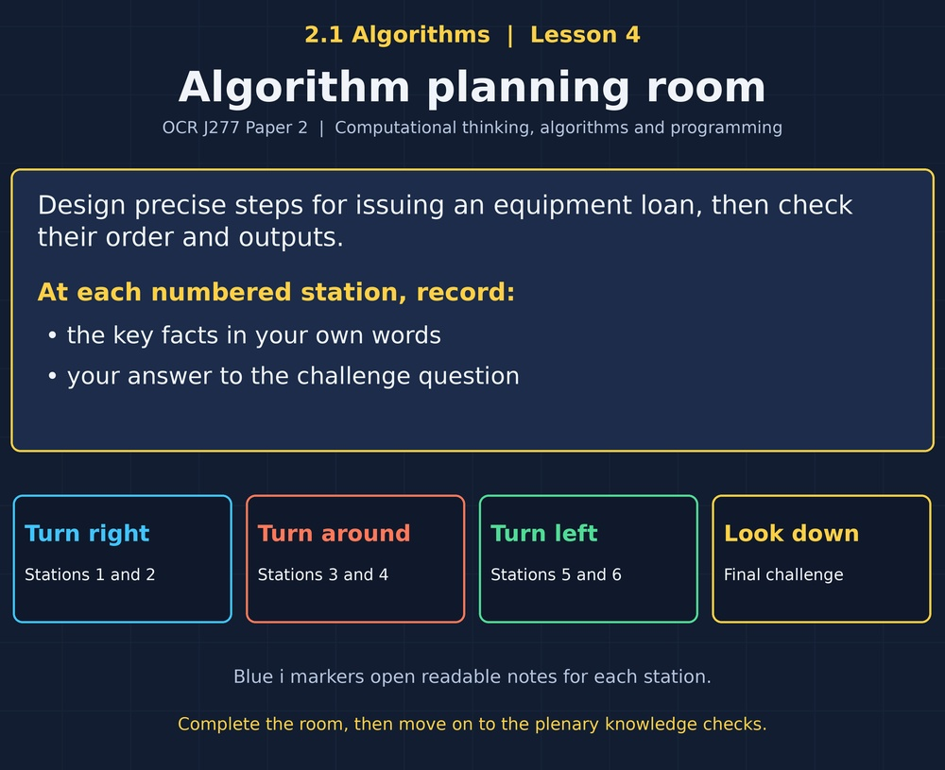

TOPIC 2.1 / LESSON 04
ALGORITHM PLANNING ROOM
Algorithmic thinking: sequence
DO NOW: RESEARCH AND DISCUSS
Why can instructions that seem obvious to a person confuse a computer?
1 / 18
Notes:
Topic 2.1 lesson 4: Algorithmic thinking: sequence.
Source sequence: supplied 2.1 - Algorithms(3).pdf, lessons 1–16. Original Revise360 explanations and practice questions.
Curriculum: OCR J277 specification v3.1, sections 2.1.1–2.1.3, https://www.ocr.org.uk/Images/558027-specification-gcse-computer-science-j277.pdf

Slide 2
TOPIC 2.1 / LESSON 04 / WORKSHEET
By the end of this lesson
1.
Explain algorithmic thinking.
2.
Identify inputs, processes and outputs.
3.
Write precise ordered instructions.
2 / 18
Notes:
Topic 2.1 lesson 4: Algorithmic thinking: sequence.
Source sequence: supplied 2.1 - Algorithms(3).pdf, lessons 1–16. Original Revise360 explanations and practice questions.
Curriculum: OCR J277 specification v3.1, sections 2.1.1–2.1.3, https://www.ocr.org.uk/Images/558027-specification-gcse-computer-science-j277.pdf

Slide 3
TOPIC 2.1 / LESSON 04 / WORKSHEET STARTER
Starter: before the experience
Put these actions in order: display total, input price, calculate total.
3 / 18
Notes:
Topic 2.1 lesson 4: Algorithmic thinking: sequence.
Source sequence: supplied 2.1 - Algorithms(3).pdf, lessons 1–16. Original Revise360 explanations and practice questions.
Curriculum: OCR J277 specification v3.1, sections 2.1.1–2.1.3, https://www.ocr.org.uk/Images/558027-specification-gcse-computer-science-j277.pdf

Slide 4
TOPIC 2.1 / LESSON 04 / CHECK
Starter: sample answers
1.
Input price, calculate total, display total.
4 / 18
Notes:
Topic 2.1 lesson 4: Algorithmic thinking: sequence.
Source sequence: supplied 2.1 - Algorithms(3).pdf, lessons 1–16. Original Revise360 explanations and practice questions.
Curriculum: OCR J277 specification v3.1, sections 2.1.1–2.1.3, https://www.ocr.org.uk/Images/558027-specification-gcse-computer-science-j277.pdf

Slide 5
TOPIC 2.1 / LESSON 04 / WORKSHEET KEY TERMS
Key terminology quiz
1.
Algorithm
2.
Sequence
5 / 18
Notes:
Topic 2.1 lesson 4: Algorithmic thinking: sequence.
Source sequence: supplied 2.1 - Algorithms(3).pdf, lessons 1–16. Original Revise360 explanations and practice questions.
Curriculum: OCR J277 specification v3.1, sections 2.1.1–2.1.3, https://www.ocr.org.uk/Images/558027-specification-gcse-computer-science-j277.pdf

Slide 6
TOPIC 2.1 / LESSON 04 / CHECK
Key terminology: answers
Algorithm
A finite set of precise steps for solving a problem.
Sequence
Executing instructions in their stated order.
6 / 18
Notes:
Topic 2.1 lesson 4: Algorithmic thinking: sequence.
Source sequence: supplied 2.1 - Algorithms(3).pdf, lessons 1–16. Original Revise360 explanations and practice questions.
Curriculum: OCR J277 specification v3.1, sections 2.1.1–2.1.3, https://www.ocr.org.uk/Images/558027-specification-gcse-computer-science-j277.pdf

Slide 7
TOPIC 2.1 / LESSON 04 / EXPERIENCE
Worksheet + experience
01 OPEN THE EXPERIENCE NOW
Open Algorithm planning room in Topic 2.1. Keep the worksheet beside you.
02 SIX STATIONS
At each station, write key facts IN YOUR OWN WORDS. Answer its worksheet challenge before tapping the badge.
03 FINAL CHALLENGE
Attempt the worksheet final challenge before tapping the star. Record your score, then use review mode to correct mistakes.
04 PLENARY
Finish the experience in this lesson. Near the end, close it for the plenary knowledge checks.
7 / 18
Notes:
Topic 2.1 lesson 4: Algorithmic thinking: sequence.
Source sequence: supplied 2.1 - Algorithms(3).pdf, lessons 1–16. Original Revise360 explanations and practice questions.
Curriculum: OCR J277 specification v3.1, sections 2.1.1–2.1.3, https://www.ocr.org.uk/Images/558027-specification-gcse-computer-science-j277.pdf
Allow approximately 25–30 minutes for the experience and worksheet. Pupils record facts in their own words.

Slide 8
TOPIC 2.1 / LESSON 04 / CONSOLIDATION
After the experience
Return to the Do Now question. Use two things you learned in the room to improve your original answer.
Link your explanation to the problem and use a worked example where it helps.
8 / 18
Notes:
Topic 2.1 lesson 4: Algorithmic thinking: sequence.
Source sequence: supplied 2.1 - Algorithms(3).pdf, lessons 1–16. Original Revise360 explanations and practice questions.
Curriculum: OCR J277 specification v3.1, sections 2.1.1–2.1.3, https://www.ocr.org.uk/Images/558027-specification-gcse-computer-science-j277.pdf

Slide 9
TOPIC 2.1 / LESSON 04 / CONSOLIDATION
Check and improve
Use review mode to correct any mistakes. Write one correction and explain why the right answer fits. Then complete the plenary from memory.
9 / 18
Notes:
Topic 2.1 lesson 4: Algorithmic thinking: sequence.
Source sequence: supplied 2.1 - Algorithms(3).pdf, lessons 1–16. Original Revise360 explanations and practice questions.
Curriculum: OCR J277 specification v3.1, sections 2.1.1–2.1.3, https://www.ocr.org.uk/Images/558027-specification-gcse-computer-science-j277.pdf

Slide 10
TOPIC 2.1 / LESSON 04 / CHECK
A stronger explanation
Compare your reasoning, then improve one sentence on your worksheet.
Check the result
Multiply quantity by price. Adding gives 7, not the expected 12.
Review and explain
Your correction should name the correct idea and explain why it fits the question. Use the experience feedback to check it.
10 / 18
Notes:
Topic 2.1 lesson 4: Algorithmic thinking: sequence.
Source sequence: supplied 2.1 - Algorithms(3).pdf, lessons 1–16. Original Revise360 explanations and practice questions.
Curriculum: OCR J277 specification v3.1, sections 2.1.1–2.1.3, https://www.ocr.org.uk/Images/558027-specification-gcse-computer-science-j277.pdf

Slide 11
TOPIC 2.1 / LESSON 04 / ANSWERS
After the experience: stations 1–3
Check your key facts and challenge responses.
1 A clear goal
The goal defines what counts as a correct result.
2 Input, process, output
The number of hours and the hourly rate.
3 Order matters
The total has not yet been calculated from the inputs.
11 / 18
Notes:
Topic 2.1 lesson 4: Algorithmic thinking: sequence.
Source sequence: supplied 2.1 - Algorithms(3).pdf, lessons 1–16. Original Revise360 explanations and practice questions.
Curriculum: OCR J277 specification v3.1, sections 2.1.1–2.1.3, https://www.ocr.org.uk/Images/558027-specification-gcse-computer-science-j277.pdf

Slide 12
TOPIC 2.1 / LESSON 04 / ANSWERS
After the experience: stations 4–6
Check your key facts and challenge responses.
4 Remove ambiguity
Add 5 bonus points to score is one precise example.
5 Follow the steps
x becomes 7 and then 14, so 14 is printed.
6 Check the result
Multiply quantity by price. Adding gives 7, not the expected 12.
12 / 18
Notes:
Topic 2.1 lesson 4: Algorithmic thinking: sequence.
Source sequence: supplied 2.1 - Algorithms(3).pdf, lessons 1–16. Original Revise360 explanations and practice questions.
Curriculum: OCR J277 specification v3.1, sections 2.1.1–2.1.3, https://www.ocr.org.uk/Images/558027-specification-gcse-computer-science-j277.pdf

Slide 13
TOPIC 2.1 / LESSON 04 / CHECK
Final challenge: answers
Check your choices and the reasons you gave.
1. Put a simple loan algorithm in order.
Answer: Read borrower ID and item ID → Check the item is available → Record the loan if available → Display the result
The check must happen before recording the loan.
2. What is the charge for 4 hours at 3 per hour?
Answer: 12
13 / 18
Notes:
Topic 2.1 lesson 4: Algorithmic thinking: sequence.
Source sequence: supplied 2.1 - Algorithms(3).pdf, lessons 1–16. Original Revise360 explanations and practice questions.
Curriculum: OCR J277 specification v3.1, sections 2.1.1–2.1.3, https://www.ocr.org.uk/Images/558027-specification-gcse-computer-science-j277.pdf

Slide 14
TOPIC 2.1 / LESSON 04 / PLENARY
Plenary: questions (a–b)
Take the headset off or close the page. Answer from memory on the worksheet.
a)
Explain algorithmic thinking. [2]
b)
Write an algorithm to input length and width and output area. [3]
14 / 18
Notes:
Topic 2.1 lesson 4: Algorithmic thinking: sequence.
Source sequence: supplied 2.1 - Algorithms(3).pdf, lessons 1–16. Original Revise360 explanations and practice questions.
Curriculum: OCR J277 specification v3.1, sections 2.1.1–2.1.3, https://www.ocr.org.uk/Images/558027-specification-gcse-computer-science-j277.pdf
Close the experience before attempting the questions.

Slide 15
TOPIC 2.1 / LESSON 04 / PLENARY
Plenary: question (c)
Keep the experience closed. Explain your reasoning in full sentences.
c)
Explain why the order of instructions matters. [2]
Use the marks in brackets to judge how much detail to include.
15 / 18
Notes:
Topic 2.1 lesson 4: Algorithmic thinking: sequence.
Source sequence: supplied 2.1 - Algorithms(3).pdf, lessons 1–16. Original Revise360 explanations and practice questions.
Curriculum: OCR J277 specification v3.1, sections 2.1.1–2.1.3, https://www.ocr.org.uk/Images/558027-specification-gcse-computer-science-j277.pdf

Slide 16
TOPIC 2.1 / LESSON 04 / CHECK
Plenary: answers (a–b)
Indicative points. Credit accurate answers in students’ own words.
a Plan a logical sequence of steps (1) that solves a stated problem (1).
b Input length and width (1), area = length * width (1), output area (1).
16 / 18
Notes:
Topic 2.1 lesson 4: Algorithmic thinking: sequence.
Source sequence: supplied 2.1 - Algorithms(3).pdf, lessons 1–16. Original Revise360 explanations and practice questions.
Curriculum: OCR J277 specification v3.1, sections 2.1.1–2.1.3, https://www.ocr.org.uk/Images/558027-specification-gcse-computer-science-j277.pdf

Slide 17
TOPIC 2.1 / LESSON 04 / CHECK
Plenary: answer (c)
Indicative points for the final question.
Later instructions can depend on earlier results (1), so using a result before calculation can be incorrect (1).
17 / 18
Notes:
Topic 2.1 lesson 4: Algorithmic thinking: sequence.
Source sequence: supplied 2.1 - Algorithms(3).pdf, lessons 1–16. Original Revise360 explanations and practice questions.
Curriculum: OCR J277 specification v3.1, sections 2.1.1–2.1.3, https://www.ocr.org.uk/Images/558027-specification-gcse-computer-science-j277.pdf

Slide 18
TOPIC 2.1 / LESSON 04 / SELF-CHECK
How confident am I?
On the worksheet, select Not yet, Getting there or Confident for each objective.
1.
Explain algorithmic thinking.
2.
Identify inputs, processes and outputs.
3.
Write precise ordered instructions.
18 / 18
Notes:
Topic 2.1 lesson 4: Algorithmic thinking: sequence.
Source sequence: supplied 2.1 - Algorithms(3).pdf, lessons 1–16. Original Revise360 explanations and practice questions.
Curriculum: OCR J277 specification v3.1, sections 2.1.1–2.1.3, https://www.ocr.org.uk/Images/558027-specification-gcse-computer-science-j277.pdf

