Slide 1
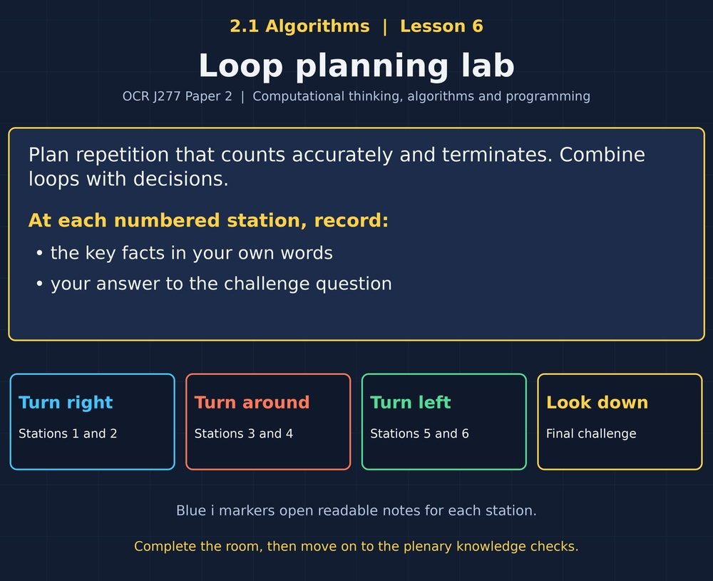

TOPIC 2.1 / LESSON 06
LOOP PLANNING LAB
Algorithmic thinking: iteration
DO NOW: RESEARCH AND DISCUSS
How could a program process 100 loans without writing the same instructions 100 times?
1 / 18
Notes:
Topic 2.1 lesson 6: Algorithmic thinking: iteration.
Source sequence: supplied 2.1 - Algorithms(3).pdf, lessons 1–16. Original Revise360 explanations and practice questions.
Curriculum: OCR J277 specification v3.1, sections 2.1.1–2.1.3, https://www.ocr.org.uk/Images/558027-specification-gcse-computer-science-j277.pdf

Slide 2
TOPIC 2.1 / LESSON 06 / WORKSHEET
By the end of this lesson
1.
Choose count- or condition-controlled iteration.
2.
Trace loops and running totals.
3.
Explain why loops terminate.
2 / 18
Notes:
Topic 2.1 lesson 6: Algorithmic thinking: iteration.
Source sequence: supplied 2.1 - Algorithms(3).pdf, lessons 1–16. Original Revise360 explanations and practice questions.
Curriculum: OCR J277 specification v3.1, sections 2.1.1–2.1.3, https://www.ocr.org.uk/Images/558027-specification-gcse-computer-science-j277.pdf

Slide 3
TOPIC 2.1 / LESSON 06 / WORKSHEET STARTER
Starter: before the experience
A task repeats exactly five times. Would a counter or an unknown stopping condition be clearer?
3 / 18
Notes:
Topic 2.1 lesson 6: Algorithmic thinking: iteration.
Source sequence: supplied 2.1 - Algorithms(3).pdf, lessons 1–16. Original Revise360 explanations and practice questions.
Curriculum: OCR J277 specification v3.1, sections 2.1.1–2.1.3, https://www.ocr.org.uk/Images/558027-specification-gcse-computer-science-j277.pdf

Slide 4
TOPIC 2.1 / LESSON 06 / CHECK
Starter: sample answers
1.
A count-controlled loop is suitable because the number of repetitions is known.
4 / 18
Notes:
Topic 2.1 lesson 6: Algorithmic thinking: iteration.
Source sequence: supplied 2.1 - Algorithms(3).pdf, lessons 1–16. Original Revise360 explanations and practice questions.
Curriculum: OCR J277 specification v3.1, sections 2.1.1–2.1.3, https://www.ocr.org.uk/Images/558027-specification-gcse-computer-science-j277.pdf

Slide 5
TOPIC 2.1 / LESSON 06 / WORKSHEET KEY TERMS
Key terminology quiz
1.
Iteration
2.
Accumulator
5 / 18
Notes:
Topic 2.1 lesson 6: Algorithmic thinking: iteration.
Source sequence: supplied 2.1 - Algorithms(3).pdf, lessons 1–16. Original Revise360 explanations and practice questions.
Curriculum: OCR J277 specification v3.1, sections 2.1.1–2.1.3, https://www.ocr.org.uk/Images/558027-specification-gcse-computer-science-j277.pdf

Slide 6
TOPIC 2.1 / LESSON 06 / CHECK
Key terminology: answers
Iteration
Repeating a group of instructions.
Accumulator
A variable used to build a running total.
6 / 18
Notes:
Topic 2.1 lesson 6: Algorithmic thinking: iteration.
Source sequence: supplied 2.1 - Algorithms(3).pdf, lessons 1–16. Original Revise360 explanations and practice questions.
Curriculum: OCR J277 specification v3.1, sections 2.1.1–2.1.3, https://www.ocr.org.uk/Images/558027-specification-gcse-computer-science-j277.pdf

Slide 7
TOPIC 2.1 / LESSON 06 / EXPERIENCE
Worksheet + experience
01 OPEN THE EXPERIENCE NOW
Open Loop planning lab in Topic 2.1. Keep the worksheet beside you.
02 SIX STATIONS
At each station, write key facts IN YOUR OWN WORDS. Answer its worksheet challenge before tapping the badge.
03 FINAL CHALLENGE
Attempt the worksheet final challenge before tapping the star. Record your score, then use review mode to correct mistakes.
04 PLENARY
Finish the experience in this lesson. Near the end, close it for the plenary knowledge checks.
7 / 18
Notes:
Topic 2.1 lesson 6: Algorithmic thinking: iteration.
Source sequence: supplied 2.1 - Algorithms(3).pdf, lessons 1–16. Original Revise360 explanations and practice questions.
Curriculum: OCR J277 specification v3.1, sections 2.1.1–2.1.3, https://www.ocr.org.uk/Images/558027-specification-gcse-computer-science-j277.pdf
Allow approximately 25–30 minutes for the experience and worksheet. Pupils record facts in their own words.

Slide 8
TOPIC 2.1 / LESSON 06 / CONSOLIDATION
After the experience
Return to the Do Now question. Use two things you learned in the room to improve your original answer.
Link your explanation to the problem and use a worked example where it helps.
8 / 18
Notes:
Topic 2.1 lesson 6: Algorithmic thinking: iteration.
Source sequence: supplied 2.1 - Algorithms(3).pdf, lessons 1–16. Original Revise360 explanations and practice questions.
Curriculum: OCR J277 specification v3.1, sections 2.1.1–2.1.3, https://www.ocr.org.uk/Images/558027-specification-gcse-computer-science-j277.pdf

Slide 9
TOPIC 2.1 / LESSON 06 / CONSOLIDATION
Check and improve
In Python, write and run a program that inputs three numbers and prints their total. Test 2, 3, 4 (expected 9) and -2, 2, 0 (expected 0).
9 / 18
Notes:
Topic 2.1 lesson 6: Algorithmic thinking: iteration.
Source sequence: supplied 2.1 - Algorithms(3).pdf, lessons 1–16. Original Revise360 explanations and practice questions.
Curriculum: OCR J277 specification v3.1, sections 2.1.1–2.1.3, https://www.ocr.org.uk/Images/558027-specification-gcse-computer-science-j277.pdf

Slide 10
TOPIC 2.1 / LESSON 06 / CHECK
A stronger explanation
Compare your reasoning, then improve one sentence on your worksheet.
Nested loops
Twelve prints: the three inner iterations run for each of four outer iterations.
Review and explain
Your correction should name the correct idea and explain why it fits the question. Use the experience feedback to check it.
10 / 18
Notes:
Topic 2.1 lesson 6: Algorithmic thinking: iteration.
Source sequence: supplied 2.1 - Algorithms(3).pdf, lessons 1–16. Original Revise360 explanations and practice questions.
Curriculum: OCR J277 specification v3.1, sections 2.1.1–2.1.3, https://www.ocr.org.uk/Images/558027-specification-gcse-computer-science-j277.pdf

Slide 11
TOPIC 2.1 / LESSON 06 / ANSWERS
After the experience: stations 1–3
Check your key facts and challenge responses.
1 Repeat a known count
Three times, because 1, 2 and 3 are included.
2 Repeat until a condition
When count becomes 3, count < 3 is false.
3 Accumulate a total
Earlier values are discarded at each iteration, so the running total is lost.
11 / 18
Notes:
Topic 2.1 lesson 6: Algorithmic thinking: iteration.
Source sequence: supplied 2.1 - Algorithms(3).pdf, lessons 1–16. Original Revise360 explanations and practice questions.
Curriculum: OCR J277 specification v3.1, sections 2.1.1–2.1.3, https://www.ocr.org.uk/Images/558027-specification-gcse-computer-science-j277.pdf

Slide 12
TOPIC 2.1 / LESSON 06 / ANSWERS
After the experience: stations 4–6
Check your key facts and challenge responses.
4 Guarantee progress
x stays 0, so x < 3 remains true and the loop does not terminate.
5 Selection inside a loop
Two values: 7 and 8.
6 Nested loops
Twelve prints: the three inner iterations run for each of four outer iterations.
12 / 18
Notes:
Topic 2.1 lesson 6: Algorithmic thinking: iteration.
Source sequence: supplied 2.1 - Algorithms(3).pdf, lessons 1–16. Original Revise360 explanations and practice questions.
Curriculum: OCR J277 specification v3.1, sections 2.1.1–2.1.3, https://www.ocr.org.uk/Images/558027-specification-gcse-computer-science-j277.pdf

Slide 13
TOPIC 2.1 / LESSON 06 / CHECK
Final challenge: answers
Check your choices and the reasons you gave.
1. Order a running-total algorithm.
Answer: Set total to 0 → Repeat for each input value → Add the value to total inside the loop → Output total after the loop
Initialise once, update repeatedly and output at the end.
2. A loop starts n = 1, adds 1 while n < 4. What is n after the loop?
Answer: 4
13 / 18
Notes:
Topic 2.1 lesson 6: Algorithmic thinking: iteration.
Source sequence: supplied 2.1 - Algorithms(3).pdf, lessons 1–16. Original Revise360 explanations and practice questions.
Curriculum: OCR J277 specification v3.1, sections 2.1.1–2.1.3, https://www.ocr.org.uk/Images/558027-specification-gcse-computer-science-j277.pdf

Slide 14
TOPIC 2.1 / LESSON 06 / PLENARY
Plenary: questions (a–b)
Take the headset off or close the page. Answer from memory on the worksheet.
a)
Explain one difference between count-controlled and condition-controlled loops. [2]
b)
Write pseudocode to input three numbers and output their total. [4]
14 / 18
Notes:
Topic 2.1 lesson 6: Algorithmic thinking: iteration.
Source sequence: supplied 2.1 - Algorithms(3).pdf, lessons 1–16. Original Revise360 explanations and practice questions.
Curriculum: OCR J277 specification v3.1, sections 2.1.1–2.1.3, https://www.ocr.org.uk/Images/558027-specification-gcse-computer-science-j277.pdf
Close the experience before attempting the questions.

Slide 15
TOPIC 2.1 / LESSON 06 / PLENARY
Plenary: question (c)
Keep the experience closed. Explain your reasoning in full sentences.
c)
Why might a while loop never terminate? [2]
Use the marks in brackets to judge how much detail to include.
15 / 18
Notes:
Topic 2.1 lesson 6: Algorithmic thinking: iteration.
Source sequence: supplied 2.1 - Algorithms(3).pdf, lessons 1–16. Original Revise360 explanations and practice questions.
Curriculum: OCR J277 specification v3.1, sections 2.1.1–2.1.3, https://www.ocr.org.uk/Images/558027-specification-gcse-computer-science-j277.pdf

Slide 16
TOPIC 2.1 / LESSON 06 / CHECK
Plenary: answers (a–b)
Indicative points. Credit accurate answers in students’ own words.
a Count-controlled repetition uses a specified count/range (1). Condition-controlled repetition depends on a condition (1).
b Initialise total (1), loop exactly three times (1), input and add each value (1), output total after the loop (1).
16 / 18
Notes:
Topic 2.1 lesson 6: Algorithmic thinking: iteration.
Source sequence: supplied 2.1 - Algorithms(3).pdf, lessons 1–16. Original Revise360 explanations and practice questions.
Curriculum: OCR J277 specification v3.1, sections 2.1.1–2.1.3, https://www.ocr.org.uk/Images/558027-specification-gcse-computer-science-j277.pdf

Slide 17
TOPIC 2.1 / LESSON 06 / CHECK
Plenary: answer (c)
Indicative points for the final question.
Its condition remains true (1), for example because the control variable is never updated (1).
17 / 18
Notes:
Topic 2.1 lesson 6: Algorithmic thinking: iteration.
Source sequence: supplied 2.1 - Algorithms(3).pdf, lessons 1–16. Original Revise360 explanations and practice questions.
Curriculum: OCR J277 specification v3.1, sections 2.1.1–2.1.3, https://www.ocr.org.uk/Images/558027-specification-gcse-computer-science-j277.pdf

Slide 18
TOPIC 2.1 / LESSON 06 / SELF-CHECK
How confident am I?
On the worksheet, select Not yet, Getting there or Confident for each objective.
1.
Choose count- or condition-controlled iteration.
2.
Trace loops and running totals.
3.
Explain why loops terminate.
18 / 18
Notes:
Topic 2.1 lesson 6: Algorithmic thinking: iteration.
Source sequence: supplied 2.1 - Algorithms(3).pdf, lessons 1–16. Original Revise360 explanations and practice questions.
Curriculum: OCR J277 specification v3.1, sections 2.1.1–2.1.3, https://www.ocr.org.uk/Images/558027-specification-gcse-computer-science-j277.pdf

