Slide 1
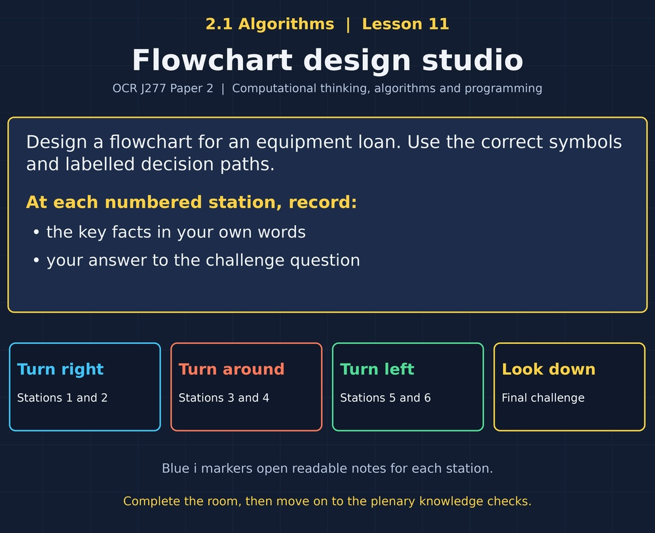

TOPIC 2.1 / LESSON 11
FLOWCHART DESIGN STUDIO
Producing algorithms: flowcharts
DO NOW: RESEARCH AND DISCUSS
How could a diagram make a decision easier to check?
1 / 18
Notes:
Topic 2.1 lesson 11: Producing algorithms: flowcharts.
Source sequence: supplied 2.1 - Algorithms(3).pdf, lessons 1–16. Original Revise360 explanations and practice questions.
Curriculum: OCR J277 specification v3.1, sections 2.1.1–2.1.3, https://www.ocr.org.uk/Images/558027-specification-gcse-computer-science-j277.pdf

Slide 2
TOPIC 2.1 / LESSON 11 / WORKSHEET
By the end of this lesson
1.
Recognise flowchart symbols.
2.
Follow decision paths.
3.
Create a complete flowchart.
2 / 18
Notes:
Topic 2.1 lesson 11: Producing algorithms: flowcharts.
Source sequence: supplied 2.1 - Algorithms(3).pdf, lessons 1–16. Original Revise360 explanations and practice questions.
Curriculum: OCR J277 specification v3.1, sections 2.1.1–2.1.3, https://www.ocr.org.uk/Images/558027-specification-gcse-computer-science-j277.pdf

Slide 3
TOPIC 2.1 / LESSON 11 / WORKSHEET STARTER
Starter: before the experience
A program reads age, checks age >= 12 and prints a result. Which step is a decision?
3 / 18
Notes:
Topic 2.1 lesson 11: Producing algorithms: flowcharts.
Source sequence: supplied 2.1 - Algorithms(3).pdf, lessons 1–16. Original Revise360 explanations and practice questions.
Curriculum: OCR J277 specification v3.1, sections 2.1.1–2.1.3, https://www.ocr.org.uk/Images/558027-specification-gcse-computer-science-j277.pdf

Slide 4
TOPIC 2.1 / LESSON 11 / CHECK
Starter: sample answers
1.
The check age >= 12 is a decision because it has true and false paths.
4 / 18
Notes:
Topic 2.1 lesson 11: Producing algorithms: flowcharts.
Source sequence: supplied 2.1 - Algorithms(3).pdf, lessons 1–16. Original Revise360 explanations and practice questions.
Curriculum: OCR J277 specification v3.1, sections 2.1.1–2.1.3, https://www.ocr.org.uk/Images/558027-specification-gcse-computer-science-j277.pdf

Slide 5
TOPIC 2.1 / LESSON 11 / WORKSHEET KEY TERMS
Key terminology quiz
1.
Flowchart
2.
Decision
5 / 18
Notes:
Topic 2.1 lesson 11: Producing algorithms: flowcharts.
Source sequence: supplied 2.1 - Algorithms(3).pdf, lessons 1–16. Original Revise360 explanations and practice questions.
Curriculum: OCR J277 specification v3.1, sections 2.1.1–2.1.3, https://www.ocr.org.uk/Images/558027-specification-gcse-computer-science-j277.pdf

Slide 6
TOPIC 2.1 / LESSON 11 / CHECK
Key terminology: answers
Flowchart
A diagram using symbols and arrows to show an algorithm.
Decision
A condition that selects between paths.
6 / 18
Notes:
Topic 2.1 lesson 11: Producing algorithms: flowcharts.
Source sequence: supplied 2.1 - Algorithms(3).pdf, lessons 1–16. Original Revise360 explanations and practice questions.
Curriculum: OCR J277 specification v3.1, sections 2.1.1–2.1.3, https://www.ocr.org.uk/Images/558027-specification-gcse-computer-science-j277.pdf

Slide 7
TOPIC 2.1 / LESSON 11 / EXPERIENCE
Worksheet + experience
01 OPEN THE EXPERIENCE NOW
Open Flowchart design studio in Topic 2.1. Keep the worksheet beside you.
02 SIX STATIONS
At each station, write key facts IN YOUR OWN WORDS. Answer its worksheet challenge before tapping the badge.
03 FINAL CHALLENGE
Attempt the worksheet final challenge before tapping the star. Record your score, then use review mode to correct mistakes.
04 PLENARY
Finish the experience in this lesson. Near the end, close it for the plenary knowledge checks.
7 / 18
Notes:
Topic 2.1 lesson 11: Producing algorithms: flowcharts.
Source sequence: supplied 2.1 - Algorithms(3).pdf, lessons 1–16. Original Revise360 explanations and practice questions.
Curriculum: OCR J277 specification v3.1, sections 2.1.1–2.1.3, https://www.ocr.org.uk/Images/558027-specification-gcse-computer-science-j277.pdf
Allow approximately 25–30 minutes for the experience and worksheet. Pupils record facts in their own words.

Slide 8
TOPIC 2.1 / LESSON 11 / CONSOLIDATION
After the experience
Return to the Do Now question. Use two things you learned in the room to improve your original answer.
Link your explanation to the problem and use a worked example where it helps.
8 / 18
Notes:
Topic 2.1 lesson 11: Producing algorithms: flowcharts.
Source sequence: supplied 2.1 - Algorithms(3).pdf, lessons 1–16. Original Revise360 explanations and practice questions.
Curriculum: OCR J277 specification v3.1, sections 2.1.1–2.1.3, https://www.ocr.org.uk/Images/558027-specification-gcse-computer-science-j277.pdf

Slide 9
TOPIC 2.1 / LESSON 11 / CONSOLIDATION
Check and improve
Create the flowchart in a diagram tool or on paper. Implement it in Python and check ages 11, 12 and 13.
9 / 18
Notes:
Topic 2.1 lesson 11: Producing algorithms: flowcharts.
Source sequence: supplied 2.1 - Algorithms(3).pdf, lessons 1–16. Original Revise360 explanations and practice questions.
Curriculum: OCR J277 specification v3.1, sections 2.1.1–2.1.3, https://www.ocr.org.uk/Images/558027-specification-gcse-computer-science-j277.pdf

Slide 10
TOPIC 2.1 / LESSON 11 / CHECK
A stronger explanation
Compare your reasoning, then improve one sentence on your worksheet.
Check every route
A correct true path does not prove the false path behaves correctly.
Review and explain
Your correction should name the correct idea and explain why it fits the question. Use the experience feedback to check it.
10 / 18
Notes:
Topic 2.1 lesson 11: Producing algorithms: flowcharts.
Source sequence: supplied 2.1 - Algorithms(3).pdf, lessons 1–16. Original Revise360 explanations and practice questions.
Curriculum: OCR J277 specification v3.1, sections 2.1.1–2.1.3, https://www.ocr.org.uk/Images/558027-specification-gcse-computer-science-j277.pdf

Slide 11
TOPIC 2.1 / LESSON 11 / ANSWERS
After the experience: stations 1–3
Check your key facts and challenge responses.
1 Start and finish
It shows which instruction executes next.
2 Read and write
An input/output parallelogram.
3 Process the data
A process rectangle, because the value is being updated.
11 / 18
Notes:
Topic 2.1 lesson 11: Producing algorithms: flowcharts.
Source sequence: supplied 2.1 - Algorithms(3).pdf, lessons 1–16. Original Revise360 explanations and practice questions.
Curriculum: OCR J277 specification v3.1, sections 2.1.1–2.1.3, https://www.ocr.org.uk/Images/558027-specification-gcse-computer-science-j277.pdf

Slide 12
TOPIC 2.1 / LESSON 11 / ANSWERS
After the experience: stations 4–6
Check your key facts and challenge responses.
4 Branch on a decision
The behaviour when the item is unavailable is not defined.
5 Use a subprogram
It keeps the main diagram manageable while detailed steps are defined separately.
6 Check every route
A correct true path does not prove the false path behaves correctly.
12 / 18
Notes:
Topic 2.1 lesson 11: Producing algorithms: flowcharts.
Source sequence: supplied 2.1 - Algorithms(3).pdf, lessons 1–16. Original Revise360 explanations and practice questions.
Curriculum: OCR J277 specification v3.1, sections 2.1.1–2.1.3, https://www.ocr.org.uk/Images/558027-specification-gcse-computer-science-j277.pdf

Slide 13
TOPIC 2.1 / LESSON 11 / CHECK
Final challenge: answers
Check your choices and the reasons you gave.
1. Choose a flowchart symbol for each action.
Answer: Read hours: Input/output; charge = hours * 3: Process; charge > 12?: Decision; Print charge: Input/output
The symbol should match the action.
2. What must a decision have in this two-way flowchart?
Answer: A labelled path for each outcome
13 / 18
Notes:
Topic 2.1 lesson 11: Producing algorithms: flowcharts.
Source sequence: supplied 2.1 - Algorithms(3).pdf, lessons 1–16. Original Revise360 explanations and practice questions.
Curriculum: OCR J277 specification v3.1, sections 2.1.1–2.1.3, https://www.ocr.org.uk/Images/558027-specification-gcse-computer-science-j277.pdf

Slide 14
TOPIC 2.1 / LESSON 11 / PLENARY
Plenary: questions (a–b)
Take the headset off or close the page. Answer from memory on the worksheet.
a)
Name the symbols for input, a calculation and a decision. [3]
b)
Draw a flowchart that inputs age, outputs Allowed if age >= 12 and otherwise outputs Too young. [5]
14 / 18
Notes:
Topic 2.1 lesson 11: Producing algorithms: flowcharts.
Source sequence: supplied 2.1 - Algorithms(3).pdf, lessons 1–16. Original Revise360 explanations and practice questions.
Curriculum: OCR J277 specification v3.1, sections 2.1.1–2.1.3, https://www.ocr.org.uk/Images/558027-specification-gcse-computer-science-j277.pdf
Close the experience before attempting the questions.

Slide 15
TOPIC 2.1 / LESSON 11 / PLENARY
Plenary: question (c)
Keep the experience closed. Explain your reasoning in full sentences.
c)
Explain why testing only one path is insufficient. [2]
Use the marks in brackets to judge how much detail to include.
15 / 18
Notes:
Topic 2.1 lesson 11: Producing algorithms: flowcharts.
Source sequence: supplied 2.1 - Algorithms(3).pdf, lessons 1–16. Original Revise360 explanations and practice questions.
Curriculum: OCR J277 specification v3.1, sections 2.1.1–2.1.3, https://www.ocr.org.uk/Images/558027-specification-gcse-computer-science-j277.pdf

Slide 16
TOPIC 2.1 / LESSON 11 / CHECK
Plenary: answers (a–b)
Indicative points. Credit accurate answers in students’ own words.
a Parallelogram (1), rectangle (1), diamond (1).
b Input age (1), correct decision (1), labelled branches (1), correct outputs (1), connected start/end paths (1).
16 / 18
Notes:
Topic 2.1 lesson 11: Producing algorithms: flowcharts.
Source sequence: supplied 2.1 - Algorithms(3).pdf, lessons 1–16. Original Revise360 explanations and practice questions.
Curriculum: OCR J277 specification v3.1, sections 2.1.1–2.1.3, https://www.ocr.org.uk/Images/558027-specification-gcse-computer-science-j277.pdf

Slide 17
TOPIC 2.1 / LESSON 11 / CHECK
Plenary: answer (c)
Indicative points for the final question.
The other branch may contain an error (1), so a test must execute that branch too (1).
17 / 18
Notes:
Topic 2.1 lesson 11: Producing algorithms: flowcharts.
Source sequence: supplied 2.1 - Algorithms(3).pdf, lessons 1–16. Original Revise360 explanations and practice questions.
Curriculum: OCR J277 specification v3.1, sections 2.1.1–2.1.3, https://www.ocr.org.uk/Images/558027-specification-gcse-computer-science-j277.pdf

Slide 18
TOPIC 2.1 / LESSON 11 / SELF-CHECK
How confident am I?
On the worksheet, select Not yet, Getting there or Confident for each objective.
1.
Recognise flowchart symbols.
2.
Follow decision paths.
3.
Create a complete flowchart.
18 / 18
Notes:
Topic 2.1 lesson 11: Producing algorithms: flowcharts.
Source sequence: supplied 2.1 - Algorithms(3).pdf, lessons 1–16. Original Revise360 explanations and practice questions.
Curriculum: OCR J277 specification v3.1, sections 2.1.1–2.1.3, https://www.ocr.org.uk/Images/558027-specification-gcse-computer-science-j277.pdf

