Slide 1
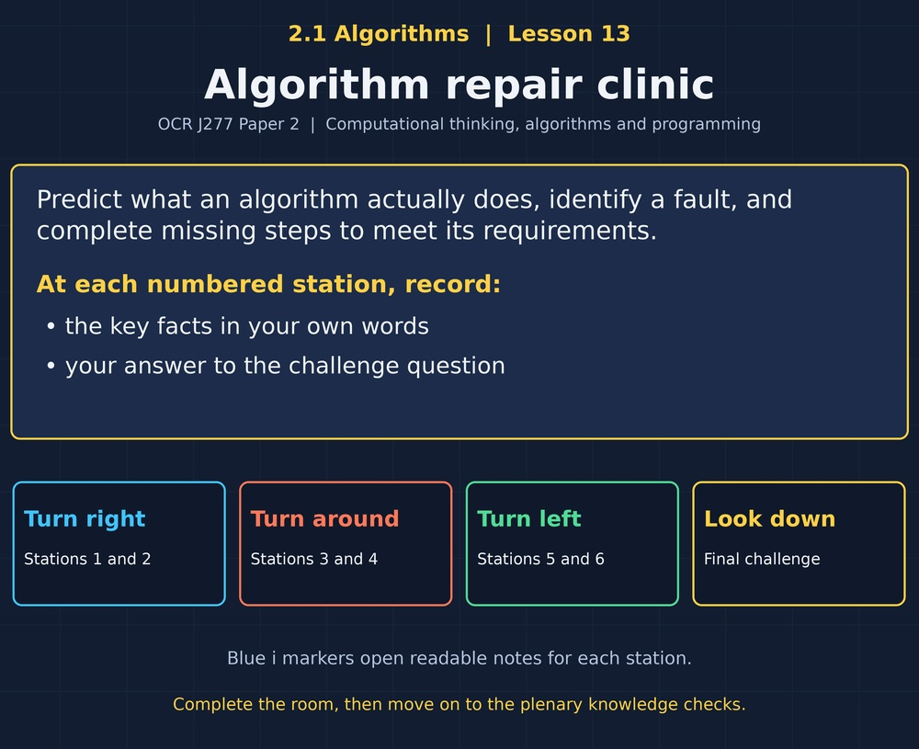

TOPIC 2.1 / LESSON 13
ALGORITHM REPAIR CLINIC
Interpreting, correcting and completing algorithms
DO NOW: RESEARCH AND DISCUSS
Can code run successfully and still give the wrong answer?
1 / 18
Notes:
Topic 2.1 lesson 13: Interpreting, correcting and completing algorithms.
Source sequence: supplied 2.1 - Algorithms(3).pdf, lessons 1–16. Original Revise360 explanations and practice questions.
Curriculum: OCR J277 specification v3.1, sections 2.1.1–2.1.3, https://www.ocr.org.uk/Images/558027-specification-gcse-computer-science-j277.pdf

Slide 2
TOPIC 2.1 / LESSON 13 / WORKSHEET
By the end of this lesson
1.
Interpret algorithms using sample inputs.
2.
Correct faulty conditions and updates.
3.
Complete missing algorithm steps.
2 / 18
Notes:
Topic 2.1 lesson 13: Interpreting, correcting and completing algorithms.
Source sequence: supplied 2.1 - Algorithms(3).pdf, lessons 1–16. Original Revise360 explanations and practice questions.
Curriculum: OCR J277 specification v3.1, sections 2.1.1–2.1.3, https://www.ocr.org.uk/Images/558027-specification-gcse-computer-science-j277.pdf

Slide 3
TOPIC 2.1 / LESSON 13 / WORKSHEET STARTER
Starter: before the experience
A total-cost algorithm adds price and quantity. Is this the correct calculation?
3 / 18
Notes:
Topic 2.1 lesson 13: Interpreting, correcting and completing algorithms.
Source sequence: supplied 2.1 - Algorithms(3).pdf, lessons 1–16. Original Revise360 explanations and practice questions.
Curriculum: OCR J277 specification v3.1, sections 2.1.1–2.1.3, https://www.ocr.org.uk/Images/558027-specification-gcse-computer-science-j277.pdf

Slide 4
TOPIC 2.1 / LESSON 13 / CHECK
Starter: sample answers
1.
No. Total cost requires price multiplied by quantity.
4 / 18
Notes:
Topic 2.1 lesson 13: Interpreting, correcting and completing algorithms.
Source sequence: supplied 2.1 - Algorithms(3).pdf, lessons 1–16. Original Revise360 explanations and practice questions.
Curriculum: OCR J277 specification v3.1, sections 2.1.1–2.1.3, https://www.ocr.org.uk/Images/558027-specification-gcse-computer-science-j277.pdf

Slide 5
TOPIC 2.1 / LESSON 13 / WORKSHEET KEY TERMS
Key terminology quiz
1.
Logic error
2.
Refinement
5 / 18
Notes:
Topic 2.1 lesson 13: Interpreting, correcting and completing algorithms.
Source sequence: supplied 2.1 - Algorithms(3).pdf, lessons 1–16. Original Revise360 explanations and practice questions.
Curriculum: OCR J277 specification v3.1, sections 2.1.1–2.1.3, https://www.ocr.org.uk/Images/558027-specification-gcse-computer-science-j277.pdf

Slide 6
TOPIC 2.1 / LESSON 13 / CHECK
Key terminology: answers
Logic error
An error in the algorithm that produces unintended behaviour.
Refinement
Improving an algorithm so it meets its requirements more fully.
6 / 18
Notes:
Topic 2.1 lesson 13: Interpreting, correcting and completing algorithms.
Source sequence: supplied 2.1 - Algorithms(3).pdf, lessons 1–16. Original Revise360 explanations and practice questions.
Curriculum: OCR J277 specification v3.1, sections 2.1.1–2.1.3, https://www.ocr.org.uk/Images/558027-specification-gcse-computer-science-j277.pdf

Slide 7
TOPIC 2.1 / LESSON 13 / EXPERIENCE
Worksheet + experience
01 OPEN THE EXPERIENCE NOW
Open Algorithm repair clinic in Topic 2.1. Keep the worksheet beside you.
02 SIX STATIONS
At each station, write key facts IN YOUR OWN WORDS. Answer its worksheet challenge before tapping the badge.
03 FINAL CHALLENGE
Attempt the worksheet final challenge before tapping the star. Record your score, then use review mode to correct mistakes.
04 PLENARY
Finish the experience in this lesson. Near the end, close it for the plenary knowledge checks.
7 / 18
Notes:
Topic 2.1 lesson 13: Interpreting, correcting and completing algorithms.
Source sequence: supplied 2.1 - Algorithms(3).pdf, lessons 1–16. Original Revise360 explanations and practice questions.
Curriculum: OCR J277 specification v3.1, sections 2.1.1–2.1.3, https://www.ocr.org.uk/Images/558027-specification-gcse-computer-science-j277.pdf
Allow approximately 25–30 minutes for the experience and worksheet. Pupils record facts in their own words.

Slide 8
TOPIC 2.1 / LESSON 13 / CONSOLIDATION
After the experience
Return to the Do Now question. Use two things you learned in the room to improve your original answer.
Link your explanation to the problem and use a worked example where it helps.
8 / 18
Notes:
Topic 2.1 lesson 13: Interpreting, correcting and completing algorithms.
Source sequence: supplied 2.1 - Algorithms(3).pdf, lessons 1–16. Original Revise360 explanations and practice questions.
Curriculum: OCR J277 specification v3.1, sections 2.1.1–2.1.3, https://www.ocr.org.uk/Images/558027-specification-gcse-computer-science-j277.pdf

Slide 9
TOPIC 2.1 / LESSON 13 / CONSOLIDATION
Check and improve
Implement the repaired countdown in Python. Confirm it prints 3, 2, 1 and stops. Change the initial value to 1 and check again.
9 / 18
Notes:
Topic 2.1 lesson 13: Interpreting, correcting and completing algorithms.
Source sequence: supplied 2.1 - Algorithms(3).pdf, lessons 1–16. Original Revise360 explanations and practice questions.
Curriculum: OCR J277 specification v3.1, sections 2.1.1–2.1.3, https://www.ocr.org.uk/Images/558027-specification-gcse-computer-science-j277.pdf

Slide 10
TOPIC 2.1 / LESSON 13 / CHECK
A stronger explanation
Compare your reasoning, then improve one sentence on your worksheet.
Recheck the correction
The correction might accidentally break behaviour that was already correct.
Review and explain
Your correction should name the correct idea and explain why it fits the question. Use the experience feedback to check it.
10 / 18
Notes:
Topic 2.1 lesson 13: Interpreting, correcting and completing algorithms.
Source sequence: supplied 2.1 - Algorithms(3).pdf, lessons 1–16. Original Revise360 explanations and practice questions.
Curriculum: OCR J277 specification v3.1, sections 2.1.1–2.1.3, https://www.ocr.org.uk/Images/558027-specification-gcse-computer-science-j277.pdf

Slide 11
TOPIC 2.1 / LESSON 13 / ANSWERS
After the experience: stations 1–3
Check your key facts and challenge responses.
1 Read what is written
14. y becomes 7, then x is assigned 7 * 2.
2 Correct an operation
The wrong result is 8. The correct total is 15.
3 Correct a boundary
40, because it should pass but the faulty condition rejects it.
11 / 18
Notes:
Topic 2.1 lesson 13: Interpreting, correcting and completing algorithms.
Source sequence: supplied 2.1 - Algorithms(3).pdf, lessons 1–16. Original Revise360 explanations and practice questions.
Curriculum: OCR J277 specification v3.1, sections 2.1.1–2.1.3, https://www.ocr.org.uk/Images/558027-specification-gcse-computer-science-j277.pdf

Slide 12
TOPIC 2.1 / LESSON 13 / ANSWERS
After the experience: stations 4–6
Check your key facts and challenge responses.
4 Complete an update
n = n - 1.
5 Refine an omitted case
The ELSE branch declares B the winner even though the values are equal.
6 Recheck the correction
The correction might accidentally break behaviour that was already correct.
12 / 18
Notes:
Topic 2.1 lesson 13: Interpreting, correcting and completing algorithms.
Source sequence: supplied 2.1 - Algorithms(3).pdf, lessons 1–16. Original Revise360 explanations and practice questions.
Curriculum: OCR J277 specification v3.1, sections 2.1.1–2.1.3, https://www.ocr.org.uk/Images/558027-specification-gcse-computer-science-j277.pdf

Slide 13
TOPIC 2.1 / LESSON 13 / CHECK
Final challenge: answers
Check your choices and the reasons you gave.
1. total = 0 inside a loop causes only the latest input to be kept. What is the fix?
Answer: Move total = 0 before the loop
2. A loop should visit indices 0 to 4. Which OCR loop fits?
Answer: for i = 0 to 4
13 / 18
Notes:
Topic 2.1 lesson 13: Interpreting, correcting and completing algorithms.
Source sequence: supplied 2.1 - Algorithms(3).pdf, lessons 1–16. Original Revise360 explanations and practice questions.
Curriculum: OCR J277 specification v3.1, sections 2.1.1–2.1.3, https://www.ocr.org.uk/Images/558027-specification-gcse-computer-science-j277.pdf

Slide 14
TOPIC 2.1 / LESSON 13 / PLENARY
Plenary: questions (a–b)
Take the headset off or close the page. Answer from memory on the worksheet.
a)
Trace x = 3, y = x + 2, x = y * 4, print(x). Give y and the output. [2]
b)
A loop starts n = 1 and repeats while n < 4 but never updates n. Explain and correct the fault. [3]
14 / 18
Notes:
Topic 2.1 lesson 13: Interpreting, correcting and completing algorithms.
Source sequence: supplied 2.1 - Algorithms(3).pdf, lessons 1–16. Original Revise360 explanations and practice questions.
Curriculum: OCR J277 specification v3.1, sections 2.1.1–2.1.3, https://www.ocr.org.uk/Images/558027-specification-gcse-computer-science-j277.pdf
Close the experience before attempting the questions.

Slide 15
TOPIC 2.1 / LESSON 13 / PLENARY
Plenary: question (c)
Keep the experience closed. Explain your reasoning in full sentences.
c)
An algorithm reports B wins whenever A is not greater than B. Explain a required refinement. [2]
Use the marks in brackets to judge how much detail to include.
15 / 18
Notes:
Topic 2.1 lesson 13: Interpreting, correcting and completing algorithms.
Source sequence: supplied 2.1 - Algorithms(3).pdf, lessons 1–16. Original Revise360 explanations and practice questions.
Curriculum: OCR J277 specification v3.1, sections 2.1.1–2.1.3, https://www.ocr.org.uk/Images/558027-specification-gcse-computer-science-j277.pdf

Slide 16
TOPIC 2.1 / LESSON 13 / CHECK
Plenary: answers (a–b)
Indicative points. Credit accurate answers in students’ own words.
a y = 5 (1), output 20 (1).
b n remains 1 (1), so the condition stays true (1). Add n = n + 1 inside the loop (1).
16 / 18
Notes:
Topic 2.1 lesson 13: Interpreting, correcting and completing algorithms.
Source sequence: supplied 2.1 - Algorithms(3).pdf, lessons 1–16. Original Revise360 explanations and practice questions.
Curriculum: OCR J277 specification v3.1, sections 2.1.1–2.1.3, https://www.ocr.org.uk/Images/558027-specification-gcse-computer-science-j277.pdf

Slide 17
TOPIC 2.1 / LESSON 13 / CHECK
Plenary: answer (c)
Indicative points for the final question.
Equal values are wrongly treated as a B win (1). Add an equality branch that outputs Draw (1).
17 / 18
Notes:
Topic 2.1 lesson 13: Interpreting, correcting and completing algorithms.
Source sequence: supplied 2.1 - Algorithms(3).pdf, lessons 1–16. Original Revise360 explanations and practice questions.
Curriculum: OCR J277 specification v3.1, sections 2.1.1–2.1.3, https://www.ocr.org.uk/Images/558027-specification-gcse-computer-science-j277.pdf

Slide 18
TOPIC 2.1 / LESSON 13 / SELF-CHECK
How confident am I?
On the worksheet, select Not yet, Getting there or Confident for each objective.
1.
Interpret algorithms using sample inputs.
2.
Correct faulty conditions and updates.
3.
Complete missing algorithm steps.
18 / 18
Notes:
Topic 2.1 lesson 13: Interpreting, correcting and completing algorithms.
Source sequence: supplied 2.1 - Algorithms(3).pdf, lessons 1–16. Original Revise360 explanations and practice questions.
Curriculum: OCR J277 specification v3.1, sections 2.1.1–2.1.3, https://www.ocr.org.uk/Images/558027-specification-gcse-computer-science-j277.pdf

