Slide 1
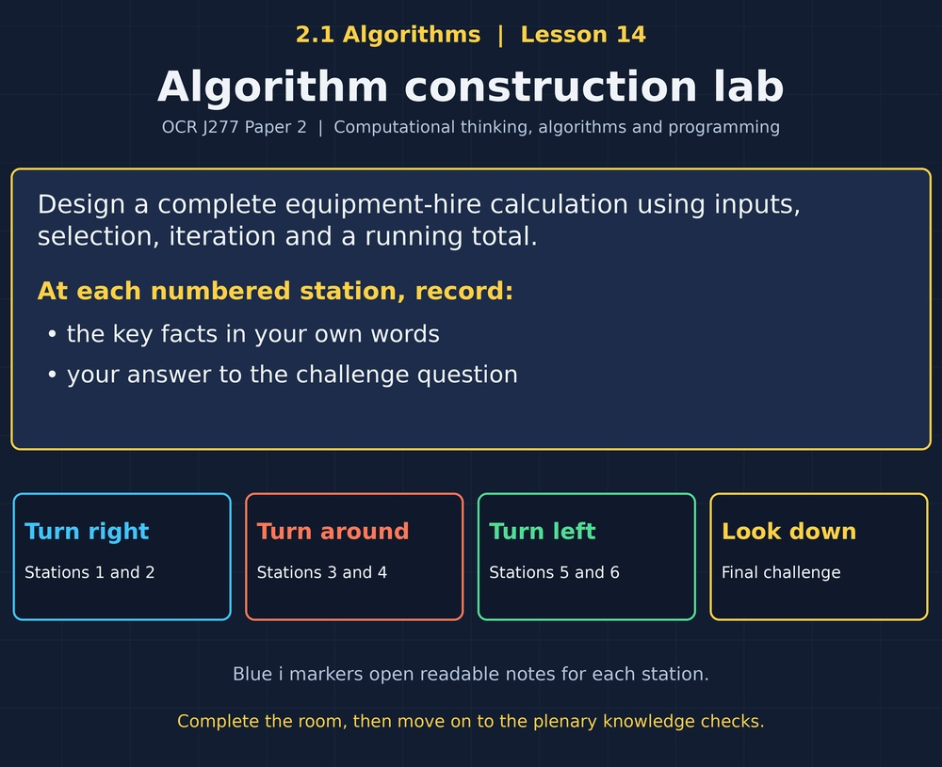

TOPIC 2.1 / LESSON 14
ALGORITHM CONSTRUCTION LAB
Producing algorithms: combined solutions
DO NOW: RESEARCH AND DISCUSS
How can you turn a long written requirement into a program you can check?
1 / 18
Notes:
Topic 2.1 lesson 14: Producing algorithms: combined solutions.
Source sequence: supplied 2.1 - Algorithms(3).pdf, lessons 1–16. Original Revise360 explanations and practice questions.
Curriculum: OCR J277 specification v3.1, sections 2.1.1–2.1.3, https://www.ocr.org.uk/Images/558027-specification-gcse-computer-science-j277.pdf

Slide 2
TOPIC 2.1 / LESSON 14 / WORKSHEET
By the end of this lesson
1.
Extract requirements from a problem.
2.
Combine sequence, selection and iteration.
3.
Refine and test a complete solution.
2 / 18
Notes:
Topic 2.1 lesson 14: Producing algorithms: combined solutions.
Source sequence: supplied 2.1 - Algorithms(3).pdf, lessons 1–16. Original Revise360 explanations and practice questions.
Curriculum: OCR J277 specification v3.1, sections 2.1.1–2.1.3, https://www.ocr.org.uk/Images/558027-specification-gcse-computer-science-j277.pdf

Slide 3
TOPIC 2.1 / LESSON 14 / WORKSHEET STARTER
Starter: before the experience
A club charges 3 per hour for each item. What is the charge for two items hired for 2 and 4 hours?
3 / 18
Notes:
Topic 2.1 lesson 14: Producing algorithms: combined solutions.
Source sequence: supplied 2.1 - Algorithms(3).pdf, lessons 1–16. Original Revise360 explanations and practice questions.
Curriculum: OCR J277 specification v3.1, sections 2.1.1–2.1.3, https://www.ocr.org.uk/Images/558027-specification-gcse-computer-science-j277.pdf

Slide 4
TOPIC 2.1 / LESSON 14 / CHECK
Starter: sample answers
1.
6 + 12 = 18. Calculate each item charge and add it to the total.
4 / 18
Notes:
Topic 2.1 lesson 14: Producing algorithms: combined solutions.
Source sequence: supplied 2.1 - Algorithms(3).pdf, lessons 1–16. Original Revise360 explanations and practice questions.
Curriculum: OCR J277 specification v3.1, sections 2.1.1–2.1.3, https://www.ocr.org.uk/Images/558027-specification-gcse-computer-science-j277.pdf

Slide 5
TOPIC 2.1 / LESSON 14 / WORKSHEET KEY TERMS
Key terminology quiz
1.
Requirement
2.
Nested structure
5 / 18
Notes:
Topic 2.1 lesson 14: Producing algorithms: combined solutions.
Source sequence: supplied 2.1 - Algorithms(3).pdf, lessons 1–16. Original Revise360 explanations and practice questions.
Curriculum: OCR J277 specification v3.1, sections 2.1.1–2.1.3, https://www.ocr.org.uk/Images/558027-specification-gcse-computer-science-j277.pdf

Slide 6
TOPIC 2.1 / LESSON 14 / CHECK
Key terminology: answers
Requirement
A statement of what a solution must do.
Nested structure
A control structure placed inside another control structure.
6 / 18
Notes:
Topic 2.1 lesson 14: Producing algorithms: combined solutions.
Source sequence: supplied 2.1 - Algorithms(3).pdf, lessons 1–16. Original Revise360 explanations and practice questions.
Curriculum: OCR J277 specification v3.1, sections 2.1.1–2.1.3, https://www.ocr.org.uk/Images/558027-specification-gcse-computer-science-j277.pdf

Slide 7
TOPIC 2.1 / LESSON 14 / EXPERIENCE
Worksheet + experience
01 OPEN THE EXPERIENCE NOW
Open Algorithm construction lab in Topic 2.1. Keep the worksheet beside you.
02 SIX STATIONS
At each station, write key facts IN YOUR OWN WORDS. Answer its worksheet challenge before tapping the badge.
03 FINAL CHALLENGE
Attempt the worksheet final challenge before tapping the star. Record your score, then use review mode to correct mistakes.
04 PLENARY
Finish the experience in this lesson. Near the end, close it for the plenary knowledge checks.
7 / 18
Notes:
Topic 2.1 lesson 14: Producing algorithms: combined solutions.
Source sequence: supplied 2.1 - Algorithms(3).pdf, lessons 1–16. Original Revise360 explanations and practice questions.
Curriculum: OCR J277 specification v3.1, sections 2.1.1–2.1.3, https://www.ocr.org.uk/Images/558027-specification-gcse-computer-science-j277.pdf
Allow approximately 25–30 minutes for the experience and worksheet. Pupils record facts in their own words.

Slide 8
TOPIC 2.1 / LESSON 14 / CONSOLIDATION
After the experience
Return to the Do Now question. Use two things you learned in the room to improve your original answer.
Link your explanation to the problem and use a worked example where it helps.
8 / 18
Notes:
Topic 2.1 lesson 14: Producing algorithms: combined solutions.
Source sequence: supplied 2.1 - Algorithms(3).pdf, lessons 1–16. Original Revise360 explanations and practice questions.
Curriculum: OCR J277 specification v3.1, sections 2.1.1–2.1.3, https://www.ocr.org.uk/Images/558027-specification-gcse-computer-science-j277.pdf

Slide 9
TOPIC 2.1 / LESSON 14 / CONSOLIDATION
Check and improve
Implement the full hire program in Python. Test 1, 2, 3 (18), 3, 3, 4 (25) and 4, 4, 4 (31). Compare each output with your design.
9 / 18
Notes:
Topic 2.1 lesson 14: Producing algorithms: combined solutions.
Source sequence: supplied 2.1 - Algorithms(3).pdf, lessons 1–16. Original Revise360 explanations and practice questions.
Curriculum: OCR J277 specification v3.1, sections 2.1.1–2.1.3, https://www.ocr.org.uk/Images/558027-specification-gcse-computer-science-j277.pdf

Slide 10
TOPIC 2.1 / LESSON 14 / CHECK
A stronger explanation
Compare your reasoning, then improve one sentence on your worksheet.
Test the complete design
It reaches the exact discount boundary of 30 and checks that the result is 25.
Review and explain
Your correction should name the correct idea and explain why it fits the question. Use the experience feedback to check it.
10 / 18
Notes:
Topic 2.1 lesson 14: Producing algorithms: combined solutions.
Source sequence: supplied 2.1 - Algorithms(3).pdf, lessons 1–16. Original Revise360 explanations and practice questions.
Curriculum: OCR J277 specification v3.1, sections 2.1.1–2.1.3, https://www.ocr.org.uk/Images/558027-specification-gcse-computer-science-j277.pdf

Slide 11
TOPIC 2.1 / LESSON 14 / ANSWERS
After the experience: stations 1–3
Check your key facts and challenge responses.
1 Read the requirements
Three hour values are inputs. The combined charge is the output.
2 Break down the solution
Calculate each item charge, add it to the running total and apply any required discount.
3 Build the running total
3 + 6 + 9 = 18.
11 / 18
Notes:
Topic 2.1 lesson 14: Producing algorithms: combined solutions.
Source sequence: supplied 2.1 - Algorithms(3).pdf, lessons 1–16. Original Revise360 explanations and practice questions.
Curriculum: OCR J277 specification v3.1, sections 2.1.1–2.1.3, https://www.ocr.org.uk/Images/558027-specification-gcse-computer-science-j277.pdf

Slide 12
TOPIC 2.1 / LESSON 14 / ANSWERS
After the experience: stations 4–6
Check your key facts and challenge responses.
4 Apply a rule once
29 stays 29. 30 qualifies and becomes 25.
5 Selection inside repetition
Inside the loop, so every item is checked using its own hours.
6 Test the complete design
It reaches the exact discount boundary of 30 and checks that the result is 25.
12 / 18
Notes:
Topic 2.1 lesson 14: Producing algorithms: combined solutions.
Source sequence: supplied 2.1 - Algorithms(3).pdf, lessons 1–16. Original Revise360 explanations and practice questions.
Curriculum: OCR J277 specification v3.1, sections 2.1.1–2.1.3, https://www.ocr.org.uk/Images/558027-specification-gcse-computer-science-j277.pdf

Slide 13
TOPIC 2.1 / LESSON 14 / CHECK
Final challenge: answers
Check your choices and the reasons you gave.
1. Where should total = 0 be placed?
Answer: Before the item loop
2. Hours 2, 2, 5 at 3 per hour. Discount is 5 if total >= 30. Output?
Answer: 27
13 / 18
Notes:
Topic 2.1 lesson 14: Producing algorithms: combined solutions.
Source sequence: supplied 2.1 - Algorithms(3).pdf, lessons 1–16. Original Revise360 explanations and practice questions.
Curriculum: OCR J277 specification v3.1, sections 2.1.1–2.1.3, https://www.ocr.org.uk/Images/558027-specification-gcse-computer-science-j277.pdf

Slide 14
TOPIC 2.1 / LESSON 14 / PLENARY
Plenary: questions (a–b)
Take the headset off or close the page. Answer from memory on the worksheet.
a)
Identify the inputs, processing and output of the hire program. [3]
b)
Write pseudocode for three item-hour inputs at 3 per hour. Subtract 5 if total >= 30, then output the charge. [6]
14 / 18
Notes:
Topic 2.1 lesson 14: Producing algorithms: combined solutions.
Source sequence: supplied 2.1 - Algorithms(3).pdf, lessons 1–16. Original Revise360 explanations and practice questions.
Curriculum: OCR J277 specification v3.1, sections 2.1.1–2.1.3, https://www.ocr.org.uk/Images/558027-specification-gcse-computer-science-j277.pdf
Close the experience before attempting the questions.

Slide 15
TOPIC 2.1 / LESSON 14 / PLENARY
Plenary: question (c)
Keep the experience closed. Explain your reasoning in full sentences.
c)
Give inputs that test the exact discount threshold and state the expected output. [2]
Use the marks in brackets to judge how much detail to include.
15 / 18
Notes:
Topic 2.1 lesson 14: Producing algorithms: combined solutions.
Source sequence: supplied 2.1 - Algorithms(3).pdf, lessons 1–16. Original Revise360 explanations and practice questions.
Curriculum: OCR J277 specification v3.1, sections 2.1.1–2.1.3, https://www.ocr.org.uk/Images/558027-specification-gcse-computer-science-j277.pdf

Slide 16
TOPIC 2.1 / LESSON 14 / CHECK
Plenary: answers (a–b)
Indicative points. Credit accurate answers in students’ own words.
a Hours for each item (1), calculate and sum charges then apply the rule (1), combined charge (1).
b Initialise total (1), three-iteration loop (1), input hours (1), accumulate hours * 3 (1), correct discount after loop (1), output final total (1).
16 / 18
Notes:
Topic 2.1 lesson 14: Producing algorithms: combined solutions.
Source sequence: supplied 2.1 - Algorithms(3).pdf, lessons 1–16. Original Revise360 explanations and practice questions.
Curriculum: OCR J277 specification v3.1, sections 2.1.1–2.1.3, https://www.ocr.org.uk/Images/558027-specification-gcse-computer-science-j277.pdf

Slide 17
TOPIC 2.1 / LESSON 14 / CHECK
Plenary: answer (c)
Indicative points for the final question.
For example 3, 3, 4 hours makes a raw total of 30 (1) and output 25 (1).
17 / 18
Notes:
Topic 2.1 lesson 14: Producing algorithms: combined solutions.
Source sequence: supplied 2.1 - Algorithms(3).pdf, lessons 1–16. Original Revise360 explanations and practice questions.
Curriculum: OCR J277 specification v3.1, sections 2.1.1–2.1.3, https://www.ocr.org.uk/Images/558027-specification-gcse-computer-science-j277.pdf

Slide 18
TOPIC 2.1 / LESSON 14 / SELF-CHECK
How confident am I?
On the worksheet, select Not yet, Getting there or Confident for each objective.
1.
Extract requirements from a problem.
2.
Combine sequence, selection and iteration.
3.
Refine and test a complete solution.
18 / 18
Notes:
Topic 2.1 lesson 14: Producing algorithms: combined solutions.
Source sequence: supplied 2.1 - Algorithms(3).pdf, lessons 1–16. Original Revise360 explanations and practice questions.
Curriculum: OCR J277 specification v3.1, sections 2.1.1–2.1.3, https://www.ocr.org.uk/Images/558027-specification-gcse-computer-science-j277.pdf

