Slide 1
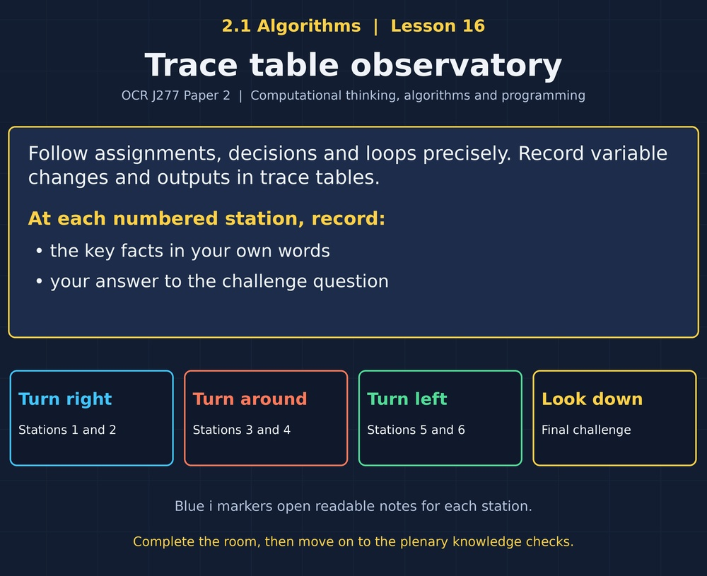

TOPIC 2.1 / LESSON 16
TRACE TABLE OBSERVATORY
Trace tables
DO NOW: RESEARCH AND DISCUSS
How can you check what a program does without running it?
1 / 18
Notes:
Topic 2.1 lesson 16: Trace tables.
Source sequence: supplied 2.1 - Algorithms(3).pdf, lessons 1–16. Original Revise360 explanations and practice questions.
Curriculum: OCR J277 specification v3.1, sections 2.1.1–2.1.3, https://www.ocr.org.uk/Images/558027-specification-gcse-computer-science-j277.pdf

Slide 2
TOPIC 2.1 / LESSON 16 / WORKSHEET
By the end of this lesson
1.
Complete trace tables.
2.
Trace selection and nested iteration.
3.
Use traces to locate logic errors.
2 / 18
Notes:
Topic 2.1 lesson 16: Trace tables.
Source sequence: supplied 2.1 - Algorithms(3).pdf, lessons 1–16. Original Revise360 explanations and practice questions.
Curriculum: OCR J277 specification v3.1, sections 2.1.1–2.1.3, https://www.ocr.org.uk/Images/558027-specification-gcse-computer-science-j277.pdf

Slide 3
TOPIC 2.1 / LESSON 16 / WORKSHEET STARTER
Starter: before the experience
x = 2, x = x + 3, print(x). List each value stored in x and the output.
3 / 18
Notes:
Topic 2.1 lesson 16: Trace tables.
Source sequence: supplied 2.1 - Algorithms(3).pdf, lessons 1–16. Original Revise360 explanations and practice questions.
Curriculum: OCR J277 specification v3.1, sections 2.1.1–2.1.3, https://www.ocr.org.uk/Images/558027-specification-gcse-computer-science-j277.pdf

Slide 4
TOPIC 2.1 / LESSON 16 / CHECK
Starter: sample answers
1.
x is first 2 and then 5. The output is 5.
4 / 18
Notes:
Topic 2.1 lesson 16: Trace tables.
Source sequence: supplied 2.1 - Algorithms(3).pdf, lessons 1–16. Original Revise360 explanations and practice questions.
Curriculum: OCR J277 specification v3.1, sections 2.1.1–2.1.3, https://www.ocr.org.uk/Images/558027-specification-gcse-computer-science-j277.pdf

Slide 5
TOPIC 2.1 / LESSON 16 / WORKSHEET KEY TERMS
Key terminology quiz
1.
Trace table
2.
Dry run
5 / 18
Notes:
Topic 2.1 lesson 16: Trace tables.
Source sequence: supplied 2.1 - Algorithms(3).pdf, lessons 1–16. Original Revise360 explanations and practice questions.
Curriculum: OCR J277 specification v3.1, sections 2.1.1–2.1.3, https://www.ocr.org.uk/Images/558027-specification-gcse-computer-science-j277.pdf

Slide 6
TOPIC 2.1 / LESSON 16 / CHECK
Key terminology: answers
Trace table
A table recording variable values and outputs while stepping through an algorithm.
Dry run
Following an algorithm manually with chosen inputs.
6 / 18
Notes:
Topic 2.1 lesson 16: Trace tables.
Source sequence: supplied 2.1 - Algorithms(3).pdf, lessons 1–16. Original Revise360 explanations and practice questions.
Curriculum: OCR J277 specification v3.1, sections 2.1.1–2.1.3, https://www.ocr.org.uk/Images/558027-specification-gcse-computer-science-j277.pdf

Slide 7
TOPIC 2.1 / LESSON 16 / EXPERIENCE
Worksheet + experience
01 OPEN THE EXPERIENCE NOW
Open Trace table observatory in Topic 2.1. Keep the worksheet beside you.
02 SIX STATIONS
At each station, write key facts IN YOUR OWN WORDS. Answer its worksheet challenge before tapping the badge.
03 FINAL CHALLENGE
Attempt the worksheet final challenge before tapping the star. Record your score, then use review mode to correct mistakes.
04 PLENARY
Finish the experience in this lesson. Near the end, close it for the plenary knowledge checks.
7 / 18
Notes:
Topic 2.1 lesson 16: Trace tables.
Source sequence: supplied 2.1 - Algorithms(3).pdf, lessons 1–16. Original Revise360 explanations and practice questions.
Curriculum: OCR J277 specification v3.1, sections 2.1.1–2.1.3, https://www.ocr.org.uk/Images/558027-specification-gcse-computer-science-j277.pdf
Allow approximately 25–30 minutes for the experience and worksheet. Pupils record facts in their own words.

Slide 8
TOPIC 2.1 / LESSON 16 / CONSOLIDATION
After the experience
Return to the Do Now question. Use two things you learned in the room to improve your original answer.
Link your explanation to the problem and use a worked example where it helps.
8 / 18
Notes:
Topic 2.1 lesson 16: Trace tables.
Source sequence: supplied 2.1 - Algorithms(3).pdf, lessons 1–16. Original Revise360 explanations and practice questions.
Curriculum: OCR J277 specification v3.1, sections 2.1.1–2.1.3, https://www.ocr.org.uk/Images/558027-specification-gcse-computer-science-j277.pdf

Slide 9
TOPIC 2.1 / LESSON 16 / CONSOLIDATION
Check and improve
Use review mode to correct any mistakes. Write one correction and explain why the right answer fits. Then complete the plenary from memory.
9 / 18
Notes:
Topic 2.1 lesson 16: Trace tables.
Source sequence: supplied 2.1 - Algorithms(3).pdf, lessons 1–16. Original Revise360 explanations and practice questions.
Curriculum: OCR J277 specification v3.1, sections 2.1.1–2.1.3, https://www.ocr.org.uk/Images/558027-specification-gcse-computer-science-j277.pdf

Slide 10
TOPIC 2.1 / LESSON 16 / CHECK
A stronger explanation
Compare your reasoning, then improve one sentence on your worksheet.
Locate a fault with a trace
total = total + value, which accumulates instead of replacing the total.
Review and explain
Your correction should name the correct idea and explain why it fits the question. Use the experience feedback to check it.
10 / 18
Notes:
Topic 2.1 lesson 16: Trace tables.
Source sequence: supplied 2.1 - Algorithms(3).pdf, lessons 1–16. Original Revise360 explanations and practice questions.
Curriculum: OCR J277 specification v3.1, sections 2.1.1–2.1.3, https://www.ocr.org.uk/Images/558027-specification-gcse-computer-science-j277.pdf

Slide 11
TOPIC 2.1 / LESSON 16 / ANSWERS
After the experience: stations 1–3
Check your key facts and challenge responses.
1 Record each change
10, because only print(x) produces output.
2 Use current values
8. The current value of a is 9, so b becomes 9 - 1.
3 Trace only the chosen branch
y = 0 is skipped because x >= 5 is true.
11 / 18
Notes:
Topic 2.1 lesson 16: Trace tables.
Source sequence: supplied 2.1 - Algorithms(3).pdf, lessons 1–16. Original Revise360 explanations and practice questions.
Curriculum: OCR J277 specification v3.1, sections 2.1.1–2.1.3, https://www.ocr.org.uk/Images/558027-specification-gcse-computer-science-j277.pdf

Slide 12
TOPIC 2.1 / LESSON 16 / ANSWERS
After the experience: stations 4–6
Check your key facts and challenge responses.
4 Trace a running total
1, 3 and 6. The output after the loop is 6.
5 Trace nested loops
2, 3, 3, 4.
6 Locate a fault with a trace
total = total + value, which accumulates instead of replacing the total.
12 / 18
Notes:
Topic 2.1 lesson 16: Trace tables.
Source sequence: supplied 2.1 - Algorithms(3).pdf, lessons 1–16. Original Revise360 explanations and practice questions.
Curriculum: OCR J277 specification v3.1, sections 2.1.1–2.1.3, https://www.ocr.org.uk/Images/558027-specification-gcse-computer-science-j277.pdf

Slide 13
TOPIC 2.1 / LESSON 16 / CHECK
Final challenge: answers
Check your choices and the reasons you gave.
1. total = 0. For i = 1 to 3, add i * 2. What is printed after the loop?
Answer: 12
2. n = 4. While n > 1, print n then subtract 1. Outputs?
Answer: 4, 3, 2
13 / 18
Notes:
Topic 2.1 lesson 16: Trace tables.
Source sequence: supplied 2.1 - Algorithms(3).pdf, lessons 1–16. Original Revise360 explanations and practice questions.
Curriculum: OCR J277 specification v3.1, sections 2.1.1–2.1.3, https://www.ocr.org.uk/Images/558027-specification-gcse-computer-science-j277.pdf

Slide 14
TOPIC 2.1 / LESSON 16 / PLENARY
Plenary: questions (a–b)
Take the headset off or close the page. Answer from memory on the worksheet.
a)
Trace x = 5, y = x - 2, x = y * 4, print(x). State each assignment and the output. [4]
b)
A loop starts total = 0 and adds i for i = 1 to 4 inclusive. Give the total after each iteration. [4]
14 / 18
Notes:
Topic 2.1 lesson 16: Trace tables.
Source sequence: supplied 2.1 - Algorithms(3).pdf, lessons 1–16. Original Revise360 explanations and practice questions.
Curriculum: OCR J277 specification v3.1, sections 2.1.1–2.1.3, https://www.ocr.org.uk/Images/558027-specification-gcse-computer-science-j277.pdf
Close the experience before attempting the questions.

Slide 15
TOPIC 2.1 / LESSON 16 / PLENARY
Plenary: question (c)
Keep the experience closed. Explain your reasoning in full sentences.
c)
Explain how a trace table can help find a logic error. [2]
Use the marks in brackets to judge how much detail to include.
15 / 18
Notes:
Topic 2.1 lesson 16: Trace tables.
Source sequence: supplied 2.1 - Algorithms(3).pdf, lessons 1–16. Original Revise360 explanations and practice questions.
Curriculum: OCR J277 specification v3.1, sections 2.1.1–2.1.3, https://www.ocr.org.uk/Images/558027-specification-gcse-computer-science-j277.pdf

Slide 16
TOPIC 2.1 / LESSON 16 / CHECK
Plenary: answers (a–b)
Indicative points. Credit accurate answers in students’ own words.
a x = 5 (1), y = 3 (1), x = 12 (1), output 12 (1).
b 1 (1), 3 (1), 6 (1), 10 (1).
16 / 18
Notes:
Topic 2.1 lesson 16: Trace tables.
Source sequence: supplied 2.1 - Algorithms(3).pdf, lessons 1–16. Original Revise360 explanations and practice questions.
Curriculum: OCR J277 specification v3.1, sections 2.1.1–2.1.3, https://www.ocr.org.uk/Images/558027-specification-gcse-computer-science-j277.pdf

Slide 17
TOPIC 2.1 / LESSON 16 / CHECK
Plenary: answer (c)
Indicative points for the final question.
It records intermediate values in execution order (1), so the first wrong value can be linked to the statement that produced it (1).
17 / 18
Notes:
Topic 2.1 lesson 16: Trace tables.
Source sequence: supplied 2.1 - Algorithms(3).pdf, lessons 1–16. Original Revise360 explanations and practice questions.
Curriculum: OCR J277 specification v3.1, sections 2.1.1–2.1.3, https://www.ocr.org.uk/Images/558027-specification-gcse-computer-science-j277.pdf

Slide 18
TOPIC 2.1 / LESSON 16 / SELF-CHECK
How confident am I?
On the worksheet, select Not yet, Getting there or Confident for each objective.
1.
Complete trace tables.
2.
Trace selection and nested iteration.
3.
Use traces to locate logic errors.
18 / 18
Notes:
Topic 2.1 lesson 16: Trace tables.
Source sequence: supplied 2.1 - Algorithms(3).pdf, lessons 1–16. Original Revise360 explanations and practice questions.
Curriculum: OCR J277 specification v3.1, sections 2.1.1–2.1.3, https://www.ocr.org.uk/Images/558027-specification-gcse-computer-science-j277.pdf

