Slide 1
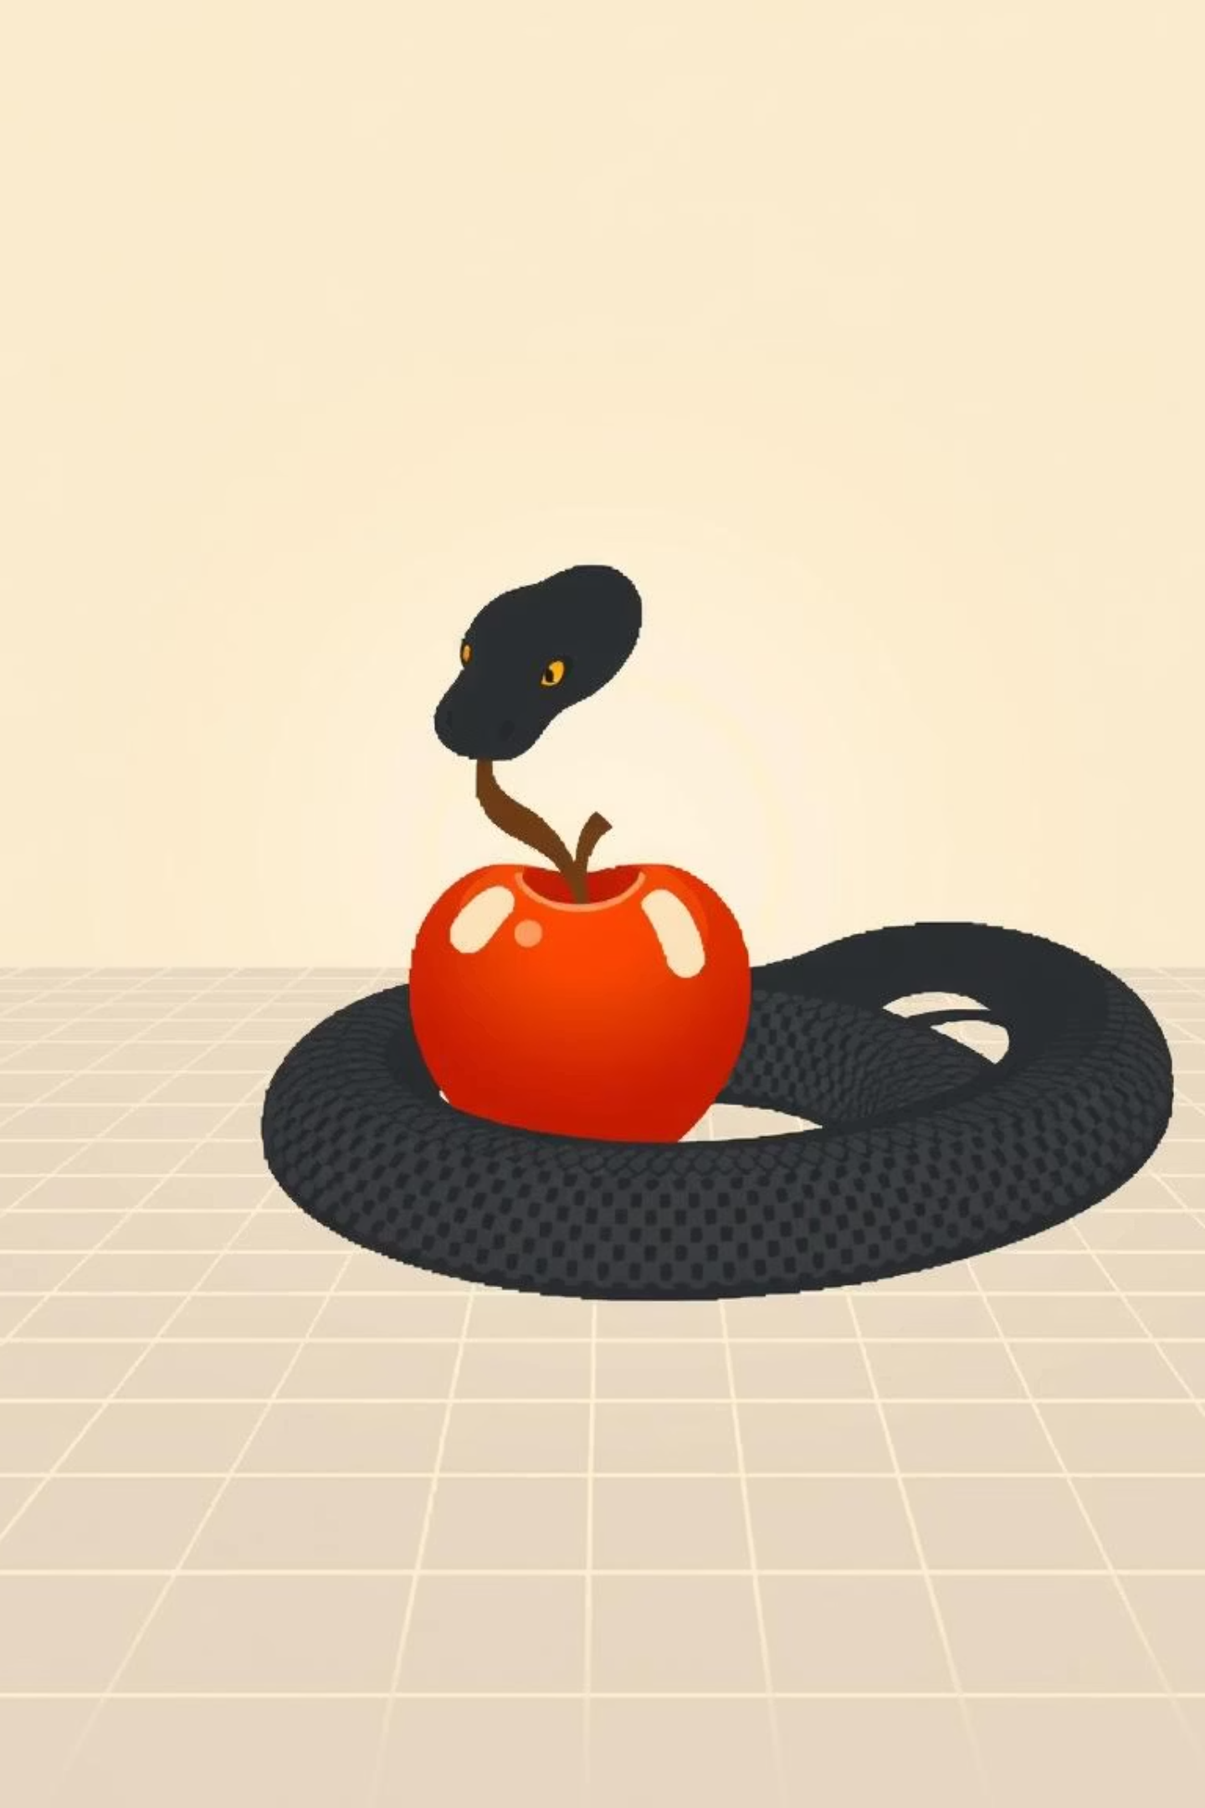

Snake Game in C++: A Journey from Concept to Code
Welcome to an exploration of a classic arcade game reimagined in C++. This presentation will cover the development, mechanics, and learning benefits of building a Snake game using fundamental C++ programming concepts.

Slide 2
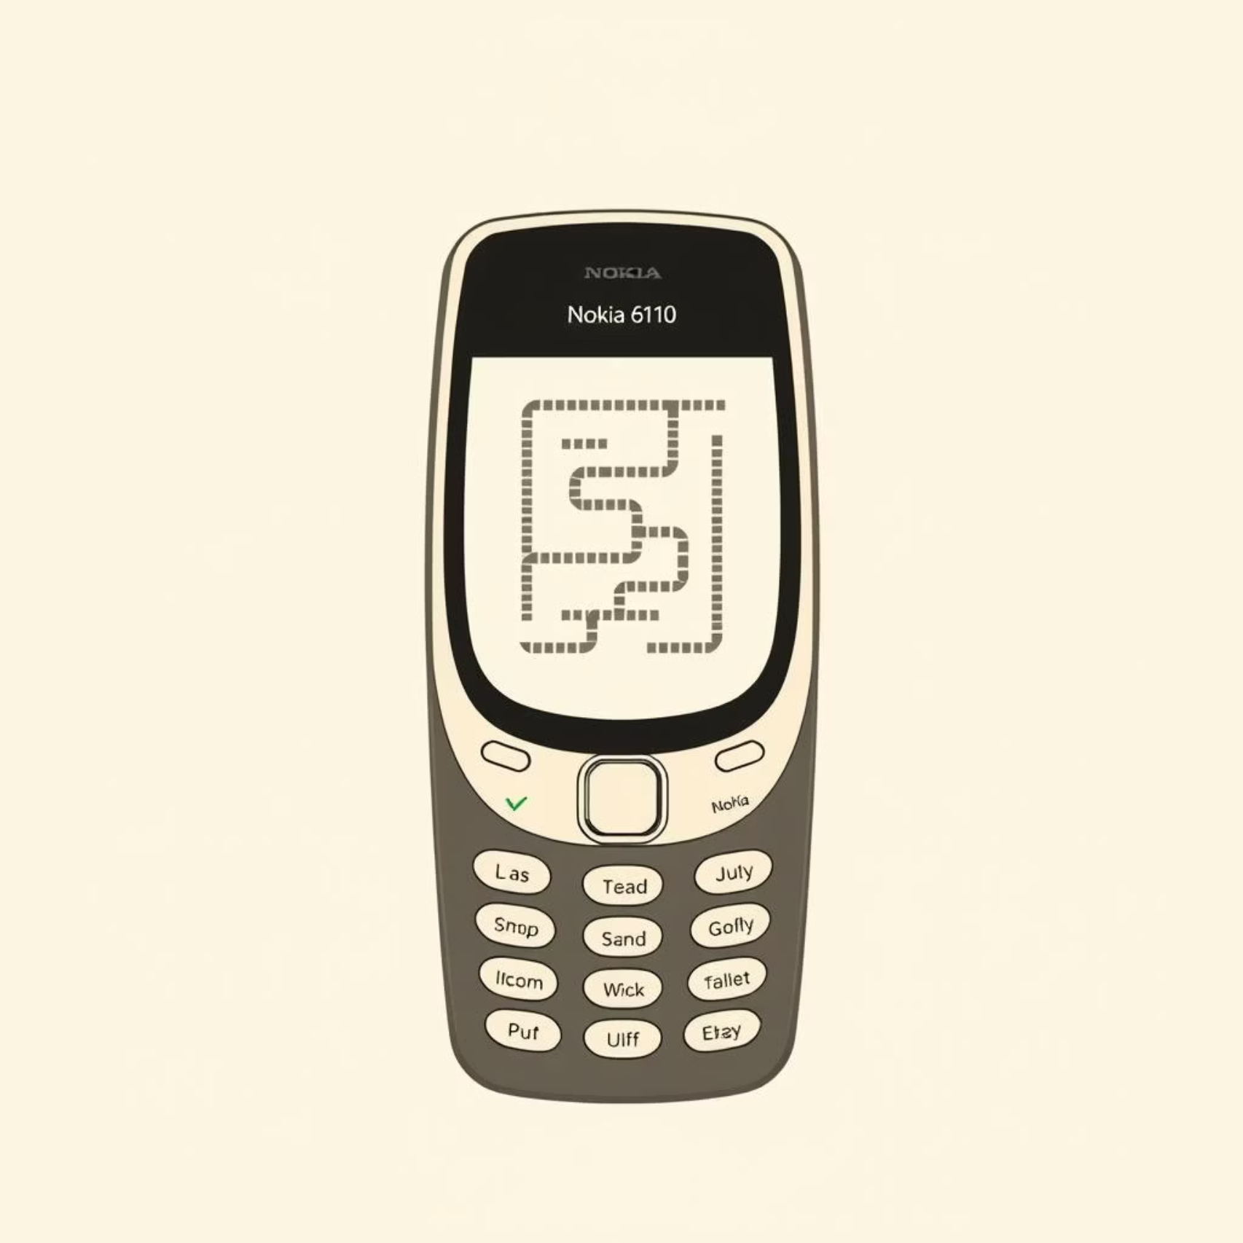
Chapter 1
The Legacy of Snake
The Snake game has a rich history, originating in the mid-1970s as "Blockade" in arcade machines. Its simple yet addictive gameplay captured imaginations early on.
It truly gained global recognition and iconic status when it was pre-installed on Nokia phones, starting with the Nokia 6110 in 1997, making it one of the earliest and most beloved mobile games.

Slide 3




Chapter 2
Core Game Principles
Intuitive Controls
Growth & Score
Players navigate the snake using simple keyboard inputs (arrow keys).
Eating X increases the snake's length the head is addressed as & and the body gets developed by #
Collision Avoidance
Performance Metric
The primary objective is to avoid hitting walls or the snake's own growing body.
The game concludes upon any collision reflecting player performance.

Slide 4
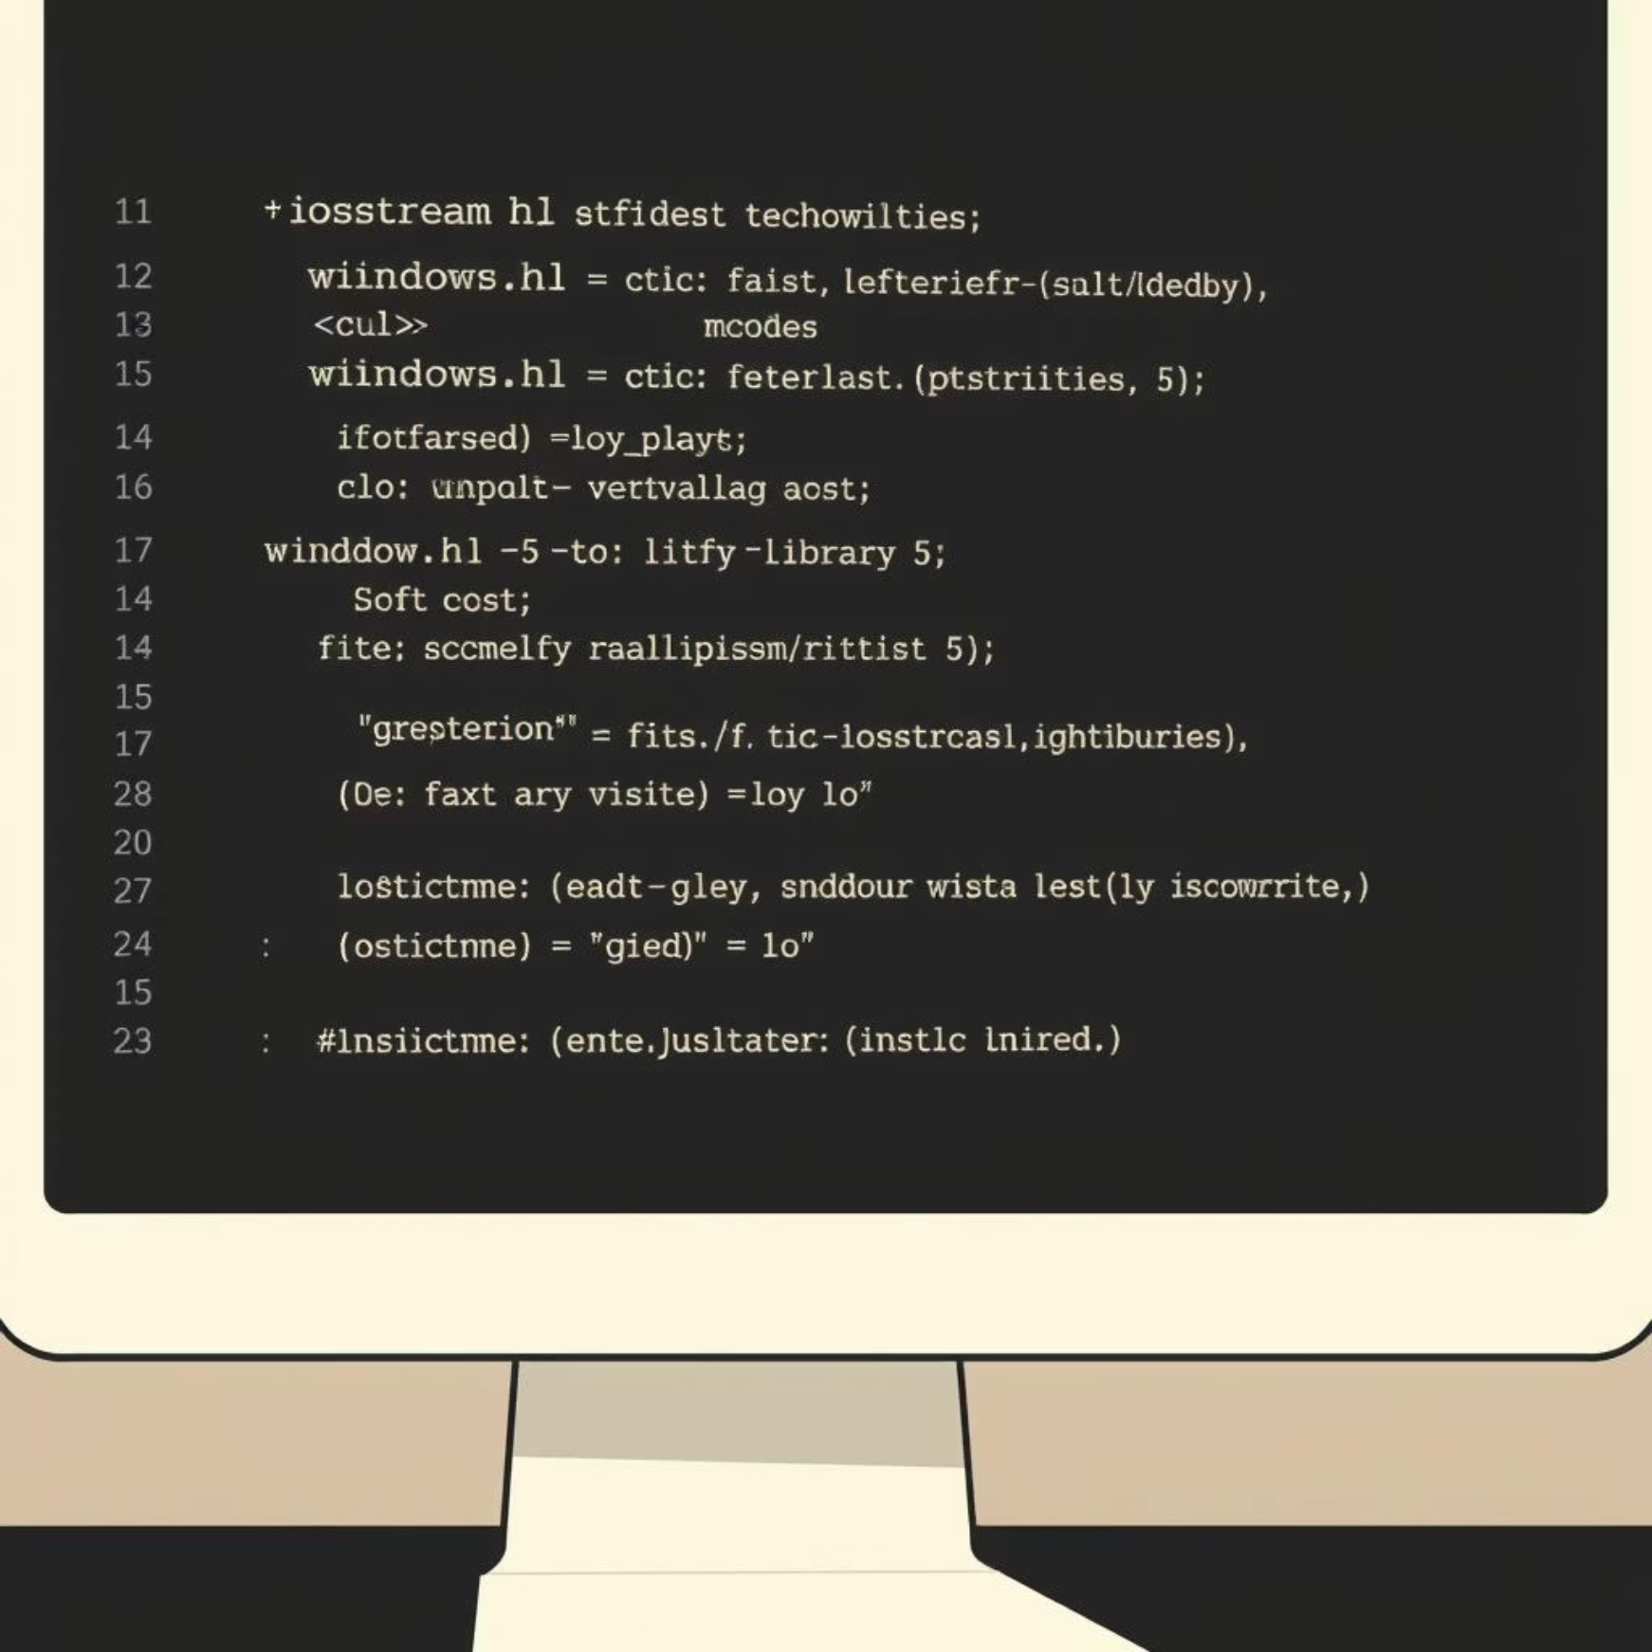
The C++ Foundation
Our Snake game is a console-based application built entirely within C++.
It leverages standard and system-specific
libraries to create a dynamic and interactive experience.
Core Libraries Utilized
iostream: For standard input/output operations.
windows.h: For system-specific functions like setting cursor position.
The design emphasizes modularity, utilizing classes and functions to encapsulate different game elements, all orchestrated by a central game loop.

Slide 5




Chapter 4
Anatomy of the Code
The game's functionality is broken down into distinct components, each responsible for a specific aspect of gameplay.
Snake Class
Board Rendering
Manages the snake's segments, including its position, movement logic, and how it grows after consuming food.
Handles the visual representation of the game, drawing the snake, food item, and defining the game boundaries within the console.
Input Handling
Collision Detection
Captures real-time user keystrokes, translating them into directional commands for the snake's movement.
Continuously monitors the snake's position to detect impacts with walls or its own body, triggering the 'game over' condition.

Slide 6
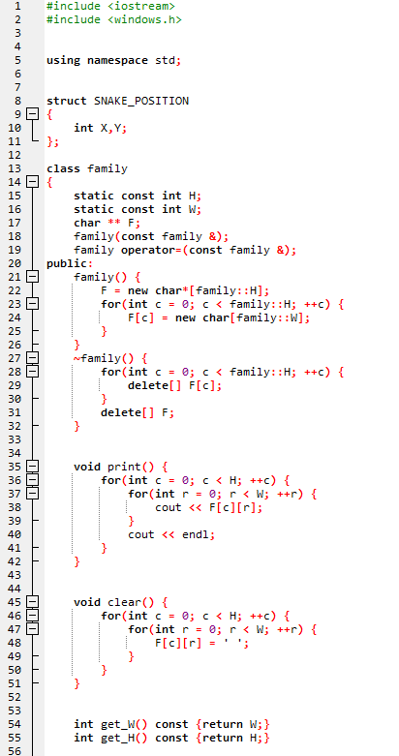
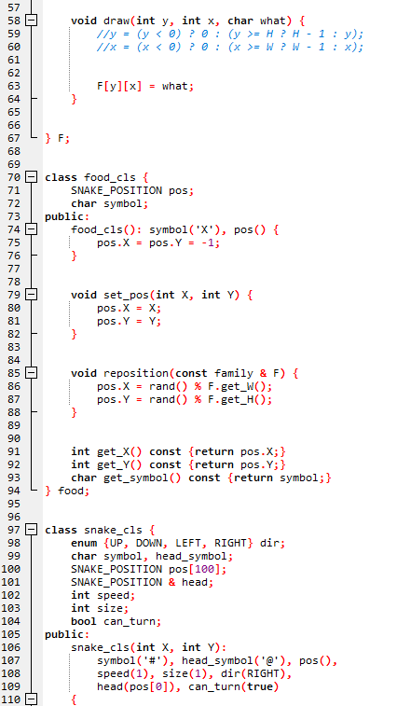
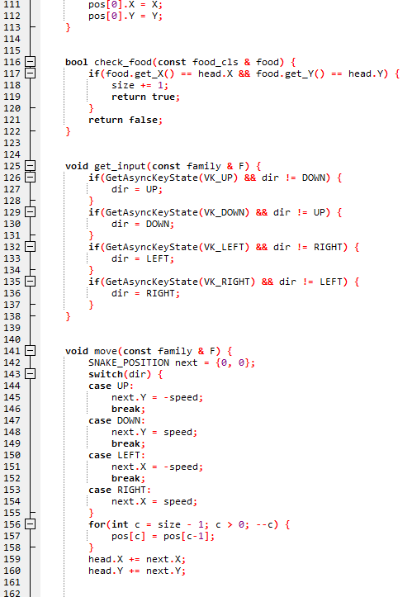

Slide 7
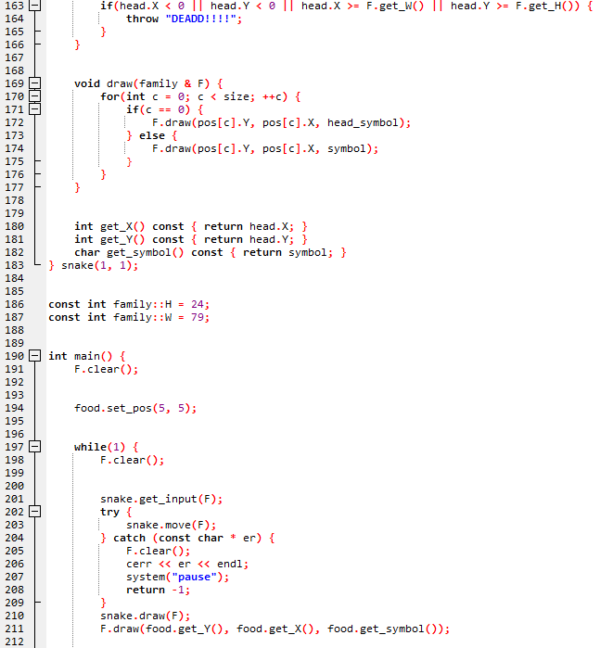
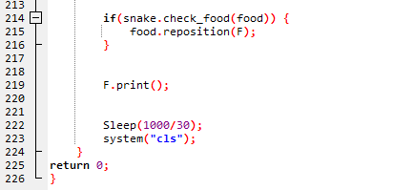

Slide 8










Chapter 5
The Game Loop: Heart of the System
The game operates on a continuous cycle, updating the state and rendering the visuals to create a smooth, interactive experience.
Initialization Step
Frame Timing and Cleanup
At the start (before entering the loop), the board is cleared and the initial food position is set. The snake is already positioned via its constructor.
The loop sleeps to cap the frame rate (Sleep(1000/30)+30 FPS) then clears the console (system(“cls”) to prepare for the next frame. If the snake died the exception is caught a message is shown and the program exits
Input Handling
Each iteration, the loop reads input via snake.get_input(..) pooling the arrow keys with GetAsynckeyState to update the snakes direction.
Render Frame
The snake {head and body ) and the food are drawn onto the board buffer. The current frame is output to the console via F-printf()
Update Game Stat
The snake is moved based on its current direction after movement, the program checks if the snakes head is on food if so snake’s size increases

Slide 9
Conclusion & The Road Ahead
The C++ Snake game successfully demonstrates core programming and game design principles.
Key Takeaways
Future Enhancements
A classic game recreated, showcasing C++ capabilities.
Graphical Interface: Transition from ASCII to full graphics (e.g., SDL2).
Practical application of OOP and fundamental algorithms.
Multiplayer Mode: Implement local or network-based competitive play.
A solid foundation for future development endeavors.
Advanced Scoring: Introduce high score tables and power-ups.
Level Design: Create different game environments and challenges.
This project encourages deeper exploration into interactive programming, turning theoretical knowledge into tangible, playable results.

