Slide 1

Quality Management

Slide 2
Quality Management
Software quality is a complex concept that is not directly comparable with quality in manufacturing
Good quality managers aim to develop a quality culture where everyone responsible for product development is committed to achieving a high level of product quality
Software quality management for large systems can be structured into three main activities
Quality Assurance – The establishment of a framework of organisational procedures and standards that lead to high quality software
Quality Planning – The selection of appropriate procedures and standards from this framework adapted for a specific software project
Quality Control – The definition and enactment of processes that ensure the software development team has followed project quality procedures and standards

Slide 3
Quality Management
Quality management provides an independent check on the software development process.
The quality management process checks the project deliverables to ensure that they are consistent with organisational standards and goals
The quality assurance team should be independent from the development team so that they can take an objective view of software. They report problems and difficulties to senior management in organisation
The following is the diagram for quality management and software development

Slide 4
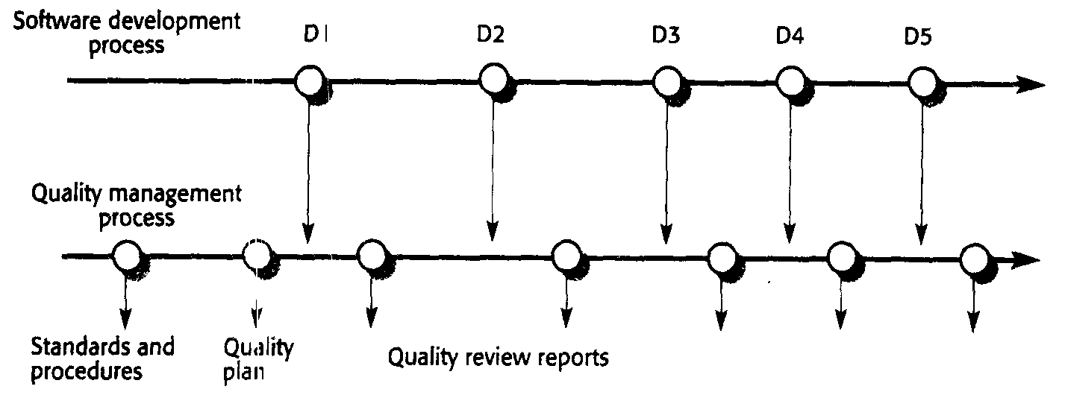
Quality Management And Software Development

Slide 5
Quality Assurance And Standards
Quality assurance is a process of defining how software quality can be achieved and how a development organisation knows that the software has the required level of quality.
The QA process is primarily concerned with defining or selecting standards that should be applied to the software development process or software product.
As part of QA process selection for tools and methods to support these methods can be done
The two types of standards that can be established as a part of quality assurance process are
Product Standards – These standards apply to the software product being developed. They include document standards, such as the structure of requirements documents; documents standards, such as a standard comment header for an object class definition; and coding standards that define how a programming language should be used
Process standards – These standards define the processes that should be followed during software development. They may include definitions of specification, design and validation processes and a description of the documents that should be written in the course of these processes

Slide 6
ISO 9000
An international set of standards that can be used in the development of a quality management system in all industries
These standards can be applied to a range of organisations from manufacturing to service industries
ISO 9001 is the most general of these standards and applies to organisations concerned with the quality process in organisation that design, develop and maintain products.
This standard isn’t specifically aimed at software development but sets out general principles that can be applied to software.
The ISO 9001 standard describes various aspects of the quality process and lays out the original standards and procedures that a company should define
These should be documented in an organisational quality manual.
The process definition should include descriptions of the documentation required to demonstrate that the defined process have been followed during product development
The ISO 9001 standard does not define the quality processes that should be used. It does not constrain the processes used in any organisation in any way.
This allows flexibility across industrial sectors and means that small companies can have fairly unbureaucratic processes and still be ISO 9000 compliant.
This flexibility means that one cannot make any assumption about the similarity or differences between the processes in ISO 9000 compliant companies

Slide 7
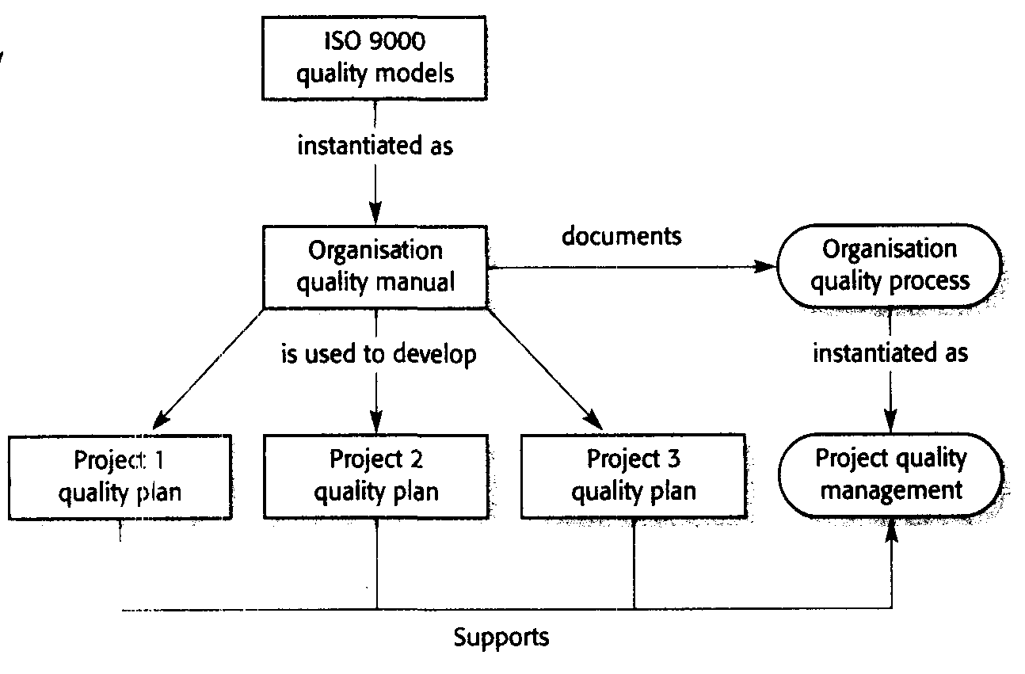
ISO 9000 And Quality Management

Slide 8
Quality Planning
It is the process of developing a quality plan for the project which should set out the desired software qualities and describe how these are to be assessed
It therefore defines what high quality software actually means
Without this definition engineers may make different and sometimes conflicting assumptions about which product attributes should be optimised
The quality plan should select these organisational standards that are appropriate to a particular product and development process
New standards may have to be defined if the project uses new methods and tools
Quality plans differ in detail depending on the size and the type of the system . However when writing quality plans try to keep them as short as possible else people will not read and the purpose of producing a quality plan will be a failure

Slide 9
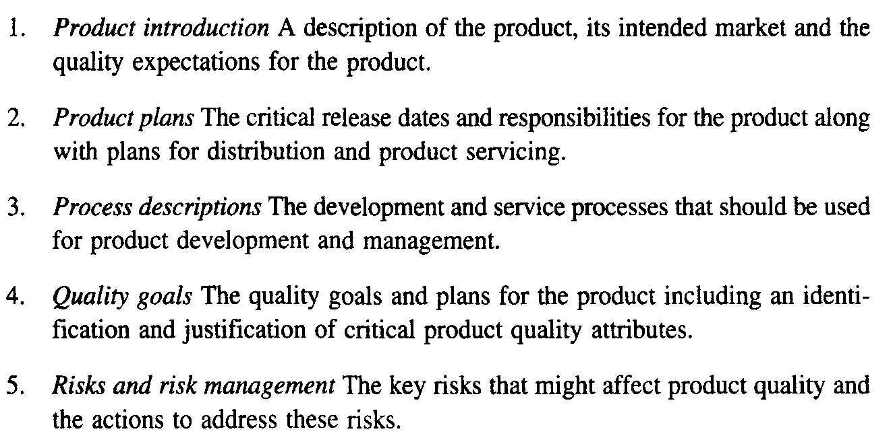
Outline Structure For Quality Plan

Slide 10
Quality Planning
There are wide range of potential software quality attributes that should be considered during the quality planning process
As it is not possible for any system to be optimised for all the attributes hence in quality plan the most important quality attributes for the software that is being developed must be defined
It may be that efficiency is critical and other factors have to be sacrificed to achieve this and if this is stated in the quality plan the engineers working on the development can cooperate to achieve this
The plan should also include a definition of the quality assessment process which should be a standard way of assessing whether some quality such as maintainability or robustness is present in the product

