Slide 1
The Sprint Retrospective
Derek Parker
Agile Coach and Trainer

Slide 2
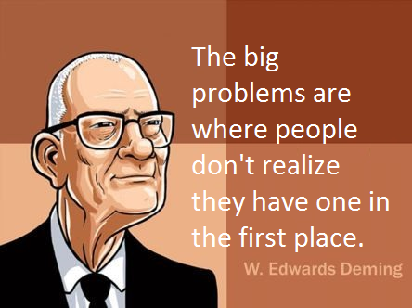
Next Sprint

Slide 3
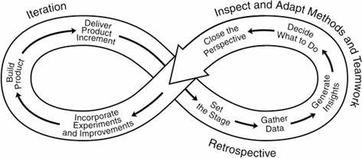
What is a Retrospective?
The 12th principle of Agile states, “At regular intervals, the team reflects on how to become more effective, then tunes and adjusts its behavior accordingly.”
Next Sprint
The Retrospective is performed at time-boxed iteration intervals and to a specific cadence to allow the sprint team to look back at the last iteration and determine:
What is going well?
What Areas could use improvement?
What should the team be doing differently?
As problems are identified and their value determined, and the solutions are discussed and acted upon.
Any solution that did not help is considered a learning opportunity.

Slide 4
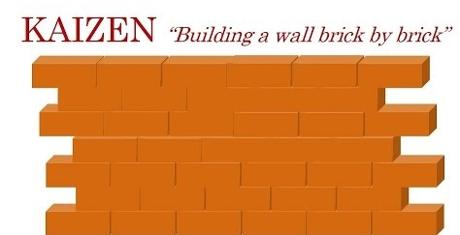
Next Sprint
Kaizen is continuous improvement through incremental change
No matter how good your team is today, the philosophy of Kaizen says it can be better. Continuous improvement never stops
To generate a Kaizen, everyone involved must begin thinking about their work in a new way – in terms of:
Now: Present condition
Next: Desired state
New: How to reach that state

Slide 5
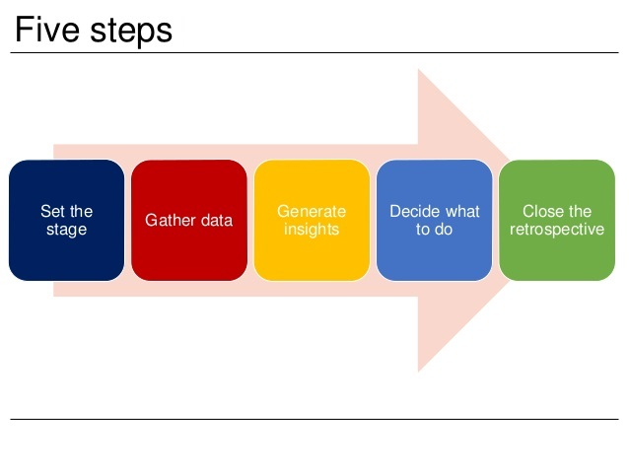
The Steps of the Sprint Retrospective
Next Sprint

Slide 6
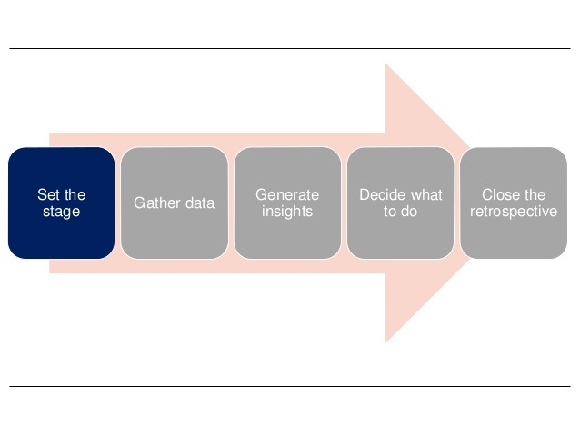
Set the Stage
Next Sprint

Slide 7

Set the Stage
Next Sprint
The facilitator gets all participants talking from the beginning.
Check-ins. Participants answer a series of check-in questions with one or two word answers.
Facilitator goes over what the team should focus on and what they should focus off.
Inquiry rather than Advocacy
Dialog rather than debate
Conversations rather than argument
Understanding rather than defending
Working agreements- the team brainstorms and then defines the working agreements they would like to put in place for the retrospective.

Slide 8
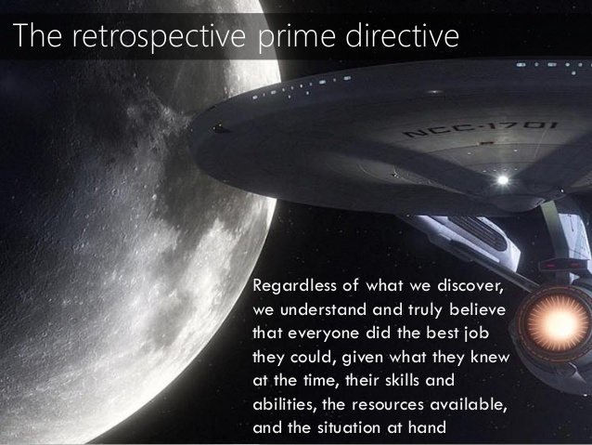
Set the Stage
Next Sprint

Slide 9
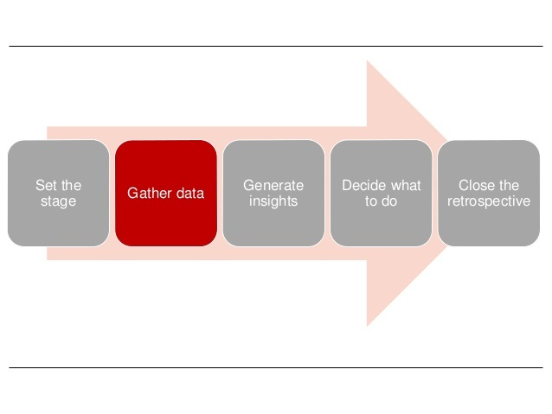
Gather Data
Next Sprint

Slide 10
Gather Data
Create a shared picture of what happened during the iteration
Begin the problem-solving process by collecting and integrating the pieces of the puzzle we are trying to solve.
Examples of team-based facilitation techniques used to gather data:
Timeline: the team members create a timeline to track the progress of the iteration
Triple Nickels: the team is divided into groups that spend five minutes gathering or building on five ideas, five times
Color Code Dots: the team members identify where their energy was high and low during the course of the iteration
Satisfaction Histogram: The team members create a graph that shows how satisfied they feel about a particular area or issue.
Team Radar: The team assesses how they have performed against their previous process improvement goals
Like to Like: the team compares their reactions to events that occurred over the course of the iteration.
You can find other examples in LinkedIn groups for Agile SMs and Coaches and at the Agile Uprising Coalition (https://coalition.agileuprising.com/).
Next Sprint

Slide 11
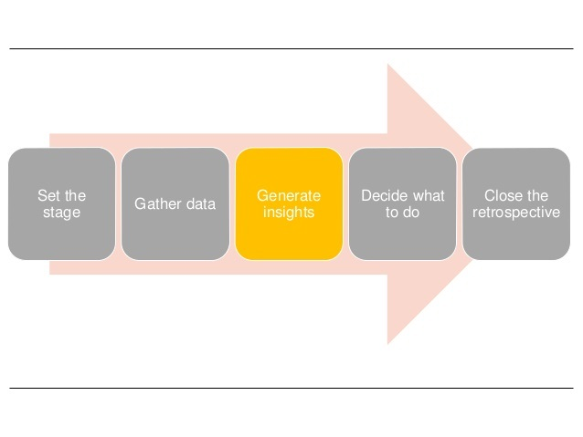
Generate Insights
Next Sprint

Slide 12
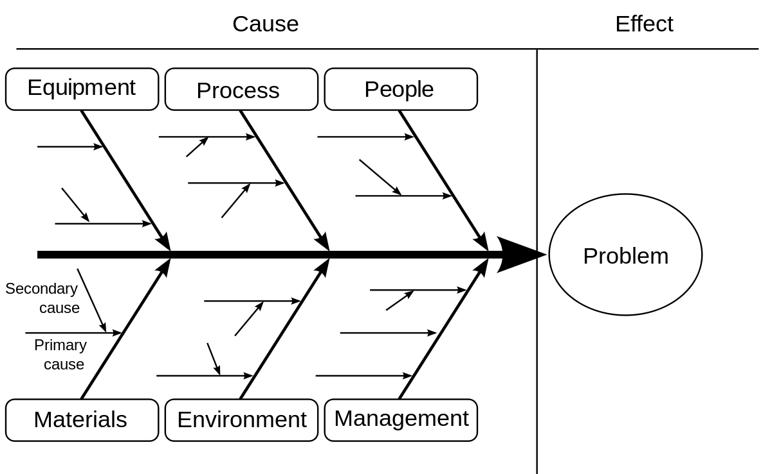
Generate Insights
Allows us to evaluate the data we gathered in the previous step and derive meaningful insights from it.
There are several team-based activities that we can use to generate insights, including:
Brainstorming
Root Cause Analysis (The Five Whys)
Root Cause Analysis (Fishbone Diagraming - below)
Identify Themes
Next Sprint

Slide 13
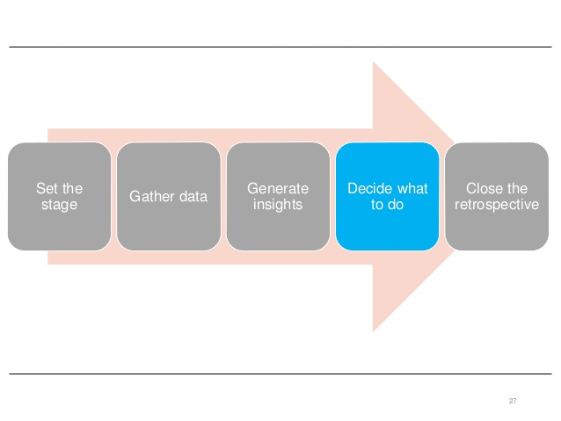
Deciding What to Do
Next Sprint

Slide 14
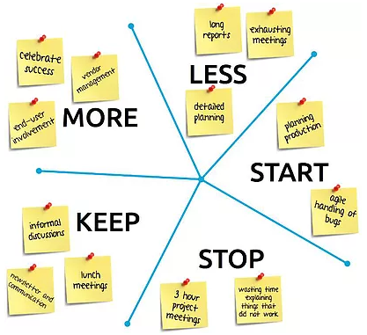
Deciding What to Do
The last of the three problem solving steps. This moves from thinking about the last iteration and thinking about the next one and what we will improve.
There are several activities we can use to help decide on a plan of action including:
Short Subjects/Starfish – Do more of, do less of, keep doing, start doing, stop doing.
Next Sprint

Slide 15
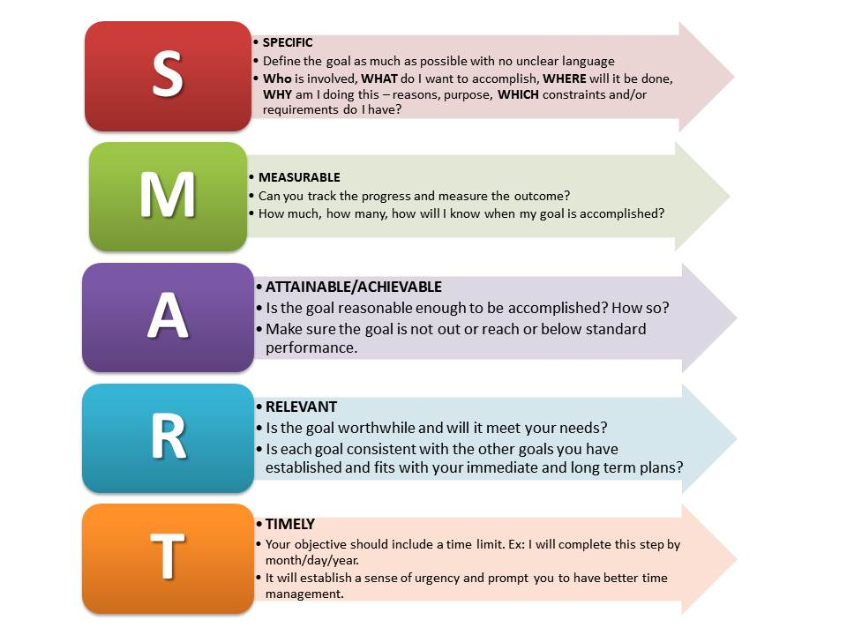
Deciding What to Do
SMART Goals: the participants transform their list of action items into goals that are SMART.
Next Sprint

Slide 16

Deciding What to Do
Circle of Questions – Each participant asks a question about how to improve one of the issues that has been identified, to be addressed by the next person in the circle.
Next Sprint
As with data gathering games, you can find other examples in LinkedIn groups for Agile SMs and Coaches and at the Agile Uprising Coalition (https://coalition.agileuprising.com/).

Slide 17
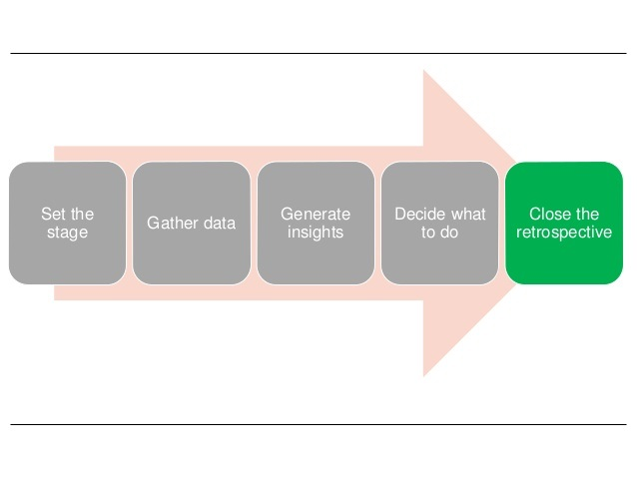
Close the Retrospective
Next Sprint

Slide 18
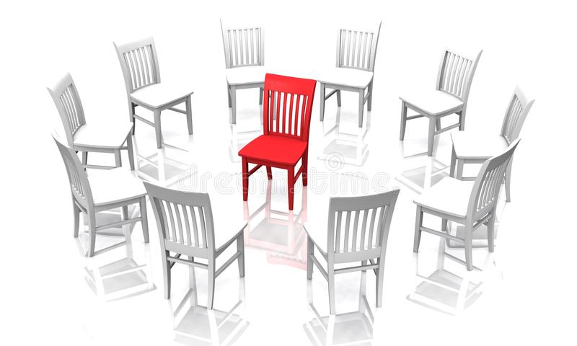
Close the Retrospective
Reflect on what happened during the retrospective and express our appreciation to each other.
The team provides feedback for the retrospective itself, such as:
Helped, Hindered, Hypothesis: What helped, what hindered, any ideas they came up with (hypothesis) for improving future retrospectives.
Return on Time Invested (ROTI): participants discuss the benefits of retrospectives, and then grade the meeting on a five-point scale to show whether the time was well spent.
Appreciations: team members have an opportunity to express their appreciation to each other for specific efforts during the iteration (Central Chair exercise, Appreciation Post Cards, etc.)
Next Sprint

Slide 19
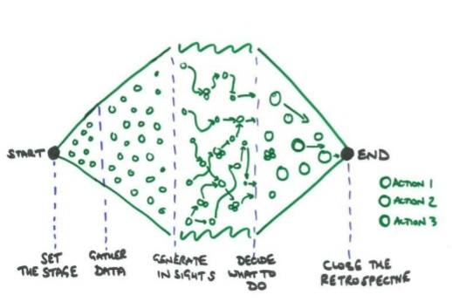
Questions on the Sprint Retrospective
Next Sprint

