Slide 1
High Level Movement Control for
Autonomous Vehicle

Slide 2
Why do we need robots?
Human can't / won't do this work.
  Waste of time
    Mow the lawn
    Do the hoovering
  Not strong enough
    Build cars
  Vulnerable
    Repair damaged nuclear power plants
  ...

Slide 3
When has a robot to be autonomous?
Not possible to create a connection
  Deep in the sea
  Behind the Moon
To slow connection
  Mars, Moon robots
React very quickly
  Soccer robots

Slide 4
What means autonomous?
No human manipulation or control
No connection to a
  other robot
  control centre
  ...
No signs

Slide 5
Duties
Estimate the current position
  Possible positions
  Types of measure failures of sensors
Think about the target
  Were will i arrive
Plan the selected root
Refresh the root if something goes wrong
  Unknown barriers

Slide 6
Problems
Measure faults
Choice of sensors
  Cheap
  Different
  Combine them
Actor variation
  Motor RPM
Positioning
  Kidnapped Robot Problem

Slide 7
Environment

Slide 8
Arduino
Environment to program an micro-controller
  Board with full hardware
    USB – Serial
    Power supply
    Wide up pin distance
  Software to program
  Stackable shields

Slide 9
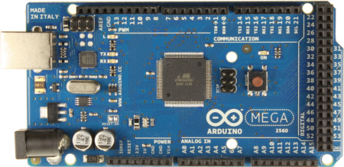
Arduino Mega 2560

Slide 10
Programming an microcontroller
Data types differs
  int (16)
  long (32)
  float (32)
  double (32)
Floating-point numbers
  Very slow
  Precision 6-7 digits

Slide 11
Programming an microcontroller
IO
  Binary I/O
  Analog, PWM
  UART / RS232
  I2C / TWI

Slide 12
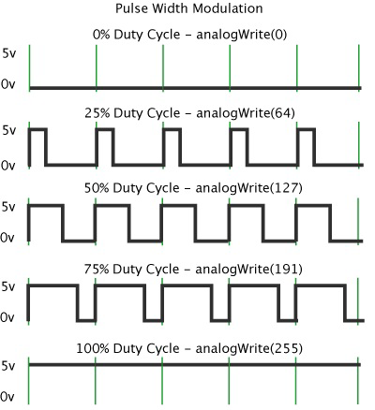
PWM – analog output

Slide 13
Programming an microcontroller
Interrupts
  Timer
  Pin change
Exception Result
  Continue
  Restart

Slide 14
Positioning

Slide 15
Sensor Types
Absolute sensors
  Lateration
    GPS, Mobile telephony
Environment detection
  Image recognition
  Bumper, distance sensor
Relative sensors
  Gyro, acceleration, magnetometer
  Rotary encoder
  Mouse sensor

Slide 16
Measure failures
Methodical
  Wrong calibration
  Wrong filter algorithm
  ...
Randomly
Runaway value

Slide 17
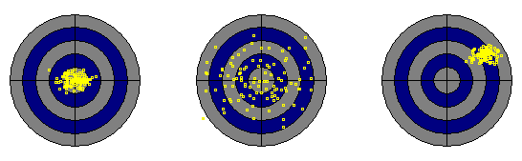
Measure failures

Slide 18
Combine different sensors
Weight of sensor
Type of sensor
Measure fault type
Precision
Calibration
Previous filters

Slide 19
Position specification
Stored
  Position + direction
    2D
    3D
  Particle cloud
    Probability
Related to
  Start point
  Objects (Barriers)

Slide 20
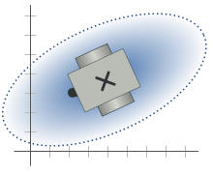
Position specification

Slide 21
Thank you for your attention

