Slide 1
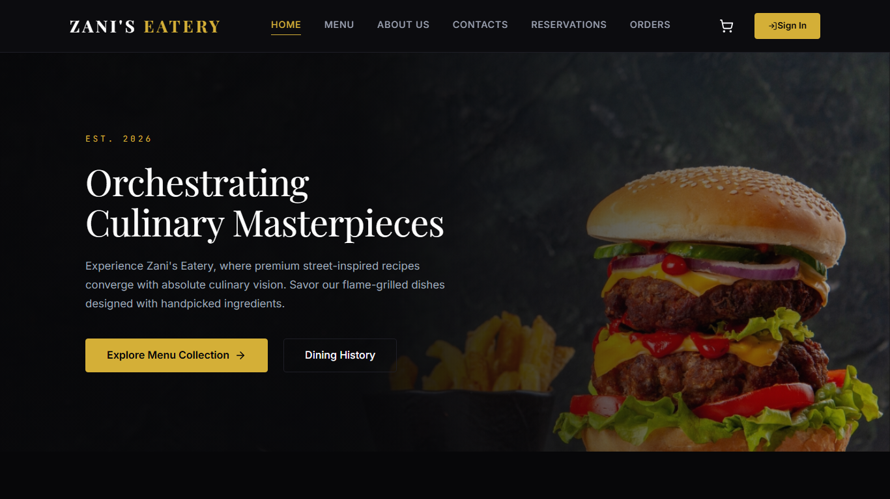
AWS Cloud Migration Presentation
Zani's Eatery
Static website, online bookings, orders, and a serverless AWS architecture for a growing local restaurant.
S3
af-south-1
Static website hosting and menu assets
Cape Town region for South African users
Prepared as a solutions architecture deck | May 2026
Notes:
Introduce the project as a migration story: Zani's Eatery needed to move from manual bookings and orders to a simple static website backed by AWS services.

Slide 2
TABLE OF CONTENTS
The story moves from business problem to AWS solution.
01
Company overview
Where the restaurant is from and why it was selected
02
Restaurant challenges
Manual bookings, order mix-ups, and scaling limits
03
Static website build
How the front end was designed and deployed
04
AWS migration architecture
Services, data flow, benefits, and roadmap
Source: zani-eatery-aws-report.md and deployed S3 website
02
Notes:
Use this slide to set expectations. The presentation is intentionally concise and uses speaker notes for extra detail.

Slide 3
COMPANY OVERVIEW
Zani's Eatery is a local restaurant ready for a digital operating model.
Background
100+
54.2K
Local township restaurant in Katlehong, South Africa.
daily customers noted in the project report
Instagram following used as demand signal
Growing demand across walk-ins, phone bookings, and food orders.
Selected because its manual process creates visible customer-service risk.
Solution architect view
Goal: let customers browse, book, and order from a simple website.
The first release should stay simple: static website on S3, then add secure identity, database-backed bookings, and staff notifications as the business grows.
Source: zani-eatery-aws-report.md and deployed S3 website
03
Notes:
Explain that the restaurant was chosen because it represents a realistic small-business AWS migration: high demand, manual processes, limited budget, and a need for fast deployment.

Slide 4
RESTAURANT CHALLENGES
Manual booking and order handling created avoidable errors.
Challenge
Business impact
Risk
Manual bookings
Paper or spreadsheet records caused double bookings and slow confirmations.
High
Order mix-ups
Handwritten or phone orders were easy to misread during peak hours.
Critical
No customer history
Repeat customers, preferences, and special requests were not centralized.
High
Scaling cost
More demand meant more admin work, staff pressure, and on-premises risk.
High
Source: zani-eatery-aws-report.md and deployed S3 website
04
Notes:
Tie the challenge to the assignment requirements: no cloud migration, operational inefficiency, no centralized customer data, and expensive scaling.

Slide 5
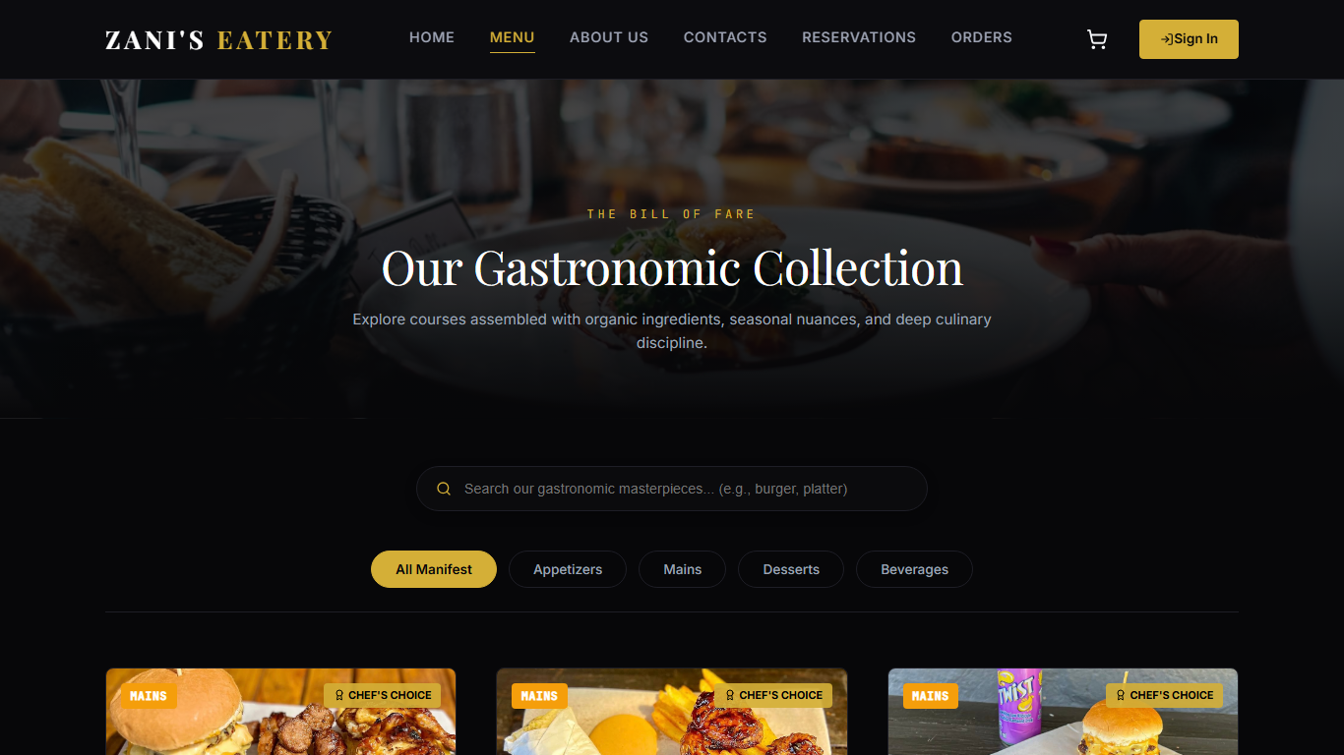
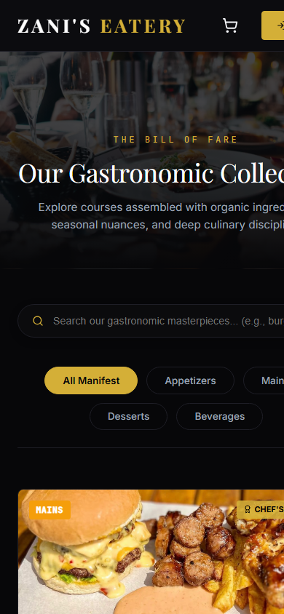
STATIC WEBSITE DESIGN
The website gives customers a direct path to menu browsing and orders.
Design decisions
Dark restaurant theme with gold call-to-action accents.
Responsive navigation for desktop and mobile visitors.
Search and category filters for fast menu discovery.
Authentication gate before checkout and order history.
Source: deployed S3 website screenshots
05
Notes:
Demonstrate the website visually. Mention that customers can explore the menu, use search/category filters, and are guided toward sign-in for protected order history or checkout actions.

Slide 6
BUILD AND DEPLOYMENT
The first release is a static front end deployed to Amazon S3.
1. Design
2. Package
3. Upload
4. Serve
HTML, CSS, JavaScript, responsive pages, menu data, and images
Optimized static files: index.html, /pages, /styles, /scripts, /data
aws s3 sync build/ to the website bucket in af-south-1
S3 website endpoint hosts the live restaurant site
Live URL
http://aws-restart-03.s3-website.af-south-1.amazonaws.com/pages/menu.html
S3 gives the restaurant a low-cost public website without managing web servers.
Source: zani-eatery-aws-report.md and deployed S3 website
06
Notes:
Explain that the current deployed artifact is static: S3 hosts the front-end pages and images. Dynamic capabilities are handled in the target architecture through Cognito, API Gateway, Lambda, RDS or DynamoDB, and SNS.

Slide 7
TARGET AWS INFRASTRUCTURE
AWS separates the static website from secure business workflows.
Customer layer
Customer browser
Amazon CloudFront
Amazon S3
Mobile or desktop
Fast cached delivery
Static website and menu images
Application layer
Amazon Cognito
API Gateway
AWS Lambda
Amazon SNS
Customer sign-in and profiles
Booking and order APIs
Validation, processing, confirmation
Staff email or SMS alerts
Data layer
Amazon RDS or DynamoDB
Customers, bookings, orders, preferences
Source: zani-eatery-aws-report.md and deployed S3 website
07
Notes:
Walk through the architecture from left to right. S3 and CloudFront serve static content. Secure actions go through Cognito, API Gateway, Lambda, and the database. SNS notifies staff when action is required.

Slide 8
AWS SERVICES USED
Each AWS service maps to a specific restaurant need.
Service
Restaurant use
Why it fits
Amazon S3
Host static website and store menu images
Low-cost, highly durable object storage
Amazon Cognito
Customer sign-in and order history access
Managed authentication without custom auth servers
Amazon RDS or DynamoDB
Store profiles, bookings, and order records
Central source of truth for operations
AWS Lambda
Run booking/order logic and confirmation tasks
Serverless compute, scales with demand
Amazon SNS
Notify staff about new bookings and orders
Fast SMS/email fan-out to the team
API Gateway
Expose secure booking and order endpoints
Managed front door for the application API
Source: zani-eatery-aws-report.md and deployed S3 website
08
Notes:
Keep this slide concise. The key is service-to-business-fit, not a deep AWS feature lecture.

Slide 9
BOOKING AND ORDER FLOW
A customer request becomes a stored record and staff notification.
1. Visit site
2. Sign in
3. Submit request
4. Process
5. Confirm
Customer opens S3-hosted website through browser
Cognito validates identity for protected actions
Booking or order form sends API request
Lambda validates, checks conflicts, and writes data
SNS/email alerts staff and confirms the customer
Data written to Amazon RDS or DynamoDB
Operational result: fewer double bookings, fewer order mistakes, and faster customer confirmations.
Source: zani-eatery-aws-report.md and deployed S3 website
09
Notes:
Explain the flow as a practical restaurant journey: customer submits, Lambda checks business rules, the database stores the record, and SNS/Lambda handles notification and confirmation.

Slide 10
MIGRATION APPROACH
The migration is phased so the restaurant gets value early.
Phase 1
Phase 2
Phase 3
Static website
Secure workflows
Operate and improve
Publish menu, brand pages, contact details, and basic order journey on S3.
Add Cognito, API Gateway, Lambda, and database-backed bookings/orders.
Add monitoring, analytics, automated notifications, and cost controls.
Architecture principle: start with the lowest operational burden, then add managed services only where the business workflow needs them.
Source: zani-eatery-aws-report.md and deployed S3 website
10
Notes:
Describe this as a conservative migration plan. The restaurant does not need to buy servers or build everything at once.

Slide 11
BENEFITS
AWS improves reliability while keeping the monthly run cost small.
78%
< 1%
0
estimated cost reduction vs on-premises infrastructure
target booking error rate after validation and central records
servers for the owner to patch or maintain
Why AWS is the right fit
Pay-as-you-go pricing, managed scaling for weekend rushes, durable storage for assets, centralized customer data, and a clear path to notifications, analytics, and future online payments.
Source: project report cost and outcome estimates
11
Notes:
Benefits should connect to restaurant pain points: fewer mistakes, quicker confirmations, lower infrastructure cost, less maintenance, and better customer visibility.

Slide 12
Conclusion
Zani's Eatery can migrate from manual operations to a practical AWS-backed digital platform.
Keep S3 as the low-cost static website foundation.
Add Cognito and a database for customer history.
Use Lambda and SNS to automate confirmations.
Extend later with payments, analytics, and loyalty.
Recommended next step: complete the secure booking/order workflow and connect it to the staff notification process.
12
Notes:
Close by emphasizing business value: the website is the front door; AWS managed services make the operational workflow reliable, scalable, and affordable.

