Slide 1
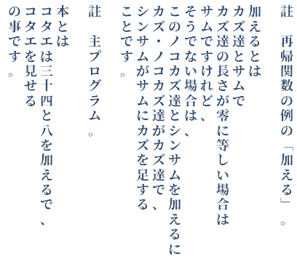
Haku
A toy functional language
based on literary Japanese
Wim Vanderbauwhede
2021

Slide 2
About the name
I call the language 'haku' because I like the sound of it, and also because that word can be written in many ways and mean many things in Japanese.

Slide 3

Haku from Spirited Away

Slide 4
His name would be written
珀

Slide 5
... or in full ...
邇芸速水琥珀主

Slide 6
but I prefer to write it
魄

Slide 7
because that means
soul, spirit

Slide 8
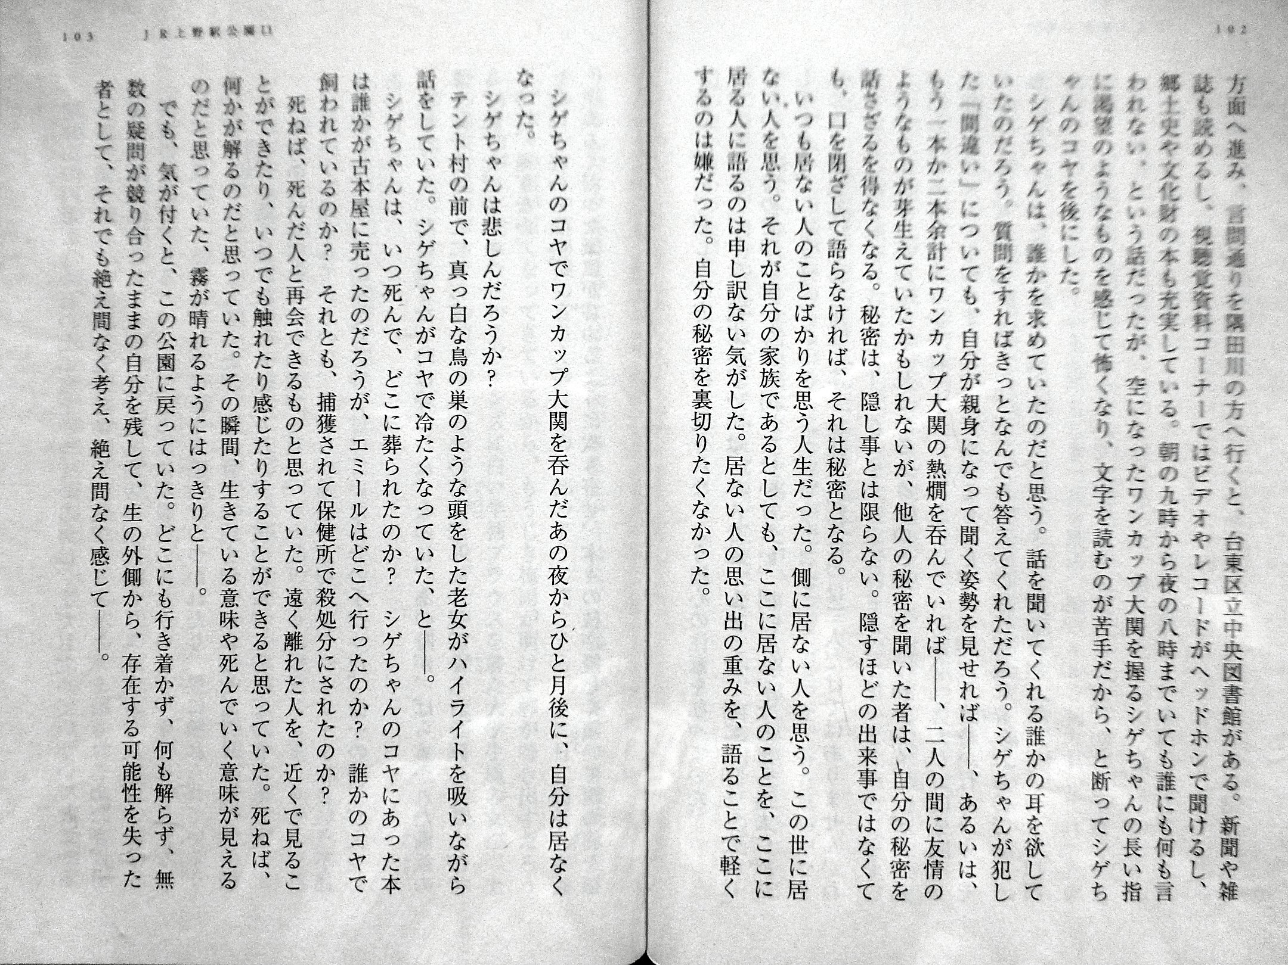
Literary Japanese

Slide 9
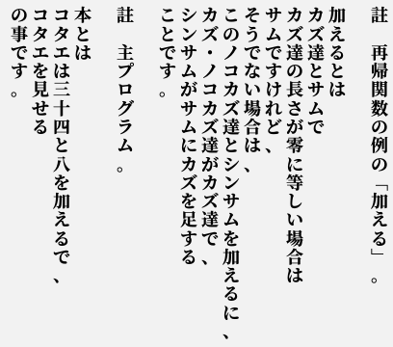
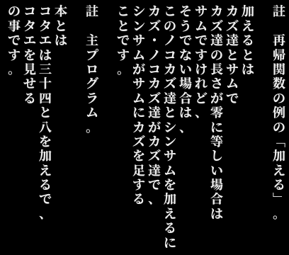
A Haku program

Slide 10
A Haku program

Slide 11
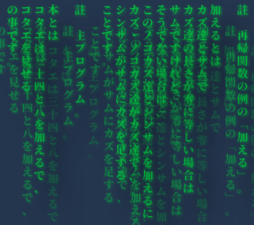

Slide 12
Motivation
There are several practical programming languages based on Japanese. So why make another one?
Short answer: to see what I would end up with.
Slightly longer answer: the existing languages serve a practical purpose. They want to make programming easier for Japanese native speakers, and most of them target education.

Slide 13
Motivation
I don't want to create a practical language.
I want to explore what the result is of creating a programming language based on a non-English language, in terms of syntax, grammar and vocabulary.
In particular, I want to allow the programmer some control over the register of the language.

Slide 14
Motivation: syntax
I also want the language to be closer, at least visually, to literary Japanese.
So Haku uses the Japanese writing system.
It does not use Roman letters, Arabic digits or common arithmetic or logical operators.
And it supports top-to-bottom, right-to-left writing.

Slide 15
Motivation: grammar
Japanese grammar is very different from most Indo-European languages. In particular, it has subject-object-verb order. This makes familiar constructs quite different.
From a poll about how coders perceive function calls, 3/4 of respondents answered "imperative" (other choices: infinitive, noun, -ing form). In Japanese, the imperative is rarely used.
In Haku, a function can be a verb or a noun, and the difference is clear from the syntax and the grammar. You can conjugate the verb forms.

Slide 16
Motivation: giving meaning
In principle, a programming language does not need to be based on natural language at all.
E.g. APL, uses symbols for everything. Agda programmers also use many mathematical symbols.
It works because of familiarity with the symbols.
Can an experienced programmer who does not know Japanese understand a Haku program?
If not, what are the minimal changes needed to make it understandable?

Slide 17
Parsing
Japanese does not use spaces. So how do we tokenise a string of Japanese?
There are three writing systems:
  katakana (angular):カタカナ
  hiragana (squigly):ひらがな
  kanji (Chinese character, complicated):漢字

Slide 18
Parsing
Katakana is used in a similar way as italics
Nouns, verb, adjectives and adverbs normally start with a kanji
Hiragana is used for verb/adjective/adverb endings and "particles", small words or suffixes that help identify the words in a sentence.
A verb/adjective/adverb can't end with a hiragana character that represents a particle.

Slide 19
Parsing
So we have some simple tokenisation rules:
  a sequence of katakana
  a kanji followed by more kanji or hiragana that do not represent particles
  hiragana that represent particles
Where that fails, we can introduce parentheses.
In practice, only specific adverbs and adjectives are used in Haku.

Slide 20
Tokenisation example
ラムダは或エクスでエクス掛けるエクスです。

Slide 21
Tokenisation example
ラムダは或エクスでエクス掛けるエクスです。

Slide 22
Tokenisation example
ラムダは
或エクスで
エクス掛けるエクス
です。

Slide 23
Tokenisation example
ラムダ, エクス: katakana word
は,で: (hiragana) particle
或: (kanji) pre-noun adjective
掛ける: verb (kanji followed by hiragana)
です: copula (hiragana)

Slide 24
A more complete example
試すとはサイとワイで
【このエクス割るサイに
ワが四十二で御座います、
エクスがワ足すワイで御座います】
と弐を掛けて下さい
と言う事で御座います。

Slide 25
Semantics
Haku is a simple, mostly-pure, implicitly typed, strict functional language.
Think Scheme with a sprinkling of Haskell

Slide 26
Core constructs
numeric and string constants
named functions
lambdas
let-bindings
lists and maps
conditional expressions

Slide 27
A Haku example
註 例のはくのプログラム。
本とは
ラムダは或エクスでエクス掛けるエクスです、
カズ達は八十八と七千百と五十五で、
イ・ロ・ハ・空はカズ達で、
シンカズはイとロの和で、
シンカズを見せる、
ケッカは〈七百四十壱をラムダする〉足す九百十九、
【ケッカとシンカズの和】を見せる
のことです。

Slide 28
Compiled to Scheme
; 例のはくのプログラム
(define (hon)
(let* (
(RAMUDA (lambda (EKUSU) (* EKUSU EKUSU )))
(KAZUTACHI (list 88 7100 55))
(I (car KAZUTACHI))
(RO (cadr KAZUTACHI))
(HA (caddr KAZUTACHI))
(SHINKAZU (+ I RO ))
(KEKKA (+ (RAMUDA 741) 919 ))
)
(displayln SHINKAZU)
(displayln (+ KEKKA SHINKAZU ))
)
)
(hon)

Slide 29
The main program
註 ... 。is a comment.
The main program (called 本, hon) has a fixed begin and end string:
本とは ... の事です。
In Romaji this reads:
"Hon to wa ... no koto desu."
This roughly translates as "Main is the following thing(s): ...".
In Scheme I emit Hon as a function with as body a let*-binding (i.e. binding is sequential):
(define (hon) (let* ( … ) … ))

Slide 30
Assignments and lambdas
In the example we have an number of different types of assignments:
ラムダは或エクスでエクス掛けるエクスです、
"RAMUDA wa aru EKSU de EKSU Kakeru EKSU desu"
Katakana is for variables, kanji for functions and keywords, hiragana for keywords and verb endings (e.g. in 掛ける and 見せる).
This means "as for RAMUDA, with a given X it is X times X", so RAMUDA binds to a lambda function. The 或 is like \ in Haskell.
In Scheme this becomes:
(RAMUDA (lambda (EKUSU) (* EKUSU EKUSU )))

Slide 31
Numbers and lists
Next we have an assignment to a list of number constants:
カズ達は八十八と七千百と五十五です、
"KAZUTachi wa 88 to 7100 to 55 desu,"
Numbers are written in kanji using the Japanese system.
The particle to is the list separator.
You can use 達 tachi to show that a variable name is plural.
In Scheme this becomes:
(KAZUTACHI (list 88 7100 55))

Slide 32
Iroha
Next we have a bit of syntactic sugar borrowed from Haskell (cons):
イ・ロ・ハ・空はカズ達です、
"I:RO:HA:Kuu wa KAZUTachi desu,"
空 kuu means "empty".
This means that the list is deconstructed into elements I, RO, HA and and empty list.
Scheme does not have this kind of pattern matching so each assignment is generated separately using car, cadr and friends.

Slide 33
Arithmetic operations
The next assignment,
シンカズはイとロの和で、
"SHINKAZU wa I to RO no Wa de"
This means
"SHINKAZU is the sum of I and RO"
There is also - (差), * (積) and / (除)
In Scheme
(SHINKAZU (+ I RO ))

Slide 34
Printing
Then we have a print function:
シンカズを見せる、
"SHINKAZU wo Miseru"
"To show SHINKAZU"
In Scheme:
(displayln SHINKAZU)

Slide 35
Calling a bound lambda
Then follows another assignment:
ケッカは〈七百四十壱をラムダする〉足す九百十九、
The 〈...〉are one form of parentheses
"KEKKA wa (741 wo RAMUDA suru) Tasu 919"
"KEKKA is (RAMUDA of 741) plus 919"
(KEKKA (+ (RAMUDA 741) 919 ))

Slide 36
More parentheses
And finally we show the result of an expression:
【ケッカとシンカズの和】を見せる
The 【...】are another form of parentheses
"(KEKKA to SHINKAZU no Wa) wo Miseru"
"To show the sum of KEKKA and SHINKAZU"
(displayln (+ KEKKA SHINKAZU ))

Slide 37
TMTOWDI
Haku offers variants for many constructs:
  Identifiers (verb, noun, katakana-word)
  Function calls (verb, noun, adjectival)
  Conditionals
  Let-bindings
And Haku allows verb conjugation

Slide 38
Haku registers
Given a function send: 送るとは... and an argument message:メッセージ
In Scheme: (send message)
Plain Haku
  メッセージを送る。
  “To send a message”
Polite Haku
  メッセージを送って下さい。
  “Please send the message”
And there are many more forms
Insistent Haku
  メッセージを送なさい。
  “Do send the message”
Adverbial
  送ったメッセージ。
  “The sent message”

Slide 39
Implementation
Haku is implemented in Raku, a gradually-typed multi-paradigm language.
The parser uses Raku’s Grammars. It is a recursive descent, longest token match parser.
The parser populates an AST using Haku’s Actions.
The AST is an algebraic datatype implemented using Haku’s Roles.
The emitter generates Raku code which is executed via dynamic module loading.
Currently all type checking is delegated to Raku.

Slide 40
If you don’t know Japanese
Haku requires some knowledge of Japanese.
But most programmers outside of Japan don’t have this.
How can they still experience Haku?
Enter Roku!

Slide 41
Roku
A version of Haku without kanji or kana.
It uses Romaji (latin alphabet) and some ASCII symbols instead.
It still keeps Haku's "no whitespace" idea and the grammatical order, and the case reflects the kana/kanji.

Slide 42
Roku example
# Example Roku program.
Main{
LL=\X->XtimesX;
NRS=77,7100,55;
X:Y:Z:[]=NRS;
NNR=X,Y|>sum;
NNR|>show;
RES=(741|>LL)add919;
(RES,NNR|>sum)|>show
}

Slide 43
Current status
Haku is available to play around with but it is not feature-complete or robust.
Roku is in the design phase.
You can find Haku at codeberg.org/wimvanderbauwhede/haku

Slide 44
Thank you!
どうも有難う御座います！

Slide 45
Questions?
質問？

