Slide 1
Ci/cd udacity-project
Give your application auto-deploy powers
By Mahmoud Elsayed Aly

Slide 2
Overview of presentation
The concept of CI/CD.
Benefits of CI/CD pipelines.
Technical Benefits of CI/CD pipelines.
Confronted challenges with automation Powers.
CI/CD pipeline

Slide 3
The concept of CI/CD
Continuous Integration
Continuous Delivery
Continuous Deployment

Slide 4
Continuous Integration
In continuous integration, source code changes are frequently and rapidly turned into software release candidates, to be further evaluated in Continuous Delivery. Continuous integration purposes include:
Ensured sufficient quality on the software to enable subsequent integration.
Rapid feedback on changes and software quality to developers.
Rapid software release candidate for production.
Frequent software release candidate for production.

Slide 5
Continuous delivery
It can be defined as the continuous provision of ready-to-install integrated software through automated delivery mechanisms. With cloud-native applications, more opportunities arise to automate delivery and lifecycle management on a fine-grained microservice level.
The process includes the automated validation from a functional and performance point of view with different test engines and tools integrated into the CI flow. Successful validation can mean to commit and deliver the new release to next level CI stages or deployment.

Slide 6
Continuous deployment
It is the continuous provision of software functions and features which are available for testing or activation in a lab, staging or production environment through automated deployment. In the service provider context continuous deployment applies updates in phases across production sites or network slices.
Continuous deployment can be thought of as an extension of continuous integration, aiming at minimizing lead time, the time elapsed between development writing one new line of code and this new code being used in commercial deployment.

Slide 7
benefits of CI/CD pipelines
Using CI/CD pipelines ensures that fault isolations are faster to detect and easier to implement. Fault isolations combine monitoring the system, identifying when the fault occurred, and triggering its location.
CI/CD continuously merges codes and continuously deploys them to production after thorough testing, keeping the code in a release-ready state.
The advantages of CI/CD do not only fall into the technical aspect but also in an organization scope.
CI/CD is a great way to get continuous feedback not only from your customers but also from your own team. This increases the transparency of any problems in the team and encourages responsible accountability.

Slide 8
benefits of CI/CD pipelines
Automation in the CI/CD pipeline reduces the number of errors that can take place in the many repetitive steps of CI and CD. Doing so also frees up developer time that could be spent on product development as there aren’t as many code changes to fix down the road if the error is caught quickly. Another thing to keep in mind: increasing code quality with automation also increases your ROI.
Maintenance and updates are a crucial part of making a great product. However, it’s important to note within a CI/CD process to perform maintenance during downtime periods, also known as the non-critical hour.
Testing is a large part of that process because even if you are able to make your integrations and delivery faster, it would mean nothing if was done so without quality in mind. Also, the more steps of the CI/CD pipeline that can be automated, the faster quality releases can be accomplished.

Slide 9
Technical benefits of CI/CD pipelines
There are many technical benefits of using CI/CD pipelines which serves (Protecting Revenue - Increasing Revenue - Reducing Cost - Avoiding Cost)
Automated Rollback Triggered by Job Failure.
Deploy to Production Without Manual Checks.
Faster and More Frequent Production Deployments.
Automate Infrastructure Cleanup.
Detect Security Vulnerabilities.
Automate Infrastructure Creation.

Slide 10
Confronted challenges with automation Powers.
Performance Issues
Perform load simulation and performance testing to compare build performance.
Team Communication
Transparency and cooperation in your team smoothen the CI/CD pipeline workflow.

Slide 11
Confronted challenges with automation Powers.
Version Control
Ensure that the new version is stable. Only then should you update it.
Flawed Automated Testing
Don’t ignore potential red flags and ignore warnings only when they are genuinely not affecting your build performance.

Slide 12
Confronted challenges with automation Powers.
Security Vulnerabilities
With an effective monitoring system, threats can be detected quickly, and you can defend the pipeline effectively.
Testing Infrastructure
Choose a testing infrastructure that is flexible enough to handle updating versions, adding devices, and manage data capacity while maintaining stability.

Slide 13
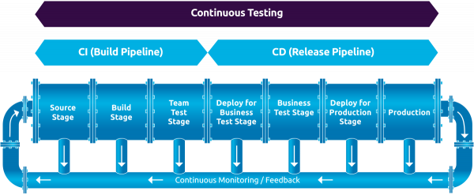

Slide 14

Thank you

