Slide 1
Fullstack development

Slide 2
What is fullstack development?
Complicated
Frontend
Backend
Databases, authentication, ssr, microservices, https, apis, ...
We’re gonna go through the very basics of what frontend and backend are and how they connect.
We’ll focus on the basics
BUT we’ll be thorough

Slide 3
Terms
Program: code runs (java, python, any other language)
Server: program that runs until we shut it down
Web server: server that specifically respond to HTTP requests
Client: someone that makes HTTP requests

Slide 4
The HTTP request
A string of text in a specific format
GET /download HTTP/1.1
Host: www.nixos.org

Slide 5
The HTTP request
A string of text in a specific format
GET /download HTTP/1.1
Host: www.nixos.org
User-Agent: curl/8.5.0
Accept: */*
Content-Type: application/json
Content-Length: 42
[body would go here; html, JSON, or any other file]

Slide 6
The HTTP request
A string of text in a specific format
Method + host + endpoint = ID (GET vg.no/daily)
GET /download HTTP/1.1
Host: www.nixos.org
User-Agent: curl/8.5.0
Accept: */*
Content-Type: application/json
Content-Length: 42
[body would go here; html, JSON, or any other file]

Slide 7


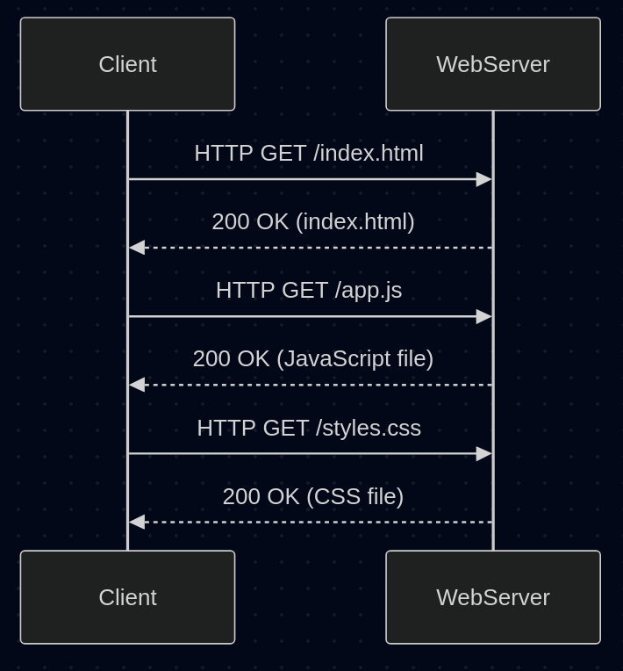

The HTTP request
A string of text in a specific format
Method + host + endpoint = ID (GET vg.no/daily)
Host: Google headquarters
GET /download HTTP/1.1
Host: www.nixos.org
User-Agent: curl/8.5.0
Accept: */*
Content-Type: application/json
Content-Length: 42
[body would go here; html, JSON, or any other file]
Endpoint: Suncar Pichai
Method: Give me money
GET /download HTTP/1.1
Host: www.nixos.org
Method + host + endpoint = ID (GET vg.no/daily)

Slide 8
The HTTP request
A string of text in a specific format
Method + host + endpoint = ID (GET vg.no/daily)
Optional body: Any file
Content type: the type of file in the body
GET /download HTTP/1.1
Host: www.nixos.org
User-Agent: curl/8.5.0
Accept: */*
Content-Type: application/json
Content-Length: 42
[body would go here; html, JSON, or any other file]

Slide 9
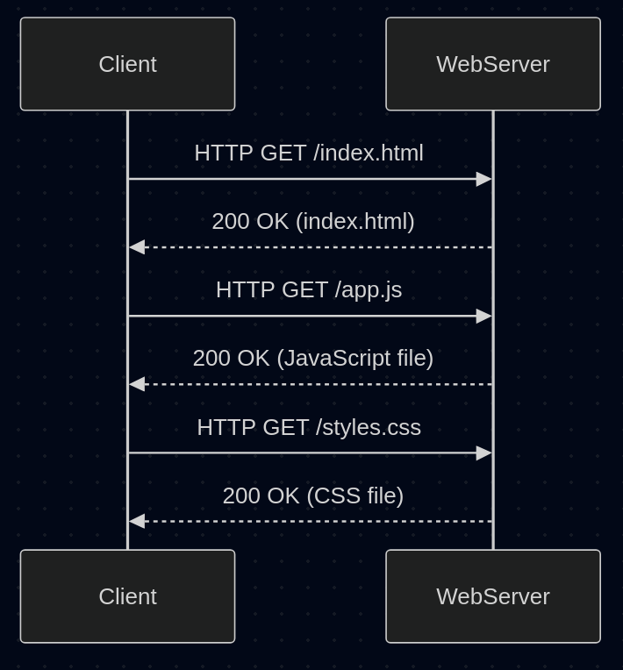

Slide 10
Demo time!
Sending HTTP requests
Running spring boot
Controllers (which and why?)
Sending requests to our endpoints
Using JS to send requests
Hosting static files

Slide 11
Tasks
Write java code so that a random of 3 quotes is returned when someone sends GET /quote to the server.
Add a CSS file, a JS file and an image in index.html (served by Spring Boot!). Without looking in the network tab, how many total HTTP requests are made to the server when the page loads?
Write an HTML form that “sends a question to customer support”. (form fields: name, phone number, question). What happens by default when you hit a button with `type=submit` within a form?
Research the `action` attribute of HTML form. Try to send a POST request with JS instead of having the form do it automatically.
Specify in Spring Boot how it should handle the POST requests from the form. Make a GET endpoint that returns all the questions people sent in (intended for use by staff).

