Slide 1

Nuke.me
By James Puppin, Jeeven Mann,
Esheaka Sinera, & Robel Negash

Slide 2
Problem
Don't want to leave important information on your device that you don't want others to see?
As a user do you have difficulty clearing cookies or clearing login passwords/usernames?

Slide 3
Technical Challenges
Limited knowledge of Javascript
Even more limited knowledge of google APIs
Time crunch

Slide 4
Demo
Here is a demo of our extension in use

Slide 6
Future Wireframes
Delete for browser or specific website
Delete individual things
UI/UX Update
Login/Password with Increased Security

Slide 7
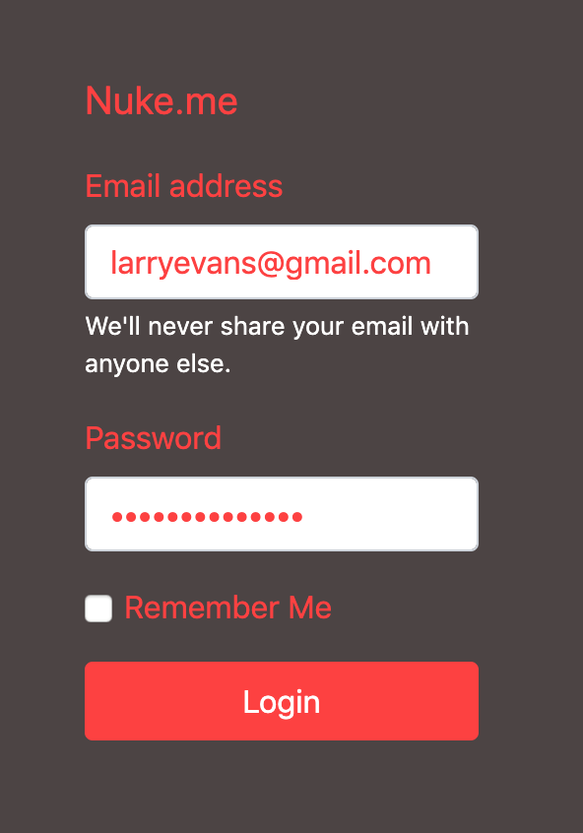
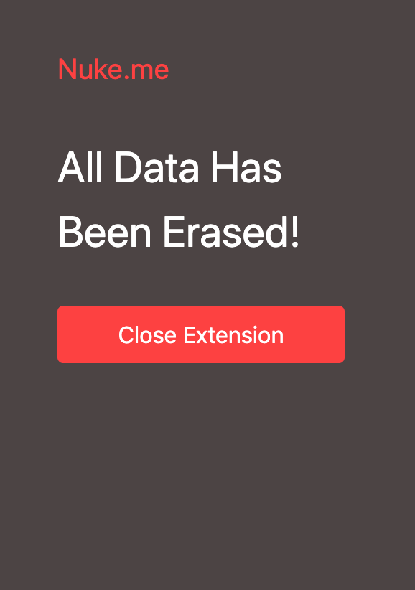
Future Wireframes

Slide 8
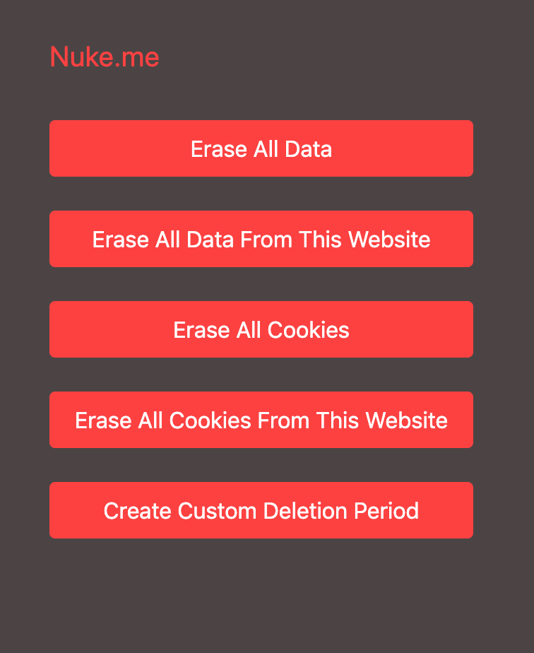
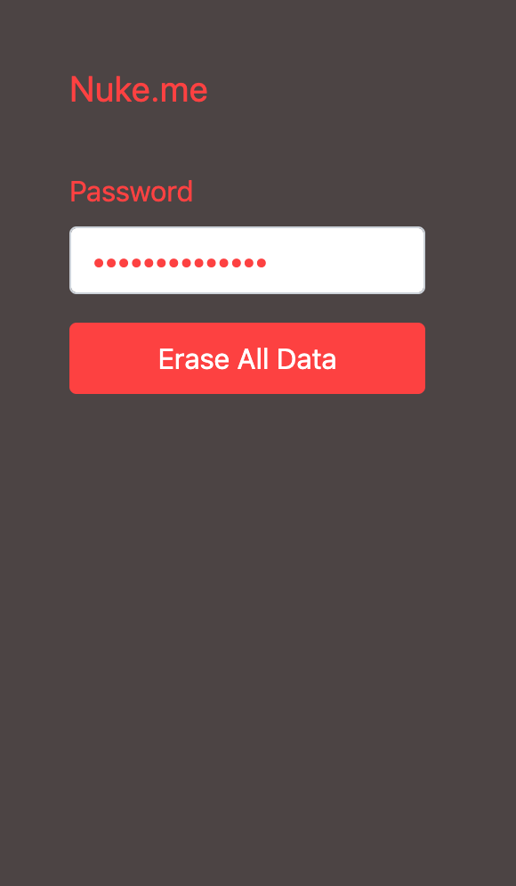
Future Wireframes

Slide 9
Why choose us?
Why go to a 7-Eleven when you can go to grocery store - James Puppin
6 clicks through multiple pages vs. 3 clicks in 1 page

