Slide 1
Intelligent Baby Monitoring System

Slide 2
ABSTRACT
The Reason behind this project is to design a system for monitoring the baby's body at any time using internet connectivity.
The function of this system is to measuring some biological parameter of the baby's body by using sensors and sends the values to IOT Cloud platform through Internet.
All information about the patient health will be stored on the cloud.
Which enables the doctors to monitor baby's health, where the doctor can continuously monitor the baby's condition on his Smart phone.

Slide 3
Literature Survey
LITERATRUE NAME | Journal Name | FEATURES
“An IOT Based Health care monitoring system” | International journal of Advanced Research in Electrical, Electronics and Instrumentation Engineering | Author designs and build the sensing data that conditions the system to display accurate body parameters of the patients.
“An IOT Based Smart Health care system using Raspberry Pi” | International journal of Research and Scientific Innovation | Here the author has concentrated over the idea of separating wireless sensor network and cloud computing.
“Internet of Things as Key Enabler for Sustainable Healthcare Delivery” | International e-Journal For Technology and Research | This paper aims to show how radio frequencies are identified and Internet of Things technologies allow patients to access healthcare services.

Slide 4
Literature Survey
LITERATRUE NAME | Journal Name | FEATURES
“Simulation of Health care Monitoring System in Internet of Things by Using RFID” | International journal of Engineering and Computer Science | In this paper, there is a discussion over the security requirements of authentication. Particularly they have represented an ECC-based RFID authentication in terms of implementation and authentication.
“A Literature Survey in ECG Feature Extraction” | Open Access Journal | The system enables the doctors to monitor patient’s health parameters. The parameters of the patient are measured continuously (temp, heartbeat, ECG) and wirelessly transmitted using ZigBee.
“IOT Based Patient Monitoring System” | International journal of Computing, Communications and Instrumentation Engineering | It is a mobile physiological monitoring system that is capable of continuously monitoring the patient’s heart rate using ECG. This paper shows the use of smart healthcare system.

Slide 5
Drawback
Not integrated with lot
Less portable system
Visualisations technics failed drastically

Slide 6
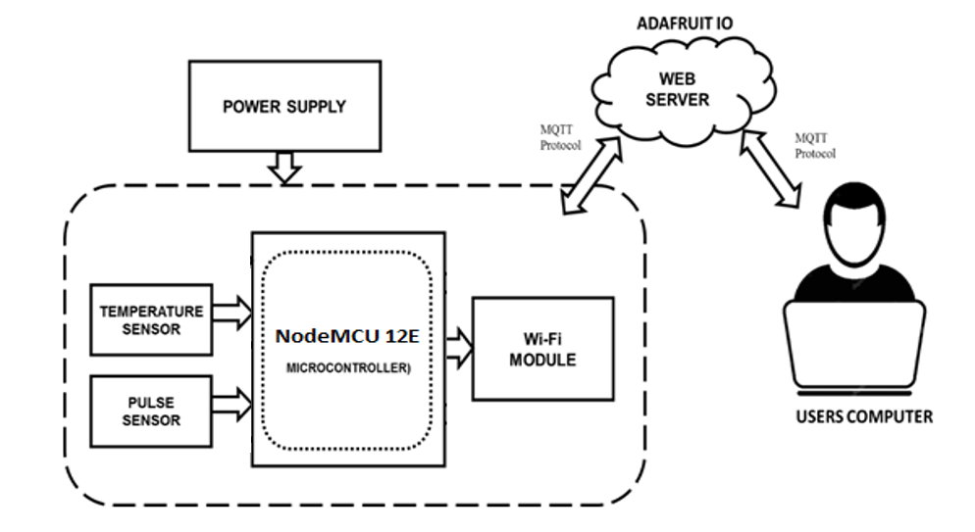
Block Diagram of Proposed System

Slide 7
MODULE DISCRIPTION
Body Health Parameter Sensing
The system has been designed to take several inputs to measure physiological parameters of human such as temperature, heart rate
The DS18B20 Digital Thermometer is the sensor used for temperature sensing.
photo phlethysmography based pulse rate sensor was used for pulse measurement

Slide 8
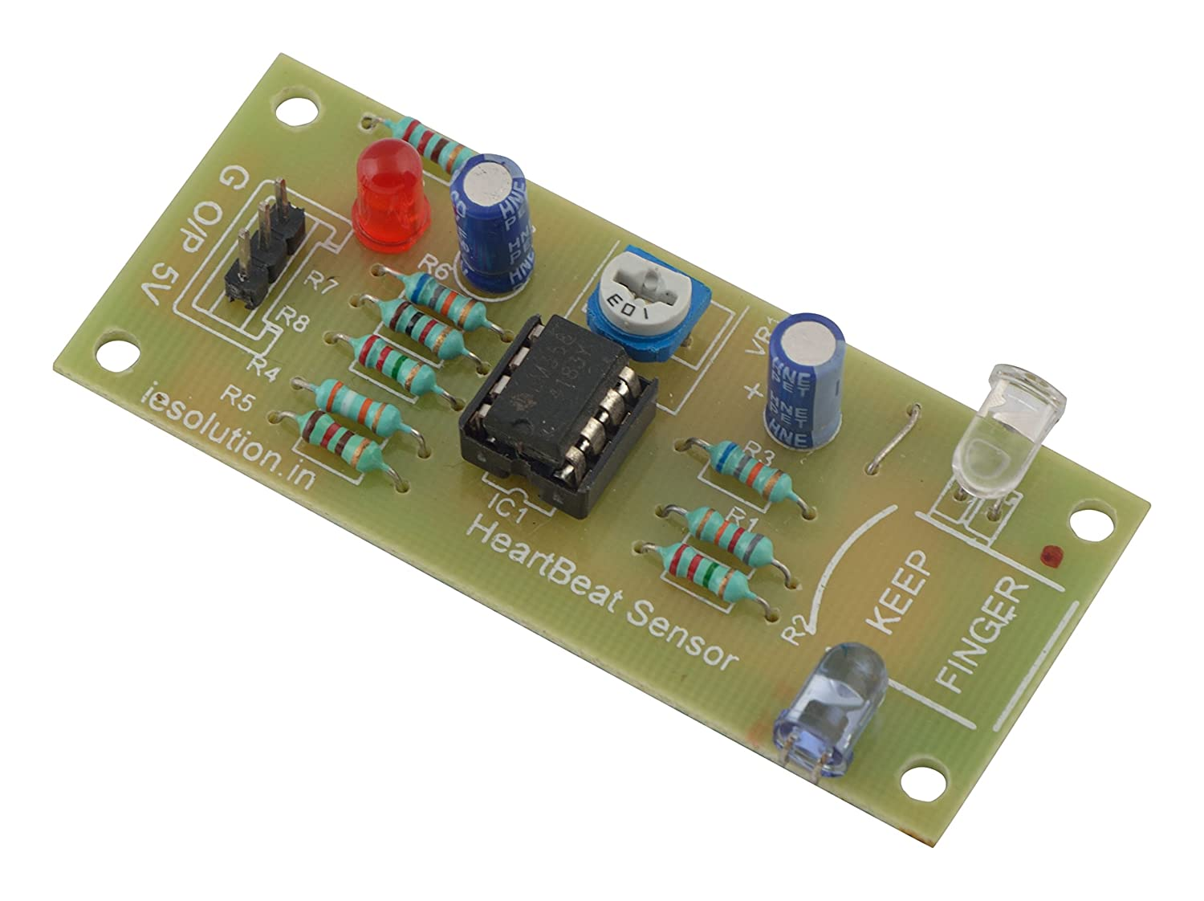
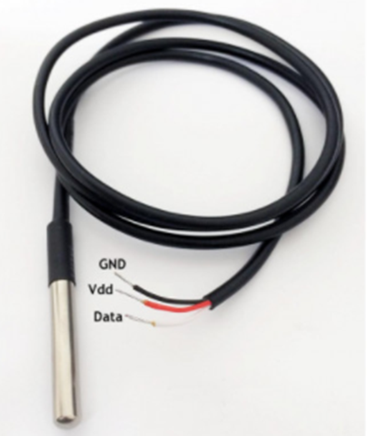
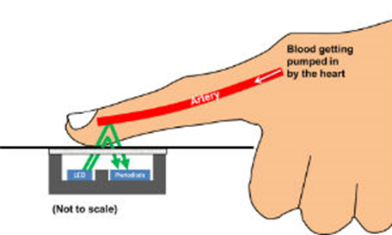
SENSORS
DS18B20 Digital Thermometer
Pulse sensor

Slide 9
MODULE DISCRIPTION
Data processing
Nodemcu 12e microcontroller was used to processes the data received from all the above sensors.
It is an WiFi enabled board with on board antenna for easy connectivity
Thus the processed data can be send to a web server using internet connectivity fot remote monitoring

Slide 10
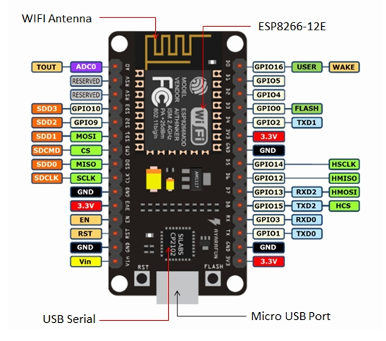
NODEMCU12E

Slide 11
MODULE DISCRIPTION
Online data Visualization
The data from the device is now received by the internet server and visualized as a web page for this we have made use of blink web sevices
blink web services is a cloud service - that just means we run it for you and you don't have to manage it. You can connect to it over the Internet. It's meant primarily for storing and then retrieving data.
blink web services can handle and visualize multiple feeds of data. Dashboards are a feature integrated into blink web sevices IO which allow you to chart, graph, gauge, log, and display your data. You can view your dashboards from anywhere in the world.

Slide 12
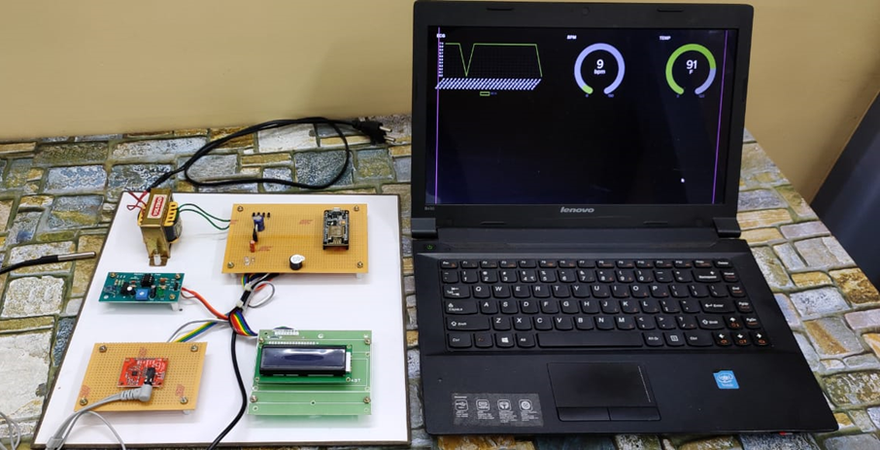
RESULT

Slide 13
Conclusion and Future Work
A IoT-based health monitoring system has been presented in this work.
By using the system, the healthcare professionals can monitor, diagnose, and advice their patients all the time.
The physiological data are stored and published online. Hence, the healthcare professional can monitor their patients from a remote location at any time.
Future work
Some additional sensors and automation devices can also be integrated in to the system for better performance

Slide 14
References
[1] Nabil Alshurafa, Costas Sideris, Mohammad Pourhomayoun, Haik Kalantarian, Majid Sarrafzadeh, Jo-Ann Eastwood, Year: 2017, “Remote Health Monitoring Outcome Success Prediction Using Baseline and First Month Intervention Data”, IEEE Journal of Biomedical and Health Informatics, vol. 21, no. 2, pp. 507 – 14.
[2] Marjorie Skubic, Rainer Dane Guevara, Marilyn Rantz, Year: 2015, “Automated Health Alerts Using In-Home Sensor Data for Embedded Health Assessment”, IEEE Journal of Translational Engineering in Health and Medicine, vol. 3, no. 7, pp. 50–54.
[3] Andreas K. Triantafyllidis, Vassilis G. Koutkias, Ioanna Chouvarda, Nicos Maglaveras, Year: 2016, “A Pervasive Health System Integrating Patient Monitoring, Status Logging, and Social Sharing”, IEEE Journal of Biomedical and Health Informatics, vol. 17, no. 1, pp. 30 – 37.
[4] Nabil Alshurafa, Jo-Ann Eastwood, Suneil Nyamathi, Jason J. Liu, Year: 2015, “Improving Compliance in Remote Healthcare Systems Through Smartphone Battery Optimization”, IEEE Journal of Biomedical and Health Informatics, vol. 19, no. 1, pp. 57 – 63.
[5] Misha Pavel, Holly B. Jimison, Ilkka Korhonen, Christine M. Gordon, Niilo Saranummi, Year: 2015, “Behavioral Informatics and Computational Modeling in Support of Proactive Health Management and Care”, IEEE Transactions on Biomedical Engineering, vol. 62, no. 12, pp. 2763 – 2775.

Slide 15
References
{6] Joshua Juen, Qian Cheng, Bruce Schatz, Year: 2015, “A Natural Walking Monitor for Pulmonary Patients Using Mobile Phones”, IEEE Journal of Biomedical and Health Informatics, vol. 19, no. 4, pp. 1399 – 1405.
[7] Abdul Qadir Javaid, Hazar Ashouri, Srini Tridandapani, Omer T. Inan, Year: 2016, “Elucidating the Hemodynamic Origin of Ballistocardiographic Forces: Toward Improved Monitoring of Cardiovascular Health at Home”, IEEE Journal of Translational Engineering in Health and Medicine, vol. 4, no. 10, pp. 27 – 37.
[8] Mohammad Kachuee, Mohammad Mahdi Kiani, Hoda Mohammadzade, Mahdi Shabany, Year: 2017, “Cuffless Blood Pressure Estimation Algorithms for Continuous Health-Care Monitoring”, IEEE Transactions on Biomedical Engineering, vol. 64 , no. 4, pp. 859 – 869.
[9] Qinghua Shen, Xiaohui Liang, Xuemin (Sherman) Shen, Xiaodong Lin, Henry Y. Luom, Year: 2014, “Exploiting Geo- Distributed Clouds for a E-Health Monitoring System With Minimum Service Delay and Privacy Preservation”, IEEE Journal of Biomedical and Health Informatics, vol. 18 , no. 2, pp. 430 – 439.
[10] Daryush D. Mehta, Matías Zañartu, Shengran W. Feng, Harold A. Cheyne II, Robert E. Hillman, Year: 2012, “Mobile Voice Health Monitoring Using a Wearable Accelerometer Sensor and a Smartphone Platform”, IEEE Transactions on Biomedical Engineering, vol. 59 , no. 11, pp. 3090 – 3096.

Slide 16
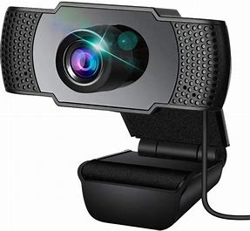
WEB CAMERA
WEB CAMERA IS USED TO MONITOR WHETHER THE BABY TO WHICH IS ACTIVE OR NOT.
S

Slide 17


