Slide 1

Healthcare Dashboard Report
Insights from Jan 2023 – Mar 2023 | Power BI Visualization

Slide 2
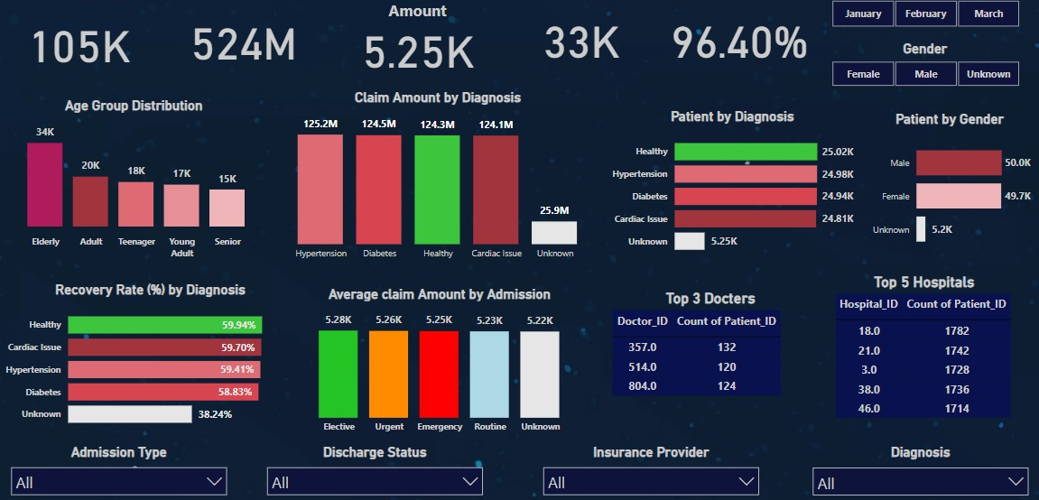
Project Overview
This Power BI dashboard analyzes patient health outcomes and insurance claims data from January to March 2023. It provides key metrics around recovery rates, diagnosis categories, hospital and doctor performance, and claim amounts to support data-driven healthcare improvements.

Slide 3
Key Metrics
- Total Patients: 105K
- Total Claim Amount: $524M
- Average Claim Amount: $5.25K
- Total Recovered Patients: 33K
- Recovery Rate: 96.4%

Slide 4
Age Group and Gender Insights
The elderly age group leads in patient count with 34K cases, indicating a higher burden of chronic conditions in older adults. Gender distribution is nearly equal—50K males and 49.7K females—suggesting balanced healthcare access. Unknown gender records (5.2K) may indicate data collection gaps.

Slide 5
Patient Diagnosis Overview
Top Diagnoses include Healthy (25K), Hypertension (25K), Diabetes (24.9K), and Cardiac Issues (24.8K). Balanced distribution of diagnoses indicates a wide variety of health issues being addressed.
Unknown diagnoses (5.2K) highlight an opportunity to improve data completeness.

Slide 6
Recovery Rate by Diagnosis
The highest recovery rate is observed in Healthy patients (59.9%), followed closely by Cardiac Issues and Hypertension. Unknown diagnosis group has significantly lower recovery (38.2%), suggesting these patients may require special attention or more follow-up.

Slide 7
Claim Amount by Diagnosis
Hypertension leads with $125.2M in claim amounts, followed closely by Diabetes, Healthy, and Cardiac Issues. High costs are consistent with chronic disease management. Unknown diagnosis claims ($25.9M) need further investigation.

Slide 8
Average Claim Amount by Admission Type
Elective admissions have the highest average claim at $5.28K, with other types closely trailing. This consistency in cost indicates efficient budgeting, but further analysis can identify optimization opportunities.

Slide 9

Top 5 Hospitals
Hospital ID 18.0 leads with 2,160 patients treated, followed closely by Hospitals 21.0, 3.0, 46.0, and 38.0. This suggests concentrated patient care delivery in key institutions, useful for load balancing and resource planning.

Slide 10
Top 3 Doctors
Doctor ID 804.0 treated 146 patients, slightly ahead of Doctors 357.0 and 514.0 with 142 each. Monitoring high-performing doctors can help identify successful treatment patterns and mentorship opportunities.

Slide 11
Thank You
Thank you for exploring the Healthcare Dashboard insights.
For further information or a guided walkthrough, please refer to the Linkedin or contact Me.
Gmail – rijwanmohmmad99@gmail.com

