Slide 1

Audit
Contextual
Advertising
Audit
Google Ads
platform
Strategy
document type
2026
year
Anand Desai Law
Google Ads Audit | 2024 vs 2025-2026
Full Advertising Account Strategy
TOLK
tolk.agency

Slide 2
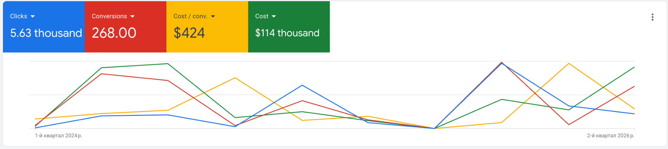
01
Strategic Shift (2024 Success vs 2026 Failure)
Audit | Google Ads
2024 (Success Period): The previous agency heavily localized the account (North Hollywood) and focused on general "Auto Accidents". Total spend was ~$57k with 113 conversions (CPA $510).
2025-2026 (Current Period): The strategy shifted to broad California targeting, heavily focusing on "Truck Accidents" and generic PI. Total spend ~$55k with 155 conversions (CPA $360 on paper, but low quality/rejected cases).
Outcome: The expansion diluted the budget into highly competitive, generic truck auctions, severely decreasing case quality and increasing CPA for relevant cases.

Slide 3
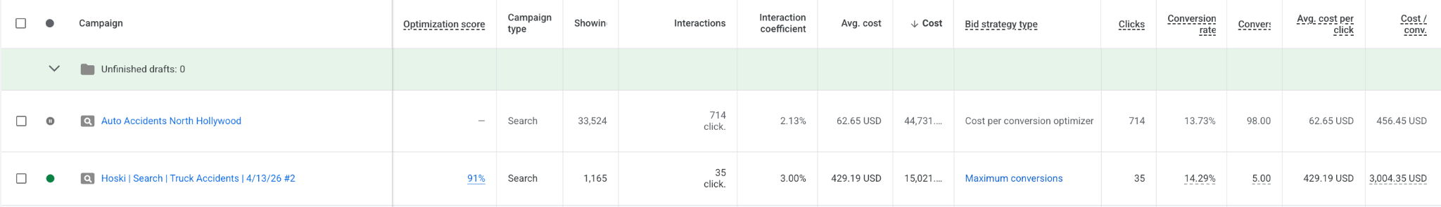
02
Campaigns & Budgets Comparison
Audit | Google Ads
Winning Campaign (2024): `Auto Accidents North Hollywood` was the anchor of the account. It spent $44,731 and generated 98 conversions at an efficient $456 CPA.
Failing Campaign (2026): `Hoski | Search | Truck Accidents` spent $15,021 but generated only 5 conversions, resulting in an unsustainable $3,004 CPA.
Conclusion: The hyper-specific Truck campaign failed to deploy budget efficiently and risked wrong-intent traffic compared to the successful Auto campaign.

Slide 4


03
Geographic Targeting Comparison
Audit | Google Ads
2024: Geo Success (The "Interest" Factor)
Tight geographic "seed" targets combined with Google's natural expansion worked well.
Strategic Seed: Specific cities like North Hollywood delivered 10 leads at $385 CPA.
Algorithmic Efficiency: 88/113 conversions came from "Other locations" at $462 CPA.
Outcome: Account successfully used seeds to train Google's algorithm for efficient expansion.
2026: Geo Failure (Forced Broadness)
Aggressively forcing budget into broad, expensive areas burned resources.
Broad Waste: Los Angeles consumed $18,708 at a massive $1,100 CPA.
Zero Return: Cities like Norwalk ($1,223) and Glendale ($2,894) yielded only 0-1 conversions.
Outcome: Explicitly forcing broad targets or expensive zip codes drained the budget.
Key Conclusion
The shift from algorithmic training (2024) to manual budget forcing (2026) resulted in a dramatic loss of efficiency and high CPA spikes in expensive metropolitan areas.

Slide 5

04
Landing Page Comparison
Audit | Google Ads
Winning Page (2024)
The subdomain approach proved highly effective for direct response.
Subdomain Strategy: Traffic was routed to accident.lawdesai.com.
Performance: Spent $27,251 to generate 40.5 conversions.
Efficiency: Delivered an efficient $672 CPA.
Failing Page (2026)
The hyper-specific "Truck" landing page is significantly underperforming.
High Costs: Spent $10,781 for just 3 conversions ($3,593 CPA).
Better Alternative: General page performed better ($1,386 CPA / $12,477 spend).
UX Gap: Suffers from poor intent mismatch.
Conclusion
The new "Truck" landing page is either suffering from wrong intent entirely compared to the 2024 winning subdomain model.

Slide 6

05
Account Setup & Budgets
Audit | Google Ads
Account Parameters
Date Range: September 1, 2025 – June 22, 2026
Campaign Status: 25 campaigns exist. Recent activity heavily utilized PMax and Search, but most high-spending campaigns are currently PAUSED.
Spend Distribution Analysis
Search campaigns dominate the total $55k spend.
Search Spend: $45,000
PMax Spend: $10,000
Key Takeaway: Budget is currently heavily weighted toward Search, while PMax serves as a secondary channel with significant pause activity in high-spend segments.

Slide 7
06
Step 2 - Conversion Tracking
Audit | Google Ads
Integration & Optimization
GA4 & CRM Integration: Primary conversions focus on micro-actions ("Lead form", “Click to call”, "Calls from ads" - 80+ hits). CRM (GHL) "Qualified Lead" has only 1 conversion.
Missing Tracking: Without GHL offline conversion imports, the system cannot optimize for retained cases.
Key Takeaway: The reliance on micro-conversions without offline feedback loops prevents the algorithm from bidding on high-value business outcomes.

Slide 8
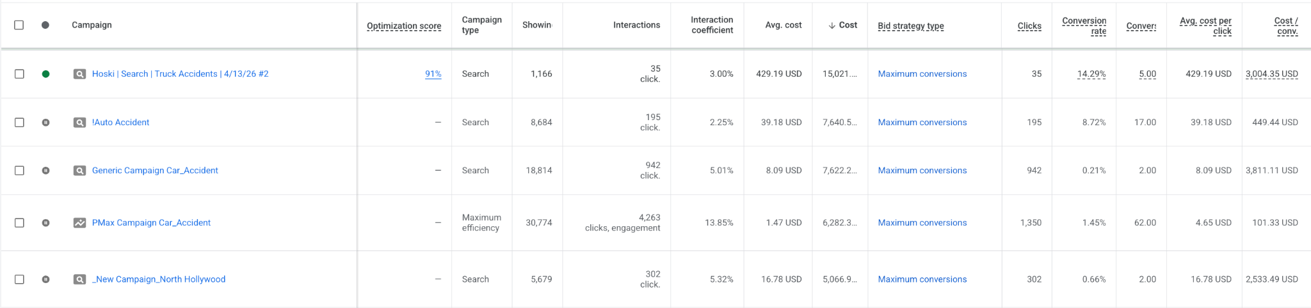
07
Step 3 - Campaign Settings & Bidding Strategy
Audit | Google Ads
Bidding Strategy Analysis
Problematic Campaign: `Hoski | Search | Truck Accidents` - $15k spend, 5 conv running on Maximize Conversions.
The Issue: Lack of CRM feedback (actual "Retained Cases") leads the algorithm to bid on low-quality, top-of-funnel clicks.
Networks & Devices
Ensure Search Partners are turned off for Search campaigns.
Key Takeaway: Without a signals feedback loop, Google's algorithm cannot distinguish between a $3,000 "bad" click and a high-value lead.

Slide 9

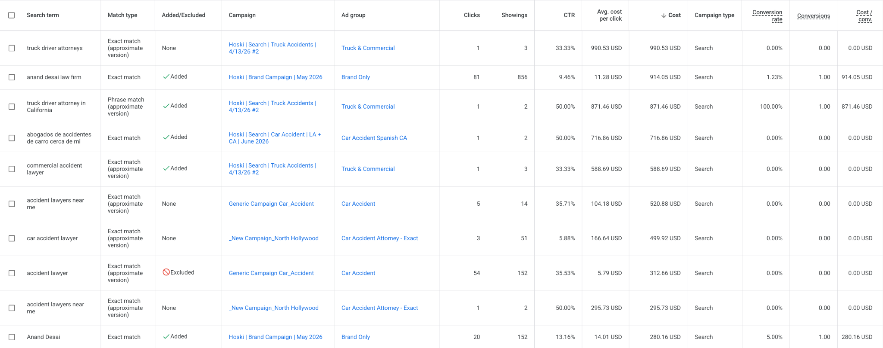
08
Step 4 - Keywords, Search Terms & Negatives
Audit | Google Ads
Keyword Strategy Analysis
Active Keywords: The account relies heavily on Phrase and Exact Match. The ad group structure requires optimization. There is a specific ad group overloaded with over 100 keywords, which destroys ad relevance for those queries. Furthermore, identical keywords are running simultaneously across different match types, leading to internal competition. • Negative Lists: While the account has massive negative lists, they missed the specific generic truck terms banned by the Playbook. As a result, terms like "truck driver attorneys" spent $990 with 0 conversions.
Action Required
1. Update global negatives with the exact generic truck terms.
2. Completely restructure the overloaded ad group by breaking it into High-Intent clusters.
3. Structure Strategy: Either implement an Alpha/Beta campaign structure (separating Exact and Phrase match with strict cross-negatives) if using Manual CPC, OR pause the exact match duplicates, leave only Phrase match, and transition the bidding to Target CPA.

Slide 10

09
Step 5 - Ads, Assets & Ad Strength
Audit | Google Ads
Search Ad Strength Analysis
Status: Almost all RSAs have a "Good" Ad Strength. While "Excellent" is the goal, "Good" is sufficient and not the root cause of high CPAs.
PMax Asset Groups Issue
Problem: Algorithm is failing to deliver quality cases despite Video assets being present.
Root Cause: CRM offline tracking didn’t track. PMax is aggressively optimizing for cheap, low-intent micro-conversions (Display/Search Partners) instead of retained clients.
Urgent Action: Fix CRM offline conversion tracking to re-align PMax optimization towards lead quality.

Slide 11
10
Step 6 - Extensions (Assets)
Audit | Google Ads
Asset Coverage Analysis
Status: The account has excellent asset coverage. All key extensions—including Sitelinks, Callouts, Structured Snippets, Images, and Call Extensions—are actively utilized across the campaigns.
Compliance: The setup is fully compliant with best practices.
Optimization Opportunities
Critical for Law Firms: The presence of Call Extensions is crucial.
Best Practice: Ensure extensions are scheduled to run only during office hours (or when intake is fully available) to avoid paying for missed calls.
Summary: Leverage existing excellent coverage while fine-tuning scheduling for maximum lead efficiency.

Slide 12
11
Step 7 - Landing Pages Analysis
Audit | Google Ads
The Truck Disaster (Inefficient)
The Auto Success (High ROI)
Truck-specific pages have burned over $12,800 for only 3 conversions.
Blended CPA: $4,200+
Pages: truck-accident-lawyer, commercial-truck, 18-wheeler
100% Speed Score (Not a UX issue)
Problem: Broad intent & poor traffic quality
Auto accident pages are highly efficient, capturing high-intent leads.
$66.85 CPA: auto-accident-lawyer-california (10 conv.)
$195.62 CPA: /faq variant (4 conv.)
$568 CPA: Spanish auto page (abogado-accidentes)
Efficiency driven by superior intent matching.
error_outline
Strategic Reallocation
Pause all Truck landing page traffic. Reallocate 100% of the budget to high-performing Auto Accident URLs to capture high intent at a fraction of the current cost.

Slide 13
12
Step 8 - Audit Conclusion
Audit | Google Ads
Strategic Misalignment Identified
The massive CPA spike from $450 to over $3,000 in key campaigns is not a technical failure, but a fundamental misalignment of targeting, structure, and intent.
1. Keyword Bloat
Dumping 100+ keywords into single ad groups and overlapping match types destroyed ad relevance. Combining this with Maximize Conversions forces the algorithm to buy low-intent junk traffic.
2. Geographic Failure
Forcing budget into broad, expensive Geos like Los Angeles failed. Success in 2024 relied on tight "seed" locations that allowed for natural, interest-based expansion.
3. Intent Mismatch
The Truck page burned through $12,800 at a $4,200 CPA, while Auto Accident pages converted efficiently at $66-$195 CPA. Intent matching is the core performance driver.
Verdict: The account is currently funding the wrong strategy.

Slide 14
13
Step 9 - Action Plan
Audit | Google Ads
1. Verify & Optimize Offline Conversions (The Priority)
Verify Offline Conversion Tracking (OCT) from GHL. Once confirmed, gradually shift all campaigns to target "Qualified Leads" (Retained Cases) to give the algorithm the exact signals it needs.
2. Reallocate Budget to "Auto" Winners
Immediately pause all traffic to failing Truck pages (go. and commercial-truck). Reallocate budget entirely to proven pages: auto-accident-lawyer-california and /faq.
3. Restructure Semantics & Bidding
Break down 100+ keyword ad groups into tight, High-Intent clusters. Implement Alpha/Beta structure or transition exclusively to Phrase match on Target CPA.
4. Revert Geographic Strategy & Clean Traffic
Stop budget bleed in broad LA and Glendale. Reinstate tight "seed" targets (e.g., North Hollywood). Add generic "Truck" terms to global negative lists immediately.

