Slide 1
Project name: Brick Breaker Game.

Slide 2
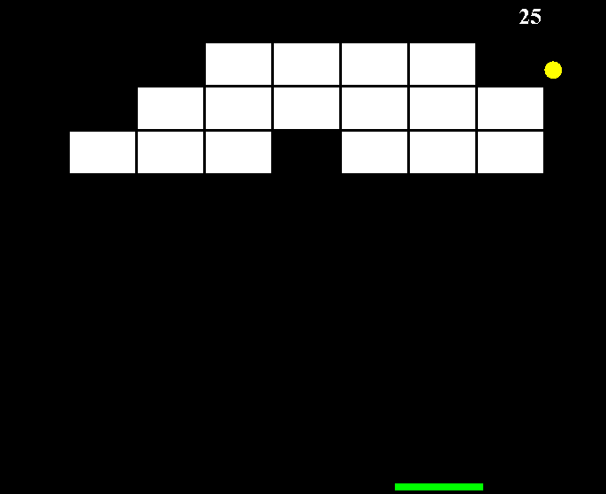
Project Name: Brick Breaker
Requirements:
IDE – Eclipse.
Language – JAVA.

Slide 3
Algorithm:
Step 1. Start.
Step 2. Draw background and make x & y axis.
i. Select background color.
ii. Select background size.
Step 3. Draw a ball.
i. Select ball color and size.
ii. Select ball state. Upright, up left, downright, down left.
iii. In the up states , it will either hit the bricks or the wall.
iv. For the state in which the ball is moving , the ball can hit
brick , paddle or ground.
Step 4. Add Dx to x and Dy to y.

Slide 4
Algorithm:
Step 5. Make the paddle.
i. Select paddle color , height &width.
Step 6. Make the blocks
i. Blocks height and width.
ii. Number of blocks and its color.
Step 7. If the ball touch the paddle through it to y axis
else
Show game over and score.
Step 8. If the ball clears all the blocks then show the total point and congrats the user with a restart button.

Slide 5
Project Name: DX-Ball game.
Flow Chart:
N0 YES
Press Enter to Start
The Ball Start Moving
Game over.
Ball Touch the Bar
Brake blocks
All Blocks cleared.
Congratulations.

Slide 6
Thanks Everyone.

