Slide 1

Empty Parking Detection using IOT
Department of Computer Engineering

Slide 2
Team Members :
Shreyas Kulkarni (22130)
Kunal Desai (22114)
Mayur Kharmate (22207)
Yash Kudale (22129)
Aniket Uttekar (22155)
Parth Hamane (22204)
Guided By :
Prof. Pragati Choudhari

Slide 3
Contents
Problem Statement
Motivation
Objectives
Methodology/ Proposed system block diagram
Software and Hardware requirements
Challenges faced
Conclusion and Future Scope
Implementation and Result

Slide 4
Problem Statement
To implement Empty parking slot detection using IOT to display If there is an empty parking slot at the parking area over the mobile phone using Blynk application .

Slide 5
Motivation
Now the era of Internet of things i.e. IOT has began so we can see the use of IOT in every place so we are also using same advancement so that using IOT we can get to know the empty parking slot at a parking area even if we are anywhere in the world .

Slide 6
Objectives
To improve the Traditional parking system by using IOT.
Implementing the Empty parking slot detection using IOT.
To display which parking slot is empty and which is full .
Save both Time and Fuel of vehicle driver.

Slide 7
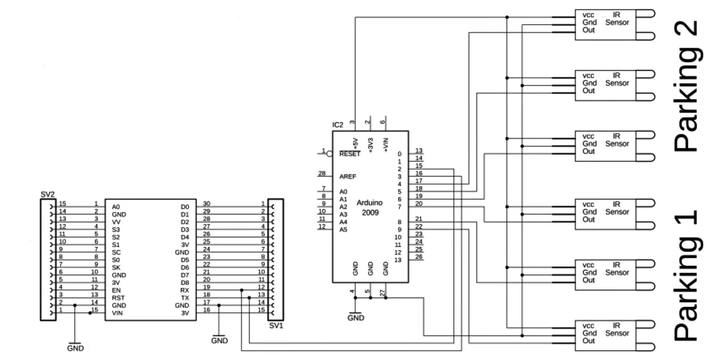
Methodology/ Proposed System Block Diagram

Slide 8
Software and Hardware requirements
Arduino IDE – To run and embed the code in Arduino.
Arduino – To execute the code embedded properly to function the detection of vehicle in parking system
NodeMCU (ESP8266) – To connect to internet and send data to Blynk application .
IR sensors – To count number of vehicles entered an left the parking area.
Blynk Application – To display empty parking slot .
Jumper wires – To connect all the components to each other.

Slide 9
Challenges Faced
One of the difficult challenge was the internet connectivity because as we search online there were many chips , modules that were being used to connect internet and all of those were good in their way .

Slide 10
Conclusion
Empty parking slot detection using IOT is implemented efficiently so that driver will know if the parking area has empty space or not using his mobile .
Future Scope/Possible Changes
We can use a bookmark like notation in the app so that driver can add it to the parking slot where he/she has parked the vehicle .
We can implement online parking slot booking so that anyone can book the parking slot and pay its price through online means .

Slide 11
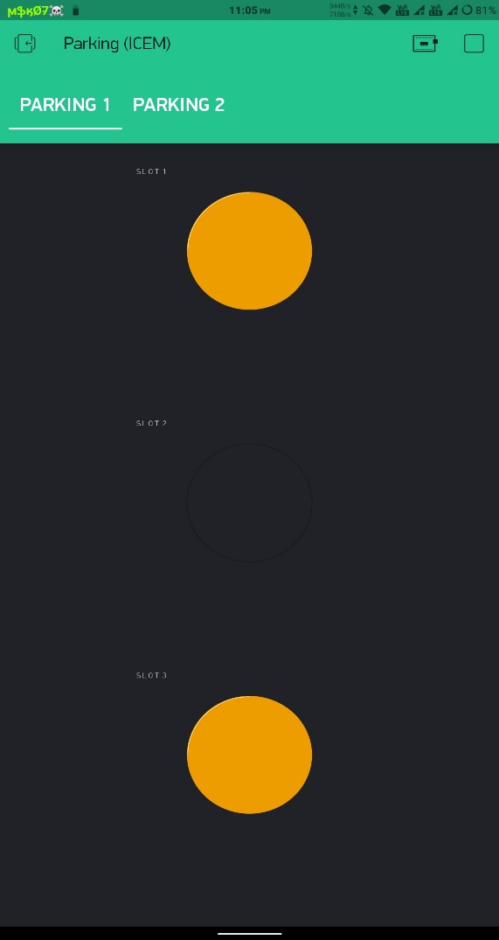
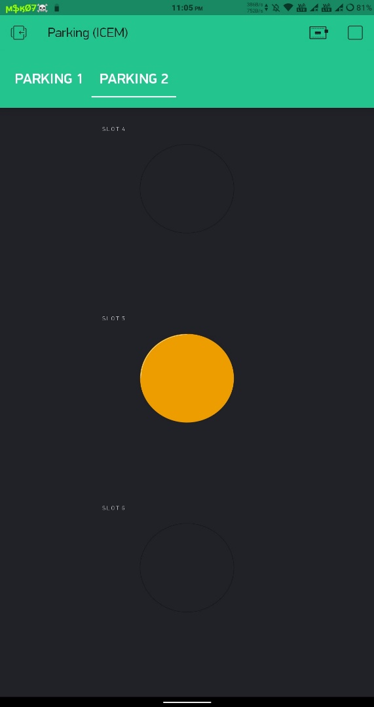
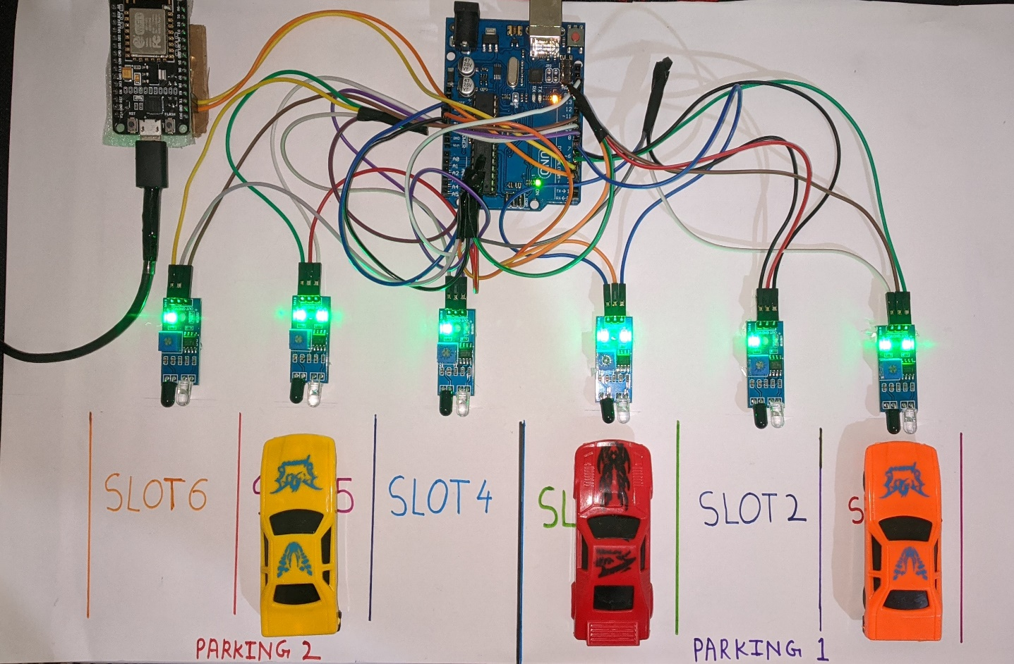
Implementation

Slide 12
Thank You !

