Slide 1
Application for health related medical records
1. Kharmate Mayur Sambhaji
2. Uttekar Aniket Rajesh
3. Kudale Yash Satish

Slide 2
Aim
Develop a Blockchain based application for health related medical records .

Slide 3
Introduction :
Blockchain has a wide range of applications and uses in healthcare. Distributed ledger technology facilitates the secure transfer of patient medical records, manages the medicine supply chain and helps healthcare researchers for same.

Slide 4
Concepts used :
Smart Contract :
A Smart contract is a computer program that directly and automatically controls the transfer of digital assets between parties under certain conditions .
Remix IDE :
It is a Platform which is used to create and deploy the smart contracts using Solidity Programming language
Solidity :
Solidity is an object-oriented programming language for implementing smart contracts on various blockchain platforms, most notably, Ethereum

Slide 5
Project Functionality :
This project manages the health records securely based on blockchain using Ethereum platform. Following are the main functionalities of this project:
Doctor's detail is updated/Registered by owner Admin has the ability to add or remove doctors from the list .
Admin will deploy smart contracts Patient's health records can only be added by registered doctors.
Only Authorized doctors can view the patients records .
Patients can see their prescription history in relation to the doctor.

Slide 6
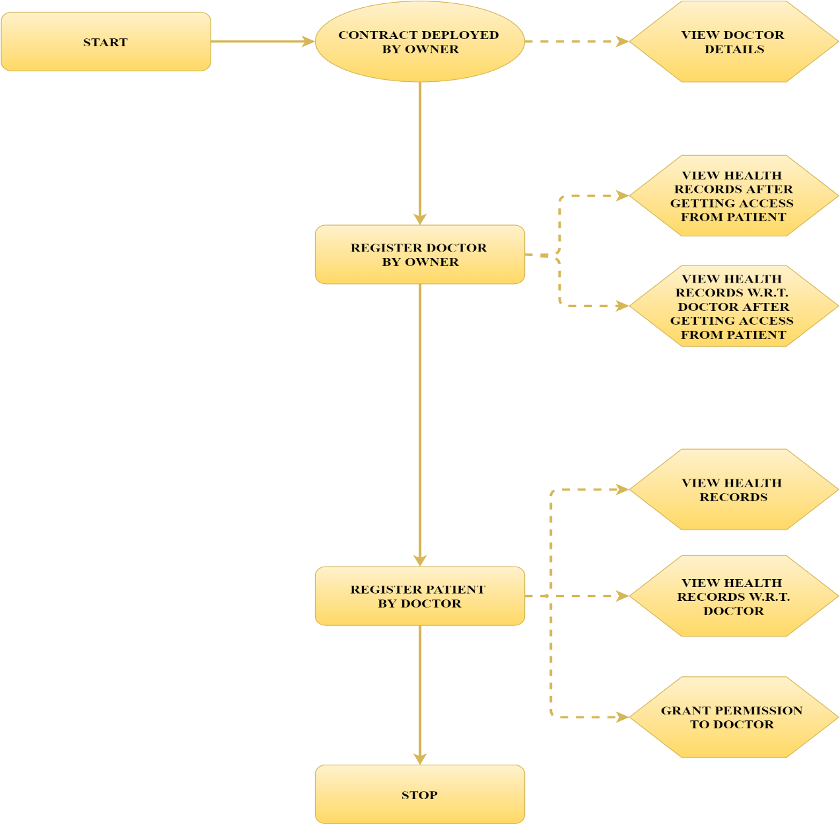
Flow Diagram :

Slide 7
Benefits :
Security and privacy of records
One source of truth
Reduced costs and complexity
Supply chain management
Reduced risk and increased trust
Patients could own their own records, sharing them seamlessly and securely
Generate new insights about population health
Stop the selling of medical records by cybercriminals

Slide 8
Conclusion :
Thus , We successfully developed a Blockchain based application for health related medical records.

