Slide 1
Arduino
Popular Extensions

Slide 2
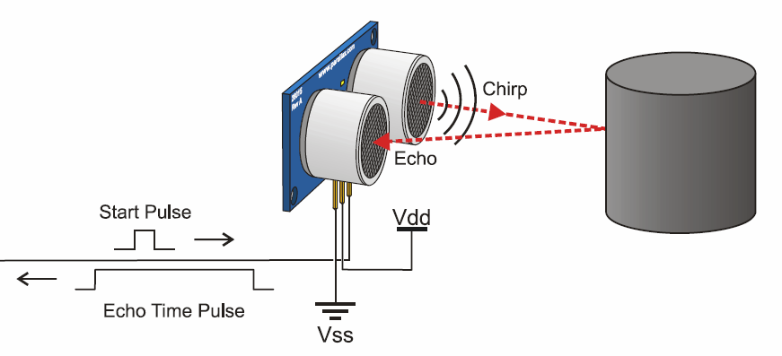
Ultrasonic Sensor:
This Sensor work in one way to serve several purposes.
It has an ultrasonic sender and receiver.
The calculation of time between sending and receiving the wave can:
Calculate distance.
Check for Obstacle.

Slide 3
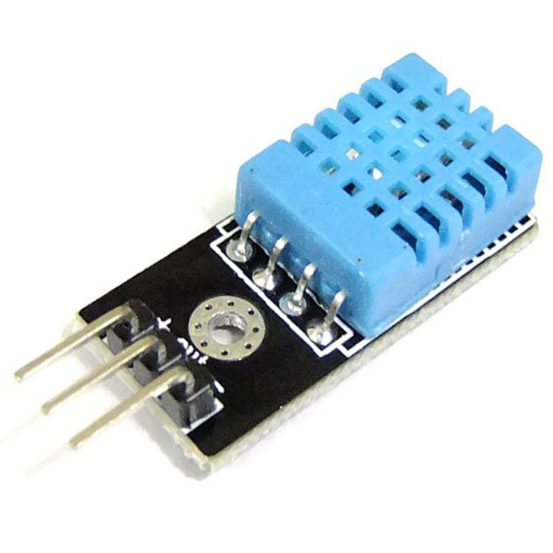
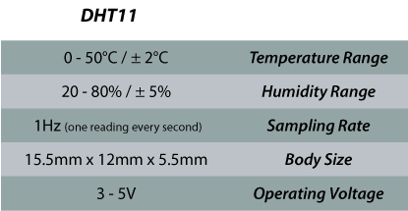
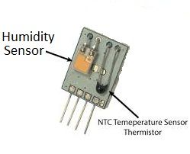
DHT11 Temperature and Humidity Sensor
- The Sensor consists of a humidity sensing component, a NTC temperature sensor (or thermistor) and an IC on the back side of the sensor.

Slide 4
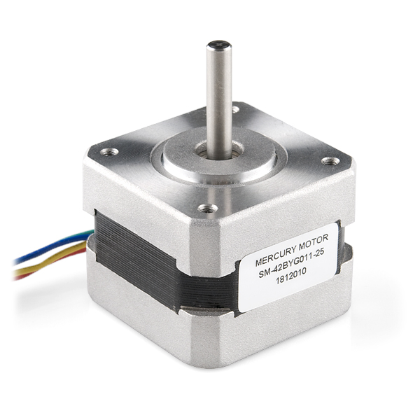
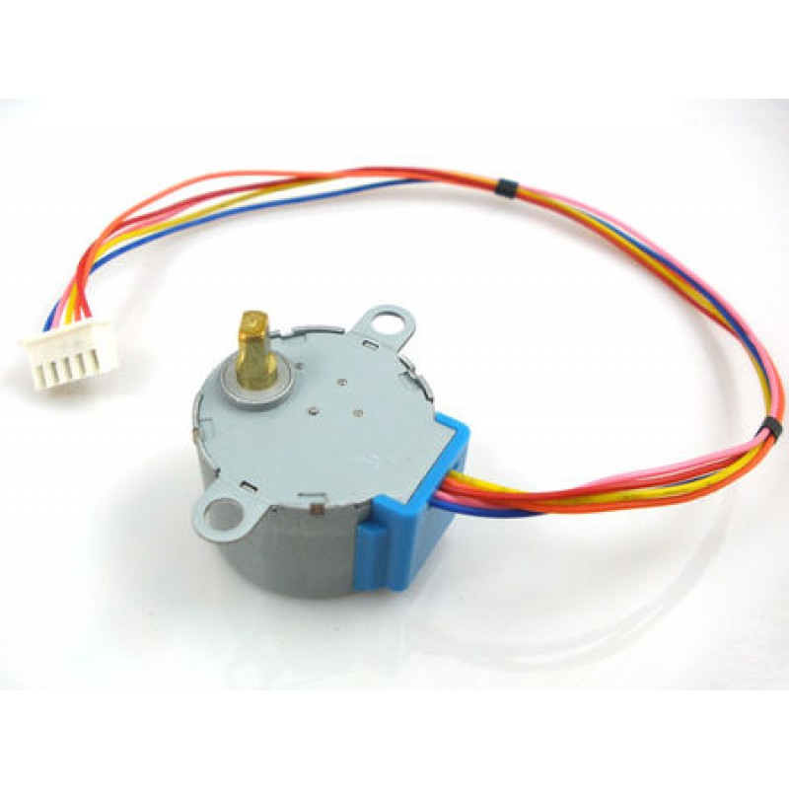
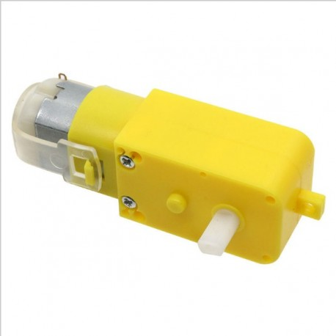
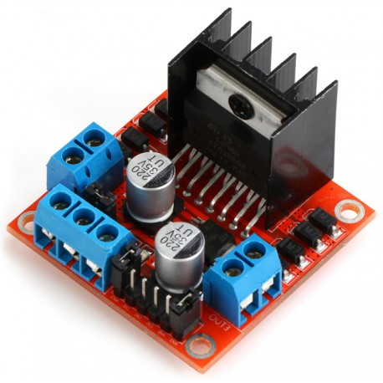
L298D Motor Driver (H-Bridge)
This Driver make controlling DC and Stepper Motors easier, it can:
Speed Control.
Direction Control.
Stopping.

Slide 5
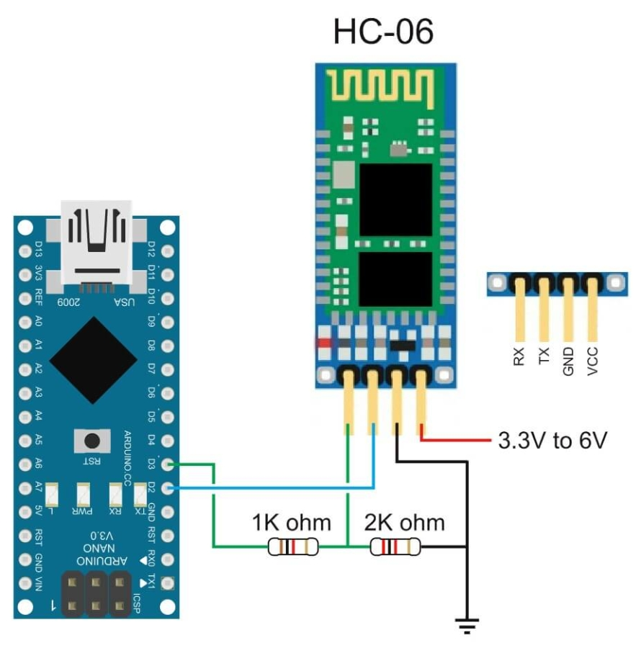
HC-06 Bluetooth Module:
The HC-06 is a class 2 slave Bluetooth module designed for transparent wireless serial communication. Once it is paired to a master Bluetooth device such as PC, smart phones and tablet, its operation becomes transparent to the user. All data received through the serial input is immediately transmitted over the air. When the module receives wireless data, it is sent out through the serial interface exactly at it is received. No user code specific to the Bluetooth module is needed at all in the user microcontroller program.

Slide 6
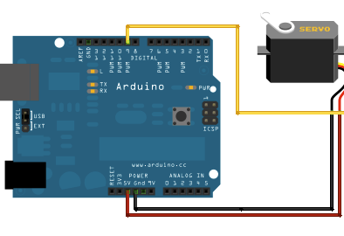
Servo Motors:
Servo motors are great devices that can turn to a specified position.
Servo motors were first used in the Remote Control (RC) world, usually to control the steering of RC cars or the flaps on a RC plane. With time, they found their uses in robotics, automation, and of course, the Arduino world.

Slide 7
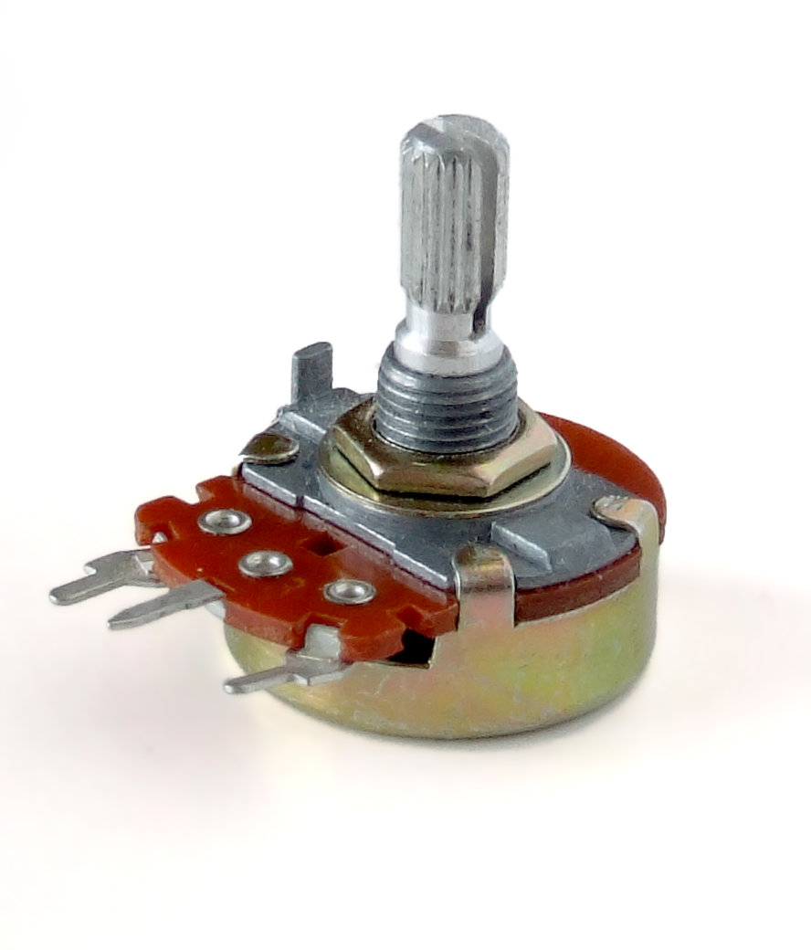
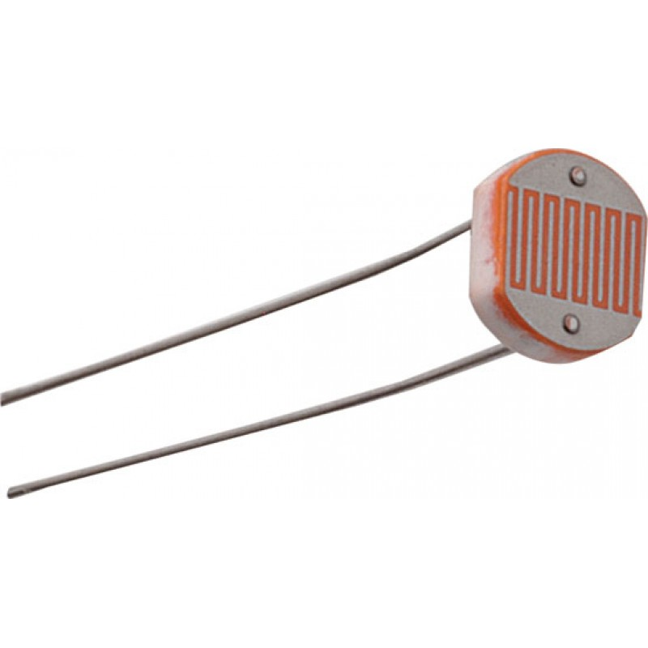
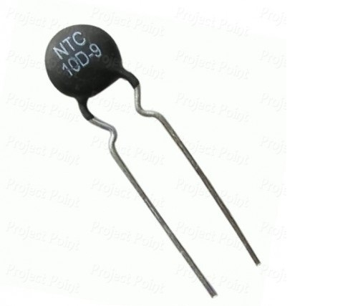
Useful Resistors:
Resistors voltage control can be used for other purposes:
Potentiometer.
LDR.
Thermistor.

