Slide 1
Arduino Introduction & Programming

Slide 2
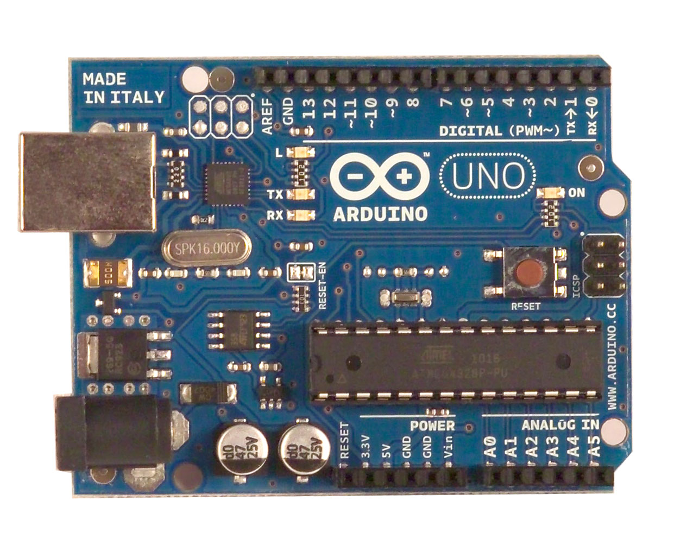
What is an Arduino?
Open Source electronic prototyping platform based on flexible easy to use hardware and software.

Slide 3
Uses of Arduino:
Educational Projects
Home Automation
Learn Programming
And the most important is to Have FUN

Slide 4
Getting started with Programming

Slide 5
Bare minimum code:
void setup() { // put your setup code here, to run once:
}
void loop() { // put your main code here, to run repeatedly:
}

Slide 6
Bare minimum code:
setup : It is called only when the Arduino is powered on or reset. It is used to initialize variables and pin modes
loop : The loop functions runs continuously till the device is powered off. The main logic of the code goes here. Similar to while (1) for micro-controller programming.

Slide 7
PinMode:
A pin on Arduino can be set as input or output by using pinMode function.
pinMode(13, OUTPUT); // sets pin 13 as output pin
pinMode(13, INPUT); // sets pin 13 as input pin

Slide 8
Reading/writing digital values:
digitalWrite(13, LOW); // Makes the output voltage on pin 13 , 0V
digitalWrite(13, HIGH); // Makes the output voltage on pin 13 , 5V
int buttonState = digitalRead(2); // reads the value of pin 2 in buttonState

Slide 9
Analog to Digital Conversion:
What is analog ?
It is continuous range of voltage values (not just 0 or 5V)
Why convert to digital ?
Because our microcontroller only understands digital.

Slide 10
ADC in Arduino Uno:

Slide 11
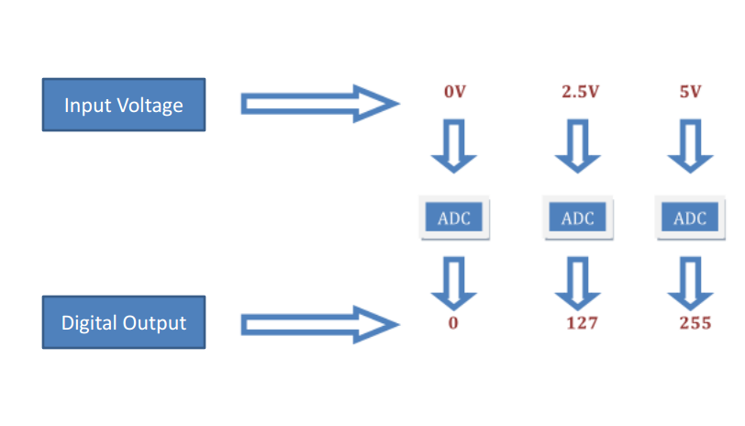
Converting Analog Value to Digital:

Slide 12
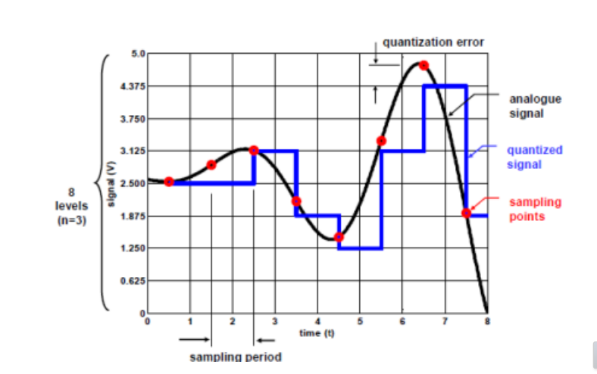
Quantization the signal:

Slide 13
ADC in Arduino
The Arduino Uno board contains 6 pins for ADC
10-bit analog to digital converter
This means that it will map input voltages between 0 and 5 volts into integer values between 0 and 1023

Slide 14
Reading/Writing Analog Values
analogRead(A0); // used to read the analog value from the pin A0
analogWrite(2,128);

Slide 15
Thank you! Code your imagination

