Slide 1

Compressor-Performance-Analyzer
The Compressor Performance Analyzer is a sophisticated, browser-based thermodynamic simulation platform designed to help engineers, researchers, and students accurately analyze, optimize, and forecast the performance of multi-stage centrifugal air compressor systems.

Slide 2

Reaction Pathway for PTA Production From Para-Xylene
Process Air Compressor (PAC) - Process Description
Overall Reaction:
Configuration of PAC
CH3
COOH
Five-stage centrifugal compressor.
Intercooler between 1st and 2nd stage.
Intercooler between 2nd and 3rd stage.
Intercooler between 3rd and 4th stage.
Steam Turbine, Process Air Compressor, and Expander are mounted on a common shaft.
Inlet Guide Vanes (IGV) provided for flow control.
HBR,CO/MN Acetate in Acidic Medium
+
302
+
2H2O
+
Heat
200 C, 14.7(Barg)
CH3
COOH
Step vise Reaction :
CH3
CHO
+
02
+
H2O
Working Principle
Atmospheric air enters the compressor through the inlet section.
Air is compressed in five stages.
The pressure increases progressively in each stage.
Compression increases air temperature.
Intercoolers remove heat between stages.
Compressed air leaves the fifth stage at the required process pressure and temperature.
The compressed air is then supplied to downstream process units.
CH3
CH3
4-Methyl Benzaldehyde
CHO
COOH
+
0.502
CH3
CH3
Para Toluic Acid
COOH
COOH
+
+
H2O
Compressor Drive System
02
During start-up, the compressor is driven by an electric motor.
During normal operation, the compressor is driven by a steam turbine and expander.
Integrated turbine-expander arrangement enables energy recovery and utilization.
This arrangement improves plant energy efficiency.
CH3
CHO
4-Carboxy Benzaldehyde
COOH
COOH
1
+
0.502
CHO
COOH
Terepthalic Acid

Slide 3
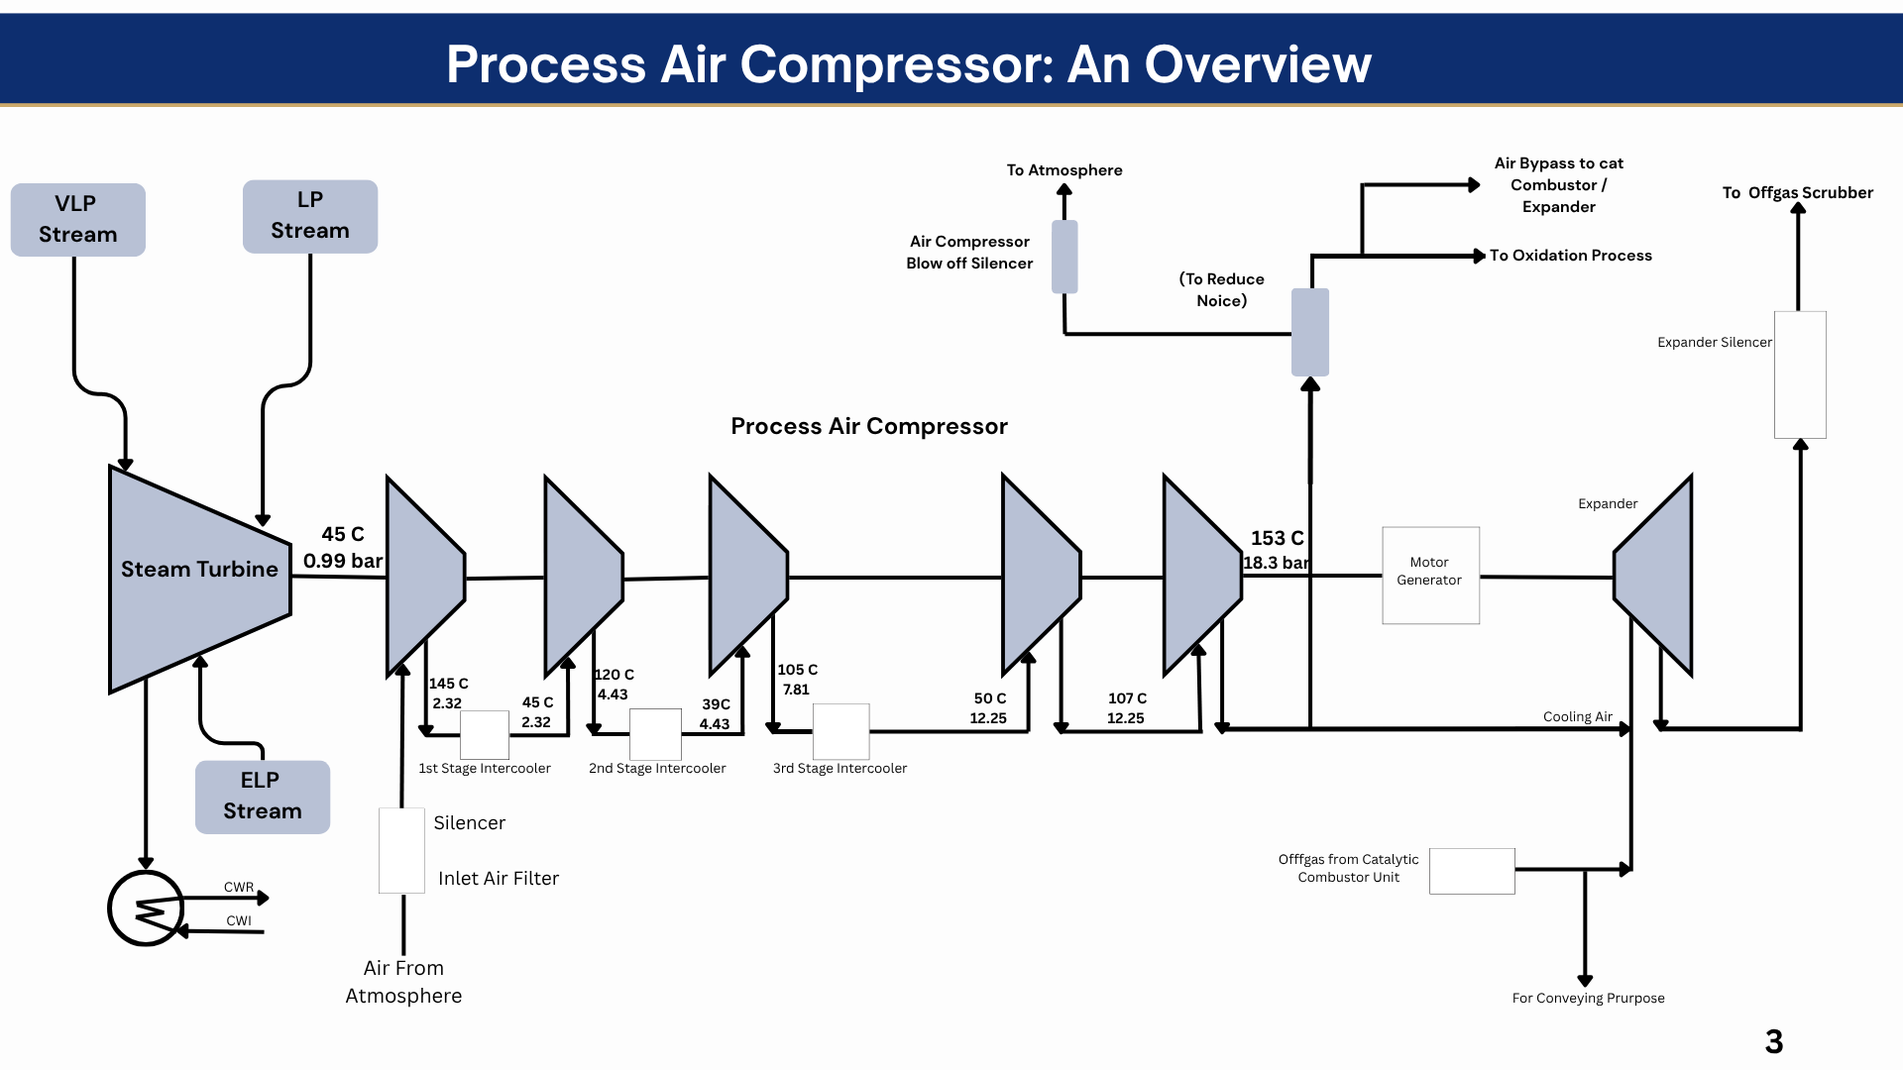

Slide 4
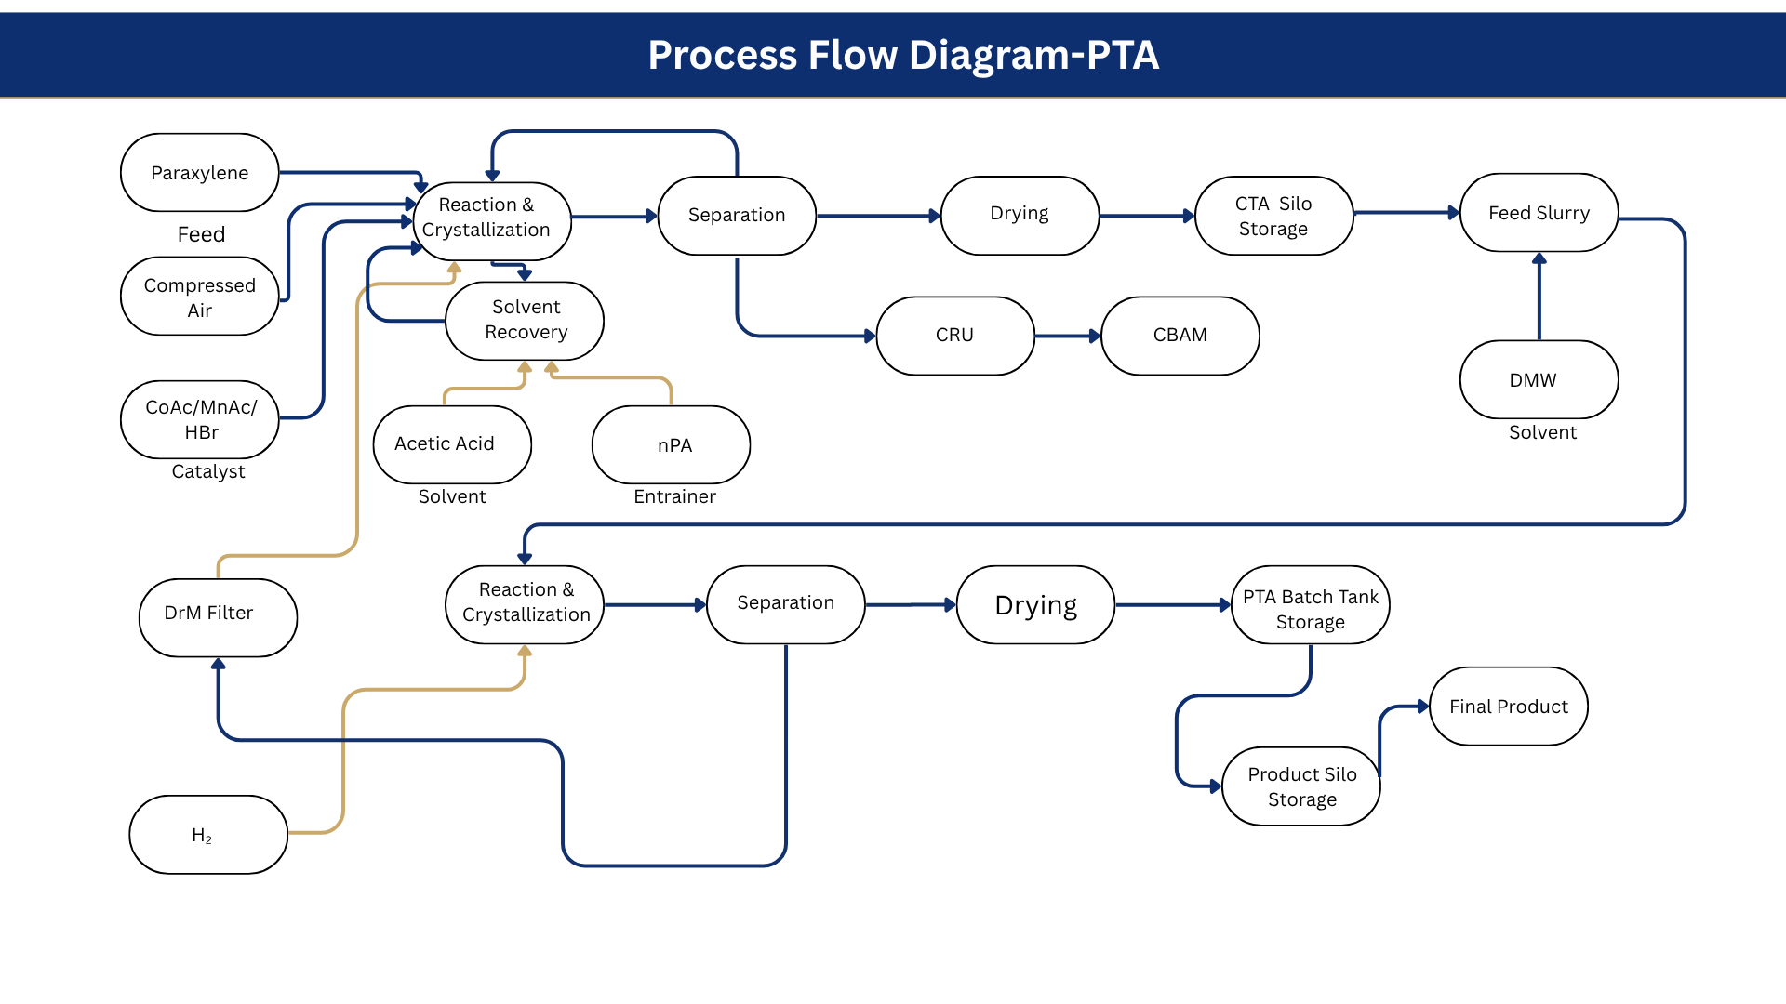

Slide 5

App Screenshot

Slide 6
Comparison of Design and Calculated Inlet Air Conditions :
Design
Calculated
Relative Humidity | 60 | %
Atomspheric Pressure | 0.99 | bar
Suction Pressure | 99000 | Pa
Temperaturein | 45 | C
Vapour Pressure of Water Vapour | 9552 | Pa
Partial Pressure of Water Vapour | 5731 | Pa
Mole Fraction(Xw) of water in | 0.05789
Relative Humidity | 65 | %
Atomspheric Pressure | 0.9932 | bar
Suction Pressure | 99320 | Pa
Temperaturein | 34 | C
Vapour Pressure of Water Vapour | 5302 | Pa
Partial Pressure of Water Vapour | 3446 | Pa
Mole Fraction(Xw) of water in | 0.03470

Slide 7
Stage-wise Water Vapour Mole Fraction Analysis (Design Case) :
Design
Stage | Xwin | Pin | Tin | Pstageout | Tstageout | Pcoolerstage,out | Tcoolerstage,out | V.Pstage out | Xwout | Remarks
1 | 0.05789 | 0.99 | 45 | 2.32 | 145 | 2.319 | 40 | 7352.789 | 0.03171 | Condensation
2 | 0.03171 | 2.319 | 40 | 4.43 | 120 | 4.43 | 39 | 6969.77 | .01573 | Condensation
3 | 0.01573 | 4.43 | 39 | 8.19 | 105 | 7.81 | 50 | 12296.2 | .01501 | Condensation
4 | 0.01501 | 8.19 | 50 | 12.25 | 107 | 12.25 | 107 | 129570.3 | .01501 | No Condensation
5 | 0.01501 | 13.05 | 107 | 18.3 | 153 | 18.3 | 153 | 511403 | .01501 | No Condensation

Slide 8
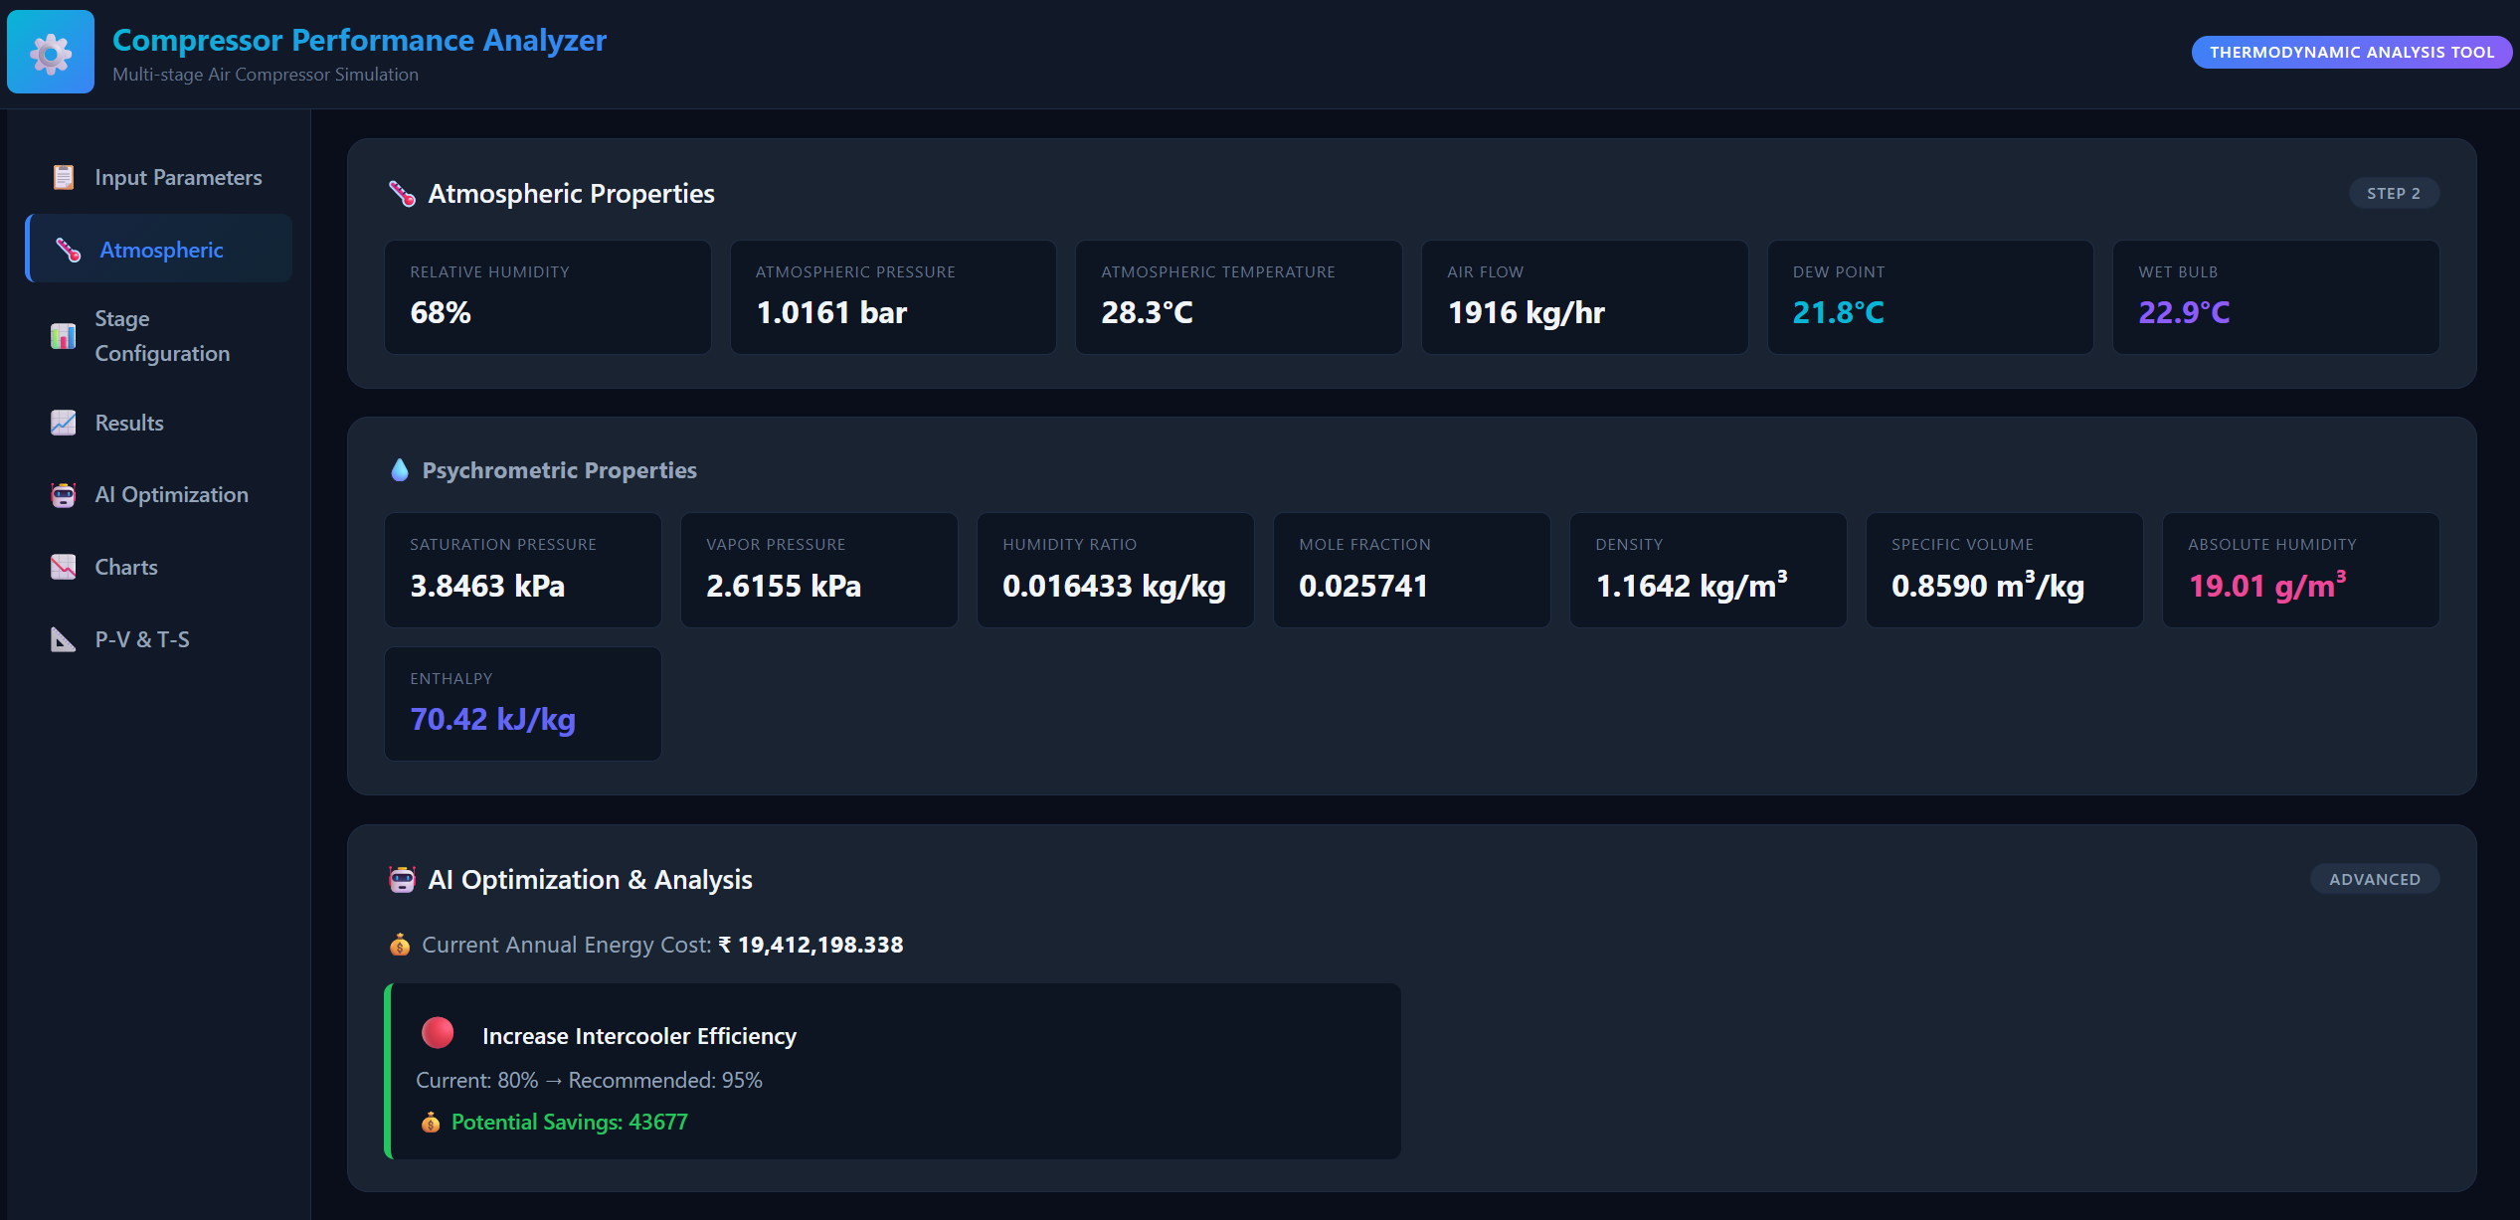
App Screenshot

Slide 9
Stage-wise Water Vapour Mole Fraction Analysis (Calculated Case) :
Calculated
Stage | Xw,in | P,in | T,in | Pstageout | Tstageout | Pcoolerstage,out | Tcoolerstage,out | VP stage out | Xw,out | Remarks
1 | 0.03470 | 0.9932 | 34 | 2.34 | 138.3 | 2.3432 | 55.8 | 16301.2 | 0.03470 | No Condensation
2 | 0.03470 | 2.3432 | 55.8 | 4.44 | 140.8 | 4.4432 | 39.9 | 7313.687 | 0.01646 | Condensation
3 | 0.01646 | 4.4432 | 39.9 | 7.3532 | 107.9 | 7.81 | 43.8 | 8978.649 | 0.01221 | Condensation
4 | 0.01221 | 7.3532 | 43.8 | 12.3932 | 106.8 | 12.3932 | 106.8 | 128698.1 | 0.01221 | No Condensation
5 | 0.01221 | 13.05 | 106.8 | 18.3 | 153 | 18.3 | 153 | 511403.4 | .01221 | No Condensation

Slide 10
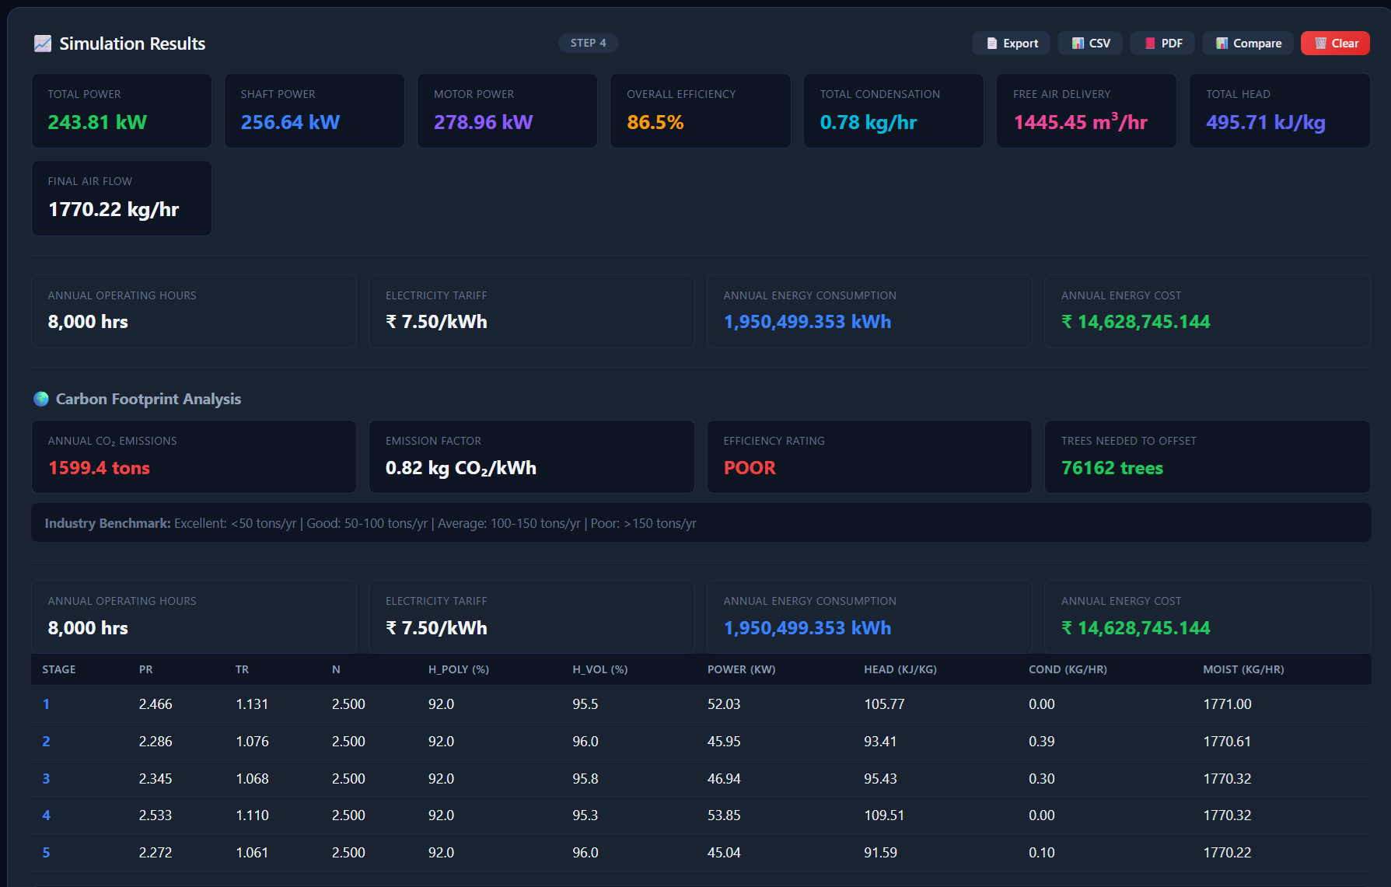
App Screenshot

Slide 11
Design Case - Stage-wise Water Condensation :
Design
Stage | Xw,in | Xw,out | Remarks | Water In (kmol/hr) | Water Out (kmol/hr) | Water Condensed (kg/hr)
1 | 0.05789 | 0.03171 | Condensation | 1039.725 | 554.026 | 8742.6
2 | 0.03171 | .01573 | Condensation | 554.026 | 270.451 | 5104.4
3 | 0.01573 | .01501 | Condensation | 270.451 | 257.895 | 226.0
4 | 0.01501 | .01501 | No Condensation | 257.895 | 257.895 | 0.0
5 | 0.01501 | .01501 | No Condensation | 257.895 | 257.895 | 0.0

Slide 12
Comparison of Mass of Water in Air at Suction Condition (Design vs. Calculated) :
Design
Calculated
Mw of water from 5th stage discharge | 28.80264542 | g/mol | -- | --
Moles of Wet Air | 17959.16229 | Kmole/hr | 510.0402 | t/hr
moles of dry air | 16919.43686 | kmole/hr | 480.512 | t/hr
Mass of water in air at suction condition | --- | --- | 29.5282 | t/hr
Mw of water from 5th stage discharge | 28.8333313 | g/mol | -- | --
Moles of Wet Air | 18662.46449 | Kmole/hr | 530.014 | t/hr
moles of dry air | 18014.88983 | kmole/hr | 511.6229 | t/hr
Mass of water in air at suction condition | --- | --- | 18.39113 | t/hr

Slide 13
Calculated Case - Stage-wise Water Condensation :
Calculated
Stage | Xw,in | Xw,out | Remarks | Water In (kmol/hr) | Water Out (kmol/hr) | Water Condensed (kg/hr)
1 | 0.03470 | 0.03470 | No Condensation | 647.575 | 647.575 | 0.0
2 | 0.03470 | 0.01646 | Condensation | 647.575 | 301.495 | 6229.4
3 | 0.01646 | 0.01221 | Condensation | 301.495 | 222.691 | 1418.5
4 | 0.01221 | 0.01221 | No Condensation | 222.691 | 222.691 | 0.0
5 | 0.01221 | .01221 | No Condensation | 222.691 | 222.691 | 0.0

Slide 14
Comparison of Stage-wise Water Condensation Across Intercoolers (Design vs. Calculated) :
Design
Calculated
Result Of all 5 stages :
Result Of all 5 stages :
Condensation in 1st stage(E-116) | 8.75 | t/hr
Condensation in 2nd stage(E-117) | 5.11 | t/hr
Condensation in 3rd stage(E-118) | 0.23 | t/hr
Total Water Condensed | 14.0886 | t/hr
Remaining Water in air | 15.4 | t/hr
Total Remaining air Flow | 496.0 | t/hr
Condensation in 1st stage(E-116) | 0.00 | t/hr
Condensation in 2nd stage(E-117) | 6.24 | t/hr
Condensation in 3rd stage(E-118) | 1.42 | t/hr
Total Water Condensed | 7.6564 | t/hr
Remaining Water in air | 10.7 | t/hr
Total Remaining air Flow | 522.4 | t/hr

Slide 15
Stage-wise Compressor Efficiency Analysis (Design Case) :
Design
Result Of all 5 stages :
Stage | Efficiency(%) | Kavg. | Pout/Pin | (K-1)/K | Tout/Tin | Zout/Zin
1 | 88.1 | 1.396 | 2.342 | 0.284 | 1.314 | 0.99685
2 | 80.5 | 1.39935 | 1.910 | 0.285 | 1.256 | 1.00190
3 | 84.4 | 1.4051 | 1.763 | 0.288 | 1.212 | 1.00190
4 | 82.0 | 1.4103 | 1.593 | 0.291 | 1.176 | 1.00280
5 | 83.8 | 1.4090 | 1.402 | 0.290 | 1.121 | 1.00290

Slide 16
Stage-wise Compressor Efficiency Analysis (Calculated Case) :
Calculated
Result Of all 5 stages :
Stage | Kavg. | Pout/Pin | (K-1)/K | Tout/Tin | Zout/Zin | Efficiency(%)
1 | 1.396 | 2.359 | 0.284 | 1.340 | 0.99685 | 84.2
2 | 1.39935 | 1.896 | 0.285 | 1.256 | 1.00190 | 78.8
3 | 1.4051 | 1.758 | 0.288 | 1.217 | 1.00190 | 81.9
4 | 1.4103 | 1.685 | 0.291 | 1.199 | 1.00280 | 82.5
5 | 1.4090 | 1.402 | 0.290 | 1.22 | 1.00290 | 83.4

Slide 17

App Screenshot

Slide 18
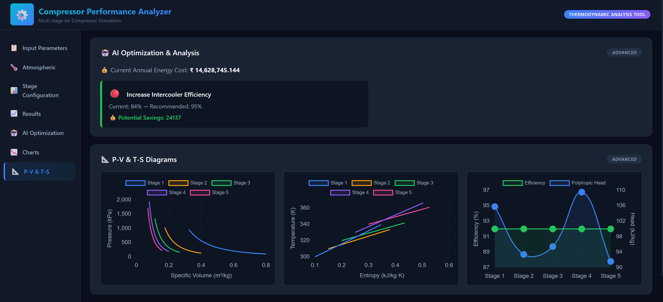
App Screenshot

Slide 19
Findings :
Stage | Efficiency Observation | Result | Conclusion
1 | Design: 88.1% Actual: 84.2% | 3.9% efficiency reduction. | Highest performance deterioration; priority for improvement.
2 | Design: 80.5% Actual: 78.8% | 1.7% efficiency reduction. | Indicates higher thermodynamic losses and requires performance optimization.
3 | Design: 84.4% Actual: 81.9% | 2.5% efficiency reduction. | Moderate performance deterioration.
4 | Design: 82.0% Actual: 82.5% | 0.5% efficiency improvement | Operating close to design conditions.
5 | Design: 83.8% Actual: 83.4% | 0.4% efficiency reduction. | Stable compressor performance.
Overall PAC | Design: 83.76% Actual: 82.16% | 1.6% overall efficiency reduction. | Performance degradation is mainly concentrated in Stages 1–3.

Slide 20
Stage-wise Polytropic and Actual Power Analysis (Design Case) :
Design
Result Of all 5 stages :
Stage | Actual Power(MW) | Polytopic Power(KW) | Polytropic exponent, n | n/(n-1) | Mw inlet | Zin | Tin(K) | AirFlow(Kg/s)
1 | 14.43 | 12891 | 1.4665 | 3.149 | 28.33 | 0.9996 | 318.15 | 141.34
2 | 11.42 | 9188 | 1.549 | 2.820 | 28.62 | 0.9993 | 313.15 | 138.91
3 | 9.18 | 7744 | 1.519 | 2.926 | 28.79 | 0.9988 | 312.15 | 137.49
4 | 7.91 | 6484 | 1.550 | 2.818 | 28.80 | 0.9984 | 323.15 | 137.43
5 | 6.47 | 5416 | 1.530 | 2.886 | 28.80 | 1.0012 | 380.15 | 137.43

Slide 21
Stage-wise Polytropic and Actual Power Analysis (Calculated Case) :
Calculated
Result Of all 5 stages :
Stage | Polytropic exponent, n | n/(n-1) | Mw inlet | Zin | Tin(K) | AirFlow(Kg/s) | Polytopic Power(KW) | Actual Power(MW)
1 | 1.508 | 2.967 | 28.59 | 0.9996 | 307.15 | 148.20 | 13172 | 15.65
2 | 1.568 | 2.760 | 28.59 | 0.9993 | 328.95 | 148.20 | 10202 | 12.95
3 | 1.543 | 2.841 | 28.79 | 0.9988 | 313.05 | 146.46 | 8252 | 10.08
4 | 1.545 | 2.834 | 28.83 | 0.9984 | 316.95 | 146.07 | 7639 | 9.26
5 | 1.534 | 2.873 | 28.83 | 1.0012 | 379.95 | 146.07 | 5749 | 6.89

Slide 22
Result of all stage water condensation :
Design
Calculated
Result Of all 5 stages :
Result Of all 5 stages :
Water condensed in 1st stage | 8742.6 | kg/hr
Water condensed in 2nd stage | 5104.4 | kg/hr
Water condensed in 3rd stage | 226.00 | kg/hr
Water condensed in 4th stage | 0.0 | kg/hr
Water condensed in 5th stage | 0.0 | kg/hr
Water condensed in 1st stage | 0.0 | kg/hr
Water condensed in 2nd stage | 6229.4 | kg/hr
Water condensed in 3rd stage | 1418.5 | kg/hr
Water condensed in 4th stage | 0.0 | kg/hr
Water condensed in 5th stage | 0.0 | kg/hr

Slide 23
Future Plans
Shell-Side and Tube-Side Heat Balance Evaluation of intercoller.
Determination of the Polytropic Exponent of the PAC Compressor in PTA-5/6.
Polytropic Power Calculation of the PAC Compressor in PTA-5/6.
Actual Power Consumption Analysis of the PAC Compressor in PTA-5/6.
Find which factors affecting PAC compressor efficiency and how we can resolve it.
What are the major causes of efficiency losses in the PAC system.
Impact of suction conditions, cooling efficiency, and pressure drops on overall efficiency as well as Weather.
Recommendations for improving PAC compressor performance and operational reliability.

Slide 24
Recommendation
Ensure proper installation, alignment, and handling of air seal strips during maintenance and shutdown activities to prevent damage and air bypassing.
Carry out periodic cleaning and inspection of finned tube bundles to maintain effective heat transfer performance.
Monitor intercooler outlet temperature, pressure drop, and condensate generation regularly to detect performance deterioration at an early stage.
Maintain adequate cooling water flow and quality to minimize fouling and sustain intercooler effectiveness.
Conduct periodic compressor performance audits to identify efficiency losses and implement corrective actions proactively.
Adopt a condition-based maintenance approach for intercoolers and compressor internals to prevent unexpected failures and efficiency degradation.

