Slide 1
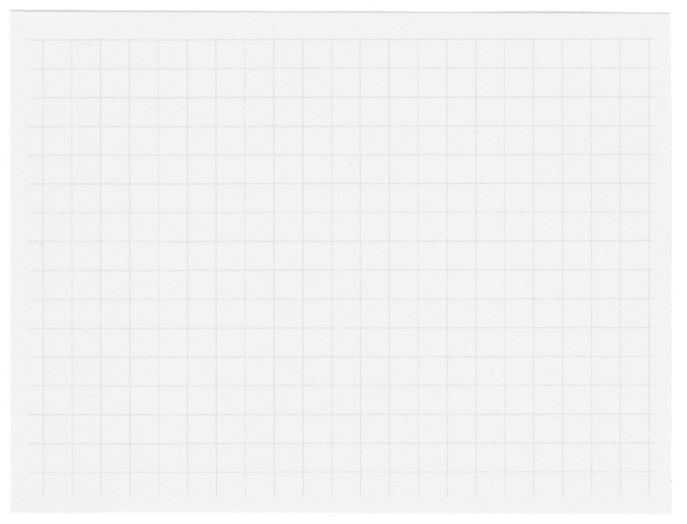














Machine Learning
SE -204
Cricket Score Prediction
Rohit Gupta (2K22/SE/142)
Rohit Kachhap (2K22/SE/143)

Slide 2
Outline Of Project
Motivation
Results
Introduction
Conclusion
DataSet
Limitation
Data Preprocessing
Research Methodology
Model Deployment

Slide 3

Motivation
Why predict IPL scores with Machine Learning? It's like having a crystal ball for cricket!
Love cricket and tech? This project combines both! Learn cool ML skills while predicting scores for your favorite IPL teams.
Data is easy to find! There's tons of past IPL data online to train your "prediction machine."
Cricket is tricky! Predicting scores is a fun challenge that tests your ML model's skills.
Never stop learning! As IPL changes, you'll keep improving your ML skills by updating your model with new data.
Imagine knowing who might win before the match even starts.

Slide 4
Introduction
Predicting IPL scores with machine learning entails collecting and preprocessing historical match data, selecting pertinent features such as player statistics and venue details, and choosing appropriate algorithms like decision trees or Regression
. The model undergoes training, evaluation using metrics like MAE and RMSE, and deployment for real-time predictions. Continuous refinement with new data enhances accuracy.
This process empowers cricket enthusiasts, analysts, and betting platforms to gain insights into match outcomes and enriches the excitement surrounding the IPL tournament.

Slide 5
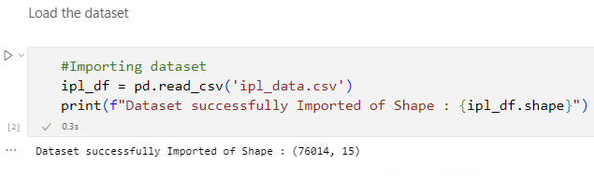
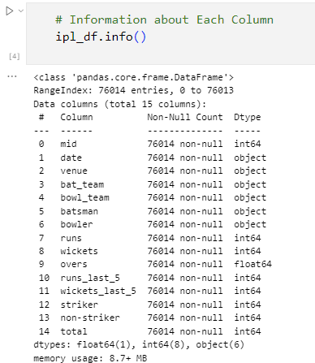
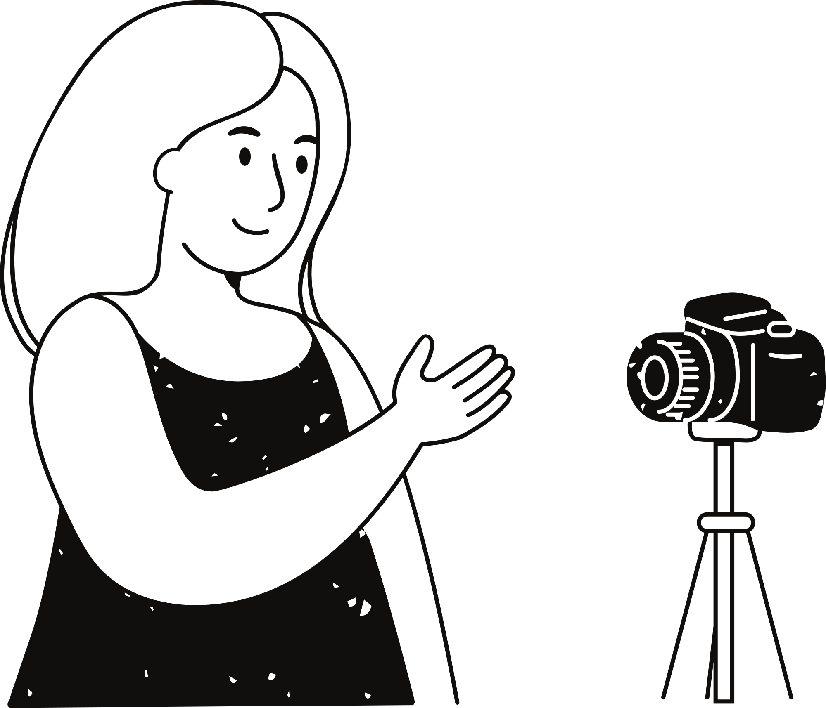
Number Of feature =15
Number Of instances = 76000+
DataSet
Source: IPL Complete Dataset (2008-2020) (kaggle.com)

Slide 6
Research Methodology
01
02
03
04
05
06
Data Collection
Data Preprocessing
Feature Selection
Feature Extraction
Model Development
Performance Measure

Slide 7

Data Collection

Slide 8
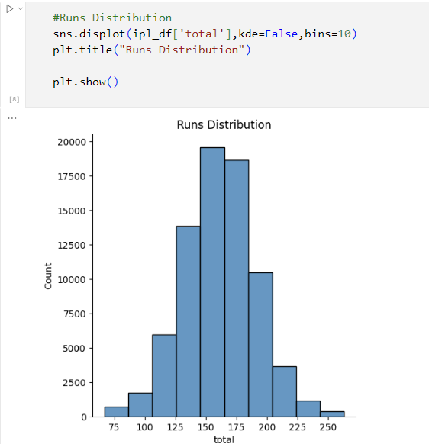
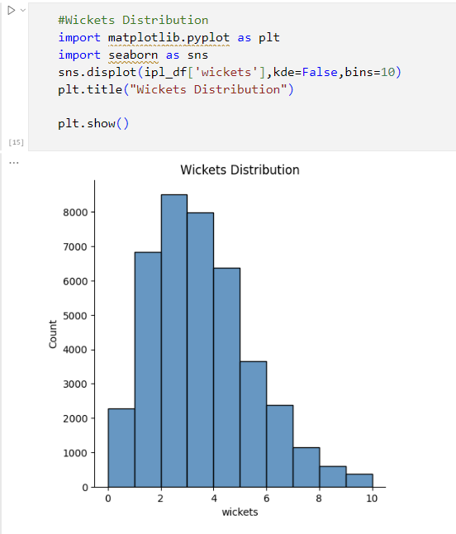
Data Collection

Slide 9
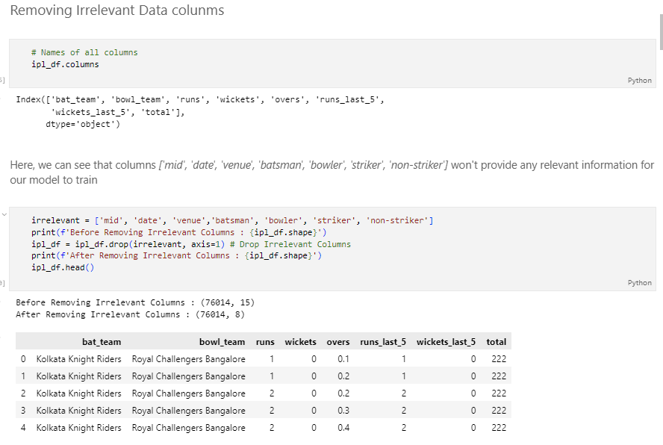
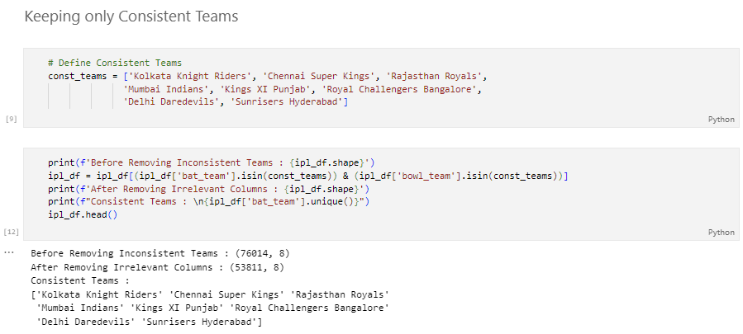
Data Preprocessing
Removing Irrelevant Data Columns
Keeping Only Consistent Teams

Slide 10

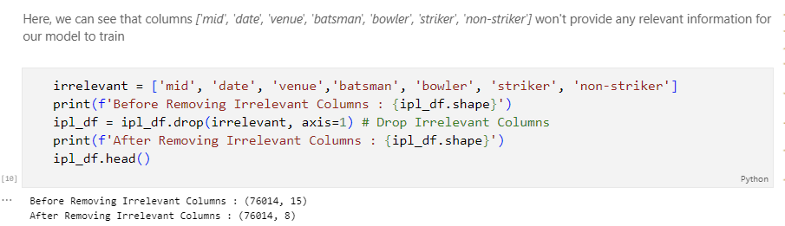
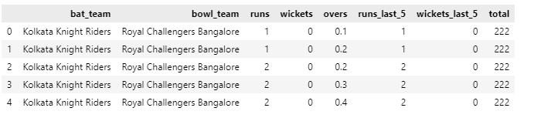
Feature Selection
Removing Irrelevant Features
Keeping Relevant Features

Slide 11
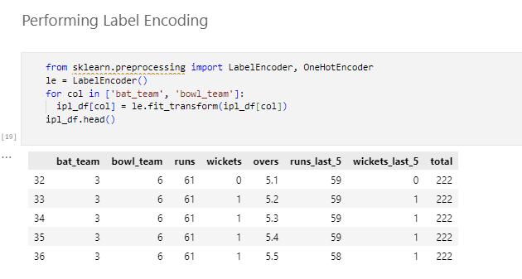
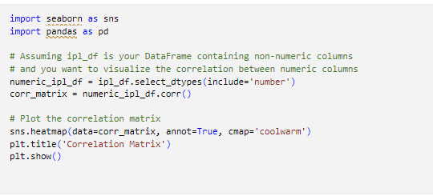
Data Preprocessing
Perform Label Encoding for teams name
Plotting a Correlation Matrix of current data

Slide 12
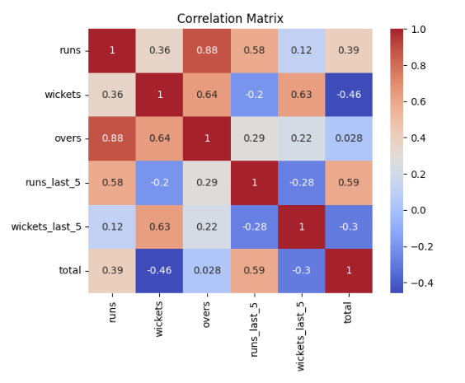
Corelation Matrix
qui officia deserunt mollit anim id est laborum.

Slide 13
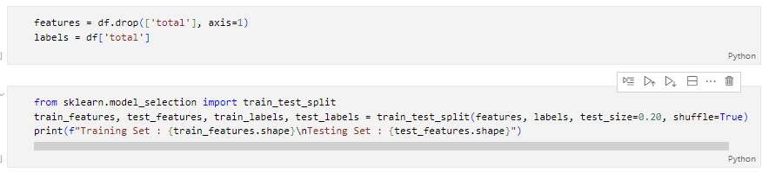

Model Development Techniques
Prepare Train and Test Data
Code
Output

Slide 14
ML Algorithms
Decision Tree Regressor
Linear Regression
Random Forest Regression
Support Vector Machine
K Neighbor Regerssor

Slide 15
A. Decision Tree Regressor
Decision Tree Regressor is a non-linear regression algorithm that works by recursively splitting the data into subsets based on the feature that results in the best split.
It predicts the target variable by averaging the target values of the training samples falling into the same leaf node.

Slide 16
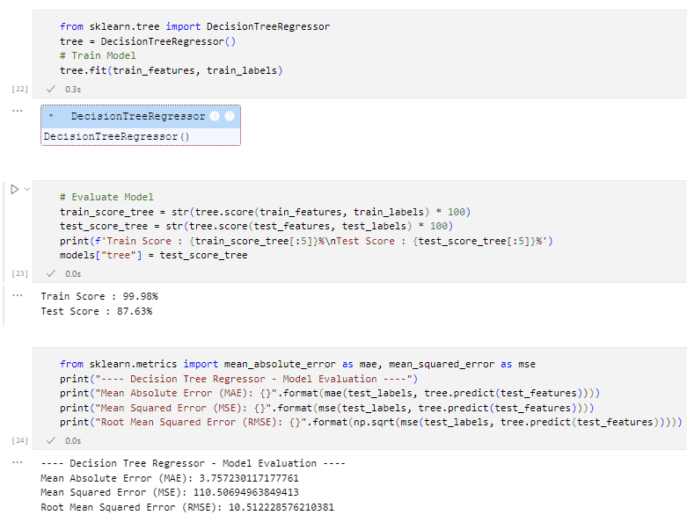

A. Decision Tree Regressor

Slide 17
B. Linear Regression
Linear Regression is a simple and commonly used regression algorithm that assumes a linear relationship between the input features and the target variable.
It finds the best-fitting linear equation to describe the relationship between the independent variables and the dependent variable.

Slide 18
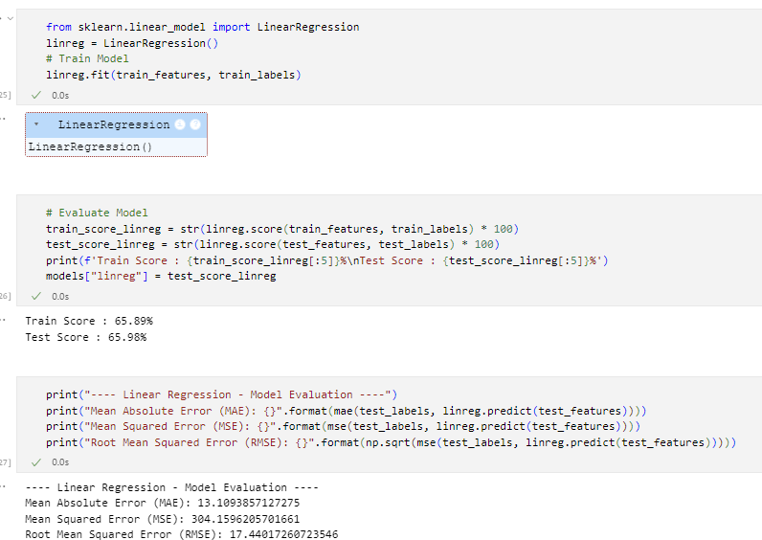
B. Linear Regression

Slide 19
C. Random Forest Regression
Random Forest Regression is an ensemble learning method that builds multiple decision trees during training and outputs the average prediction of the individual trees.
It improves upon Decision Trees by reducing overfitting and increasing robustness through the use of bootstrapping and feature randomness.

Slide 20
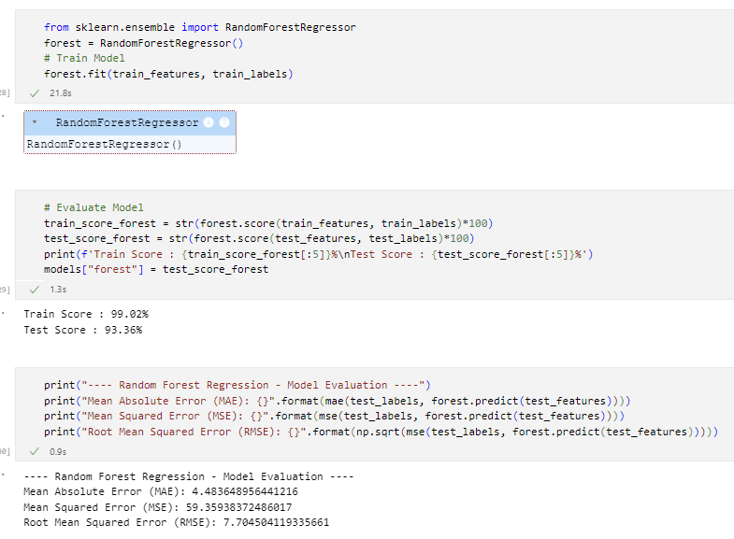
C. Random Forest Regression

Slide 21
D. Support Vector Machine
Support Vector Machine is a powerful supervised learning algorithm capable of performing linear or non-linear regression tasks.
In regression, SVM works by finding the hyperplane that best fits the data while maximizing the margin between the hyperplane and the closest data points.

Slide 22
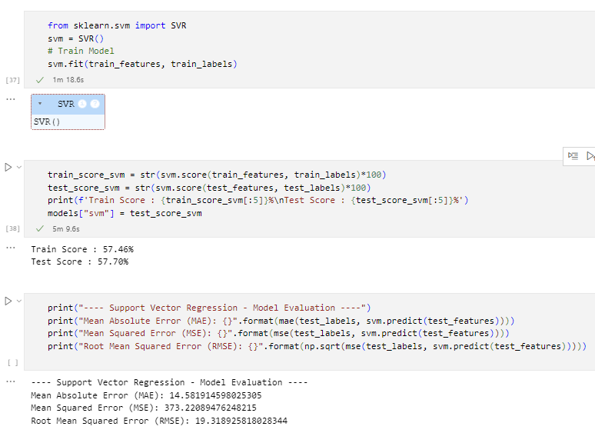
D. Support Vector Machine

Slide 23
E. K Neighbor Regressor
K Nearest Neighbor Regressor is a non-parametric regression algorithm that predicts the target variable by averaging the values of the k nearest neighbors.
It is simple to implement and does not require a training phase, as the prediction is based on the similarity between the new data point and the existing training data.

Slide 24
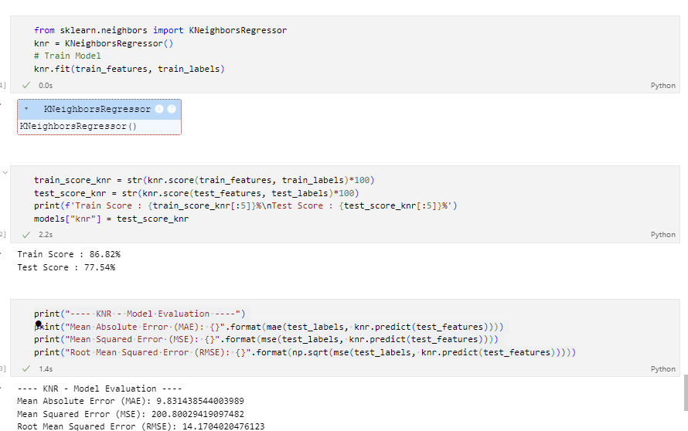
E. K Neighbor Regressor

Slide 25
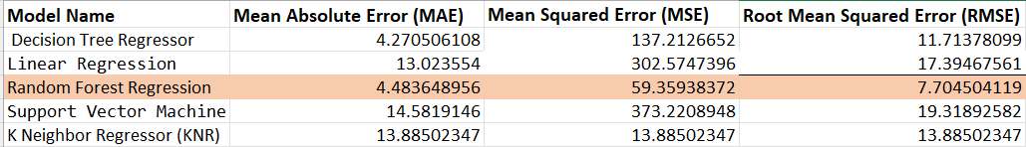
Model Selection
We can see that RFR
Have minimum error of MAE and RMSE

Slide 26
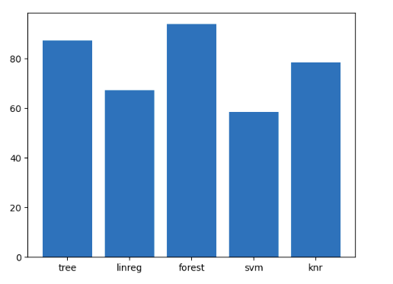
Model Selection
we can see that Random Forest performed the best, closely followed by Decision Tree and KNR.
So we will be choosing Random Forest for the final model

Slide 27
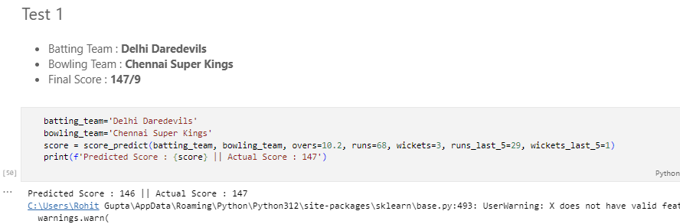
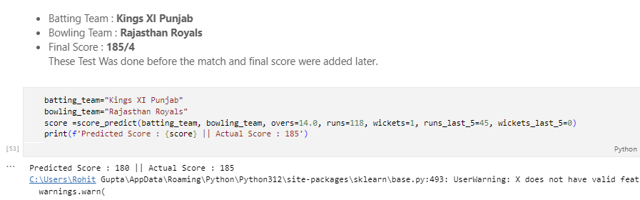
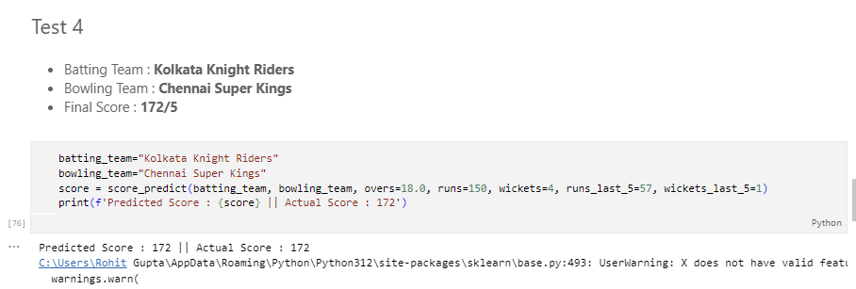
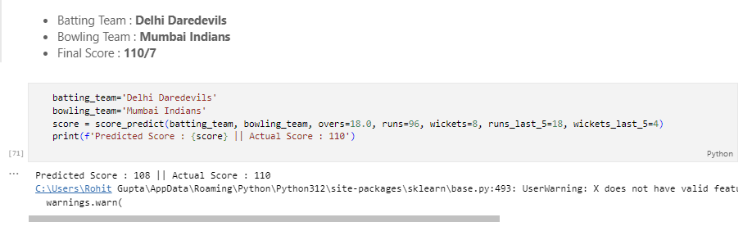
Testing

Slide 28
Limitation
1. Data Limitations:
- Availability and quality of historical cricket data, particularly for lesser-known teams or players, restrict model training and accuracy.
2. Complex Cricket Dynamics:
- Various factors like pitch conditions, player form, team strategies, and weather pose challenges in accurately capturing all relevant features.
3. Dynamic Match Nature:
- Rapid shifts in momentum, player performances, and strategies during matches can lead to deviations from predicted outcomes.
4. Model Overfitting:
- Overfitting occurs when the model learns noise or specific patterns from training data, hindering its ability to generalize to new or unseen data.

Slide 29
Reference
Mitchell, T. M. (1997). Introduction to Machine Learning. McGraw-Hill Education.
Zep Analytics. (2023). "IPLScorePredictor." GitHub. https://github.com/zepanalytics/IPLScorePredictor/blob/main/ipl_data.csv. Accessed [April 15, 2024].

Slide 30
Thank you very much!

