Slide 1
System Admin GitHub
J
Notes:
We are the system admin group.
I’m Jonathan, I’ve been taking the role of team leader.
Callum

Slide 2
Seminar goals and Objectives
Go over the core fundamentals of GitHub
Start you on your learning path
Show what GitHub can do for you as a student
J
Notes:
---

Slide 3
What is GitHub? And what is version control?
Git is open source software to allow collaboration
GitHub is a hosting solution for Git.
GitHub offers a fancy web interface to use, as well as a desktop client and a traditional CLI.
Used by companies such as Airbnb and Netflix.
C
Notes:
Before we can talk about Github, we must talk about Git.
Git is a source code and distributed revision control system with a focus on speed. It was developed my Linus Torvalds in 2005.
Git allows for several people to work on different copies of code at the same time, and then merge them together at a later date.
As Git is open source, anyone can run their own Git server and have their own Git repositories for free.
GitHub is a company that provides hosting for Git. They will take care of the server side stuff and give you a very nice web interface or the typical CLI to use.
This is fantastic for us, because we don’t need to worry about the hassle of setting up a Git server and all the issues that come with that.
---

Slide 4
Basic Terminology
Dashboard
Your personal dashboard is the main hub of your activity on GitHub. From your personal dashboard, you can keep track of issues and pull requests you're following or working on, navigate to your top repositories and team pages, and learn about recent activity in repositories you're watching or participating in
Git
Git is an open source program for tracking changes in text files, and is the core technology that GitHub, the social and user interface, is built on top of.
M

Slide 5
Basic Terminology
Collaborator
A collaborator is a person with read and write access to a repository who has been invited to contribute by the repository owner.
Contributor
A contributor is someone who has contributed to a project by having a pull request merged but does not have collaborator access.
M
Notes:
Before we can talk about Github, we must talk about Git.
Git is a source code and distributed revision control system with a focus on speed. It was developed my Linus Torvalds in 2005.
Git allows for several people to work on different copies of code at the same time, and then merge them together at a later date.
As Git is open source, anyone can run their own Git server and have their own Git repositories for free.
GitHub is a company that provides hosting for Git. They will take care of the server side stuff and give you a very nice web interface or the typical CLI to use.
This is fantastic for us, because we don’t need to worry about the hassle of setting up a Git server and all the issues that come with that.
---

Slide 6
Basic Terminology
Branch
“A branch is a parallel version of a repository. It is contained within the repository, but does not affect the primary or master branch allowing you to work freely without disrupting the "live" version.”
Commit
A commit, or "revision", is an individual change to a file (or set of files). It's like when you save a file, except with Git, every time you save it creates a unique ID (a.k.a. the "SHA" or "hash") that allows you to keep record of what changes were made when and by who. Commits usually contain a commit message which is a brief description of what changes were made
M
Notes:
Think of a branch like a branch on a tree. The tree itself is the repository and the main version, and a branch is a different parallel version. It doesn’t effect the main or master branch, and it allows you to add changes without risking major issues with the live version.
A commit is simply a change done to a file. When you save and commit a file it creates a unique ID and some metadata such as a brief description of what changes were made.

Slide 7
Basic Terminology
Remote
This is the version of something that is hosted on a server, most likely GitHub. It can be connected to local clones so that changes can be synced.
Repository
A repository is the most basic element of GitHub. They're easiest to imagine as a project's folder. A repository contains all of the project files (including documentation) and stores each file's revision history. Repositories can have multiple collaborators and can be either public or private.
M

Slide 8
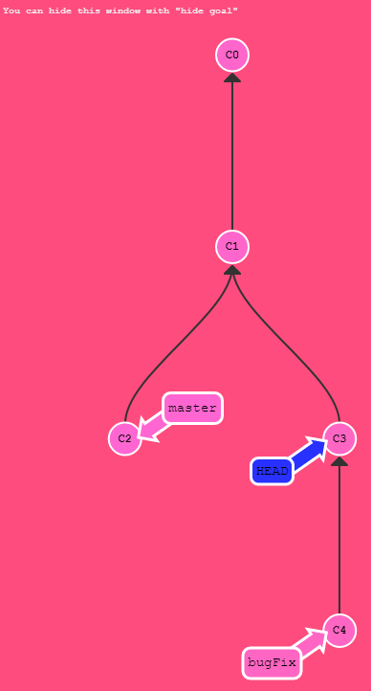
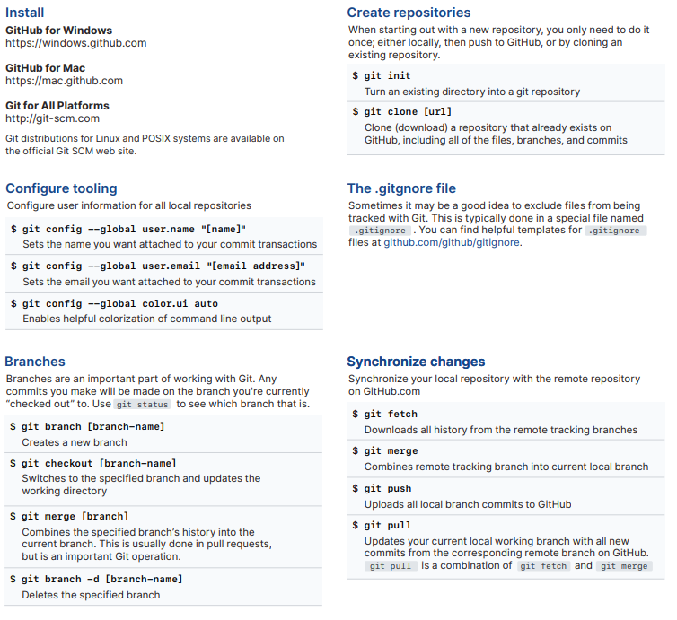
GitHub and Git Learning Opportunities
try.github.io/
C
Notes:
Try.Github.io is an interactive tool to help you learn Git and GitHub.
It includes useful tools such as a cheat sheet. This is useful as a quick reference guide for the common things you’ll be doing all the time on Git, such as creating a new branch.
I really like this learning tool because it includes a lot of visual elements that makes visualising what your doing a lot easier.
The tutorial not only covers some of the basics like committing, reversing changes, but also pulling updates and pushing updates, and how to deal with multiple parents.

Slide 9





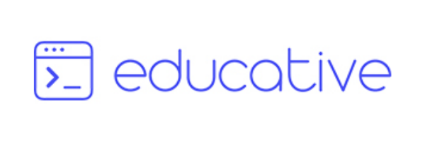








GitHub Student Developer Pack education.github.com/pack
J
Notes:
Here’s a rundown of the GitHub student pack.
GitHub Education gives students various developer tools from their partners.
It gives you access to plenty of tools from tools for Web Development like BootStrap Studio

Slide 10
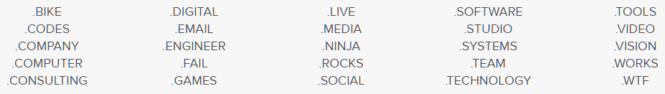
Developer Pack - Domains education.github.com/pack
Free .me domain with Namecheap.
Free domain with name.com.
Free .Tech domain.
And more!
J
Notes:
First we’ll talk about what you can get in terms of domains.
If you’re interested in hosting your personal projects to show to companies, you can get several different free domains with the student pack.
Free .me domain with namecheap for 1yr, also comes with a free SSL cert for a year.
With Name.Com you get a wide range of domains as you can see below, these also come with free WHOIS proection.
Free .tech domain with TechDomains.

Slide 11
Developer Pack - Hosting education.github.com/pack
50 USD credit with DigitalOcean.
Free static web page hosting with Page Clip
50 USD credit with MNX.io
EducationHost hosting
J

Slide 12
Developer Pack - Training education.github.com/pack
Access to AWS Training, 100 USD worth.
Access to Microsoft Azure learning resources.
60+ courses from Educative.
Educative training (Includes Web Dev, Python, Machine learning, and more)
Adafruit IO+ (Includes super interesting IOT related materials)
FrontEndMasters (Focused on Web Dev)
next.tech (Great Data Science tutorials with R and Python)
OneMonth (Fast track programs for learning Web Dev and Python)
J
Notes:
For example with AdaFruit you can learn how to create a environmental monitor and get data such as temperature, pressure, humidity, UV levels, etc. The website will even give examples on what hardware to use like Pi’s.
Front end masters focus on resources like learning node.js, JS, and general front end web development

Slide 13
Developer Pack - Other interesting tools
JetBrains
Access to PyCharm
BootstrapStudio
Easy to use tool for creating Bootstrap websites using the Bootstrap CSS Framework.
Canva
Create great looking graphics from their templates.
InterviewCake
Reference pages and cheat sheets for Data Structures and Algorithms.
Deep Source Pro
Python static code analysis. Checks for anti patters, performance optimisations, security vulnerabilities, and style issues.
J
Notes:
For example with AdaFruit you can learn how to create a environmental monitor and get data such as temperature, pressure, humidity, UV levels, etc. The website will even give examples on what hardware to use like Pi’s.
Front end masters focus on resources like learning node.js, JS, and general front end web development

Slide 14
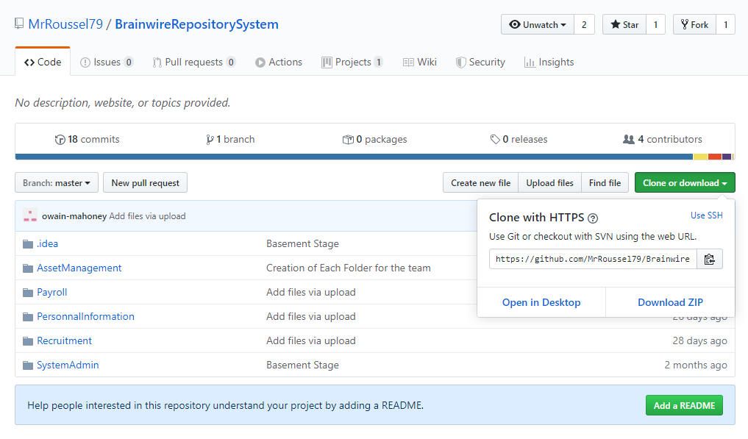
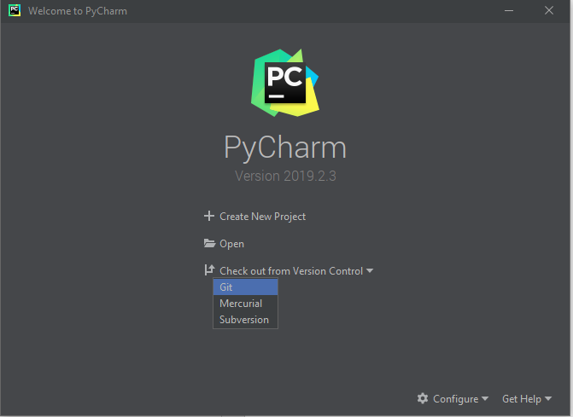
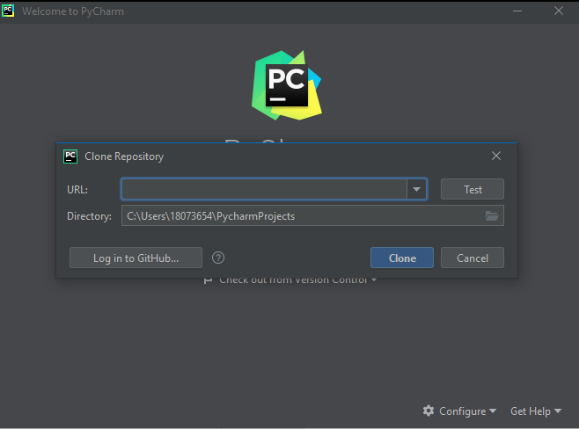
GitHub integration with PyCharm
2. Copy the URL from the drop down and past it in the URL: text box
1. When you open PyCharm you need to select Check out from version control and then select Git from the drop down menu
3. Login to gitHub
A

Slide 15
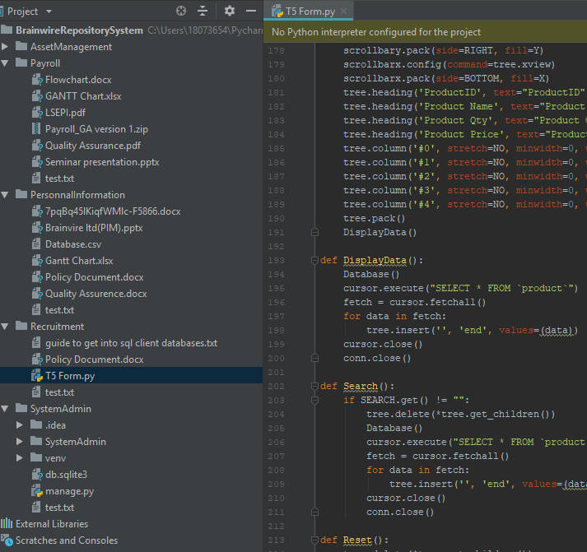
Results
A

Slide 16
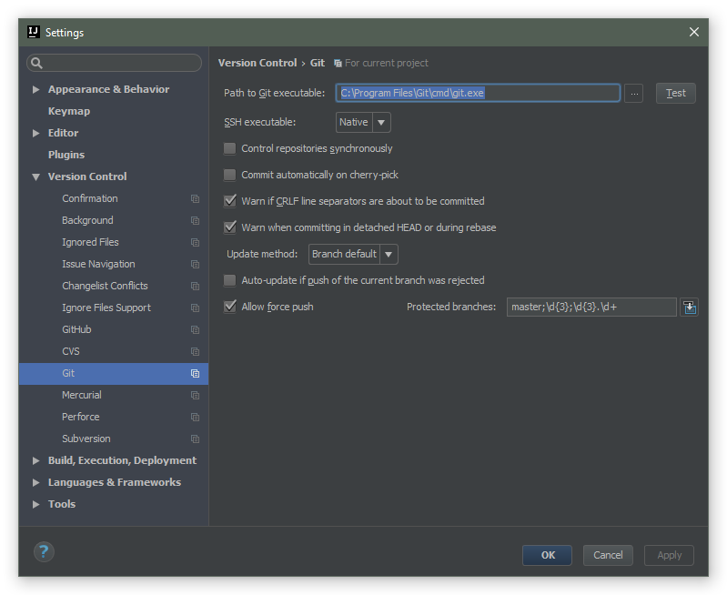
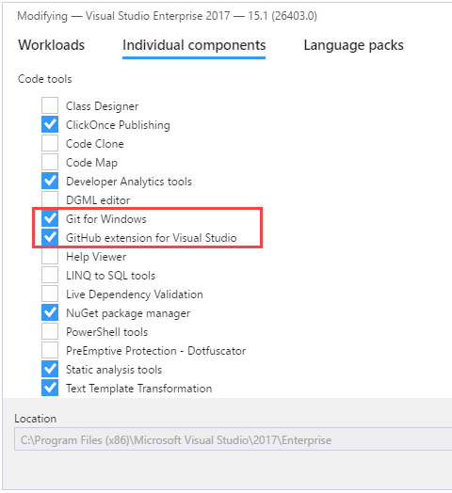
Known issues
PyCharm cant find "git.exe"
Git\bin\git.exe
Admin privileges with visual studio
A

Slide 17
Questions and feedback
www.SysAdmin.team
A
Notes:
As you can see, we used one of our free domains so that you can easily access our feedback from rather than type in a long URL.
Everyone please

