Slide 1
PDE4444 — MACHINE LEARNING FOR ENGINEERS
ML-Based Visual Quality Inspection System
Classifying breadboard circuits as PASS/FAIL using deep learning and classical ML — a comparative study
AUTHORS
BEST RESULT
MODELS EVALUATED
Aman Mishra M00983641
93.75%
DATASET
9
864
Faseeh Mohammed M01088120
CNN Tuned Validation Accuracy
CNN + 6 Classical + Variants
Augmented Images

Slide 2
ENGINEERING PROBLEM DEFINITION
Automated Breadboard Quality Control
Manual inspection of breadboard circuits is slow, inconsistent, and error-prone — defective boards reaching downstream processes cause costly failures
FAIL
Critical QC error — defective board ships
Inputs: Overhead RGB camera images (224×224 px) of assembled breadboard circuits
Output: Binary classification — PASS or FAIL — with a confidence score, in real time
PASS
Board meets quality threshold — cleared
Deployment: Live webcam inference via analyzer.py , with LED indicator and optional robotic arm integration
ENGINEERING RELEVANCE
Demonstrates a complete MLOps pipeline applicable to any visual quality inspection task in manufacturing

Slide 3
DATASET COLLECTION & FEATURE REPRESENTATION
Data Pipeline & Augmentation Strategy
AUGMENTED DATASET
CLASSICAL ML BRANCH
RAW DATASET
AUGMENTATION
CNN BRANCH
54 Images
16× Expansion
864 Images
224×224×3
64×64×3
19 PASS · 35 FAIL
→
→
304 PASS · 560 FAIL
→
→
8 rotations × 2 mirrors
150,528 input dims
12,288 input dims
Manually captured overhead shots
offline_augmentation.py
70 / 15 / 15 split
Flattened pixel vector
Class ratio preserved ~35/65
DIMENSIONALITY REDUCTION
PREPROCESSING
CLASS IMBALANCE
PCA reduced classical ML input to 50 components — capturing 87.1% of variance, enabling Newton's method optimisation
CNN: Keras Rescaling(÷255) layer. Classical ML: StandardScaler normalisation before all classifiers
35% PASS / 65% FAIL distribution preserved through augmentation — reflects real-world defect prevalence in QC scenarios

Slide 4
NEURAL NETWORK DESIGN
Convolutional Neural Network Architecture
INPUT
224 × 224 × 3 — RGB image
Training Configuration
RESCALE
÷255 normalisation
Optimiser: Adam (lr = 0.001)
Loss: Sparse Categorical CE
CONV BLOCK 1
Conv2D(32, 3×3, ReLU) + MaxPool(2×2)
Early Stopping: patience = 3
Split: 70 / 15 / 15
CONV BLOCK 2
Conv2D(64, 3×3, ReLU) + MaxPool(2×2)
CONV BLOCK 3
Conv2D(128, 3×3, ReLU) + MaxPool(2×2)
Baseline Performance
FLATTEN
Feature map → 1D vector
87.02%
DENSE
Dense(128, ReLU) + Dropout(0.5)
Test accuracy · F1 = 0.86
FAIL recall = 95%
OUTPUT
Dense(2, Softmax) — PASS / FAIL

Slide 5
NEURAL NETWORK OPTIMISATION — ACTIVATION FUNCTIONS
ReLU vs. Tanh — Activation Analysis
WINNER
UNDERPERFORMED
91.41%
65.63%
ReLU — Rectified Linear Unit
Tanh — Hyperbolic Tangent
f(x) = max(0, x)
f(x) = (eˣ − e⁻ˣ) / (eˣ + e⁻ˣ)
Avoids vanishing gradients in deeper layers. Sparse activation supports efficient feature learning in 3-conv architecture.
Converged to majority-class baseline — failed to learn discriminative features. Vanishing gradients in the 3-conv stack saturated weights, preventing meaningful updates.
+25 percentage points
ReLU outperformed Tanh by a 25.78pp margin — a decisive gap confirming that ReLU's resistance to vanishing gradients is critical even in a shallow 3-block CNN

Slide 6
NEURAL NETWORK OPTIMISATION — ALGORITHMS
Optimisation Algorithm Comparison
DEEP LEARNING — CNN
TRADITIONAL ML — LOGISTIC REG ON PCA-50
Adam
91.41%
Newton's Method
73.41%
SGD
65.62%
Coordinate Search
69.36%
Gradient Descent
65.90%
Adam 's adaptive per-parameter learning rates handled sparse gradients and class imbalance far better than fixed-step SGD
GD diverged at lr=0.01. Newton's converged in 10 iterations via Hessian-scaled steps — feasible because PCA reduced dims to 50

Slide 7
HYPERPARAMETER TUNING
Keras Tuner RandomSearch — Best CNN Configuration
BASELINE → TUNED
Before
After (val)
Tuning Strategy
87.02%
→
93.75%
+6.73pp
Keras Tuner RandomSearch
10 trials · 3-fold evaluation
~50–60 min on CPU
SEARCH SPACE
HYPERPARAMETER
BEST VALUE
SVM Tuning — No Improvement
Filters (Conv1)
64
sklearn RandomizedSearchCV
Dense Units
128
10 iterations · 3-fold
Best: C=0.1, linear kernel
Dropout Rate
0.2
Result: 82.08% (no gain — already optimal)
Learning Rate
0.001
TAKEAWAY
Tuning helps most when capacity is underutilised — SVM was already at its ceiling

Slide 8
BASELINE COMPARISON — CLASSICAL ML
Six Classical Models — Ranked Performance
SVM (Linear)
82.08%
Best Classical Model
Logistic Regression
79.19%
SVM Linear
Gradient Boosting
78.03%
80/20 held-out split · StandardScaler
Random Forest
74.57%
KNN (k=5)
69.94%
Worst — MLP Instability
MLP (sklearn)
64.74%
CV Std Dev: ±13.26%
Fold 2 dropped to 34.8% — below majority-class baseline, confirming training divergence
All models trained on flattened 12,288-dim pixel vectors — no hand-crafted features, demonstrating raw pixel viability for classical QC

Slide 9
EXPERIMENTAL RIGOR
Cross-Validation & Overfitting Analysis
5-FOLD STRATIFIED CV — CLASSICAL MODELS
CNN OVERFITTING ANALYSIS
MODEL
CV MEAN
STD DEV
Train Accuracy
Val Accuracy
SVM (Linear)
86.98%
±2.77%
99.17%
90.62%
Logistic Regression
83.21%
±2.64%
Gradient Boosting
79.59%
±3.52%
Random Forest
77.42%
±1.29%
OVERFITTING GAP
8.55pp
KNN (k=5)
72.36%
±2.19%
MLP
60.49%
±13.26%
Dropout(0.5) partially mitigated — early stopping (patience=3) limited further divergence
SVM's CV mean (86.98%) exceeds its held-out test score (82.08%) — confirming robust generalisation, not overfitting to the split
False Positives (Critical QC Error)
4 / 75 FAIL boards misclassified as PASS
FAIL recall = 95% · 13/56 PASS boards rejected · 131 held-out images

Slide 10
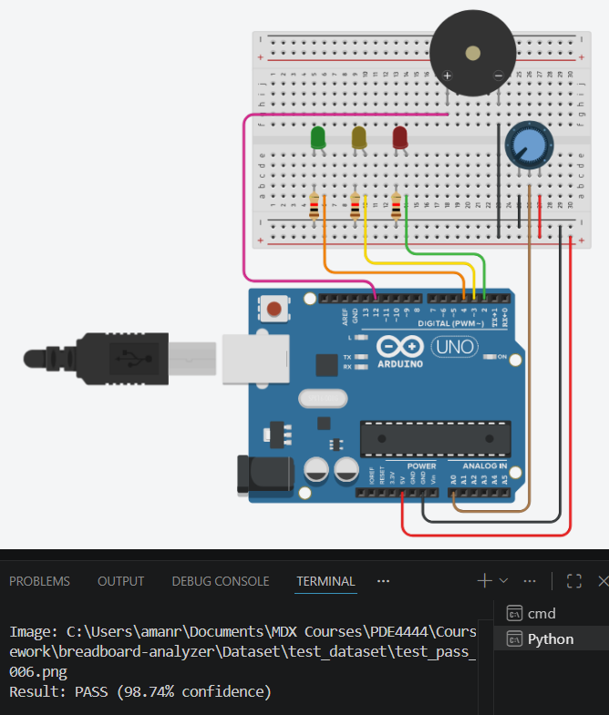
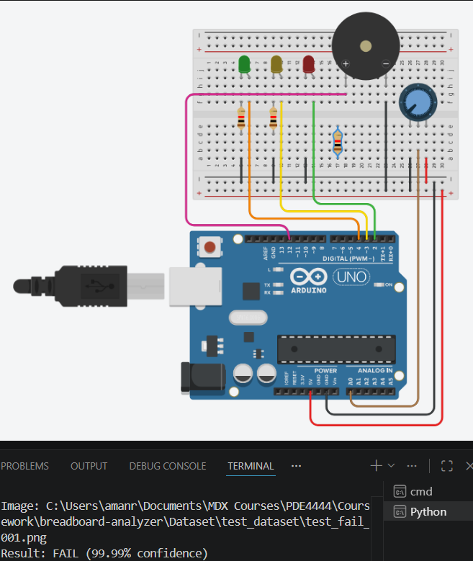
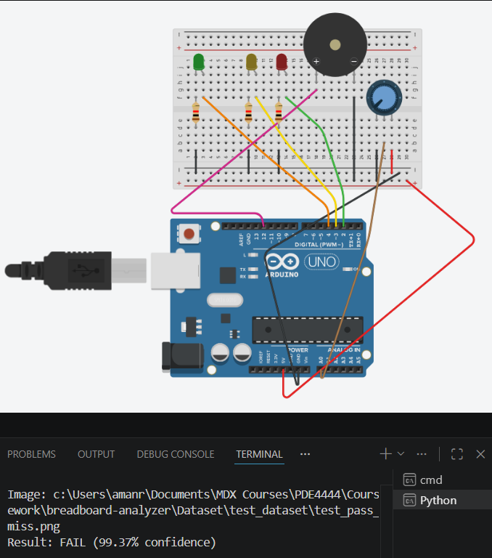
LIVE INFERENCE — ANALYZER.PY · STATIC IMAGE MODE
Classification on Unseen Data
CORRECT — TRUE PASS
CORRECT — TRUE FAIL
MISCLASSIFICATION — FALSE FAIL
PASS
FAIL
PASS
→
FAIL
Confidence: 98.74%
Confidence: 99.99%
Confidence: 99.37%
All components correctly seated
Moved component detected via learned feature maps
Unclear wiring detected as improper breadboard design
python analyzer.py → select option 1 (static image) → provide image path → result printed to terminal with class label and confidence score
HOW IT WAS RUN

Slide 11
FINAL RESULTS & DEPLOYMENT
Model Comparison & System Architecture
ALL MODELS — FINAL RANKING
MODEL
ACCURACY
NOTES
Conclusion
CNN surpasses the best classical model by +4.94pp on test data and +6.73pp after tuning — validating deep learning for visual QC tasks with a small augmented dataset
CNN — Tuned (RandomSearch)
93.75%
Best overall
CNN — ReLU + Adam
87.02%
Baseline CNN
SVM (Linear) — 5-fold CV
86.98%
Best classical
SVM (Linear) — held-out
82.08%
—
DEPLOYMENT STACK
analyzer.py — Webcam or static image inference, real-time CV overlay
Logistic Regression
79.19%
—
Gradient Boosting
78.03%
—
Arduino LED indicator — Green/Red output on PASS/FAIL
Random Forest
74.57%
—
EPSON VT6 robotic arm integration (picker-bot ) for automated sorting
KNN (k=5)
69.94%
—
MLP (sklearn)
64.74%
Unstable
Transfer learning · expanded dataset · Raspberry Pi edge deployment
FUTURE WORK

