Slide 1
MSC THESIS DEFENSE · DTU COMPUTE
Reading the Reader
A Modular, Researcher-Operated Adaptive Reading Platform
Dummy Presenter One · Dummy Presenter Two
Supervisor: [Supervisor Name] · External Censor: [Censor Name]
[Defense date] · [Venue / Room] · Technical University of Denmark
Reading the Reader · MSc Thesis Defense
1
Notes:
Open warm and brief. We are [names]. This is our MSc thesis defense. The thesis builds a modular, researcher-operated adaptive reading platform. Today: 25 minutes including a ~7-8 minute live demo, then questions. Hand to the problem.

Slide 2
THE PROBLEM
Adapting text can cost the reader their place
Digital text can be reshaped as it is read, and eye tracking reveals how a reader is coping. But the same typographic change applied at the wrong moment forces the reader to start the line again. The central challenge is changing the text without breaking the reading flow it is meant to protect.
DEFAULT TYPOGRAPHY
ADAPTED TYPOGRAPHY
Reading should feel effortless, yet text that is small, tightly tracked, or densely lined can slow a reader down and increase fatigue.
Reading should feel effortless, yet text that is small, tightly tracked, or densely lined can slow a reader down.
adaptive
intervention
At least 2.2 billion people live with a vision impairment (WHO); reading difficulty also spans dyslexia and ageing. Adaptive typography can help — if it never costs the reader their place.
Reading the Reader · MSc Thesis Defense
2
Notes:
This tension is the spine of the whole thesis. Show the two columns: same sentence, larger and more open on the right — easier to read, but if we apply that mid-line and the text reflows, the reader loses their place. So the problem is not WHAT to change, it is changing it WITHOUT breaking flow. Ground the stakes in one line: 2.2B vision impairment, plus dyslexia and ageing.

Slide 3
WHY IT MATTERS
Prior prototypes worked — but each was a monolithic fork
Earlier Reading the Reader prototypes proved gaze-driven adaptation is achievable.
But sensing, decision logic, and the reading interface shared one codebase.
Every new study extended the system by copying the previous frontend wholesale.
ONE TANGLED CODEBASE
Sensing
Decision logic
Reading UI
entangled — no seams
Study A fork
Study B fork
Study C fork
Concrete cost. Testing whether fading a change in is less disruptive than applying it abruptly means editing core code and maintaining two divergent forks. A scientifically trivial question made expensive by the architecture.
Each study duplicates the whole system.
Reading the Reader · MSc Thesis Defense
3
Notes:
The point is not that the prototypes were bad — they proved the idea. The point is the ARCHITECTURE: everything in one codebase, so the only way to run a new condition was to fork. Use the fade-vs-abrupt example to make it tangible: a trivial scientific question that the architecture makes expensive. That friction is exactly what we set out to remove.

Slide 4
FRAMING
The contribution is design knowledge, not the code
A platform can look like an engineering exercise. We argue it is also research. Under the Design Science Research paradigm, a designed artifact and the knowledge it embodies are themselves the contribution — when rigorously motivated and evaluated.
1
Motivate
2
Build
3
Evaluate
A real, unmet need: prior forks made every study expensive, and no tool unites the four capabilities.
The designed artifact — a modular, two-screen adaptive reading platform with four replaceable modules.
The knowledge it yields: do the seams actually hold under a real-time, hardware-backed reading loop?
So the research contribution is the module boundaries and integration contracts — and the evidence of whether they hold — not the running code itself.
Reading the Reader · MSc Thesis Defense
4
Notes:
This slide is deliberate insurance against the most likely challenge to a systems thesis: 'is this just engineering?'. Answer it before it is asked. Design Science Research: the artifact plus the knowledge it embodies is the contribution. State plainly that we argue it is BOTH engineering and research, and that the research lives in the contracts and the evidence that they hold.

Slide 5
THE GAP
No existing tool combines all four capabilities
Tool / Platform | Real-time gaze sensing | Context-preserving intervention | Researcher in the loop | Pluggable decision logic | Reproducible record
Tobii Pro Lab | ✓ | – | ✓ | – | ✓
EyeLink | ✓ | – | ✓ | – | ✓
PsychoPy | ✓ | – | – | – | ✓
Psychtoolbox | ✓ | – | – | – | ✓
Our platform | ✓ | ✓ | ✓ | ✓ | ✓
Commercial recorders capture and let a researcher monitor; experiment builders script stimuli. None applies real-time, context-preserving typographic intervention behind a pluggable decision boundary. Our platform is the only complete row.
Reading the Reader · MSc Thesis Defense
5
Notes:
Walk the columns, not the rows. Everyone senses gaze and records. The two empty columns for everyone else are the ones that matter: context-preserving intervention and pluggable decision logic. Commercial tools (Tobii, EyeLink) record and monitor; PsychoPy/Psychtoolbox script. Only ours is the full row. NOTE: reconcile these exact cells with the Chapter 2 market matrix before the defense.

Slide 6
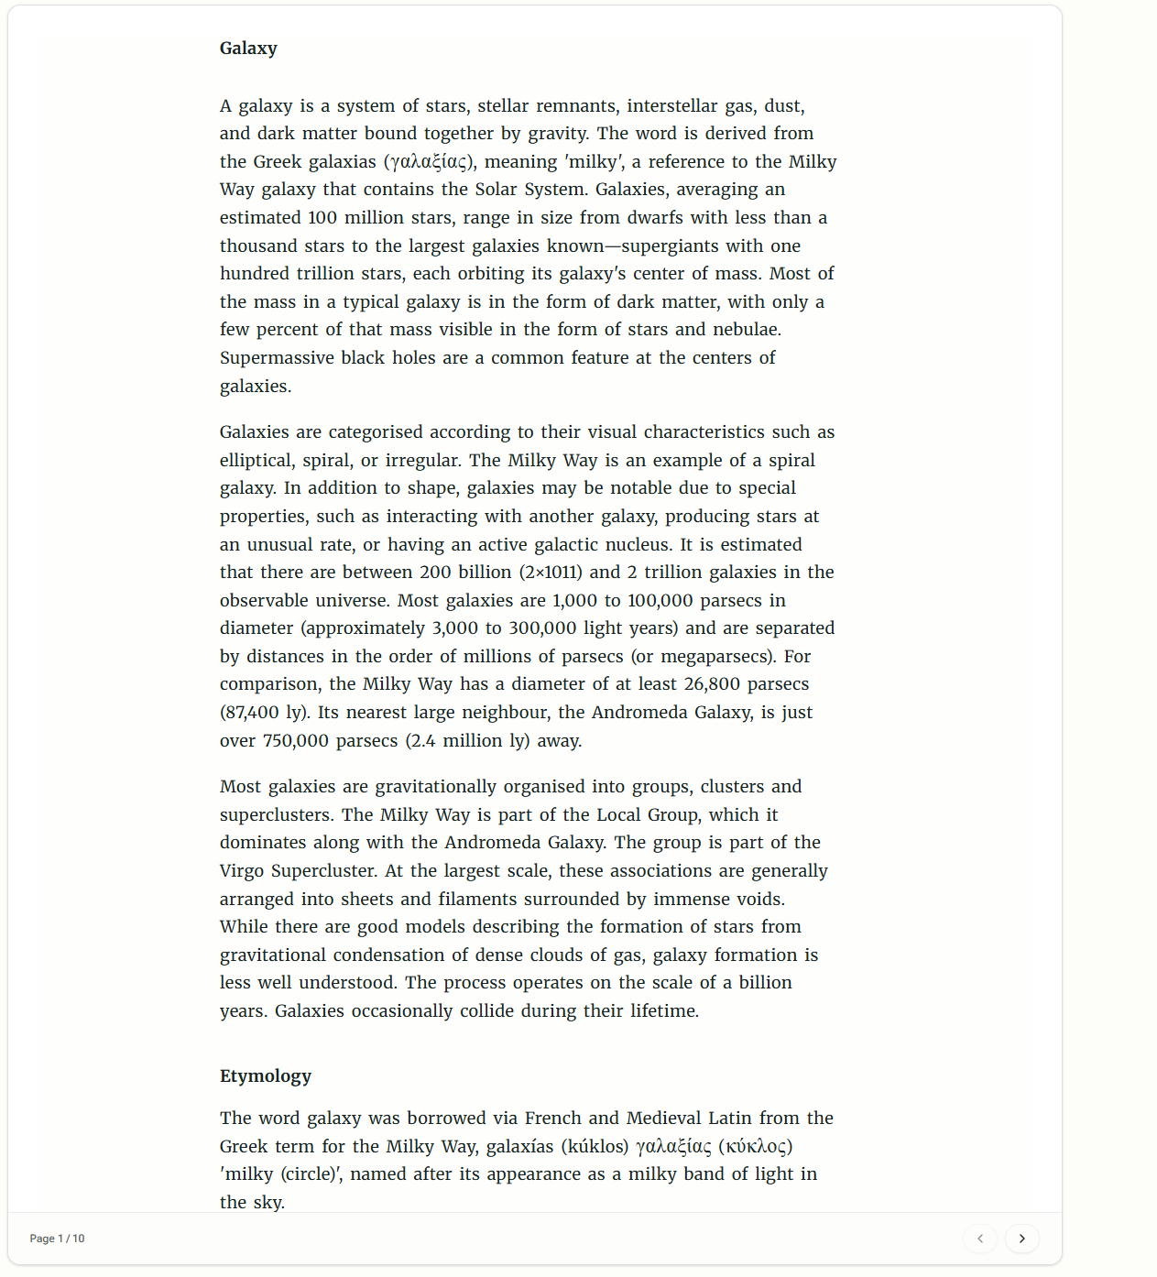
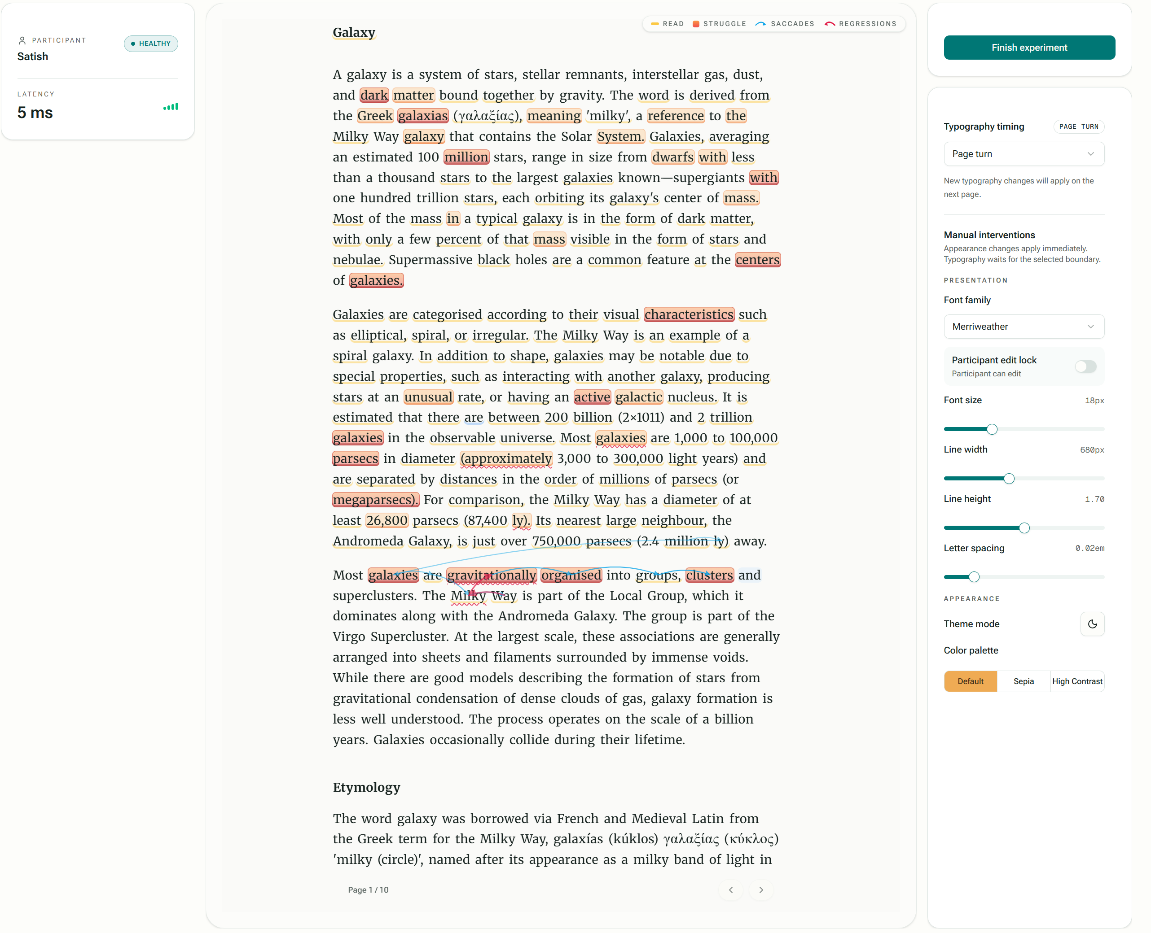
OUR CONTRIBUTION
A two-screen, modular adaptive reading platform
The rest of this talk answers four questions:
RQ1
Modularity — swap any module without touching the core
RQ2
Sensing — real Tobii stream → events, within budget
RQ3
Context — adapt the text, preserve the reader's place
Participant screen — text adapts to gaze
Researcher console — live gaze mirrored, controls
RQ4
Control — operate and reproduce the experiment
Reading the Reader · MSc Thesis Defense
6
Notes:
Reveal the artifact with the real product shots. Left: the participant only ever sees text. Right: the researcher console mirrors the participant's live gaze (heat map + saccades) and holds the controls. Then set up the spine of the talk: four research questions — modularity, sensing, context preservation, researcher control. This replaces a boring agenda slide.

Slide 7
ARCHITECTURE · RQ1
Four modules behind stable contracts
One contract shape, three intelligent seams
Analysis
Each module takes an immutable snapshot and returns an optional result — a copy of what it needs, never the live state.
So a module is replaceable without coordination and testable in isolation.
Adding one is additive: a new implementation, one registration, no edit to the reading runtime.
Because sensing speaks gaze samples (not Tobii types), the whole loop runs on a simulated source with no hardware.
Application
core
Sensing
Decision
Tobii / Simulated
Built-in / External
Intervention
Grey arrows: implementations depend inward on ports the core owns. The core depends on nothing outside it.
Reading the Reader · MSc Thesis Defense
7
Notes:
This is the central claim slide. Four concerns — sensing, analysis, decision, intervention — each a port the core owns. The load-bearing detail: a module receives a SNAPSHOT (a copy) and returns an optional result, so it can neither reach into nor mutate core state. That is what makes it independently replaceable and testable. 'Independently replaceable' now has a precise meaning: swap any implementation behind the same port with zero core changes. And because sensing is defined over gaze samples, the simulated mouse source drives the entire loop without the tracker.

Slide 8
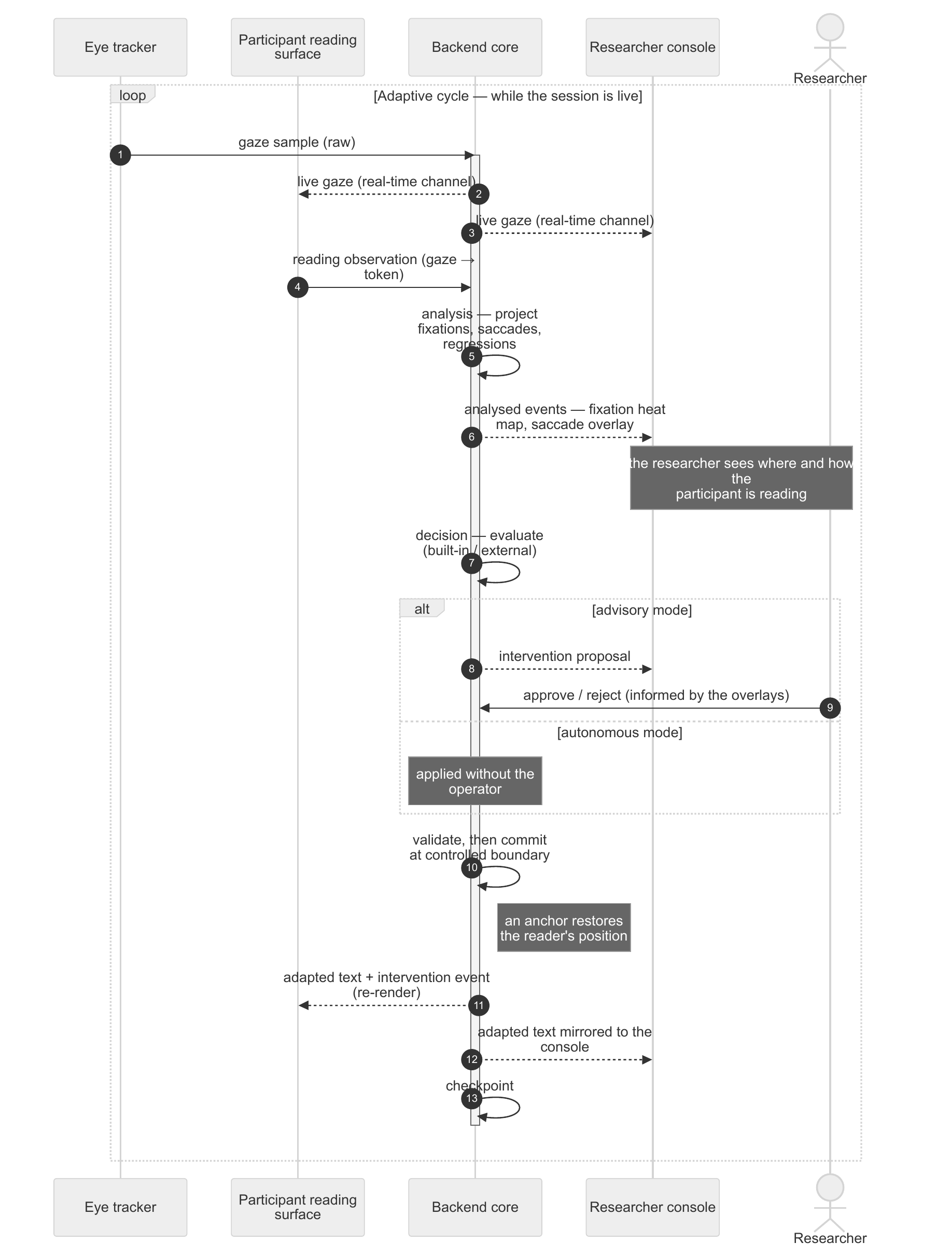
ARCHITECTURE · RQ2 / RQ3
Liveness without breaking the seams
The clean per-concern indirection is rarely the fastest at runtime. We reconcile separation with speed:
1
Two timescales
High-frequency gaze rides a dedicated real-time channel and is only sanitised, retained, and broadcast — never blocked on the slower control path.
2
Modularity off the hot path
Analysis, decision, and intervention run at the cadence of analysed-state changes, so the indirection stays off the per-sample path.
3
Two-phase commit
An intervention is validated, then committed at a controlled boundary carrying a position anchor — adapt the text, keep the reader's place (RQ3).
Reading the Reader · MSc Thesis Defense
8
Notes:
Name the tension honestly: modularity vs speed. An intervention delivered after the moment it was valid is useless. Our answer is NOT to dilute the contracts but to split timescales — gaze on a thin, direct real-time channel; the modular pipeline runs only when the analysed state changes. And the commit is two-phase: validate, then commit at a controlled boundary with an anchor that restores the reader's position. Point at the sequence diagram: gaze in, advisory approval, commit, adapted text mirrored back to both screens.

Slide 9
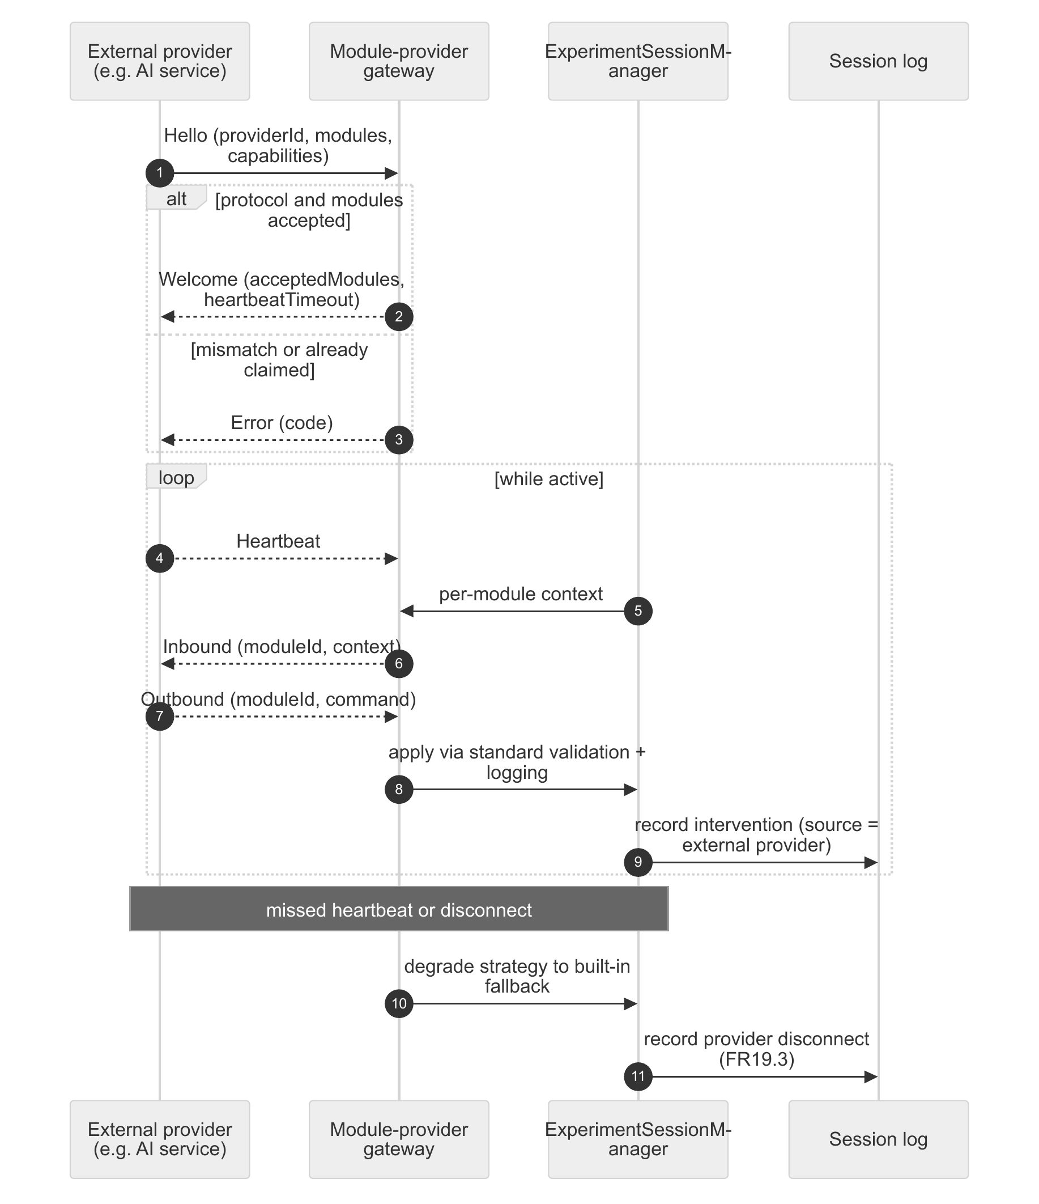
ARCHITECTURE · RQ1 / RQ4
Pluggable decisions, researcher in control
An external provider registers for a module's identity and connects out-of-process; the gateway routes context out and ingests the proposal back.
If no provider is attached, the same concern falls back to the built-in implementation — the loop runs unchanged either way.
Decision is the seam most likely externalised: the platform sends signals, expects a proposal back, and stays silent on how the proposal is reached.
A spectrum of human authority
Manual → Advisory (approve / reject) → Autonomous
Every proposal enters one pending state and resolves to exactly one recorded outcome — so control is auditable after the session, not just exercised during it.
Reading the Reader · MSc Thesis Defense
9
Notes:
Same mechanism, two concerns (analysis and decision). External provider attaches over a uniform seam keyed by module identity; no provider → built-in fallback; the loop never notices. The deeper point for RQ4: a spectrum from fully manual, through advisory approve/reject, to autonomous — the modes differ only in WHO resolves the proposal. And every proposal's fate is recorded, so the researcher's control is auditable. Mention the cross-session loop: exported records can fine-tune an external provider that re-attaches through this same seam.

Slide 10
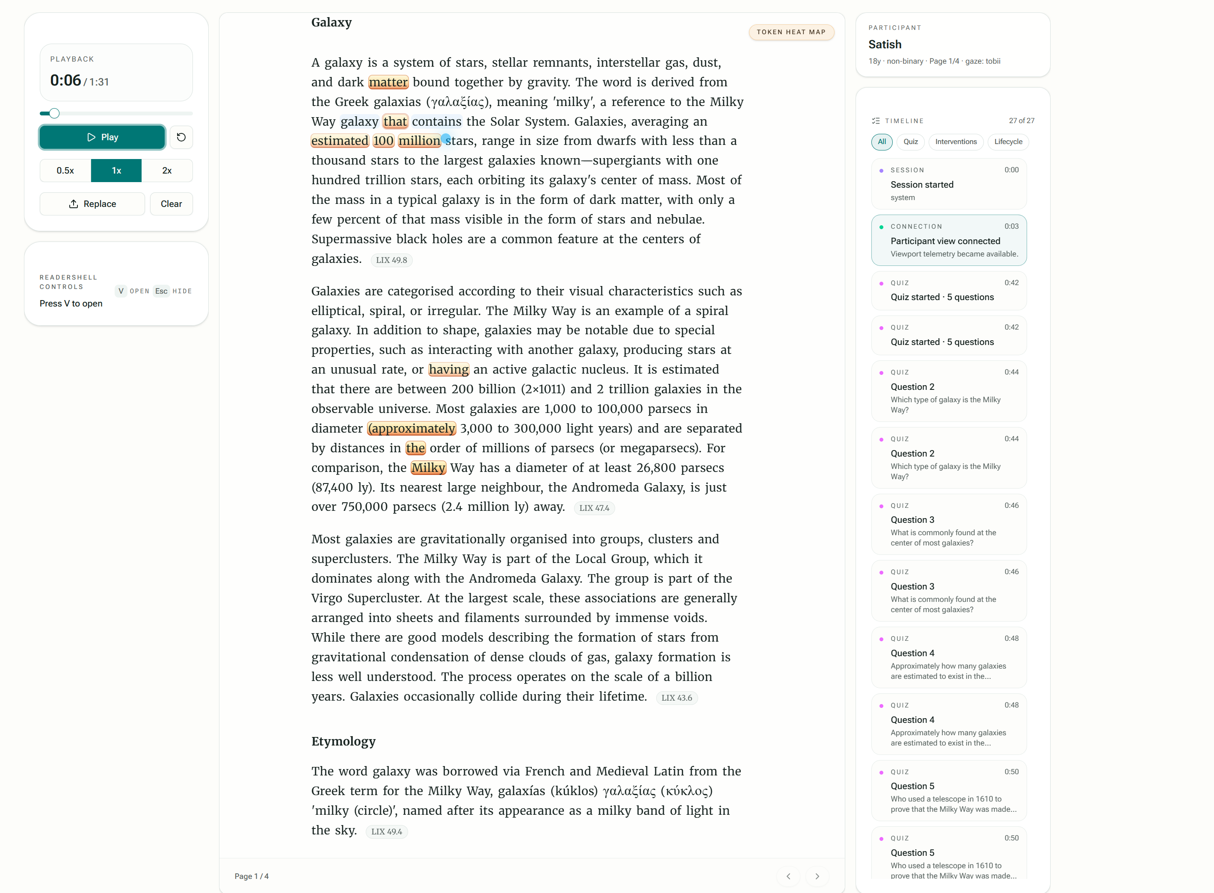
LIVE DEMONSTRATION · ~7–8 MIN
The platform, running
1
Two screens, live
Participant reads; console mirrors gaze (heat map + saccades)
2
Advisory proposal
Strategy proposes; researcher approves / rejects / overrides
3
Context-preserving commit
Text adapts; reader keeps place; resume-time instrumented
4
Swap a module
Same contract — simulated source / external provider, core untouched
5
Replay the record
Re-import an exported session — every number came from here
Reading the Reader · MSc Thesis Defense
10
Notes:
Switch to the recorded demo and both narrate over it (~7-8 min). The five beats map to the four RQs: two-screen + sensing, advisory control (RQ4), context-preserving commit (RQ3), module swap (RQ1), replay/reproducibility (RQ4). Keep narration tight and let the system speak. Return to this slide, then move to the evidence. Honesty: the demo shows the MECHANISM for one event; the aggregate results are on the next slides.

Slide 11
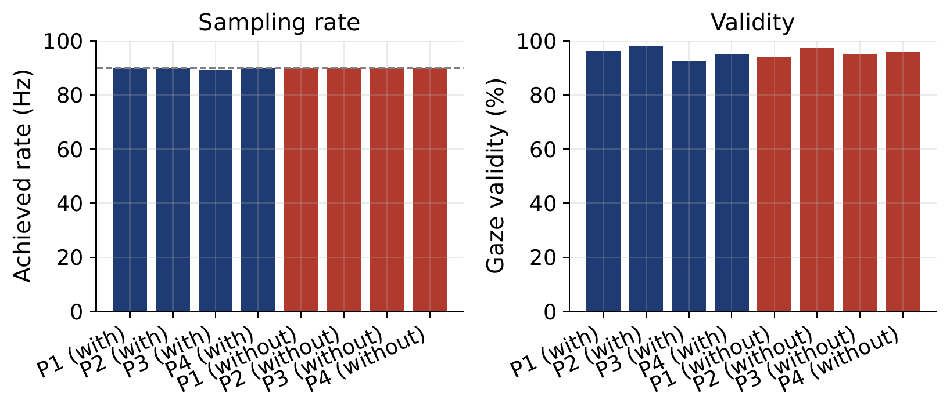
EVALUATION · RQ1 / RQ2
The seams hold; the pipeline is fast enough
RQ1 — Modularity, where it is hard to fake
RQ2 — Real Tobii sensing, within budget
✓
The core's dependency rule is enforced by the build and checked by an executable test.
90 Hz
>92%
<100 ms
rated sensing rate, sustained
gaze validity
client transport latency, every sample
✓
A new in-process module is added in a single registration.
✓
Three external providers connect with no change to the core — one wraps a collaborator's reading-difficulty model.
Per-session sensing rate and validity across eight real reading sessions.
Reading the Reader · MSc Thesis Defense
11
Notes:
Two RQs on one slide. RQ1 is the headline: modularity proven where it is hardest to fake — the boundary is a build-time invariant AND an executable test, a new module is one registration, and THREE external providers connected with zero core changes, one of them wrapping a third party's model. RQ2: the tracker ran at its rated 90 Hz, validity above 92%, and transport latency stayed under the 100 ms budget for every sample. Eight real Tobii-backed sessions.

Slide 12
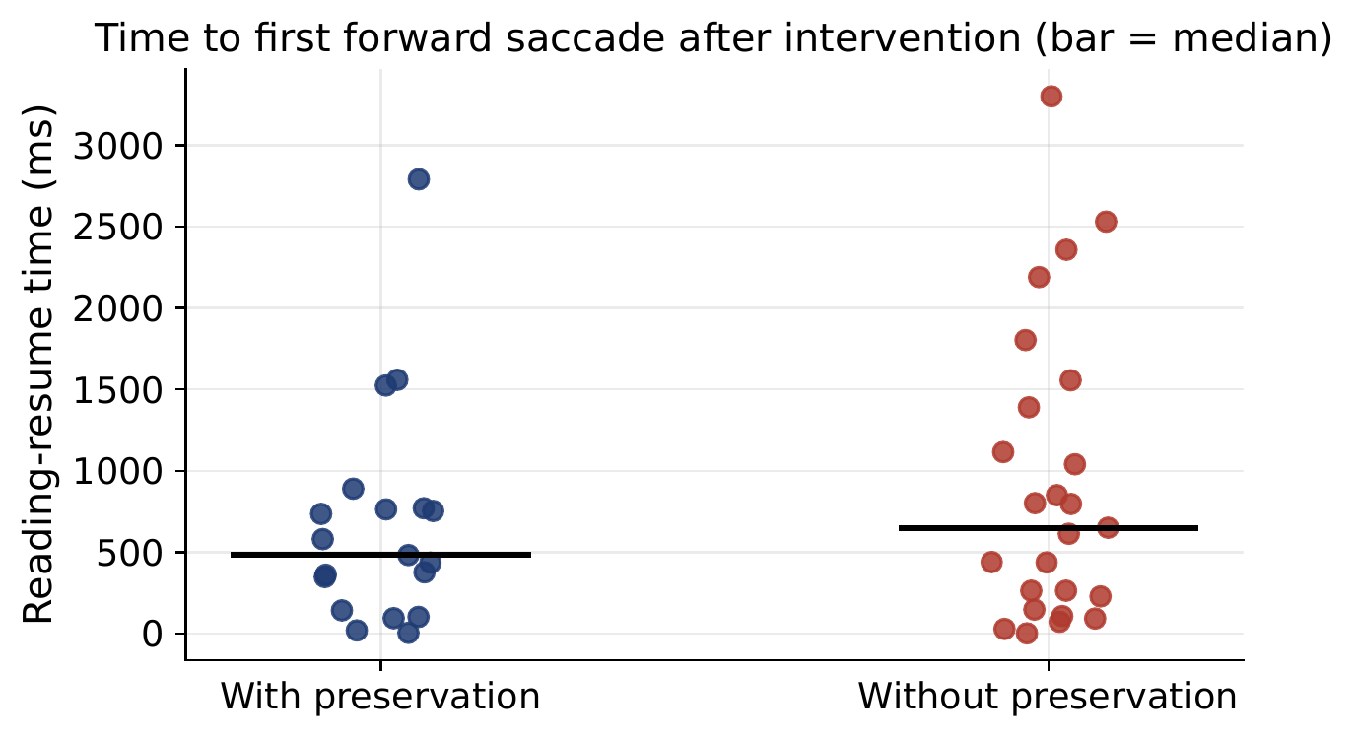
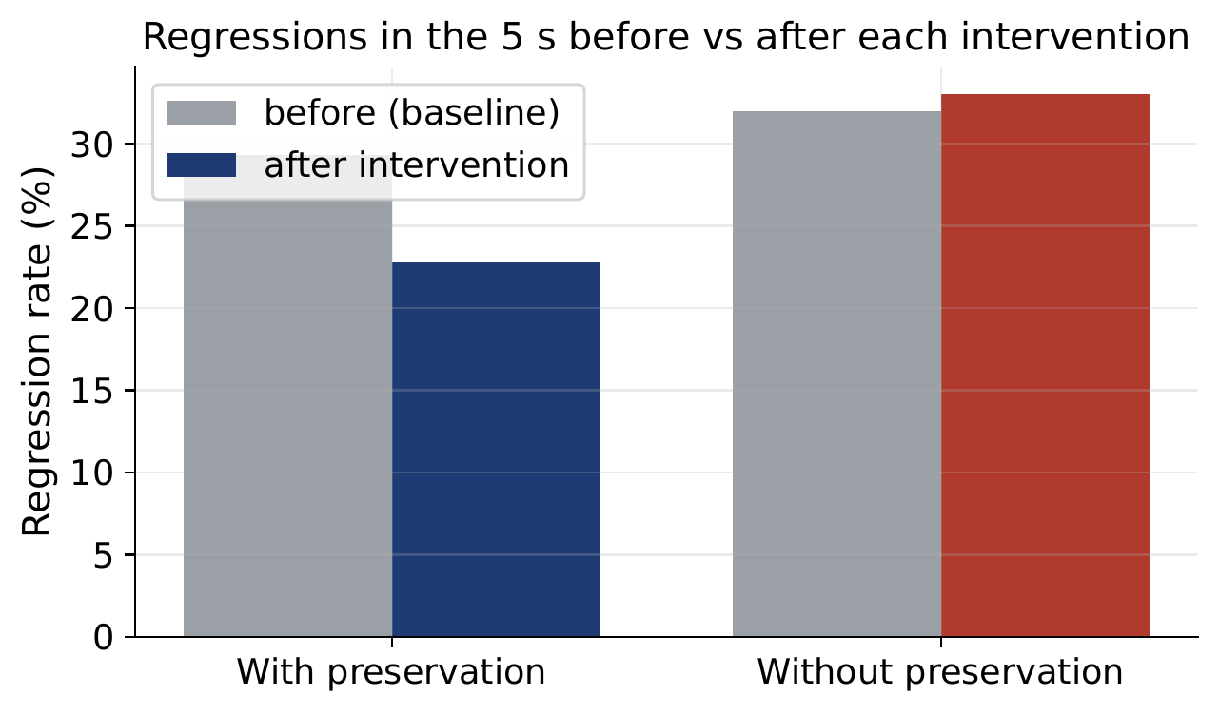
EVALUATION · RQ3 / RQ4
Context preserved; results reproducible
RQ3 — Context preservation lowered both measures
RQ4 — Operable and reproducible
One gated console operated every session — participant, licensed tracker, validated calibration, and material all required before a run can start.
Every reported result in the thesis was reconstructed from the exported session records alone — the session record is the research output.
Reading-resume time (left) and post-intervention regression rate (right): both lower with context preservation than without.
Results stated as measured; interpretation and threats live in the discussion.
Reading the Reader · MSc Thesis Defense
12
Notes:
RQ3: with the context-preserving mechanism enabled, BOTH the reading-resume time and the post-intervention regression rate came down. Show the two plots — with vs without preservation. State it plainly as a measured result; we do not over-claim from a single clip. RQ4: every session ran through one readiness-gated console, and crucially every number in the thesis was rebuilt from the exported records alone — that is what makes the platform a research instrument, not just a demo.

Slide 13
WHAT TRANSFERS
Four reusable design principles
The lasting contribution is the design knowledge — four principles that outlive this implementation.
P1
Boundary as a build-time invariant
P2
Validate the contract from outside
Enforce the module boundary in the build, not by convention — so it cannot silently erode.
Prove a seam by having an outsider integrate against it, not only its own authors.
P3
Measure the cost you claim
P4
Separate decision from commit
Every quality attribute the architecture asserts (latency, replaceability) is measured, not assumed.
Decide a change and commit it as two steps, so a disruptive update lands at a natural break.
Reading the Reader · MSc Thesis Defense
13
Notes:
This is the research takeaway — give it a clean beat and slow down. Four principles, each earned by the build and the evaluation: (P1) make the boundary a build invariant; (P2) validate the contract from OUTSIDE — the external providers are exactly this; (P3) measure every quality you claim, do not assert it; (P4) separate a change's decision from its commit so it lands at a natural break — that is the context-preserving commit generalised. These outlive this codebase.

Slide 14
HONEST REFLECTION
What we would flag, and what comes next
STATED LIMITATIONS
WHAT THE PLATFORM NOW UNBLOCKS
Decision path: single-run validation
1
External AI decision provider
The automated decision path was exercised within budget in one advisory-mode run, not at campaign scale. We treat it as a feasibility check, not a benchmark.
A trained reading-state model attaches over the existing decision seam — no core change.
2
Cross-session learning loop
Exported records become a corpus to fine-tune a provider that re-enters the loop.
Restore over-repositions on small reflows
The context-preserving restore moves the reader slightly too far when a reflow is small — an honest residual we measured rather than hid.
3
Controlled efficacy study
A clinical intervention study becomes a configuration choice, not a rewrite of core code.
Reading the Reader · MSc Thesis Defense
14
Notes:
Lead with the limitations, unprompted — this is where maturity is scored and it disarms the censor's best question. Two, stated without softening: the automated decision path was validated in a single run, not at scale; and the restore over-repositions on small reflows (we measured the residual). Then pivot to leverage: because the architecture holds, the AI decision provider, the cross-session learning, and the controlled efficacy study are now configuration, not rewrites. The thing we deliberately left out of scope is now cheap for the next team.

Slide 15
IN ONE SENTENCE
A researcher can reshape what a reader sees in real time — without costing them their place.
And every part of that loop is replaceable without touching the core. We proved the seams hold under a real 90 Hz Tobii loop, and distilled four design principles for the studies that follow.
Thank you — we welcome your questions.
With thanks to our supervisor and the Reading the Reader programme at DTU Compute (Novo Nordisk Foundation).
Reading the Reader · MSc Thesis Defense
15
Notes:
Land the core claim verbatim and stop — do not trail off. Restate the hook, then the contribution and the four principles. Then thank the room and open for questions. Be ready to jump to the backup slides. Remember: questions are not adversarial; answer the question asked, and where we have a limitation, name it.

Slide 16
BACKUP · FOR Q&A · METHOD
Fixation detection: I-AOI / dwell-based
Fixations are identified by dwell within areas of interest (I-AOI), not by a velocity threshold.
This is explicitly NOT I-DT or I-VT — there is no velocity- or dispersion-threshold classifier in the pipeline.
The analysis port abstracts the identification algorithm, so an I-DT/I-VT identifier could be substituted behind the same contract.
Reading the Reader · MSc Thesis Defense
16
Notes:
Rehearse this cold — it was answered wrong once before. Our method is I-AOI / dwell-based. Say clearly it is NOT I-DT or I-VT and there is no velocity threshold. Then note the architecture makes the choice swappable behind the analysis port.

Slide 17
BACKUP · FOR Q&A · METHOD
Line assignment: a 'poor-man's Kalman filter'
Mapping a gaze sample to a text line uses a small hysteresis: the previously chosen line gets a fixed discount before re-selection.
This biases toward continuity and suppresses jitter at line boundaries without a full probabilistic tracker.
We frame it candidly as a 'poor-man's Kalman filter' — cheap, legible, and a natural extension point toward real filtering.
Reading the Reader · MSc Thesis Defense
17
Notes:
The supervisor liked this framing. The line-bias discount adds hysteresis so gaze does not flicker between adjacent lines — a lightweight stand-in for a Kalman filter. Present it as a deliberate, honest simplification and an obvious future-work hook.

Slide 18
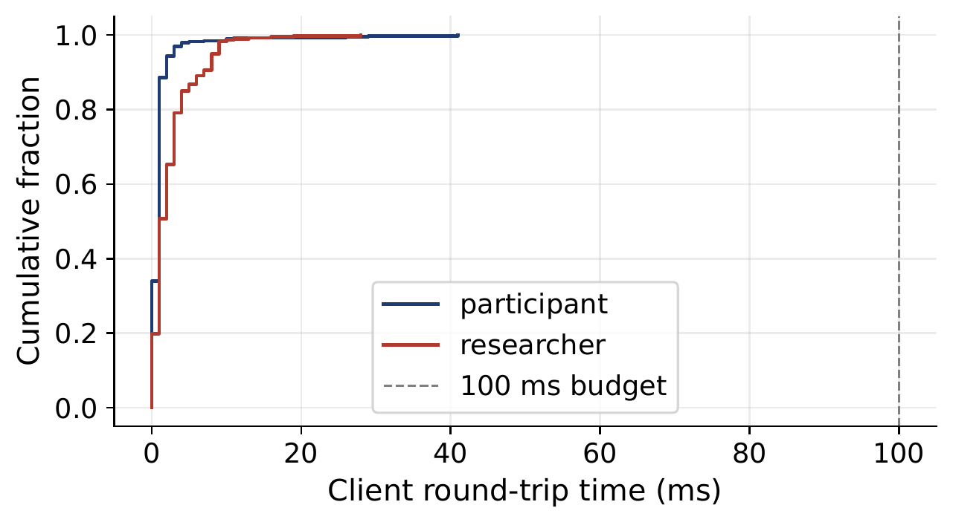
BACKUP · FOR Q&A · PERFORMANCE
Latency: hot path vs control path
Gaze travels a thin real-time channel: sanitise, retain latest, broadcast — no session lock.
Analysis/decision/intervention run on the lower-frequency control path, off the per-sample hot path.
Client transport latency stayed within the 100 ms budget for every sample across the sessions.
Reading the Reader · MSc Thesis Defense
18
Notes:
If pressed on numbers: the hot path does the minimum and never takes the lock; the modular pipeline sits on the control path. Show the RTT distribution; every sample under 100 ms.

Slide 19
BACKUP · FOR Q&A · SCOPE
Why Markdown, and not PDF
Reading material is Markdown only; PDF is explicitly out of scope (a stated constraint).
Markdown reflows cleanly, which is what makes live typographic adaptation and position anchoring tractable.
Fixed-layout PDF would fight reflow and the context-preserving commit, adding scope without serving the research questions.
Reading the Reader · MSc Thesis Defense
19
Notes:
Markdown is a deliberate constraint, not a shortcut. Reflowable text is what makes adaptation and the anchor-based restore possible; PDF's fixed layout would work against the very mechanism under study.

Slide 20
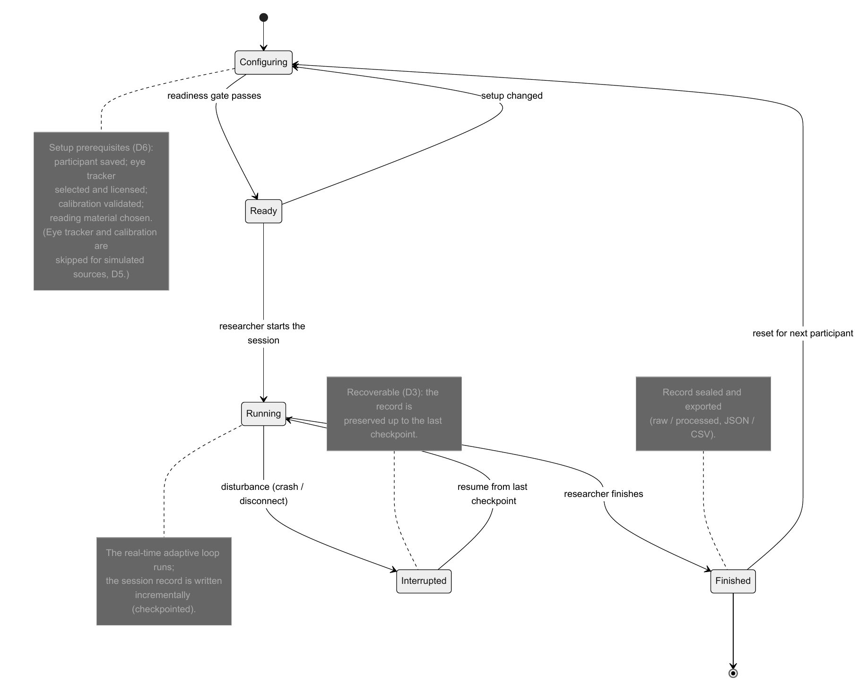
BACKUP · FOR Q&A · ROBUSTNESS
Checkpointing and recovery
Every state-changing step writes a checkpoint while holding the session lock.
A background worker also persists the session at a fixed interval and at shutdown.
Checkpointing is best-effort: it swallows its own failures so durability can never halt a live session.
Reading the Reader · MSc Thesis Defense
20
Notes:
A reading session uses an invited participant and cannot be cheaply repeated, so the loop is built to survive disturbance. Checkpoints on every state change plus a periodic background worker; all best-effort so the safety net can never itself stop the session.

Slide 21
BACKUP · FOR Q&A · INTEGRATION
What crosses the provider seam
Out: the authoritative session snapshot plus derived signals — reading focus, attention summary, oculomotor events.
Back: a proposal pairing an observed signal and a short rationale with a concrete intervention (module identity + parameters).
The seam fixes a vocabulary (signals in, proposal out) but never how the proposal is reached — that is what makes it pluggable.
Reading the Reader · MSc Thesis Defense
21
Notes:
Make concrete what an external team must build. We send context (snapshot + analysed signals); they return a proposal (which intervention, what parameters, plus a rationale). The platform stays silent on the algorithm, which is exactly the out-of-scope decision intelligence.

Slide 22
BACKUP · FOR Q&A · SCOPE
Lab participants, not clinical — by design
Sessions used general laboratory participants, so the work validates the architecture and runtime, not a clinical outcome.
The thesis builds the platform that makes adaptive-reading experiments possible; it stops short of running a definitive one.
The architecture is designed to support recruited vision-impaired or dyslexic readers in future studies without core changes.
Reading the Reader · MSc Thesis Defense
22
Notes:
Be direct: this is a scope decision aligned with the research questions, which emphasise architecture and runtime feasibility over a human-subjects effect study. The clinical study is future work the platform now makes cheap.

Slide 23
BACKUP · FOR Q&A · ETHICS
Consent, data, and the participant's experience
Participants are invited and managed by the researcher; the console gates a session behind explicit readiness before any recording.
The session record is the research artifact — captured, exportable, and reproducible for later analysis.
The participant screen shows only the text; control and observation stay on the separate researcher console.
Reading the Reader · MSc Thesis Defense
23
Notes:
Keep this factual. Researcher-operated model, readiness-gated start, separation of participant view from researcher console, and a reproducible record. Defer any formal approval specifics to what is written in the methodology chapter.

