Slide 1



SDG 7.1.1 – Trend Analysis on Access To Electricity
SIT Nagpur
Aditya Joshi
Anvesh Khode

Slide 2
Problem Statement
Brief Overview:
Globally, over 789 million people lack access to electricity, especially in rural and underdeveloped areas, limiting their potential for growth and development. Understanding electricity access trends can help policymakers and organizations prioritize areas needing intervention. This project involves developing a machine learning model to analyze and predict electricity access trends using a comprehensive dataset.
Key Objectives:
Develop an ML model to predict future electricity access levels for different regions.
Identify patterns and trends in electricity access across various geographical areas.
Assist policymakers in targeting regions that require urgent intervention.
Source :
www.freepik.com/

Slide 3
Dataset Overview(Optional)
Dataset Description: The dataset includes electricity access data with the following columns:
SeriesCode, SeriesName, Indicator, SeriesID: Representing indicator metadata.
GeoAreaCode/Reference Area Code, Ref_Area_Type, GeoAreaName/Reference Area Name: Geographical and reference area details.
TimePeriod, Value, Units: Time period of observation and the corresponding electricity access value.
Nature, Location, Reporting Type, FootNote, Source, ISOalpha3, Type: Additional contextual and metadata columns.
Key Features:
Multi-year data across multiple regions.
Contextual information about electricity access (value, unit, type).
Source :
www.freepik.com/

Slide 4
Methodology
Approach
Data Collection: Collect electricity access data from verified sources (e.g., World Bank).
Data Preprocessing:
Handle missing values and outliers.
Normalize numerical columns (e.g., Value).
Encode categorical data (e.g., GeoAreaName, Indicator).
Exploratory Data Analysis (EDA):
Visualize trends in electricity access across regions.
Analyze the impact of geography and time on electricity access levels.
Feature Engineering:
Create new features such as growth rate, region clusters, etc.
Select relevant features for model training.
Model Building:
Train ML models (Regression for continuous trends or Classification for binary outcomes).
Algorithms to be used: Random Forest Regressor, Kmeans.
Evaluation: Evaluate model performance using MSE, silhouette-score.
Algorithms Used:
Regression Model: Random Forest Regressor
Clustering Model: K-Means
Source :
www.freepik.com/

Slide 5
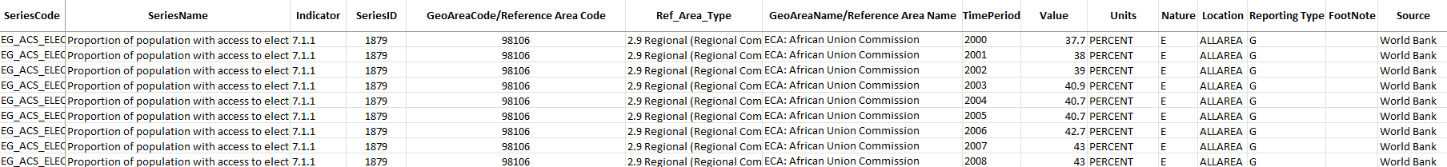
Data Collection
(Data was sourced from Tracking SDG 7.1.1 : https://trackingsdg7.esmap.org/downloads)
The dataset includes electricity access data with the following columns:
SeriesCode, SeriesName, Indicator, SeriesID: Representing indicator metadata.
GeoAreaCode/Reference Area Code, Ref_Area_Type, GeoAreaName/Reference Area Name: Geographical and reference area details.
TimePeriod, Value, Units: Time period of observation and the corresponding electricity access value.
Nature, Location, Reporting Type, FootNote, Source, ISOalpha3, Type: Additional contextual and metadata columns.
Key Features:
Multi-year data across multiple regions.
Contextual information about electricity access (value, unit, type).
Source :
www.freepik.com/

Slide 6
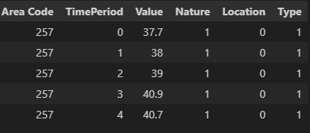
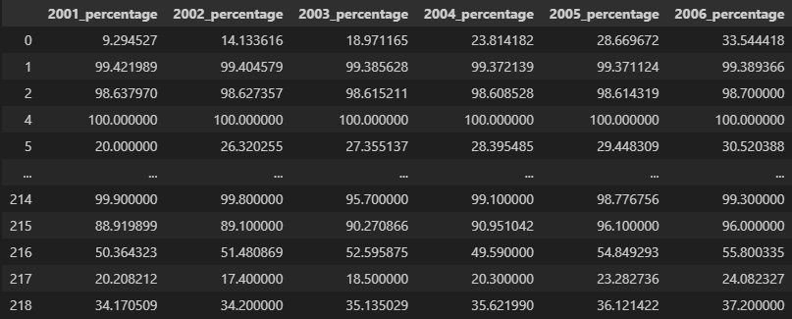
Data Preprocessing
The data was then cleaned to remove any missing values and encode strings to visualize and analyze it clearly.
Applied Feature Selection and removed all null values, then labelled the data.
Area Code: Geographical and reference area details.
TimePeriod, Value: Year of observation and the corresponding electricity access value.
Nature, Location, Type : Additional contextual and metadata columns.
Source :
www.freepik.com/

Slide 7
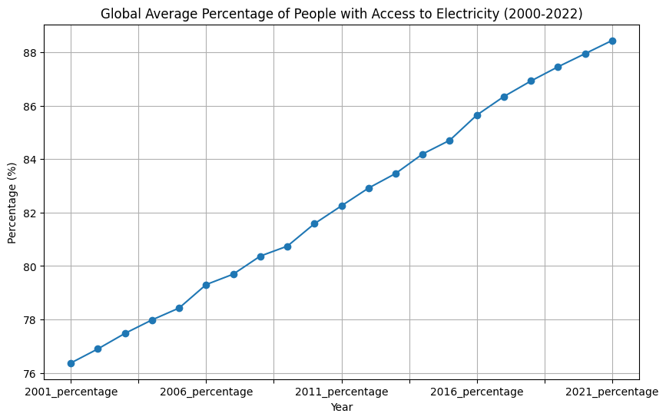
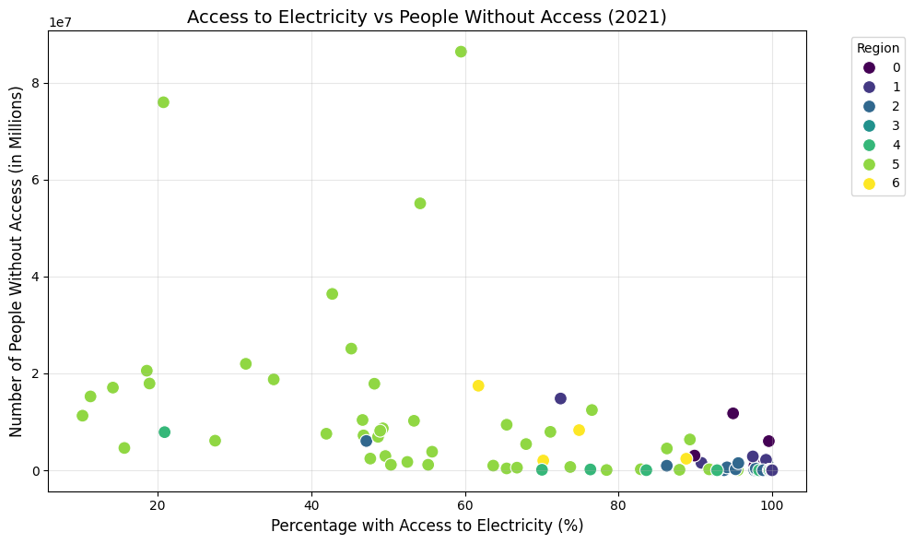
Exploratory Data Analysis (EDA)
Visualising the data revealed a linear trend in the average percentage of population increase with access to electricity, with most regions having less than 2 million people which currently do not have access to electricity. This insight was crucial to predict which countries would achieve the 95%+ electricity mark on or before 2030.
The graph on the left displays a linear trend in the average percentage of population increase with access to electricity.
The right graph shows that most regions have less than 2 million people which currently do not have access to electricity.
Source :
www.freepik.com/

Slide 8
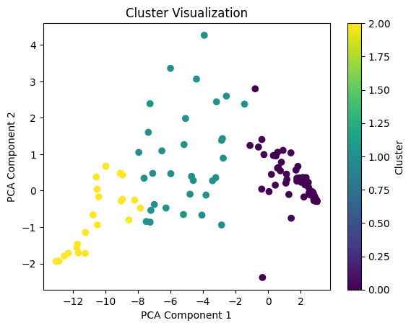
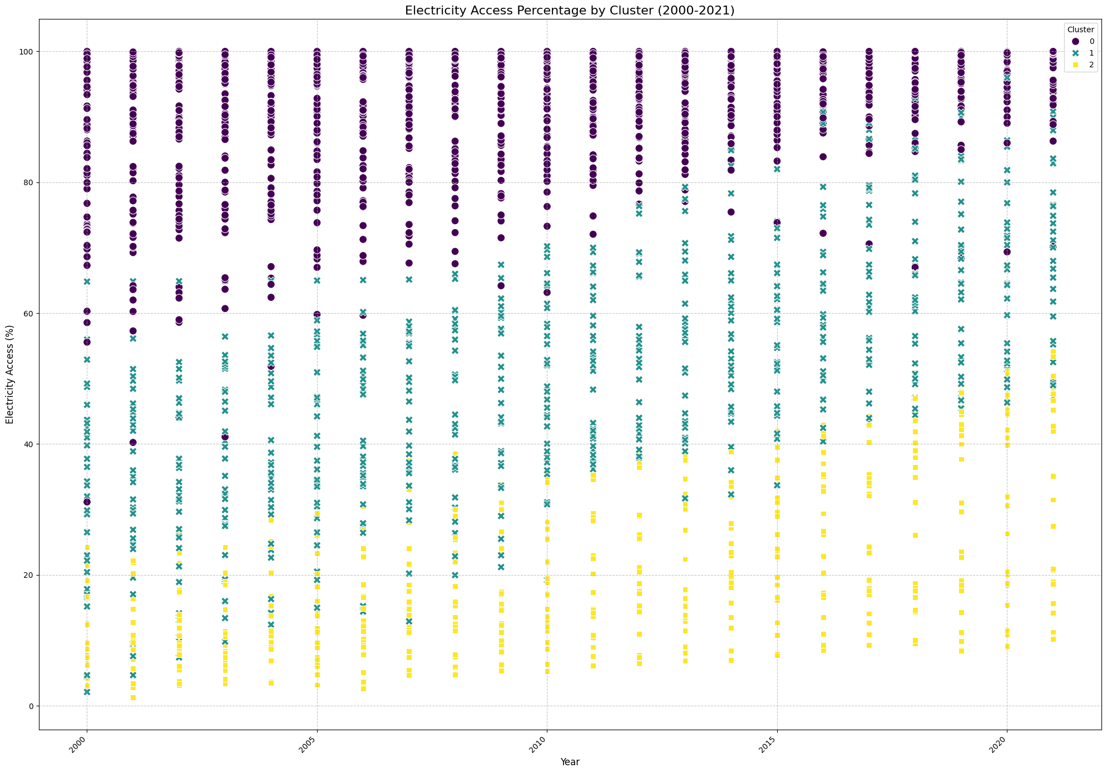
Model Trend Predictions
Formed 3 clusters and visualized each cluster of countries to help identify the model’s training accuracy in learning cluster formation.
Left Graph: PCA Component Analysis of Cluster Visualization for a particular year (here, 2005)
Right Graph: Cluster of countries displaying countries as data points belonging to one of three clusters.
Source :
www.freepik.com/

Slide 9
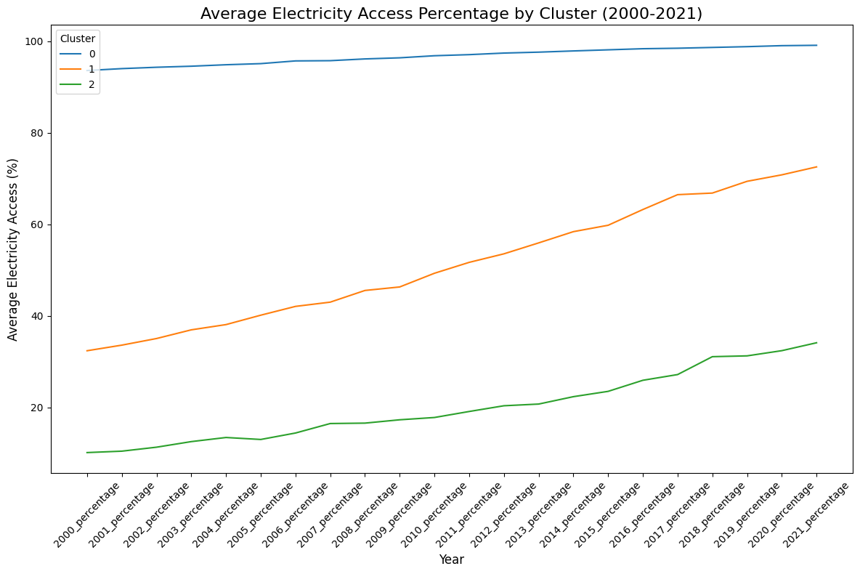
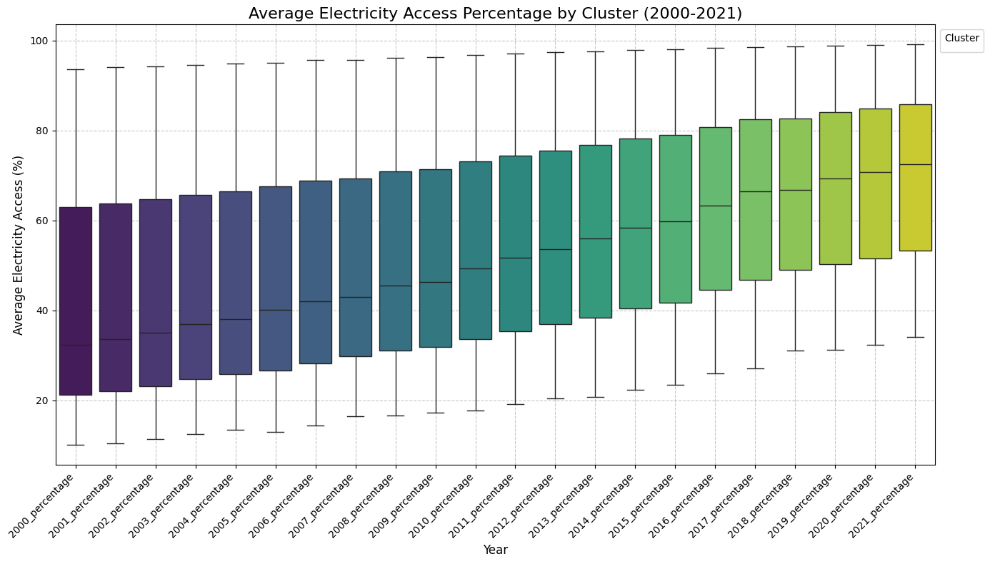
Trend Analysis grouped by Cluster
Formed 3 clusters and analyzed the trends of each cluster of countries to help identify those which will achieve 95%+ access to electricity by 2030.
Left Graph: Line graph of the average access to electricity of people belonging to a cluster of a country.
Right Graph: Boxplot of countries displaying majority of countries belonging to the cluster which has a growing number of population with access to electricity
Source :
www.freepik.com/

Slide 10
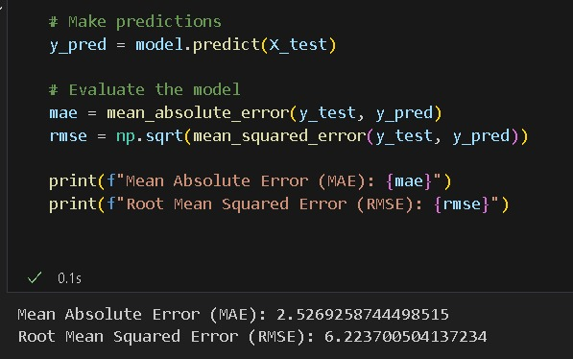
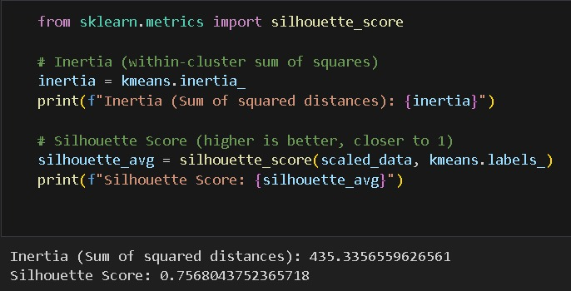
Model Accuracy
The data was then cleaned to remove any missing values and encode strings to visualize and analyze it clearly.
MAE (Mean Absolute Error): Measures the average magnitude of errors between predicted and actual values, without considering their direction.
RMSE (Root Mean Squared Error): Represents the square root of the average squared differences between predicted and actual values, penalizing large errors more heavily than MAE.
Silhouette Score: Evaluates the quality of clustering by measuring how similar data points are to their own cluster compared to other clusters, ranging from -1 to 1.
Source :
www.freepik.com/

Slide 11
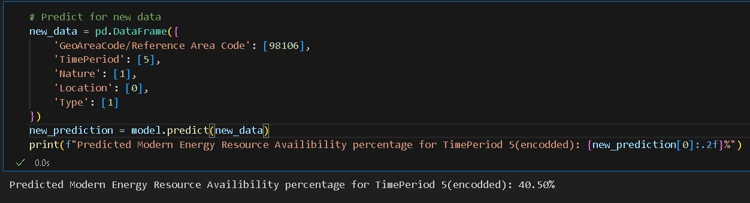
Model Prediction
Using this model, we can predict the energy resource availability percentage for a given year, by providing its area code.
The model outputs the number of years after the year 2000 expected for the area to achieve 95%+ electricity availability for the area.
Source :
www.freepik.com/

Slide 12

Conclusion
Summary:
The ML model successfully analyzes historical electricity access data to predict future trends and identify high-priority areas for intervention. This model serves as a tool for policymakers and organizations working toward SDG 7.
Future Work:
Incorporate additional datasets, such as socio-economic indicators, to improve model accuracy.
Develop region-specific models for more granular predictions.
Explore deep learning approaches for time-series predictions.
Source :
www.freepik.com/

Slide 13
References
SDG 7 Dataset: https://trackingsdg7.esmap.org/downloads
SDG 7: https://www.iges.or.jp/en/sdgs
Project GitHub Link : https://github.com/omicron9009/SDG-7.1.1-Trend-Analysis

Slide 14
Thank You
Notes:
Thank You !!

