Slide 1
Course Project - The Basics

Slide 2
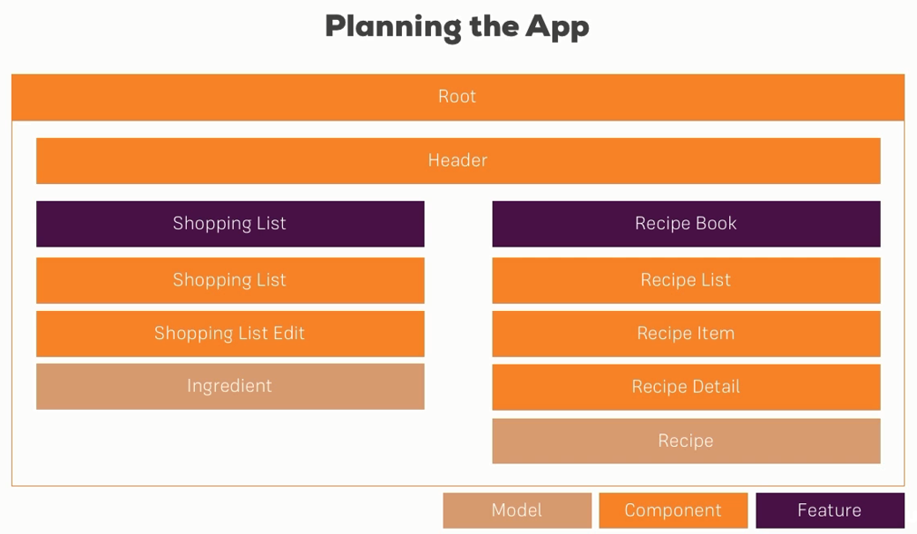

Slide 3
Hierarchy
app
recipes
recipe-detail
recipe-list
recipe-item
shopping-list
shopping-edit

