Slide 1
Weather Dashboard
Real-Time & Historical Weather Insights
Prepared by : Saurabh Mishra

Slide 2
1. Problem Statement
Aggregating real-time weather data from APIs
Providing easy-to-understand visualizations
Location-based forecasts for personalization
Supporting decisions for daily activities, travel, agriculture

Slide 3
2. Objective
Develop interactive Weather Dashboard
Provide real-time & historical weather info
Visualize temperature, humidity, rainfall, wind trends
Enable quick comparisons & insights

Slide 4
3. Data Description
Source: Weather API
Features: Country, City, Local Time, Temperature, Condition, Wind Speed

Slide 5
4. Methodology
Tools: Python, MySQL, Power BI
Steps: Fetch Data Clean EDA Visualization Insights Recommendations Conclusion Future Scope

Slide 6
5. Exploratory Data Analysis (EDA)
Basic Statistics: mean, median, min, max, std deviation
Temperature over location
Humidity distribution across cities
Wind speed variations
Correlation analysis

Slide 7
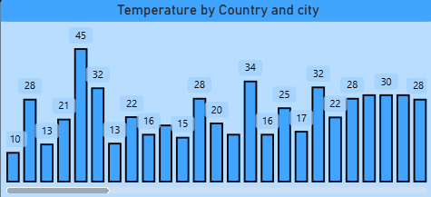
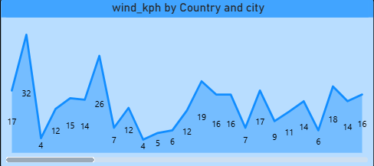

Slide 8
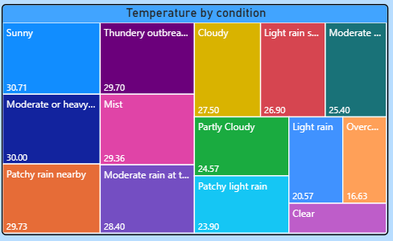

Slide 9
6. Insights
Temperature & humidity show seasonal trends
High wind speeds & precipitation indicate alerts
Weather varies across cities in same country
Negative correlation: temperature vs humidity in regions

Slide 10
7. Recommendations
Add alerts for extreme weather conditions
Correlate local events with weather impact
Include daily weather advisories (umbrella, sunscreen)

Slide 11
8. Conclusion
Weather Dashboard aggregates weather data
Identifies patterns in temperature, humidity, wind, precipitation
Supports decision-making for daily life, travel, agriculture
Visualizations enhance usability & predictive potential

Slide 12
9. Future Scope
Integrate Machine Learning models
Use multiple APIs for improved accuracy

Slide 13
Thank You
Q&A

