Slide 1
Living Standard and Economic Indicators Report
India (1975–2024)
Prepared by : Saurabh Mishra

Slide 2
Problem Statement
• Evaluate India’s living standards and economic growth trends by examining GDP, GDP per capita, population growth, and living cost over time (1975–2024).
• Identify how population growth impacts GDP and GDP per capita.
• Explore relationship between living cost and GDP per capita.
• Assess whether improvements in GDP per capita are sufficient to offset rising living costs.
Goal: Guide policy makers, economists, and businesses in improving living standards.

Slide 3
Objective
• Analyze the relationship between GDP, GDP per capita, population, and living cost in India (1975–2024).
• Identify growth trends, key influencers, and their impact on living standards.

Slide 4
Data Description
• Source: World Bank API
• Rows: 50
• Columns: 6
• Key Features: Year, Country, GDP, GDP per Capita, Living Cost, Population

Slide 5
Methodology
• Tools: Python (Pandas, Matplotlib, Seaborn, Requests), API, MySQL, Power BI
• Steps: Fetch data Data Cleaning EDA Visualization Insights Recommendations Conclusion Future Scope

Slide 6
Exploratory Data Analysis (EDA)
• Trend analysis
• GDP vs GDP per capita analysis
• GDP per capita & living cost analysis
• Population, GDP, GDP per capita and living cost by year

Slide 7
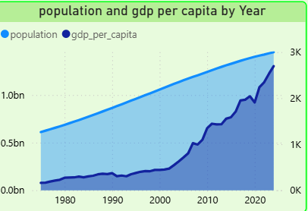

Slide 8
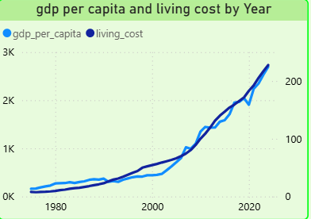

Slide 9
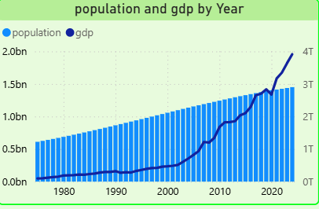

Slide 10
Insights
• Population growth increases production and consumption, raising GDP.
• If GDP grows faster than population, GDP per capita rises, improving living standards.
• GDP per capita and living cost both show a positive relationship over time.
• GDP per capita improvements alone may not offset rising living costs.

Slide 11
Recommendations
• Focus on employment-generating sectors to prevent population growth from lowering per capita income.
• Apply predictive analytics for population growth and GDP per capita forecasting.

Slide 12
Conclusion
• Rising population increases GDP via consumption and production.
• GDP growth must outpace population growth to improve living standards.
• Economic growth benefits are moderated by rising costs and population growth.
• Strategic policies are needed to ensure real improvements in quality of life.

Slide 13
Future Scope
• Assess industry contributions to GDP growth and impact on employment, income, and living cost.
• Compare India’s trends with other countries to identify best practices and improvements.

Slide 14
Thank You
Q&A

