Slide 1
Heuristics for the Set Covering Problem
THE PROJECT
42 OR-Library instances, one incremental solution state shared by every method, every result verified from scratch.
Paired seeds · equal CPU time · Holm-corrected tests · held-out confirmation
CH → RE → FI / BI → SA / TS → GA → multicover
Final presentation · from greedy construction to a genetic algorithm
Assignments 1–4, GA parameter tuning and the multicover extension
Group 11:
Artur Santoalha
Kirill Savin
6.0 → 0.76 %
avg. deviation from the best known: greedy + RE → GA with 3× the TS time
29 / 42
instances where that GA reaches the best known value
1.08 ≈ 1.04 %
GA vs. tabu search at equal CPU time (not significant)

Slide 2
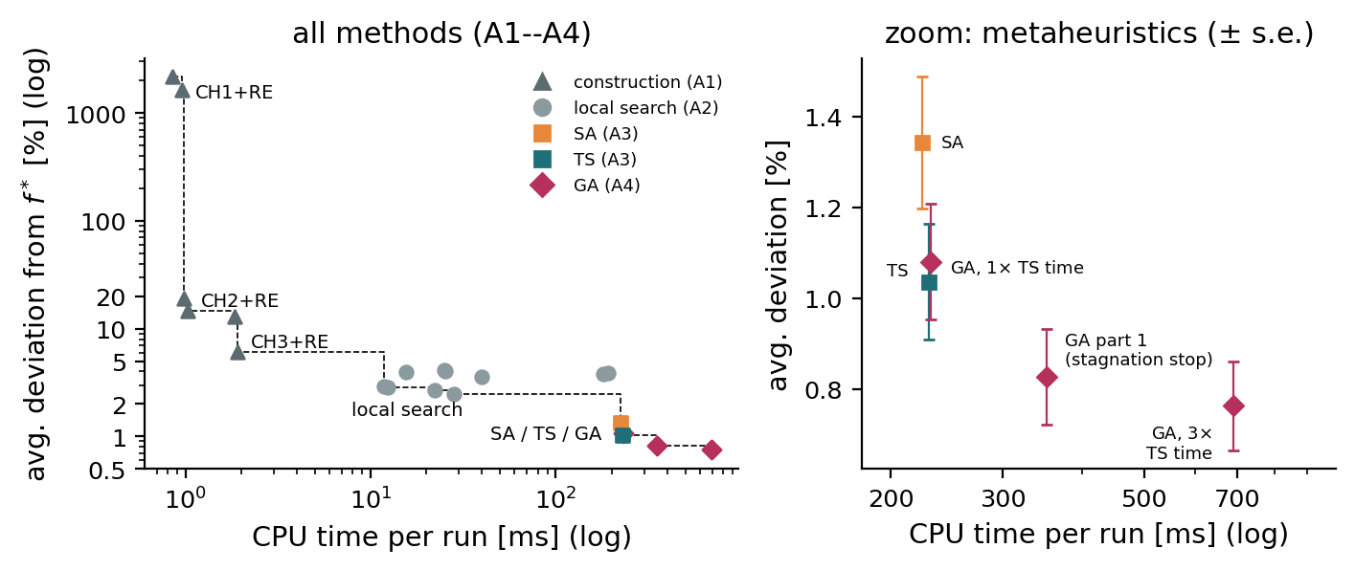
Four assignments, one toolbox
Every method re-uses the previous ones · all 42 instances, the same 10 seeds
 | Method | Key idea | Dev. % | CPU ms
A1 | CH3 + RE | Chvátal greedy (cost / new coverage), then drop redundant sets | 6.03 | 1.9
A2 | CH3 + BI | local search: drop one set, greedy repair, RE | 2.48 | 28
A3 | Sim. annealing | random neighbour, accept worse with e^(−Δ/T) | 1.34 | 224
A3 | Tabu search | best of 20 sampled neighbours, tenure 3 | 1.04 | 230
A4 | GA, 1× TS time | keep common sets, split the rest, repair + RE | 1.08 | 231
A4 | GA, 3× TS time | the same GA with more time | 0.76 | 691
What the frontier says
Every step down in error costs about ×10 in time: 6 % in 2 ms → 2.5 % in 28 ms → 1 % in 0.23 s
Redundancy elimination after every step is the most valuable building block of all methods (1.5 to 6.6 pp)
Right panel: the metaheuristics (± standard error over instances)
Effort decides the ranking
The part-1 GA (0.83 %) looked better than TS only because it used 1.5× its CPU time
At the same CPU time GA and TS are equal; with 3× the time the GA reaches 0.76 %
Group 11 · Heuristic Optimization · SCP
2 / 6

Slide 3
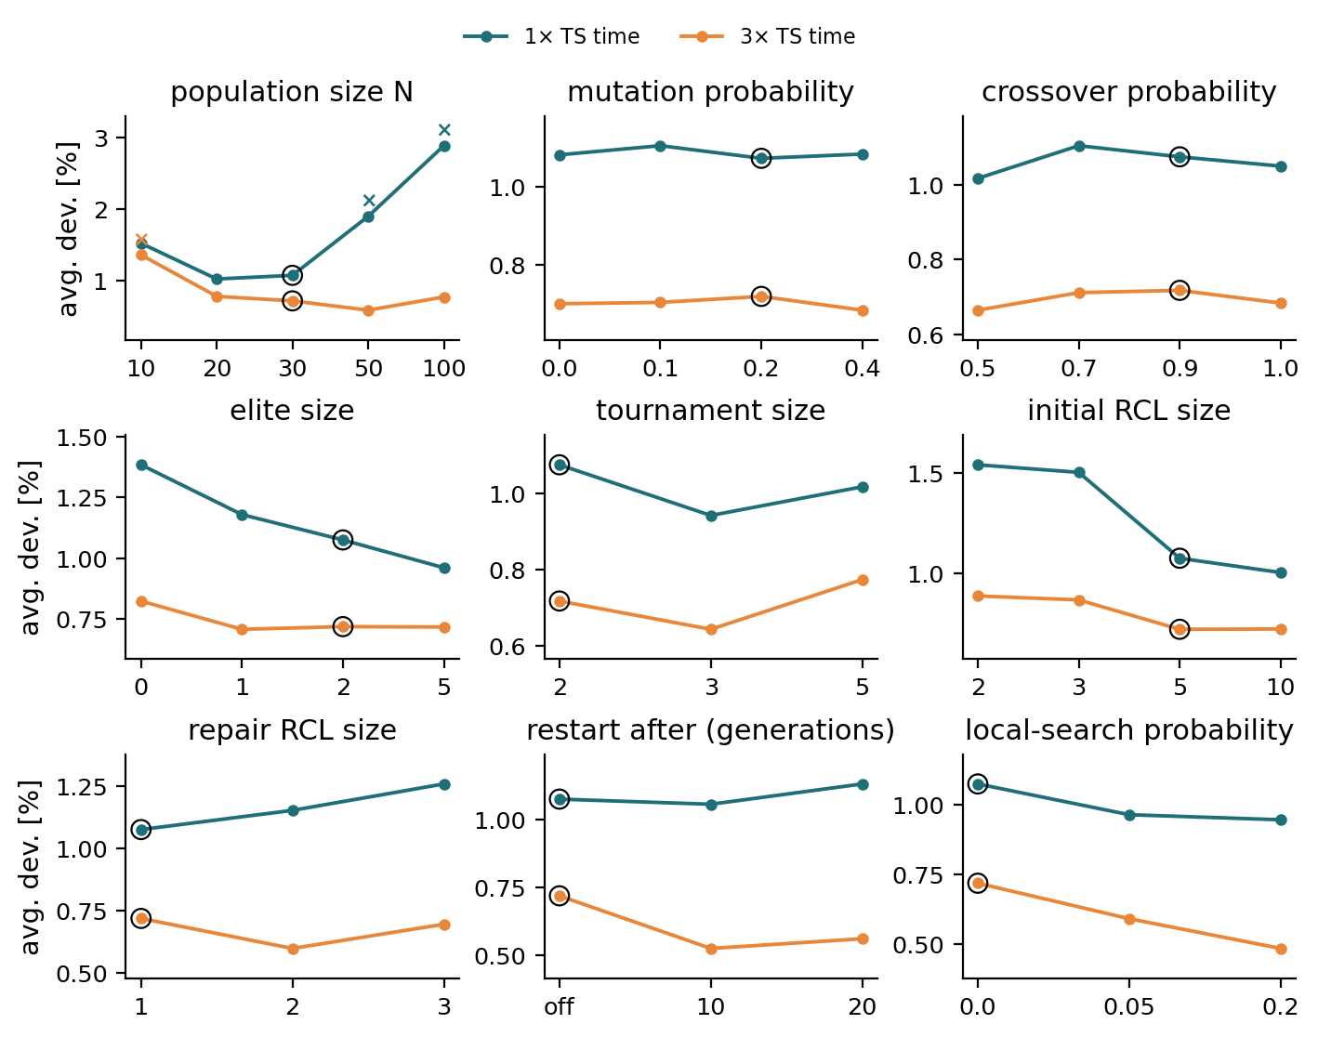
Part 2 – tuning the GA at equal CPU time
Baseline fixed before tuning · one factor at a time · 1× and 3× the TS time · 14 instances × 5 seeds · 3 500 runs
Protocol
Baseline: N = 30, elite 2, p_c 0.9, p_m 0.2, tournament 2
Equal CPU time, not equal evaluations: a new individual costs a full greedy construction
Adopt a level only if better than the baseline with Holm p < 0.05
Findings
Only the population size matters significantly
1× TS time: N = 50 / 100 worse (Holm p = 0.038 / 0.009) – N = 100 completes half a generation
3× TS time: N = 10 worse (p = 0.023), N = 50 best (n.s.)
p_m, p_c, tournament: flat plateau (≤ 0.13 pp, p ≥ 0.65)
Restarts and memetic local search help only with more time (−0.19 / −0.23 pp, n.s.)
Figure: circle = baseline level · × = significantly worse than the baseline
Group 11 · Heuristic Optimization · SCP
3 / 6

Slide 4
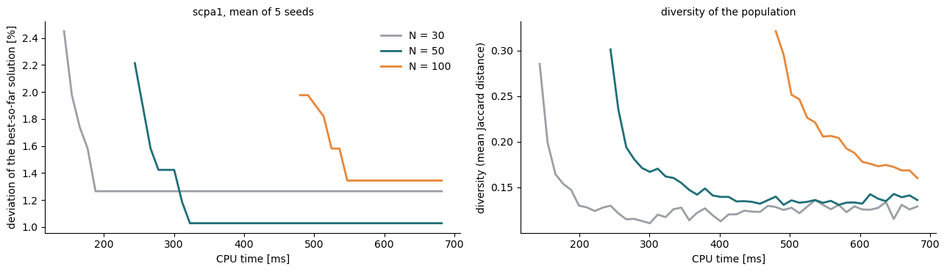
Improvement: what survived the protocol
Stage B: promising changes added one at a time on fresh seeds · then the final comparison at equal CPU time
Why the budget decides N
30 greedy individuals take 140 ms ≈ 60 % of the TS time (227 ms)
N = 50 / 100: 245 / 480 ms before the first generation
then diversity collapses to 0.12 – premature convergence
Stage B – fresh seeds 106–110
All four changes together: −0.18 pp, better on 7 / worse on 3, Holm p = 0.56
Reference moved 0.09 pp → effects ≈ seed noise; baseline kept
Method (42 inst., 10 seeds) | Dev. % | Held-out % | f* reached | CPU ms
GA, 3× TS time | 0.76 | 0.79 | 29 / 42 | 691
GA, 1× TS time | 1.08 | 1.02 | 19 / 42 | 231
Tabu search | 1.04 | 0.96 | 25 / 42 | 230
Simulated annealing | 1.34 | 1.26 | 19 / 42 | 224
GA part 1 (stagnation) | 0.83 | 0.85 | 26 / 42 | 351
Fair comparison
Same CPU time: GA 1.08 % vs. TS 1.04 % (17 : 21, p = 0.77)
3× time: 0.76 %, better than 1× on 27 instances, never worse
Convergence on scpa1 at 3× TS time: curves start when the initial population is complete.
Group 11 · Heuristic Optimization · SCP
4 / 6

Slide 5
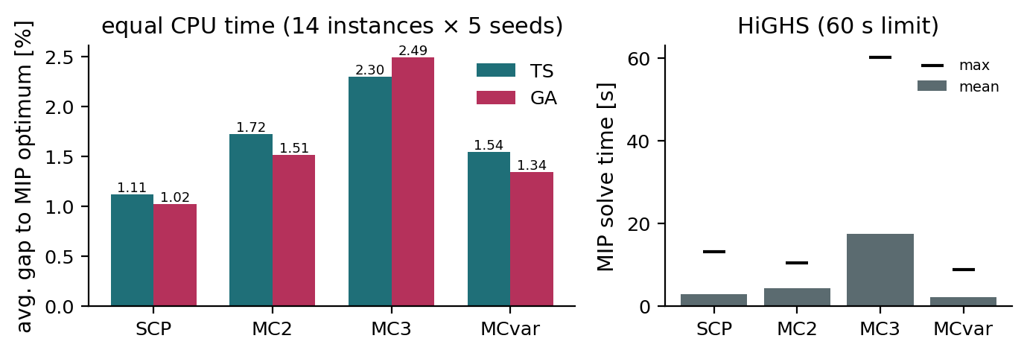
Extension: the multicover problem
Every element i must be covered by at least bᵢ selected sets · TS and GA adapted once, in the shared building blocks
Building block | SCP (b = 1) | Multicover
missing coverage | uncovered element | deficient: cnt < bᵢ
greedy repair | sets with new coverage | + exclude already selected sets
redundant set | all elements cnt ≥ 2 | all elements cnt ≥ bᵢ + 1
reference | best known value | HiGHS MIP, 60 s
Scenarios on the 14 tuning instances: b = 1 (SCP), b = 2, b = 3 and mixed bᵢ ∈ {1, 2, 3}; 5 seeds; the GA gets the CPU time TS used.
Results at equal CPU time
Gap to the optimum grows with b: TS 1.11 → 1.72 → 2.30 %, GA 1.02 → 1.51 → 2.49 %
TS vs. GA: no significant difference in any scenario (p = 0.33–0.70); GA ahead for b = 1, 2 and mixed, TS for b = 3
GA: 69–76 % of raw children violate b and are repaired; 1312 → 756 children in the same time
The MIP feels it more: 2.8 s → 17.3 s, 2 of 14 b = 3 models not proven optimal in 60 s
Challenges
A set may be used once – for b ≥ 2 the repair would otherwise pick selected sets again
No best known values → exact MIP reference; feasibility needs bᵢ ≤ deg(i) (min. degree 9)
With b = 3 a cover holds 133 sets instead of 57: one move changes less, evaluations cost more
Group 11 · Heuristic Optimization · SCP
5 / 6

Slide 6
Conclusions
What the four assignments and the extension taught us
Results
Greedy + RE 6.0 % → local search 2.5 % → SA 1.34 % → TS 1.04 % ≈ GA 1.08 % (equal CPU time)
With 3× the time the GA reaches 0.76 % and the best known value on 29 of 42 instances
Multicover: TS and GA within 1–2.5 % of the MIP optimum
Tuning
Only the population size matters – relative to the budget (initial population ≈ 60 % of the short one)
Other parameters: a flat plateau; restarts and memetic LS need longer runs
Baseline kept: nothing that failed to replicate on new seeds was adopted
Lessons
Compare at equal CPU time – evaluations flatter the GA by a factor 2.7
Confirm on new seeds / held-out instances – the winner's curse appeared in A3 and A4
Problem-specific parts (greedy repair, RE) matter more than GA parameters
Next steps
Cheaper initial population (mutate one greedy cover instead of N constructions)
Adaptive population size; restarts / memetic steps for long budgets
Lagrangian information in the greedy score; larger instances where MIP struggles
Group 11 · Heuristic Optimization · SCP
6 / 6

