Slide 1
A genetic algorithm for the Set Covering Problem
THE TASK
Choose a population-based family, justify it, design it for the SCP, sketch one run in pseudocode and build a working, verifiable version.
binary vector · corrected crossover · drop-and-repair mutation
Assignment 4 · Population-based metaheuristics
first iteration: design and working version
Group 11:
Artur Santoalha
Kirill Savin
GA
family chosen: every individual is a feasible, minimal cover
6.6 → 1.0 %
average deviation, CH3 + RE start vs. GA (7 instances, 5 seeds)
11 / 35
runs reached the best known value (all 5 on scp42 and scpb2)

Slide 2
Choice of the family and justification
Every family poses one question about the SCP – only the GA has a natural answer.
Family | Question for the SCP | Can we answer it? | Verdict
GA | Meaningful representation, crossover, mutation? | Yes: a solution is a set of columns = a binary vector; the sets both parents chose are building blocks to keep; the repair of Assignments 1–3 fixes any union of sets; mutation = drop-and-repair. | chosen
BRKGA | A useful decoder from random keys? | Yes (keys → perturbed costs → greedy), but crossover of keys does not "keep sets": the link to the cover is indirect. | possible
ACO | Solution components, what should pheromone represent? | Components = columns, pheromone = desirability of a column. Every ant constructs from scratch; only the pheromone remembers good solutions. | possible
PSO | Meaningful position and update rule? | A binary position and velocity need a decoder and a repair; "moving towards the best" has no natural meaning for sets. | weakest fit
Why GA for the SCP
(1) Natural, compact representation: one bit per column. (2) A cover is a selection of building blocks: good covers share columns, so keeping what two good parents have in common and recombining the rest is a meaningful, path-relinking-like operator. (3) All problem-specific machinery (greedy repair, RE, drop-and-repair move) exists and is validated. (4) Assignments 1–3 were single-solution methods; competition between solutions is the new ingredient.

Slide 3
Design (1): individual, feasibility, evaluation, start
The first four of the eight design questions.
1 Representation
One individual = a binary vector x ∈ {0,1}ⁿ, one bit per set; xⱼ = 1 iff set j is selected.
Example (best solution on scpa1): n = 3000 bits, 70 ones → a cover of cost 257; cost = Σ wⱼ xⱼ.
Decoded in one step into the incremental state (counts, uncovered elements) of Assignments 1–3.
2 Feasibility
Infeasibility occurs: 97 % of the raw crossover children of the initial population are not covers (about 69 % over a whole run); the drop of a mutation leaves elements uncovered.
Strategy: repair, never reject or penalise – cover the uncovered elements with the greedy ratio rule (CH3), then RE.
Every individual in the population is feasible and minimal.
3 Evaluation
Minimise the total cost. All individuals are feasible, so no violation term; ties broken arbitrarily.
Selection is built for minimisation: the tournament takes the lower cost; roulette wheel (option) uses fᵢ = z_max − zᵢ + 1 (the +1 keeps the worst one selectable).
Evaluation counts: one evaluation = one greedy repair.
4 Initial population
Mixed: one CH3 + RE (deterministic greedy seed) and N−1 randomised-greedy + RE individuals; restricted candidate list of random size 2–5 gives different quality and structure.
Duplicates are rejected; random covers are not used (10–20× more expensive, never selected).
Why different? Crossing identical parents only returns the parents.

Slide 4
Design (2): new solutions, update, diversity, stopping
Questions 5–8, with the points raised in the discussion.
5 New solutions
Two binary tournaments pick the parents. With probability p_c: corrected crossover – keep the sets chosen by both parents, give each other set to child 1 or 2 at random, then repair + RE. Otherwise: copies.
Mutation with probability p_m per child = drop-and-repair of Assignment 3 (a random set is dropped, greedy repair, RE).
The crossover is corrected by repair, like the corrected crossover for the TSP.
6 Population update
Generational with elitism: the `elite` best individuals are copied unchanged, the other places are filled with offspring (parents are replaced).
The best solution found is stored separately and can never be lost.
Alternative for later: parents + offspring compete (stronger elitism, faster loss of diversity).
7 Diversity and premature convergence
Sources: randomised start, random split in crossover, mutation, low selection pressure (binary tournament), duplicate control (a child equal to a member of the new population is mutated).
Premature convergence = the population collapses to almost identical covers; the common part is then everything and crossover returns the parents. We measure it: mean Jaccard distance and distinct individuals per generation.
8 Stopping
Stagnation: stop after ξ generations without improvement of the best solution (as in the lecture), plus a maximum number of generations as a safety net.
Reported budget: evaluated individuals (greedy repairs).
To tune later: ξ and the population size, under an equal evaluation or time budget.

Slide 5
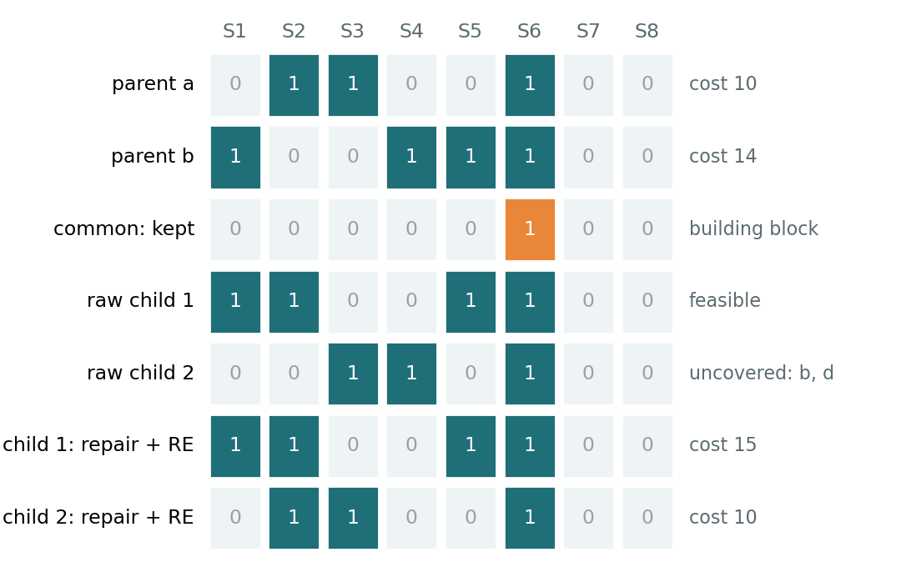
Pseudocode of one run and a worked crossover
13 lines; the red part of the generic GA outline (offspring production) is the SCP-specific work.
GA(instance; N, elite, p_c, p_m, k, ξ)
1 P ← {CH3+RE} ∪ (N−1) randomised greedy+RE (no duplicates)
2 best ← best(P); g ← 0; g_best ← 0
3 while g − g_best < ξ and g < max_gen:
4 g ← g+1; P' ← the `elite` best of P
5 while |P'| < N:
6 p1,p2 ← binaryTournament(P) twice (low cost wins)
7 if rand() < p_c: (c1,c2) ← crossover(p1,p2)
else (c1,c2) ← (p1,p2)
8 crossover: keep sets of BOTH parents, split the
others at random, repair (CH3 rule) + RE
9 for c in (c1,c2): w.p. p_m: c ← mutate(c)
(drop one set, repair, RE)
10 if c duplicates a member of P': mutate(c)
11 add c to P'
12 P ← P'; update best and g_best
13 return best (feasible, minimal; Σ w_j x_j)
Reading the example
Orange: the set both parents chose (kept).
Child 1 happens to be feasible (cost 15, minimal); child 2 misses c and d → repair adds S2 → RE drops the now redundant S4.
Generic parts: loop, tournament, elitism, probabilities, stopping. SCP-specific: the initial covers, crossover with repair, mutation, decoding.

Slide 6
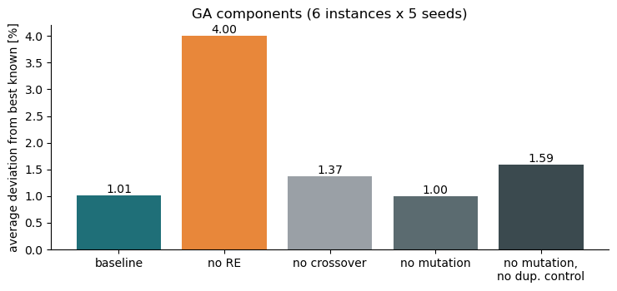
Why RE? Check of the components
Ablation of the untuned baseline: 6 instances × 5 seeds, each variant changes one component (a check of the design, not the tuning).
RE is essential
Without RE: 4.0 % vs. 1.0 % – about four times worse, although it runs 65 % more evaluations.
Crossover pays off
A population of mutated copies (no crossover) reaches 1.37 % instead of 1.01 %: recombining the building blocks of two covers is the most productive operator.
Why RE in every offspring
Every operator creates redundancy: common + half of the others, and the sets added by a repair, make other sets redundant.
Fair comparison: selection compares costs only; redundancy would add noise.
Assignment 3: RE after every move was the most important building block (≈1.5 pp).
Cheap: all redundant sets from one sparse matrix-vector product.
Diversification is needed
No random mutation: 1.00 % – the duplicate control still mutates copies. Both off: 1.59 %. Either mechanism keeps the population different.

Slide 7
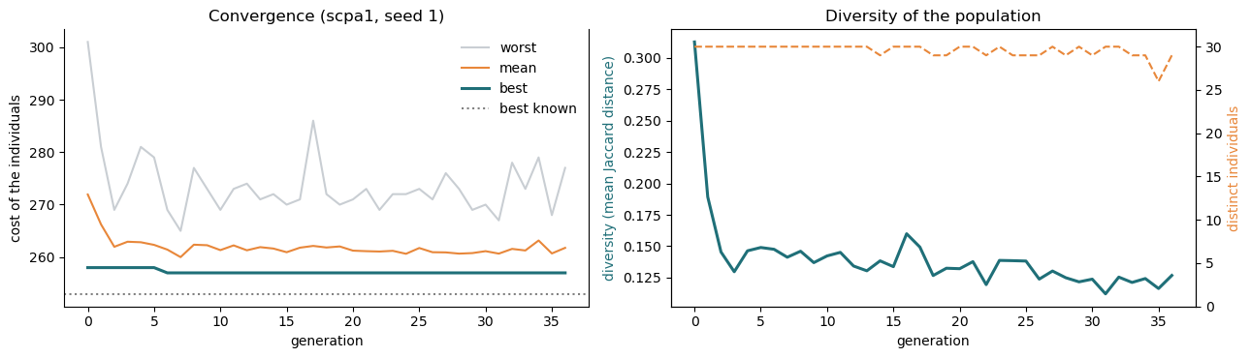
Working version on one instance (scpa1)
Runs from initialisation to termination; the best solution is recovered and verified; seeds control the randomness.
Verified
best cost 257 = recomputed from the raw instance file with an independent parser; 70 sets, all 300 elements covered, no redundant set.
check_state recomputes counts, cost and minimality from scratch.
Seeds
The same seed reproduces the run exactly (history identical).
7 seeds: mean deviation 1.30 %, std 0.50 pp, best 0.40 %.
Premature convergence
Diversity falls from 0.31 to 0.13 within a few generations; the best solution was found in generations 2–8 and about 30 stagnation generations follow.
Main point for part 2.

Slide 8
The five questions, answered with the running code
Each answer is demonstrated in NN4.ipynb (Sections 5 and 9).
1 Show one individual
An individual of the initial population (scpa1): x is a vector of 3000 bits with 73 ones. It is the cover made of these 73 sets: all elements covered, no redundant set, cost 269.
2 Infeasible solutions?
Yes. Crossover: 97 % of raw children (initial population) leave about 7 elements uncovered; mutation: the drop uncovers elements.
Next: greedy repair, then RE – nothing infeasible enters the population.
3 One new individual
Parents of 76 and 71 sets (cost 275, 260); 55 sets in common. Raw child: 75 sets, 7 elements uncovered → repair: 81 sets, cost 299 → RE: 72 sets, cost 269 → mutation: cost 272.
4 Where does diversity come from?
Randomised start (distance 0.33); random split in crossover (child–parent distance 0.20); mutation; low selection pressure; duplicate control: 278 of 1008 children were copies and were mutated.
5 Why not identical at once?
Elitism, binary tournament and duplicate control keep 29–30 distinct individuals and the mean cost improves (272 → 262). But diversity drops to 0.13 and the best stops early – premature convergence is visible.

Slide 9
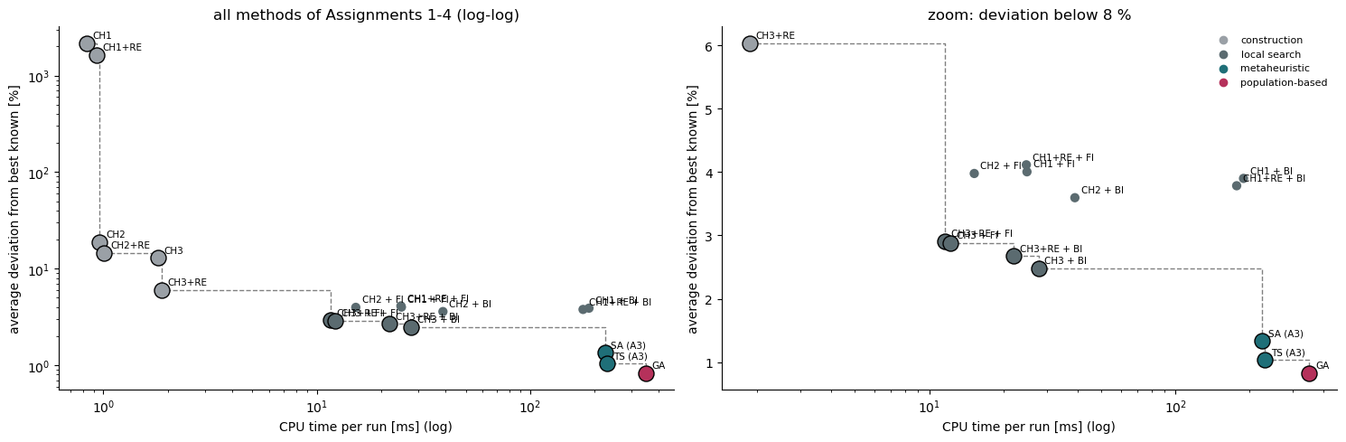
Quality vs. effort: the GA against everything before
19 methods of Assignments 1–4, all 42 instances, seeds 1–10, same code and machine (TS and SA: raw runs of Assignment 3).
The quality ladder
Construction (CH3 + RE) 6.0 % in 2 ms → local search 2.9 / 2.7 % in 12–28 ms → SA / TS 1.3 / 1.0 % in 230 ms → GA 0.83 % in 348 ms. Each step costs about ten times more time.
The GA is the most accurate, not the cheapest
348 ms per run vs. 230 ms for TS. A GA evaluation costs 0.21 ms, a TS evaluation 0.08 ms – at an equal number of evaluations the GA looks better than it is.
Frontier and reliability
Efficient frontier: construction → CH3-based local search → TS / GA; CH1/CH2-based local search is dominated. GA: smallest spread over seeds (0.42 pp) and the best known value reached on 26 of 42 instances (TS 25, SA 19, BI 8, FI 7).

Slide 10
Results table: all methods of Assignments 1–4
42 instances × 10 seeds (420 runs per method); deviation from the best known solution; CPU time from scratch.
Method | Assignment | Avg. dev. | Best of 10 | Std (seeds) | Best known | Evaluations | CPU / run
CH1 | A1 construction | 2175 % | 1867 % | 195.70 | 0 / 42 | – | 0.8 ms
CH1+RE | A1 construction | 1642 % | 1353 % | 174.17 | 0 / 42 | – | 0.9 ms
CH2 | A1 construction | 18.92 % | 11.80 % | 5.01 | 0 / 42 | – | 1.0 ms
CH2+RE | A1 construction | 14.50 % | 7.80 % | 4.65 | 0 / 42 | – | 1.0 ms
CH3 | A1 construction | 12.95 % | 10.58 % | 1.63 | 0 / 42 | – | 1.8 ms
CH3+RE | A1 construction | 6.03 % | 3.91 % | 1.53 | 1 / 42 | – | 1.9 ms
FI from CH1+RE | A2 local search | 4.11 % | 1.77 % | 1.78 | 5 / 42 | 289 | 24.8 ms
FI from CH1 | A2 local search | 4.00 % | 1.66 % | 1.87 | 9 / 42 | 291 | 24.9 ms
FI from CH2 | A2 local search | 3.98 % | 1.23 % | 2.04 | 9 / 42 | 174 | 15.2 ms
BI from CH1 | A2 local search | 3.90 % | 1.56 % | 1.80 | 9 / 42 | 2159 | 189 ms
BI from CH1+RE | A2 local search | 3.78 % | 1.50 % | 1.76 | 8 / 42 | 2138 | 177 ms
BI from CH2 | A2 local search | 3.59 % | 0.87 % | 2.12 | 16 / 42 | 449 | 39.0 ms
FI from CH3+RE | A2 local search | 2.91 % | 1.41 % | 1.20 | 7 / 42 | 118 | 11.6 ms
FI from CH3 | A2 local search | 2.88 % | 1.28 % | 1.20 | 10 / 42 | 126 | 12.2 ms
BI from CH3+RE | A2 local search | 2.67 % | 1.23 % | 1.15 | 8 / 42 | 246 | 21.9 ms
BI from CH3 | A2 local search | 2.48 % | 1.23 % | 1.06 | 7 / 42 | 262 | 27.8 ms
SA | A3 metaheuristic | 1.34 % | 0.69 % | 0.55 | 19 / 42 | 3000 | 224 ms
TS | A3 metaheuristic | 1.04 % | 0.41 % | 0.53 | 25 / 42 | 3000 | 230 ms
GA (untuned baseline) | A4 genetic algorithm | 0.83 % | 0.31 % | 0.42 | 26 / 42 | 1681 | 348 ms
Highlighted: the six methods compared in the text (CH3 + RE, FI and BI from CH3 + RE, SA, TS, GA). Std = standard deviation over the 10 seeds, averaged over instances (pp); Best known = instances where the best known value was reached in at least one of 10 runs. TS and SA: raw runs of Assignment 3 (3000 evaluations).

Slide 11
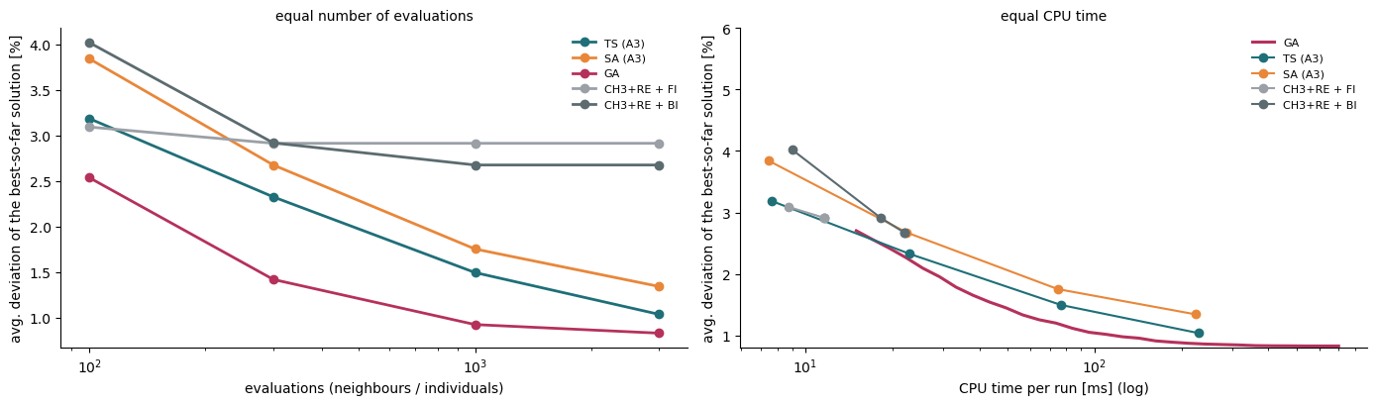
GA vs. TS vs. SA vs. local search: equal effort and statistics
Best-so-far quality at equal evaluations and at equal CPU time; paired tests over the 42 instances (10-seed means).
Method | Dev. | Best known | CPU / run
GA | 0.83 % | 26 / 42 | 348 ms
TS | 1.04 % | 25 / 42 | 230 ms
SA | 1.34 % | 19 / 42 | 224 ms
BI (CH3+RE) | 2.67 % | 8 / 42 | 22 ms
FI (CH3+RE) | 2.91 % | 7 / 42 | 12 ms
TS evals | TS CPU | TS | GA at equal evals | GA at equal CPU
100 | 8 ms | 3.18 % | 2.54 % | 3.28 %
300 | 23 ms | 2.32 % | 1.42 % | 2.23 %
1000 | 77 ms | 1.49 % | 0.92 % | 1.17 %
3000 | 230 ms | 1.04 % | 0.83 % | 0.87 %
Statistics
Friedman test: p = 7e-25; mean ranks GA 1.70, TS 1.93, SA 2.64, BI 4.06, FI 4.67.
GA vs. TS: better on 23 instances, worse on 15 – only marginally significant (Holm p = 0.049).
GA vs. SA and vs. local search: p < 0.001 (Holm).
Reading
At equal evaluations the GA is far ahead (1.42 % vs. 2.32 % after 300). At equal CPU time TS leads at about 8 ms, the GA from about 23 ms on – and its curve flattens early, which fits the premature convergence seen before.

Slide 12
Next: parameter tuning and improvement (part 2)
Baseline fixed before tuning; one change at a time; equal budget; several seeds.
Parameter | Baseline | To study
population size N | 30 | 10, 20, 30, 50, 100 (first)
patience ξ (stopping) | 30 | 10–100; budget-matched to TS / SA
mutation probability p_m | 0.2 | 0, 0.05, 0.1, 0.2, 0.4
crossover probability p_c | 0.9 | 0.5–1.0
elite size | 2 | 0, 1, 2, 10 %
tournament size | 2 | 2, 3, 5, roulette wheel
initial restricted candidate list | 5 | 2–10, share of CH3 + RE
repair randomisation (rcl) | 1 | 1, 2, 3
crossover type | uniform on differing sets | 2–3 variants
Priorities from the comparison
Premature convergence: diversity 0.31 → 0.13 in a few generations → larger population, restarts, diversification.
Effort: about 30 of ~40 generations are the stagnation tail → a shorter patience may cut the time a lot (hypothesis to test).
Fair comparison with TS / SA at an equal CPU time with the paired tests of Assignment 3, on a tuning subset and all 42 instances.
Report quality, variability, time and convergence behaviour.

