Slide 1
Improvement heuristics for the Set Covering Problem
THE TASK
Improve a constructed cover by iterative improvement, with first and best improvement.
4 initial solutions × 2 pivot rules
= 8 algorithms, applied to every instance
Assignment 2 · Heuristic Optimization
Group 11:
Artur Santoalha
Kirill Savin
8
algorithms: CH1, CH2,
CH3, CH1+RE as start,
each with FI and BI
42
OR-Library instances,
one run each,
same seed for FI and BI
1
neighbourhood: drop a set,
repair greedily, RE after
every step

Slide 2
From Assignment 1 - Three dynamic constructive heuristics
The purpose was to create three different constructive strategies with increasing use of information
In each CH, every step added one set; scores were recomputed from the current partial solution
CH1
CH2
CH3
Random element, random set
Random element, best set
Best set overall
Look at every candidate set that still covers something new
Add the one with the lowest cost per new additional element added (cost ÷ newly covered elements)
In comparison to CH2, the difference is where the choice starts -> CH3 is more globally greedy
Pick a random uncovered element
Add a random set that covers it
Repeat until all elements are covered
Does not use optimization of the cost/coverage ratio to select
Pick a random uncovered element (CH1)
Add the covering set with the lowest cost per new additional element added (cost ÷ newly covered elements)
It keeps randomness (choice of uncovered element) BUT it adds an Element-driven greedy criterion for the set selection
The baseline – Deliberate Randomness
Chvátal’s greedy rule element
Dynamic bookkeeping Adding a set updates the uncovered list and the “still uncovered” count of every affected set – only what changed is touched. A set with nothing new to cover is not considered for the candidate list, so no fully redundant set is ever added.

Slide 3
One neighbourhood, two pivot rules
Both algorithms move between minimal covers: redundancy elimination (RE) is applied after every step.
Neighbourhood: drop and repair
FI
First improvement
1
Drop remove one selected set j; its elements covered only by j become uncovered
Scan the selected sets in random order
Accept the first strictly better neighbour, then rescan
2
Repair cover them again with the greedy ratio rule of CH3 (set j forbidden)
RE remove sets that the repair made redundant
BI
Best improvement
3
Evaluate the whole neighbourhood
Accept the best neighbour, if strictly better
|N(S)| = number of selected sets. Every neighbour is a feasible, minimal cover.
Protocol FI and BI run from the same seed, so they start from the identical initial solution (variance reduction, paired comparison). Tried moves are applied and undone incrementally from a log – no state is ever copied. Both stop in a local optimum.

Slide 4
Results: the eight algorithms
42 instances, one run each, same seed. Deviation from the best known solutions.
Algorithm | Initial dev. | Final dev. | Profit | LS time
CH1 + FI | 2297 % | 3.53 % | 42 / 42 | 3.1 s
CH1 + BI | 2297 % | 4.17 % | 42 / 42 | 23.6 s
CH2 + FI | 19.45 % | 3.86 % | 42 / 42 | 1.8 s
CH2 + BI | 19.45 % | 3.98 % | 42 / 42 | 4.5 s
CH3 + FI | 13.05 % | 2.86 % | 42 / 42 | 1.4 s
CH3 + BI | 13.05 % | 2.63 % | 42 / 42 | 3.3 s
CH1+RE + FI | 1756 % | 4.50 % | 42 / 42 | 3.2 s
CH1+RE + BI | 1756 % | 3.75 % | 42 / 42 | 23.3 s
42 / 42
instances profit from the local search, for every one of the eight algorithms
2.63 %
lowest average deviation: CH3 + BI
1.4 s
fastest: CH3 + FI (2.86 % deviation)
Dev. = average % deviation from the best known; Profit = instances improved by the local search; LS time = total over all instances.

Slide 5
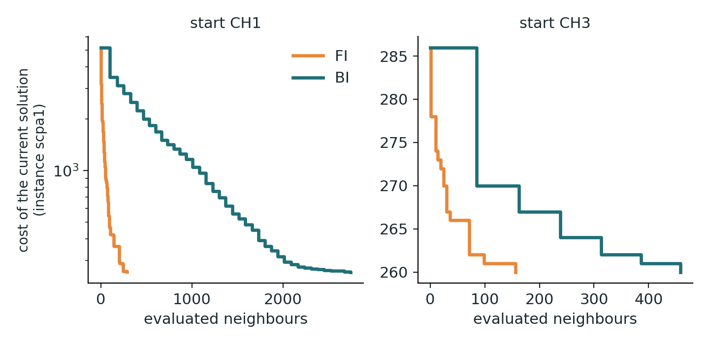
First vs. best improvement
Same start, same neighbourhood: BI takes few expensive steps, FI many cheap ones.
Start | Dev. FI | Dev. BI | Time FI | Time BI | BI / FI
CH1 | 3.53 % | 4.17 % | 3.1 s | 23.6 s | 7.6×
CH2 | 3.86 % | 3.98 % | 1.8 s | 4.5 s | 2.6×
CH3 | 2.86 % | 2.63 % | 1.4 s | 3.3 s | 2.3×
CH1+RE | 4.50 % | 3.75 % | 3.2 s | 23.3 s | 7.3×
Time follows evaluations
BI evaluates the whole neighbourhood every step (65–86 neighbours), FI stops at the first improvement (5–24). An evaluation costs about 0.26 ms either way, so BI is 2.3–7.6× slower.
Quality: no clear winner
BI is better only from CH3 (2.63 % vs. 2.86 %), and there in 5 of 5 seeds. From the other starts neither rule wins consistently; no FI/BI difference is significant at 5 % (Wilcoxon p > 0.05).
Why
Both rules end in local optima of similar quality, but FI gets there with a fraction of the evaluations: the curves show the same descent, only the effort differs. The steepest first step of BI does not pay off.

Slide 6
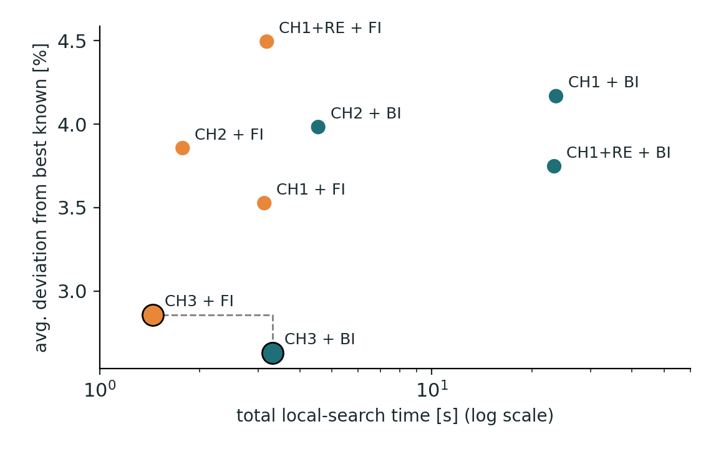
Computation time statistics
Local-search time per instance (42 instances); the spread over 5 seeds in the last column.
Algorithm | Total | Mean | Median | Max | σ (5 seeds)
CH1 + FI | 3.1 s | 75 ms | 69 ms | 210 ms | ± 0.12 s
CH1 + BI | 23.6 s | 563 ms | 576 ms | 1322 ms | ± 0.32 s
CH2 + FI | 1.8 s | 42 ms | 38 ms | 102 ms | ± 0.08 s
CH2 + BI | 4.5 s | 108 ms | 98 ms | 300 ms | ± 0.11 s
CH3 + FI | 1.4 s | 34 ms | 30 ms | 84 ms | ± 0.05 s
CH3 + BI | 3.3 s | 79 ms | 64 ms | 242 ms | ± 0.21 s
CH1+RE + FI | 3.2 s | 76 ms | 71 ms | 231 ms | ± 0.12 s
CH1+RE + BI | 23.3 s | 556 ms | 562 ms | 1343 ms | ± 0.11 s
Black edge: not dominated by any other algorithm. Orange = FI, teal = BI.
Mean / median / max: per instance. Orange names: the non-dominated algorithms.
Two algorithms matter
CH3 + FI and CH3 + BI are the only non-dominated ones: every other algorithm is both slower and worse than one of them.
Time = evaluations
Local-search time is proportional to the number of evaluated neighbours (Spearman ρ ≥ 0.96 for all eight). One evaluation costs 0.18–0.32 ms; the construction is at most 4.8 % of the total time.
Stable, not size-driven
Time varies by at most 7 % across seeds. It is only weakly related to the instance size m·n (ρ = 0.02–0.30): the number of steps decides. The slowest instance lies in set C for 7 of 8 algorithms.

Slide 7
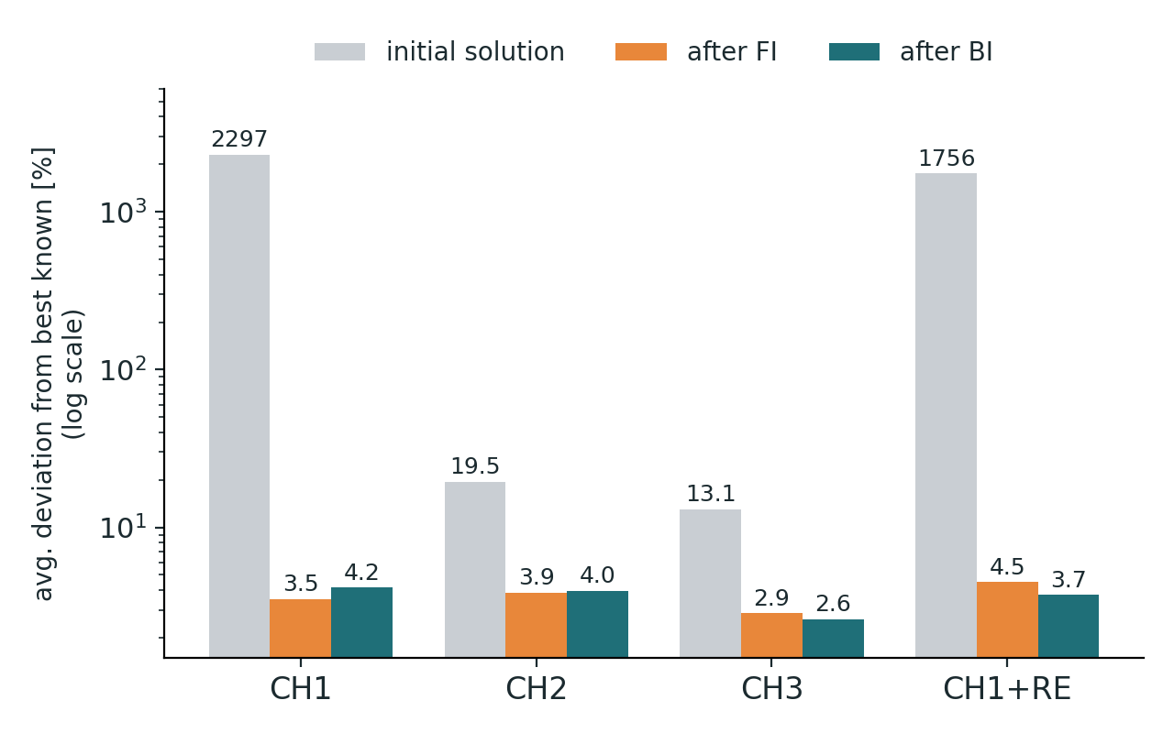
The initial solution and what remains
Average deviation before and after the local search.
13–2297 % → 2.6–4.5 %
The search closes almost the whole gap, but the start still matters: CH3 ends significantly better than CH2 and CH1+RE (p < 0.01).
CH1 ≈ CH1+RE
RE after every step cleans the start anyway, so no consistent difference. For CH3, RE alone gives 13.0 → 6.5 %; the moves add the rest.
2.6–2.9 % left
One drop-and-repair neighbourhood stalls in local optima – the case for metaheuristics.
Recommendation CH3 + FI is the best quality per time (2.86 %, 1.4 s); CH3 + BI gives the best quality (2.63 %). A good constructive start saves most of the search effort.

